Slide 1


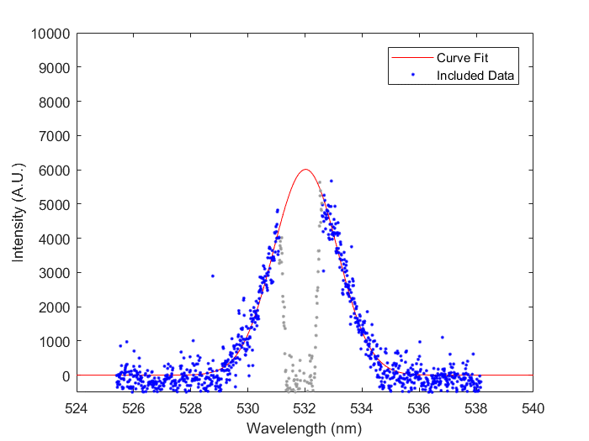
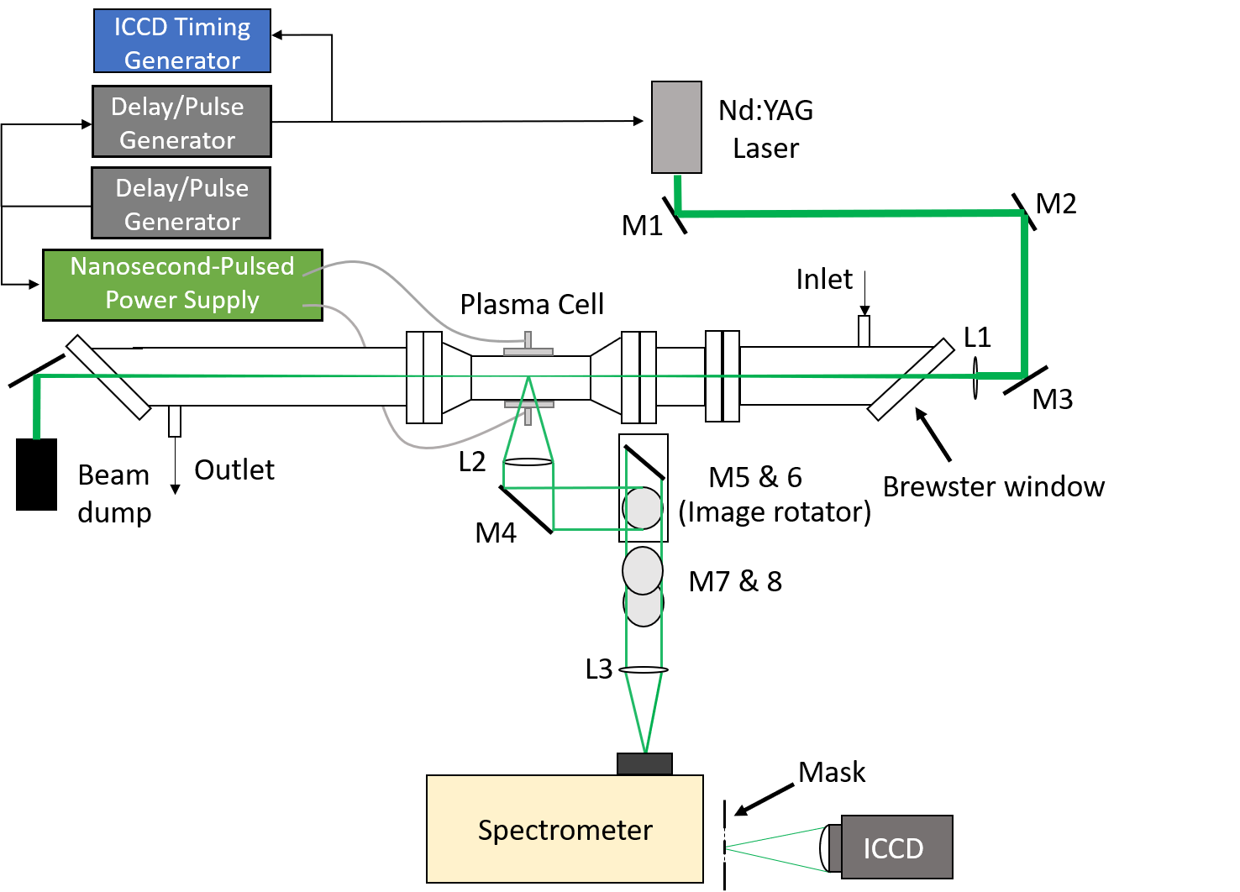
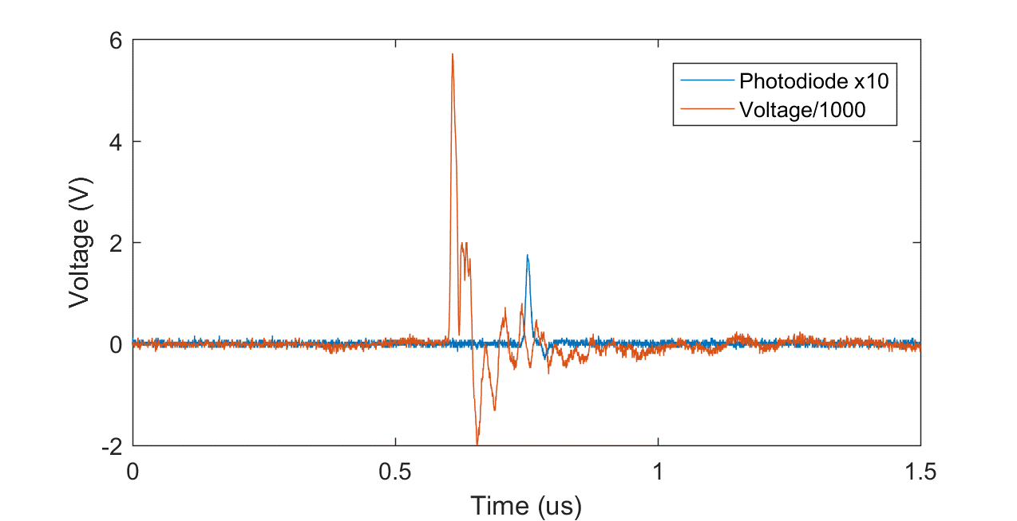
Time-resolved Laser Thomson Scattering in a Nanosecond-pulsed Helium Dielectric Barrier Discharge
Timothy Chen, Egemen Kolemen*, Yiguang Ju*
Department of Mechanical and Aerospace Engineering, Princeton University
Introduction
Plasma chemistry models are necessary to optimize plasma for potential industrial use
0-D plasma kinetic models typically leave E/N as a free parameter for tuning numerical results [1]
Thomson Scattering can be used to measure time-resolved profiles of electron temperature (T_{e}) and density (n_{e}) to remove uncertainty in E/N
T_{e} and n_{e} measurements will be made in a Helium ns-DBD at 60 Torr to demonstrate the setup’s capabilities
Progress and Results
Thomson Scattering measured with input laser energy of 230 mJ, 9,000-12,000 total laser shots averaged, and 1,500 on-chip accumulations per exposure
Figure 3. Example spectrum for Thomson Scattering, n_{e} = 3.7e12 cm⁻³ and T_{e} = 1.1 eV
Time-resolved electron number density and temperature was measured up to 300 ns after the voltage pulse
Figures 4 and 5. Time profiles of n_{e} and T_{e} in 60 Torr He, 1 kHz continuous pulse repetition rate, 50 ms plasma residence time.
Progress and Results
Preliminary laser pulse energy variation 150 ns after the voltage pulse shows little influence on electron density from photoionizing He₂ Rydberg molecules in contrast to the high pressure He discharge of [4]
Experimental Setup
Figure 1. Experimental setup for Thomson Scattering. 1” achromatic lenses collect and focus the scattered light into a f = 500 mm Acton spectrometer. Stray light is baffled after the entrance Brewster window and blocked after the spectrometer using a blackened stainless steel mask similar to [2] and [3] respectively. Temperatures from 0.2 eV to 10 eV and densities as low as 1x10¹² cm⁻³ are resolvable.
Figure 2. Voltage and photodiode waveforms for timing Thomson Scattering measurements in a nanosecond-pulsed plasma, continuously run at 1 kHz. Voltage pulse FWHM ≈ 12ns.
Figure 6. Electron density versus laser pulse energy to check for photoionization of He₂ using pulse energies of 20, 30, 40, 50, and 230 mJ
Future Work
Numerical modeling will be performed and validated by experimental data for the pure Helium discharge
Measurements in CH₄/He mixtures at 60 Torr will be conducted accompanied by numerical modeling
Plasma cell has same discharge geometry as the reactor in [1], so laser absorption studies are possible for different gas mixtures
Acknowledgements
We would like to thank ExxonMobil for supporting this project. We would also like to acknowledge Dr. Hennie van der Meiden, Dr. Benjamin M. Goldberg, Dr. Shuqun Wu, and Dr. Ahmed Diallo for their assistance and advice in realizing this Thomson Scattering system.
References
[1] Lefkowitz JK et al. 2015 Phil. Trans. R. Soc. A 373: 20140333.
[2] HJ van der Meiden et al. Rev. Sci. Instrum. 83, 123505 (2012);
[3] F Brehmer et al. 2015 J. Phys. D: Appl. Phys. 48 155201
[4] Schregel et al 2016 Plasma Sources Sci. Technol. 25 054003

