Slide 1
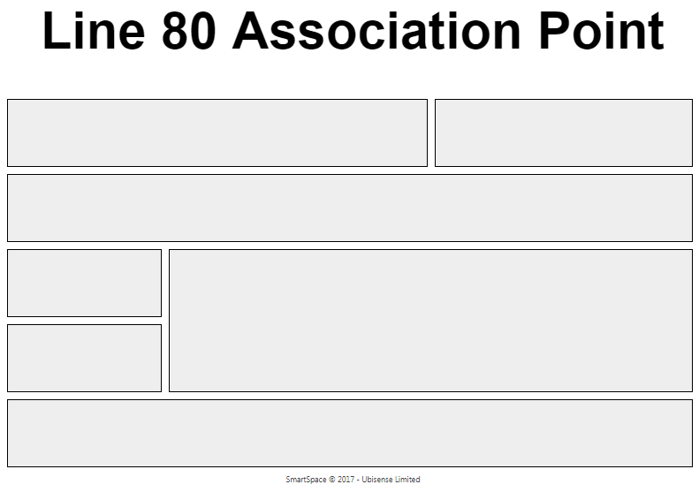
Candidate Object
Tag Position
Detected Tag
Number of Tags
Last Status Message
Number of Candidates
External System Status

Slide 2
