Slide 1

Introduction to High-Performance computing (HPC)
Yue Yu Sr. Research Computing Facilitator of Cyberinfrastructure and Research Technologies (CIRT)
Office of Information Technology (OIT)
University of California Merced

Slide 2

What is Supercomputing?
Supercomputing is the biggest, fastest computing right this minute
A supercomputer is one of the biggest, fastest computers right this minute
So, the definition of supercomputing is constantly changing.
Rule of Thumb: A supercomputer is typically at least 100 times as powerful as a PC.
Jargon:
Supercomputing is also known as
High Performance Computing (HPC) or
High End Computing (HEC) or
Cyberinfrastructure (CI)
I am working at Cyberinfrastructure and Research Technologies (CIRT) team
https://it.ucmerced.edu/CIRT
2

Slide 3

Terminologies
CPU (processor)
Central Processing Unit
GPU
Graphics Processing Unit
Deep learning, massive parallelism, 3D rendering…
Nodes
Multiple CPUs
CPU nodes
GPU nodes
Cores
Processing element
1 CPU may contain multiple cores
1 GPU many smaller specialized cores
CPU
Node
3

Slide 4


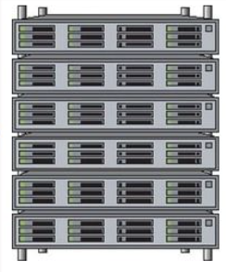
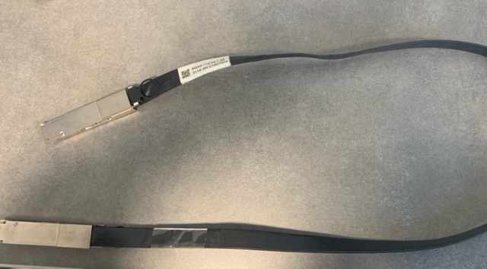
HPC Architecture
Client
Head node and login node
Compute nodes (majority of computations are performed)
CPU nodes
GPU nodes
Infiniband switches connect all nodes
Head node
login node
Storage
interconnect
4

Slide 5
HPC Architecture
Machines with large number of CPUs and memory
High-speed interconnect
Scheduling software
PROCESSING UNITS
COMPUTE CLUSTER
HIGH SPEED INTERCONNECT
SCHEDULING SOFTWARE
5

Slide 6
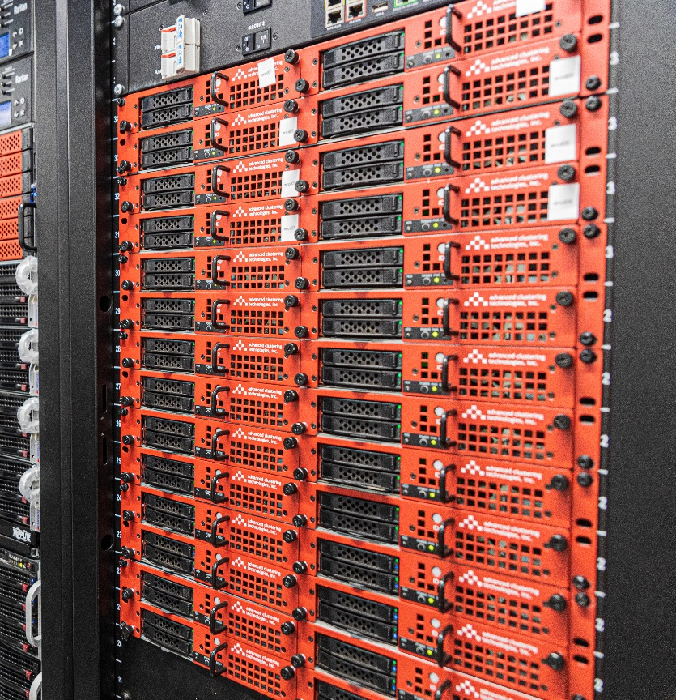
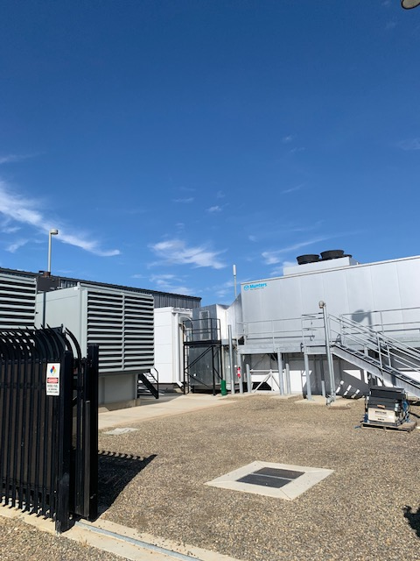
MERCED cluster Physical Setup
Merced cluster is located at Borg Cube
Head node + Login node + 80 CPU compute nodes
Multigenerational nodes
Haswell, Broadwell, Skylake…
128GB/256GB of RAM
Cluster storages + 786TB Borg storage + PI owned Storage units
6

Slide 7
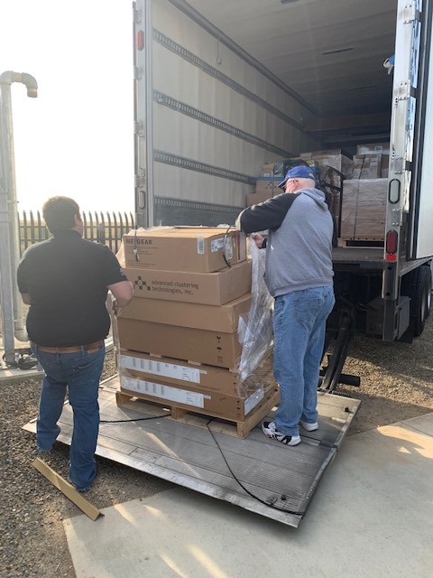
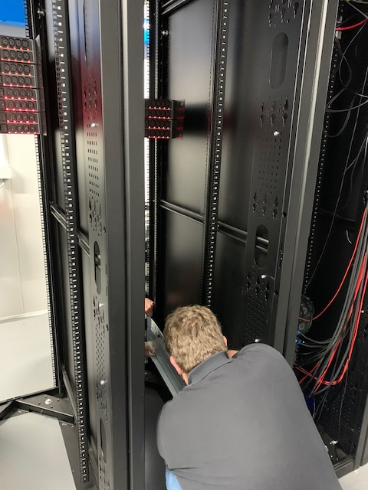
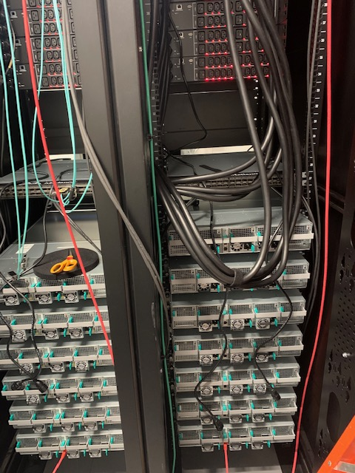
Pinnacles installation
7

Slide 8
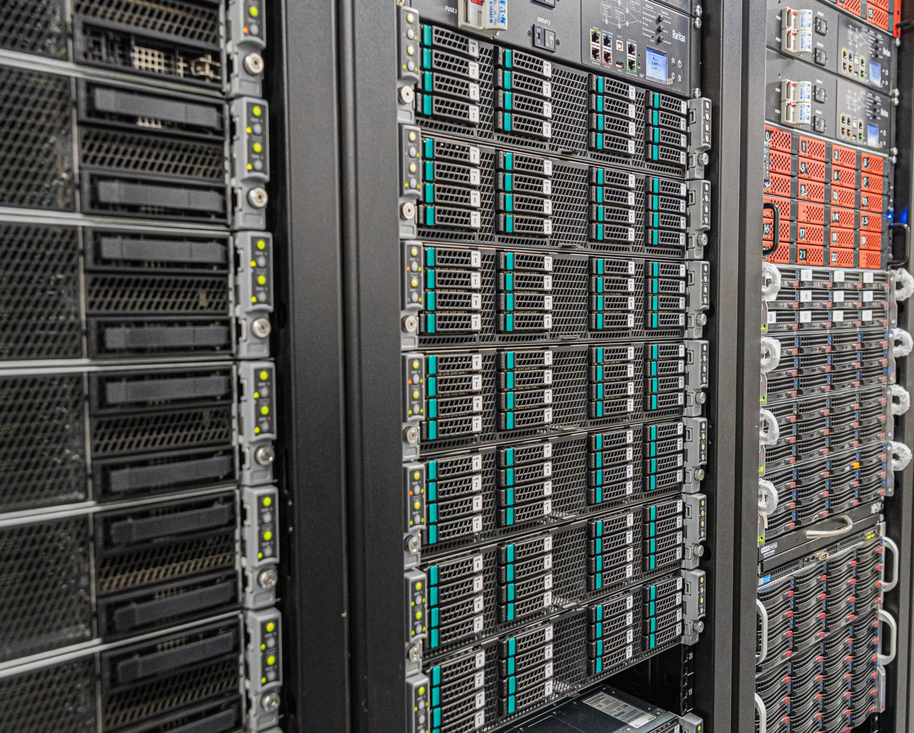
Pinnacles Cluster
Head + 2 login nodes
40 CPU compute nodes
4 big memory CPU nodes
8 GPU nodes
8
Notes:
Pinnacles cluster (talk about the detailed configurations)

Slide 9
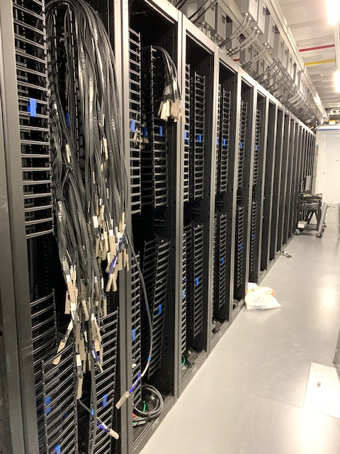
Infiniband Architecture
InfiniBand (IB) networking communications
RDMA (Remote Direct Memory Access)
10GigE has 5-6 times the latency of IB
IB has 3.7x the throughput of 10GigE
9

Slide 10
Shared Filesystem
Mounted across the cluster –
PI owned storage units
Centralized Login
Folder | Space
/home/<UCMID>/data | 500G
/home/<UCMID>/scratch | 500G
/home/<UCMID>/ | 70G
10

Slide 11
Scheduler
Scheduling is the method by which work specified by some means is assigned to resources that complete the work. The work may be virtual computation elements such as threads, processes or data flows, which are in turn scheduled onto hardware resources such as processors, network links or expansion cards.
A scheduler is what carries out the scheduling activity. Schedulers are often implemented so they keep all computer resources busy (as in load balancing), allow multiple users to share system resources effectively, or to achieve a target quality of service.
11

Slide 12
Slurm Scheduler
Slurm has three key functions.
Allocates exclusive and/or non-exclusive access to resources (compute nodes) to users for some duration of time so they can perform work.
Provides a framework for starting, executing, and monitoring work (normally a parallel job) on the set of allocated nodes.
Arbitrates contention for resources by managing a queue of pending work.
12

Slide 13
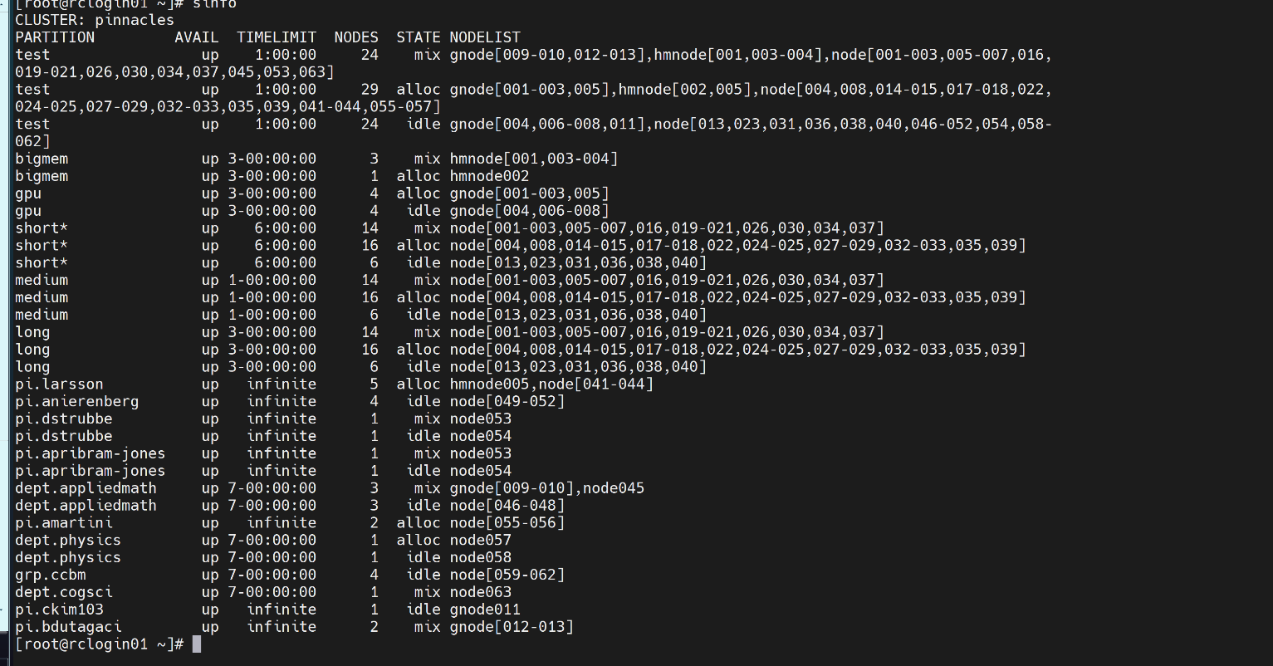
Queues and Resource Limitations
Currently, priority on the queues is setup such that each project is given equal priority (each project is assigned to a PI) and each member in that project (or PI group) has equal priority.
To view the queues and note information
Type “sinfo” in your terminal
Documentation website
https://ucm.edu/hpc_docs
13

Slide 14
Guest Account Login: (During the session you will be given a guest login information)
Otherwise, you can use your own account for this practice session
ssh Your_Acct_Name@login.rc.ucmerced.edu
To see the available modules that are installed use the following:
module avail
Copy the practice files: (always use the Tab key from keyboard to help you for autocompletion)
cp –r /home/yyu49/hpc_training/script/serial .
cp –r /home/yyu49/hpc_training/script/parallel .
The two folders have some sample scripts, user can play around with them
4. Check job: squeue --me

Slide 15
Job Submission Script
#! /bin/bash → “The hashbang line”
#SBATCH --nodes=1
#SBATCH --ntasks=1
#SBATCH -p test
#SBATCH --time=0-00:15:00 # 15 minutes
#SBATCH --output=my_%j.stdout
#SBATCH --job-name=test
#SBATCH --export=ALL
whoami
How do I actually submit the job?
sbatch sample.sub
16

Slide 16
Simple Job Submission Demo
Run single python job
Python_test1.py
Check the status of the job using “squeue –u username” or “squeue --me” commands
17

Slide 17
Getting Help
https://ucmerced.service-now.com/servicehub?id=sh_new
21

Slide 18
HPC Office Hours
WHERE? Online
WHEN? Every Friday from 10:30 am – 12 noon
Login page
CIRT website
Documentation page
22

Slide 19
Additional Resources
Slurm overview - https://slurm.schedmd.com/documentation.html
Slurm sbatch - https://slurm.schedmd.com/sbatch.html
Slurm sinfo - https://slurm.schedmd.com/sinfo.html
Slurm squeue - https://slurm.schedmd.com/squeue.html
Ganglia (Need VPN) - http://mercedhead.ucmerced.edu/ganglia/
Requesting help from CIRT - https://it.ucmerced.edu/services?field_service_service_catalog_tid=5
MERCED Wiki https://github.com/ucmerced/merced-cluster/wiki/
23

Slide 20
Diverse Research Groups on Campus
Natural Sciences – Soil Biogeochemistry, Biological Physics Theory and Computation, Theoretical Atomic and Molecular Physics, Applied Mathematics, Quantum Chemistry, Quantitative Systems Biology
Engineering – Tribology, Machine Learning, Fault tolerance/resilience in large-scale parallel and distributed systems, power-aware computing
Social Sciences Humanities and Arts- Evolution of Communication, Neural Networks, Vocal Motor Control, Mesoamerican Indigenous literatures and cultures, Central American and Latina/o cultural studies
24

Slide 21

Thank you !

