Slide 1
Final Project
An overview of iptables and a brief description of apache2

Slide 2
iptables
Created to replace ipchains from Linux 2.2 and ipfwadm from Linux 2.0
Preserves the basic ideas introduced in ipfwadm
Created tables of rules
  One for NAT
  One for filtering
The initial three filtering points were altered so that any packet only passes through one filter

Slide 3
Basic Arguments
Command | Description
-t <table> | If you don't specify a table then the filter table is assumed.
-j <target> | Jump to the specified target chain when the packet matches the current rule
-A | Append the rule to the end of the chain
-F | Flush. Delete all of the rules in the selected table
-p <protocol-type> | Match the given protocol type
-s <ip-address> | Match the source IP address
-d <ip-address> | Match the destination IP address
-i <interface-name> | Match ”input” interface on which the packet enters
-o <interface-name> | Match ”output” interface on which the packet leaves

Slide 4
Sample Setup
iptables --flush
iptables --policy INPUT DROP
iptables --policy OUTPUT DROP
iptables --policy FORWARD DROP
iptables --append INPUT -i lo -j ACCEPT
iptables --append OUTPUT -o lo -j ACCEPT
iptables --append INPUT -m state –state / ESTABLISHED,RELATED -j ACCEPT
iptables --append OUTPUT -m state --state NEW,ESTABLISHED,RELATED -j ACCEPT

Slide 5
Setup Explained
What this setup does:
  Flushes all existing rules
  Sets the default of all policies to DROP
  Allows the free flow of traffic on the loopback interface
  Allows all outgoing traffic and only necessary return traffic

Slide 6
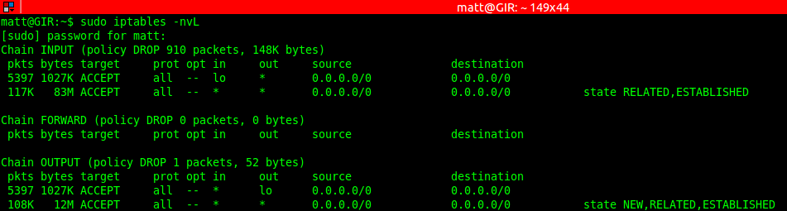
Sample Output To Confirm Rules

Slide 7
Apache2
This is the Apache HTTP server
  This SHOULD NOT be invoked directly
    Use apache2ctl to invoke and pass arguments to apache2
Designed to be run as a standalone daemon process

Slide 8
Start the Server
sudo apache2ctl start
  Starts the apache2 server running with the default configurations
Once you determine the IP Address of the machine on which the apache2 server is running using ifconfig, you can connect directly to the server
If successful you will be presented with the default apache2 web page

Slide 9
What Now?
Now that you have a web server running and are able to connect, you can test the iptables rules you are creating or have already created
Set up several rules for allowing or denying packets based on the source or destination and see how it affects your ability to connect to the apache2 server

