Slide 1
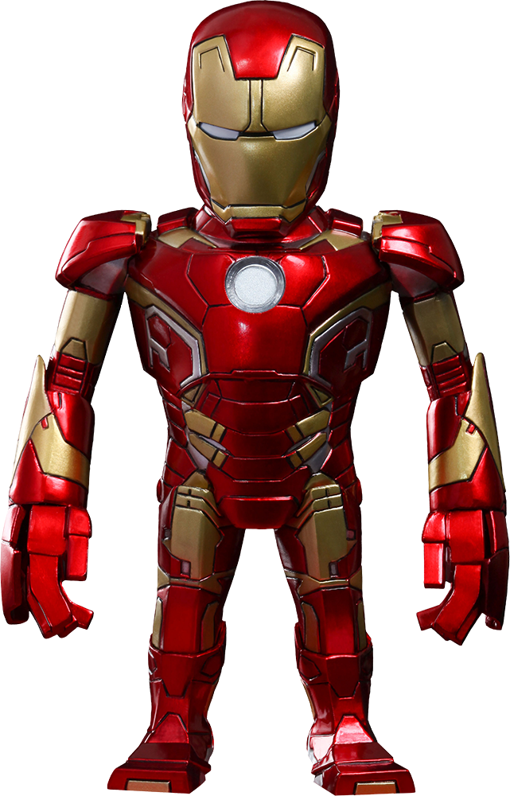
Autonomous Robots
By: Autonomous Robot Club
Notes:
Opening Questions:
Who knows this character?
By the way we will be handing out bouncy balls to whoever can answer our questions correctly.

Slide 2


Content
Overview of an Autonomous Robot
Robot Senses
Processing
Movers and Actuators
Autonomous Robot Game
IGVC
Taurus
Questions
Notes:
Go through what we will mention today and the agenda
Thank UofC, Schulich School of Engineering, ARC members, Dr. Macnab, and Chris Simon

Slide 3
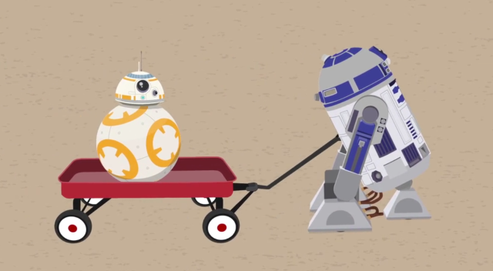
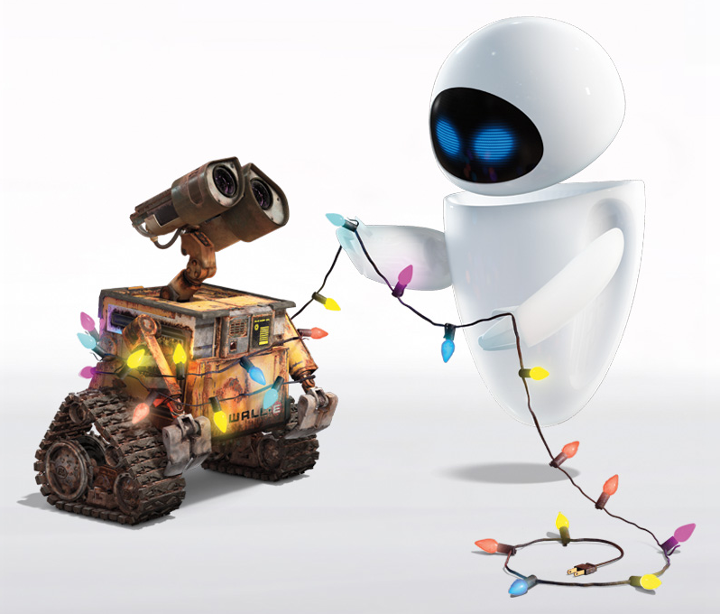
Autonomous Robots
Robot - A machine that can perform tasks
Autonomous - Acting independently
Notes:
General overview of what autonomous robots are

Slide 4
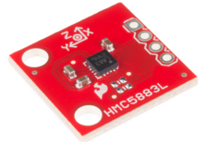
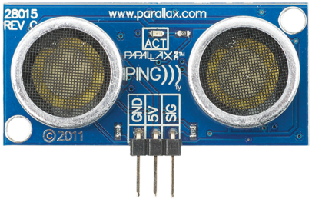
Robot Senses
Almost like living organisms
Sensors and devices
Examples:
Gyroscope - orientation
Camera – seeing
LiDar or Proximity Sensor - distance
Notes:
Robots sense things using sensors and other devices like it. Just like how we use our eyes to see what is in front of us.
Sensors are just devices that are able to measure or detect a phenomena. A common sensor in a household would be your thermostat. It detects temperature and does some calculations with it.
For autonomous robot purposes, some of the sensors used are gyroscopes, camera, and distance measuring sensors. With these items you can pretty much create a robot that can avoid things.
The red image on the slide is a magnetometer, it detects the Earth’s magnetic field and gives us an idea on where the north pole is. The blue device on the slide is an ultrasonic proximity sensor, it sends out high frequency noise and gives us an accurate measurement on how far the object in front of it is.
These are just some of the sensors and devices used to gather data of the environment. The most difficult part would be what to do with that data and how can we properly map what’s currently happening around the robot.
Show vectorNav software

Slide 5

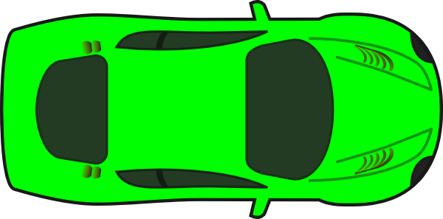
Data Processing
Notes:
car is robot
robot has to make a decision
(click) we know the target location

Slide 6
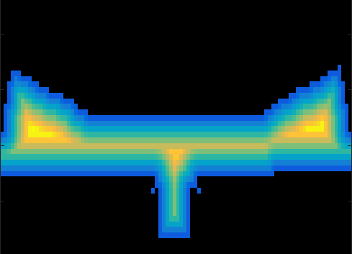
Data Processing
target
Notes:
This is a scan after we process it
blue is close to walls (should avoid), yellow is far away from walls
(click) we know our location, our direction and the targets location

Slide 7
Data Processing
target
possible target
possible target
Notes:
find the brightest yellow
now the robot has to decide

Slide 8
Data Processing
target
local target
Notes:
it will choose the one closest to the target

Slide 9
Data Processing
Compass and GPS give direction
Common intelligent algorithms?
AI?
Notes:
Maybe ask a few questions to get a feel

Slide 10
Data Processing
Compass and GPS give direction
Common intelligent algorithms?
AI?
Notes:
Maybe ask a few questions to get a feel

Slide 11
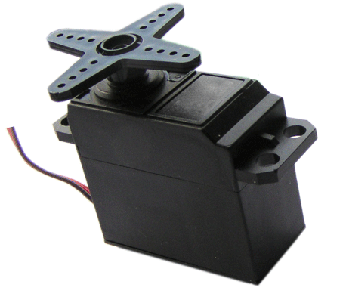
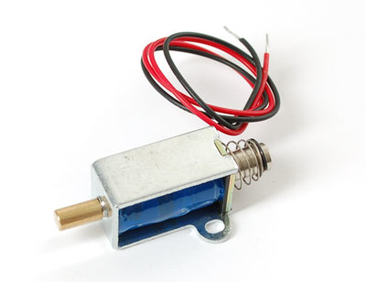
Movers and Actuators
Processed data sent to movers and/or actuators
Examples:
Motors or wheels
Arm or servos
Piston or solenoid
Mechanical

Slide 12

Autonomous Robot Game
Person 1 (Gatherer), Person 2 (Processor), Person 3 (Mover or Actor)
Person 1 tells Person 2 where the closest obstacle is located (left, right, middle) and approximately how far obstacle is from Person 3
Person 2 tells person 3 which direction to face and how many steps to take
Person 3 Moves
Repeat
Notes:
We will use phones to communicate or walkie-talkie

Slide 13
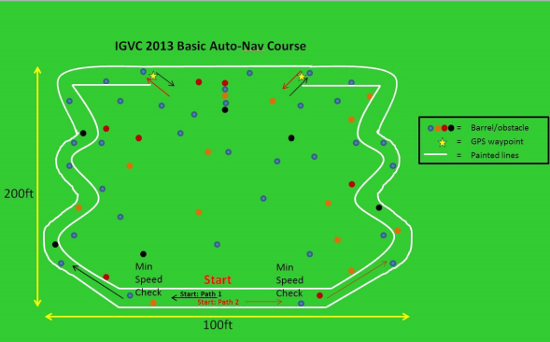
IGVC
Intelligent Ground Vehicle Competition
Autonomous vehicle to follow a path
Waypoints (GPS locations)
Obstacles to avoid

Slide 14

Taurus
First autonomous vehicle of ARC
Obstacle avoidance demo

Slide 15
Questions?

