Slide 1


Analysis ON Top Content
By: Satya Sakuntala NagaSravya Mattapalli, Zack Crowley, Edith Lotterman and Kevin Ybarra

Slide 2


Research Approach
When searching for a dataset, we wanted to capture a set within the post-COVID era timeframe
The rise in Netflix viewership during the COVID period was intriguing and we wanted to dive in further to see what the world was watching post-COVID
Notes:
Edith

Slide 3
Data Sources
“Netflix Movies and TV Shows Top Ten Lists” dataset from Netflix’s official website by 4 categories
Merged with “Netflix Titles” dataset from Kaggle to populate specific information for each movie and TV show
API call from OMDB to fill in all “NaN” values that were not in the “Netflix Titles” merge
The data provided captures from the week of 6/15/21 to 11/1/22
Notes:
Edith

Slide 4
What questions did we ask?
What are the most popular genres in the Top Ten?
What are the most popular TV Shows and Movies in the Top Ten?
Is there a difference in popularity between English vs Non-English Movies and Films in their respective Top Ten lists?
Which countries make the most recent Netflix Top Ten content?
Notes:
Satya

Slide 5
Final Dataset
Merged the two datasets and performed an API call on OMDB
Deleted rows with null values
Cleaned up countries, runtime, and genre categories
Broke genre down by type and searched for top 6 genre types
Final Dataset
Full Country Name
Columns for drama, comedy, action, family, crime, and romance added
Ratings from PG to Not-Rated
2069 total rows after deletion of NaN
Shows that had multiple seasons in top 10 were grouped for some analysis
Notes:
Satya

Slide 6
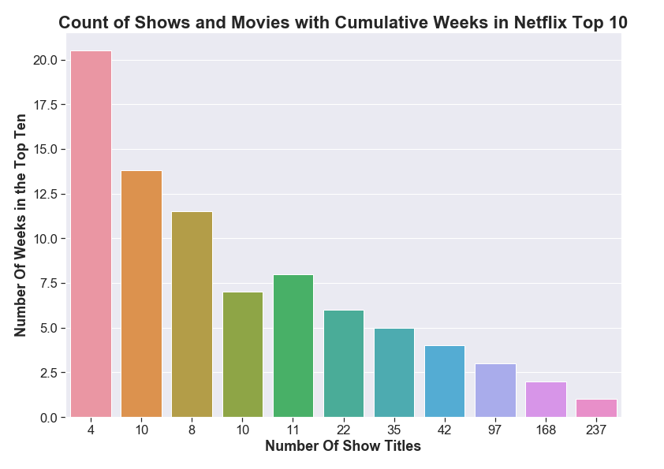
Exploratory Analysis
There are 644 total unique titles that we used for analysis
37% of titles only stay in the Top 10 for 1 week
Only 4 titles have remained in the Top 10 for more than 20 weeks
1.6% of all titles
Notes:
Satya

Slide 7
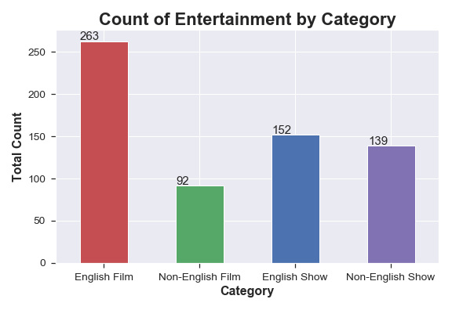
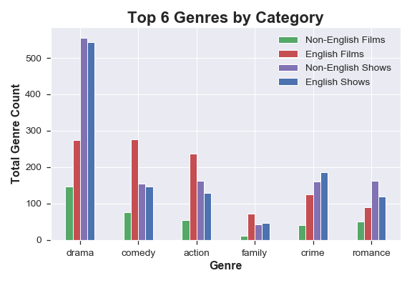
Dataset Overview
Notes:
Kevin

Slide 8
Genre Breakdown
Movie Count Chi-Square
TV Show Count Chi-Square
Non-English films vs. English films
Critical value = 11.07
P-value = 2.88 x e-08
Chi-Squared test output value of 43.53 so genre categories makeup are very different between non-English and English movies
Non-English shows vs. English shows
Critical value = 11.07
P-value = 0.045
Chi-Squared test output value of 11.33, these categories make ups are also different
Notes:
Kevin

Slide 9
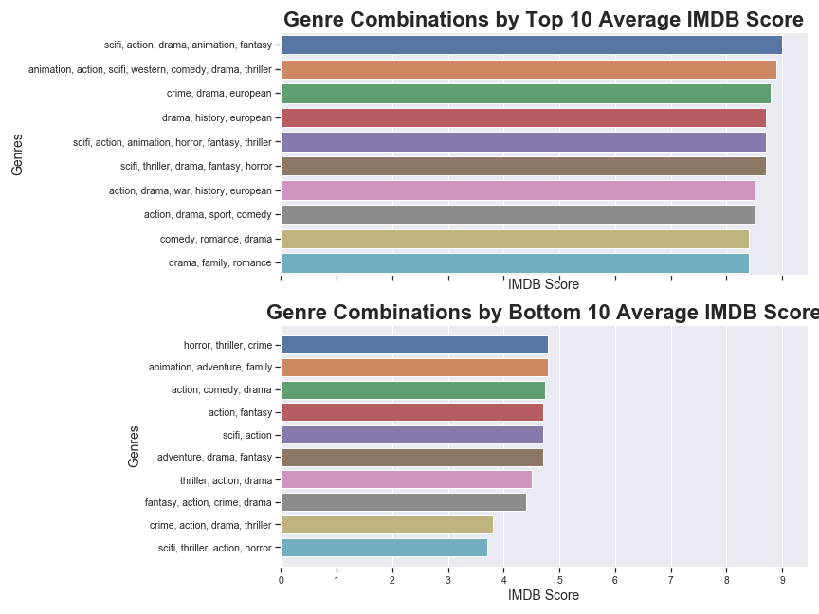
Genre Combinations
Only includes data with over 1,000 IMDB votes
More genres listed for a show or film seem to correspond to a higher IMDB score
All but one title covers drama, that drama is a genre that most viewers are watching on Netflix
Notes:
Kevin

Slide 10
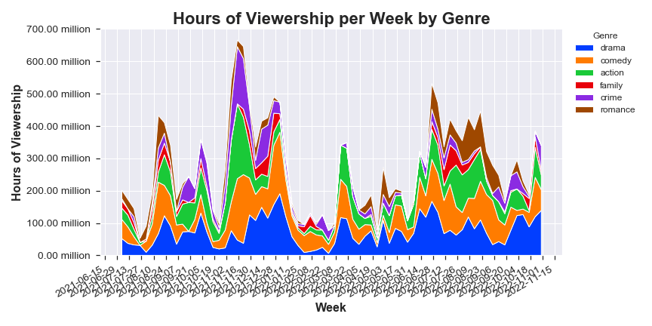
Genre Popularity Through Time
The data shown is a compounding line graph
The relative popularity of movie genres does not change throughout the year.
Spikes come from popular releases over this time period
Top ten releases account for over 25% of hours viewed
Notes:
Edith

Slide 11
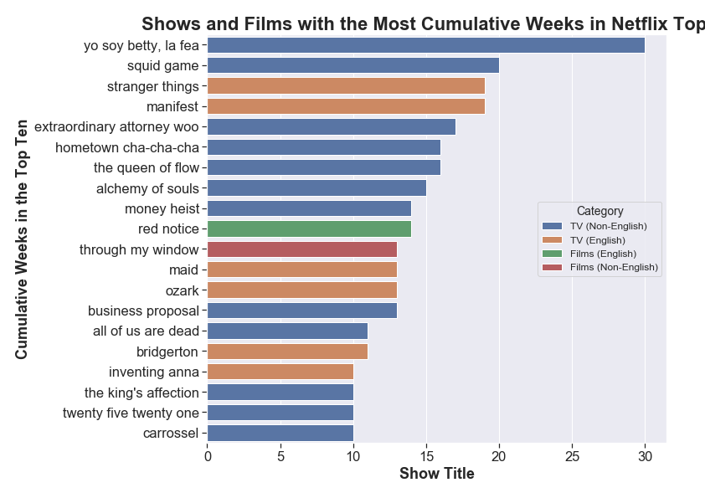
Who created the most impactful content?
From the data, the content that stays in the Top 10 the longest are Non-English TV shows
With only 2 movies making the list, we can assume that movies only create a short impact
TV shows have lasting impacts on viewership and retains viewers
Notes:
Edith

Slide 12
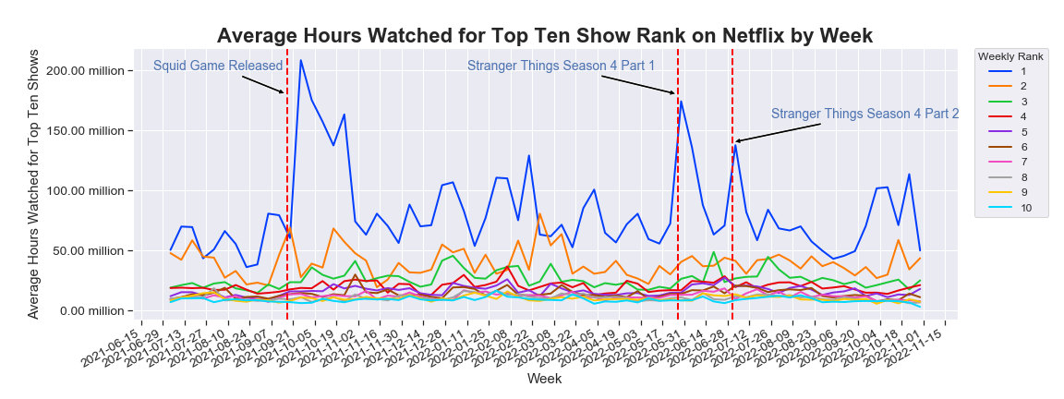
Top 10 Weekly Hours Watched
Notes:
Zach

Slide 13
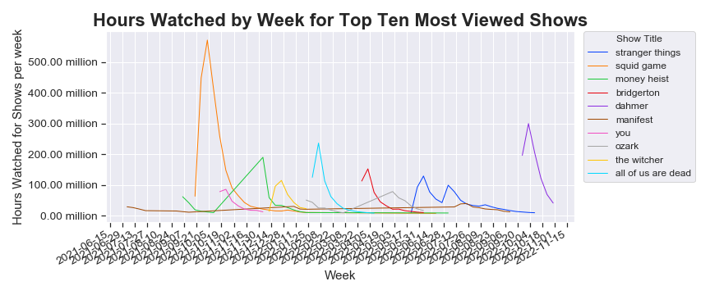
Viewing Hour Drivers
The release dates of certain TV shows corresponds with spikes in viewership that make up the Top 10 TV shows
The show “Manifest” proved to have a lasting viewership
The show “Squid Games” proved to have the greatest impact on views by week
Notes:
Zach

Slide 14
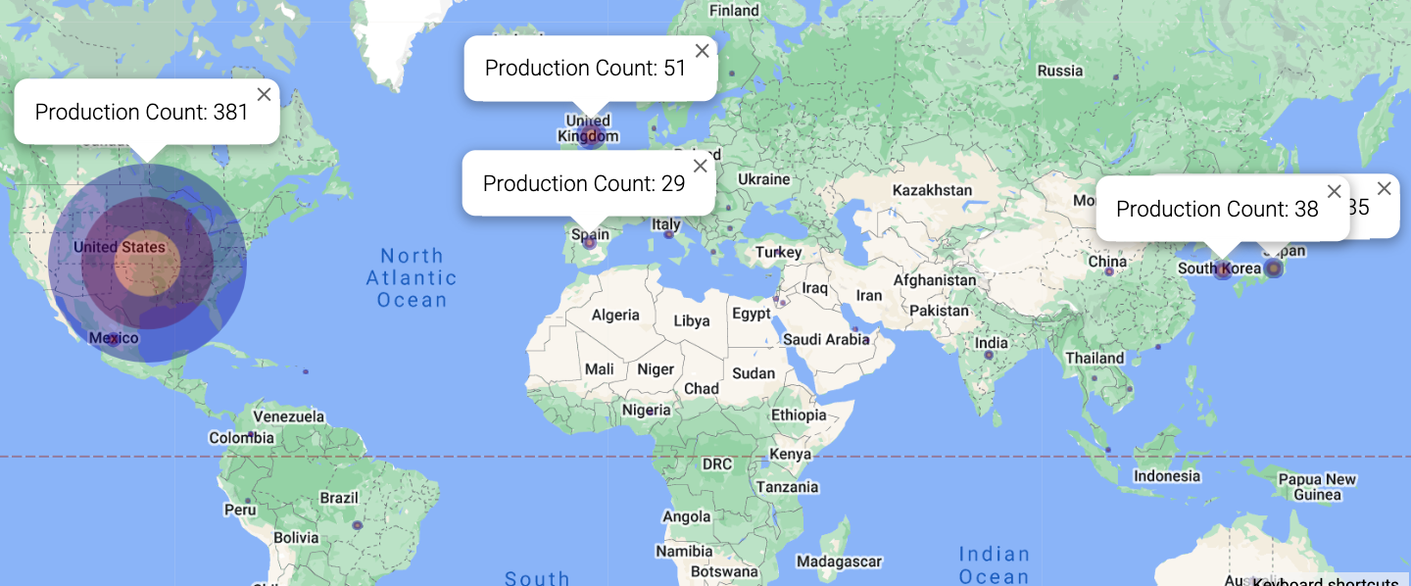
Production by Country
Top 5 countries for show/film production from the data:
United States: 381, United Kingdom: 51, South Korea: 38, Japan: 35, Spain: 29
Notes:
Zach

Slide 15
Original Questions
What are the most popular genres in the Top Ten?
What are the most popular TV Shows and Movies in the Top Ten?
Is there a difference in popularity between English vs Non-English Movies and Films in their respective Top Ten lists?
Which countries make the most recent Netflix Top Ten content?
Notes:
Zach

Slide 16
Questions Answered???
The most popular genres are drama, comedy, action, crime, romance and family with drama TV shows being the most popular.
The 2 TV shows that stayed in the Top 10 the longest are “Yo soy Betty, La Fea” and “Squid Games” The 2 Movies that stayed in the Top 10 the longest are “Red Notice” and “Through My Window”
After performing Chi-Square tests, the data indicates that the relationship between Non-English and English movies and TV shows is indeed different
The US, UK, Spain, South Korea, and Japan have created the most recent Top Ten Netflix content
Notes:
Zach

Slide 17
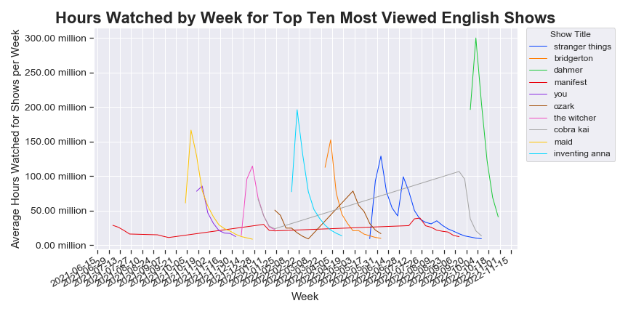
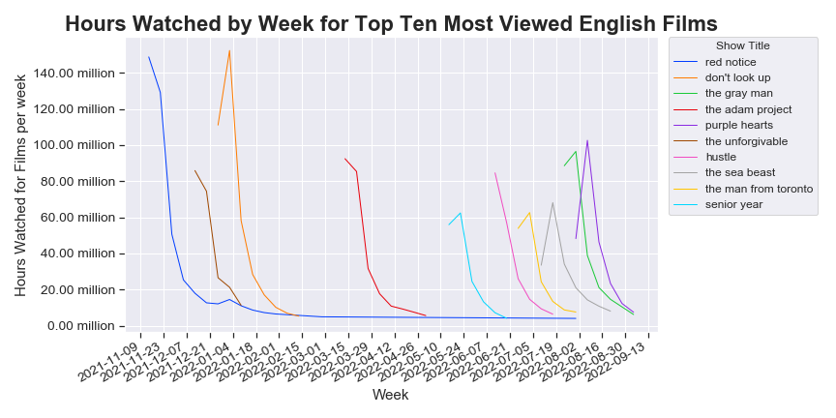
Data for English Categories
Next Steps
How do ratings vary on the number of votes each film or TV show receives?
Are there films or TV Shows that were in the Top 10 before our dataset begin date?
How old were the TV shows or movies that made the Top 10 list on a consistent basis?
If there was another year in the dataset we could see better seasonal trends.
Notes:
Kevin

Slide 18
The END

