Slide 1
Docker

Slide 2
Agenda
Docker
Container vs virtual machine
Docker engine
Docker Objects
Docker underlying technologies
Docker commands
Launch simple application
Docker commands
Private and public registry
Dockerfile
Docker compose
Networking

Slide 3
Docker:
It is a tool that packages up an application and all its dependencies in a “virtual container” so that it can be run on any Linux system or distribution.
When would I use Docker?
Configuration Simplification
Enhance Developer Productvity
Server Consolidation and Management
Application Isolation
Rapid Deployment
Build Management
Does docker run on Linux only?

Slide 4
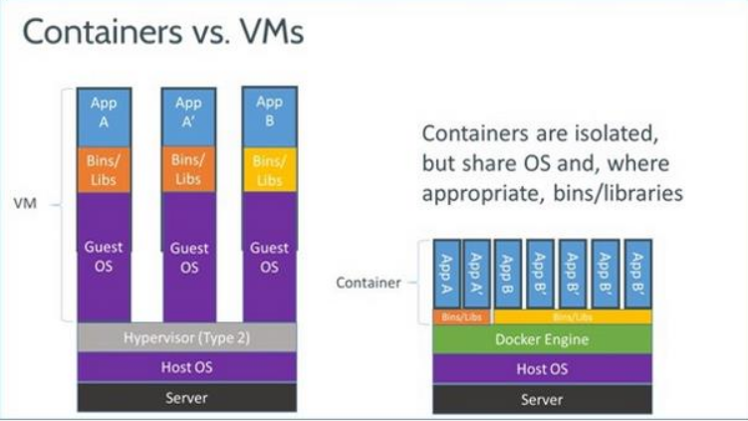
Containers VS Virtual machines

Slide 5
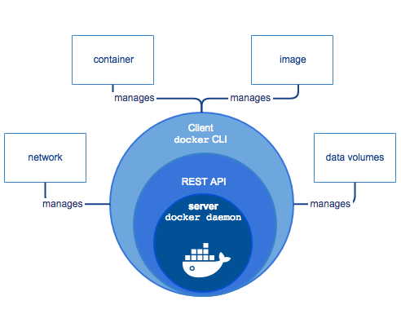
Docker Engine

Slide 6
Docker Objects
IMAGE:
An image is a read-only template with instructions for creating a Docker container.
CONTAINER:
A container is a runnable instance of an image. You can create, start, stop, move, or delete a container using the Docker API or CLI. You can connect a container to one or more networks, attach storage to it, or even create a new image based on its current state.
REGISTRY:
A Docker registry stores Docker images. Docker Hub and Docker Cloud are public registries that anyone can use, and Docker is configured to look for images on Docker Hub by default. You can even run your own private registry.

Slide 7
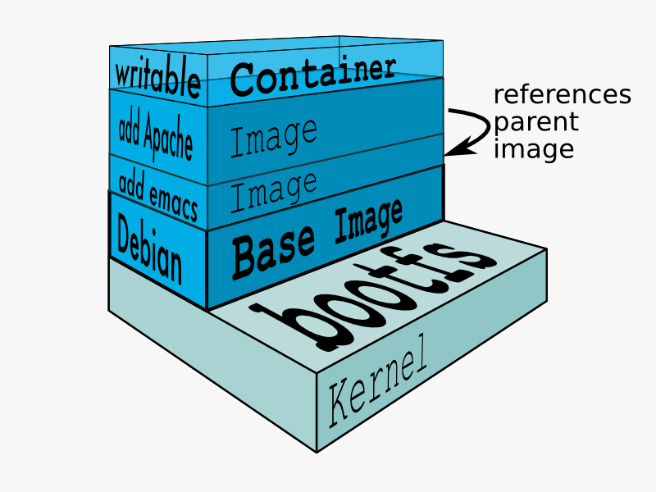
The underlying technologies
Namespaces: Isolation
Control groups:limits an application to a specific set of resources.
Union file systems: AUFS(advanced multi-layered unification filesystem)
Container format : libcontainer
[Source: https://docs.docker.com/terms/layer/]

Slide 8
Docker Commands
-it : docker run -i -t ubuntu /bin/bash
-d : docker run -i -t -d –name c1 ubuntu:14.04 Install apache docker commit -m "apache2 installed“ c1 apache:1.0
volume : docker run -i -t -d --name c2 -v /root/website/:/var/www/html/ apache:1.0
public port : docker run -i -t -d --name c3 -p 8080:80 apache:1.0
--net : docker run -it -d --name c4 --net=host apache:1.0

Slide 9
docker container ls # List all running containers docker container ls -a # List all containers, even those not running docker run friendlyhello # Run "friendlyname" mapping port 4000 to 80 docker container stop <hash> # Gracefully stop the specified container docker container kill <hash> # Force shutdown of the specified container docker container rm <hash> # Remove specified container from this machine docker image ls -a # List all images on this machine docker image rm <image id> # Remove specified image from this machine docker tag <image> username/repository:tag # Tag <image> for upload to registry docker push username/repository:tag # Upload tagged image to registry docker pull username/repository:tag # Upload tagged image to registry

Slide 10
Dockerfile
FROM debian:stable
RUN apt-get update && apt-get install -y --force-yes apache2
EXPOSE 80 443
VOLUME ["/var/www", "/var/log/apache2", "/etc/apache2"]
ENTRYPOINT ["/usr/sbin/apache2ctl", "-D", "FOREGROUND"]
docker build [-f /path/to/a/Dockerfile] [-t image:tag] [context]

Slide 11
Public Registry: Docker Hub
1. create a account in https://hub.docker.com/
2. Create a repository using github repository
Link github account to docker hub account
goto profile settings --> click Linked account and Services and link github
Create repository
click create button --> Create Automated build --> click on github and select github repository
Create a build
goto dashboard --> goto repository --> click on Build settings --> select correct branch and Trigger the build
3. Create a repository using docker CLI:
push local image to docker hub registry
docker push username/repository:tag

Slide 12
Private Registry: untrusted registry
echo “hostip privateregistry” >> /etc/hosts
docker run -d -it --restart=always -e REGISTRY_STORAGE_FILESYSTEM_ROOTDIRECTORY='/data' --net=host -v /root/data:/data --name privateregistry -p 5000:5000 registry:2
curl -X GET http://privateregistry:5000/v2/_catalog
docker run -d -it --name registry-web -e REGISTRY_URL=http://privateregistryip:5000/v2 -e REGISTRY_NAME=privateregistryip:5000 -p 8080:8080 hyper/docker-registry-web
echo "{ "insecure-registries":["privateregistry:5000"] }" > /etc/docker/daemon.json
docker tag image privateregistry:5000/repository:tag
docker push privateregistry:5000/repository:tag

Slide 13
Services are really just “containers in production.” A service only runs one image
Compose is a tool for defining and running multi-container Docker applications.
Docker-compose:
version: '3'
services:
web:
image: basivireddy/apache:latest
ports:
- "5000:80"
restart: always
scale:5

Slide 14
Network
Bridge: The default network driver. If you don’t specify a driver, this is the type of network you are creating. Bridge networks are usually used when your applications run in standalone containers that need to communicate.
host: For standalone containers, remove network isolation between the container and the Docker host, and use the host’s networking directly.
none: For this container, disable all networking. Usually used in conjunction with a custom network driver.

Slide 15
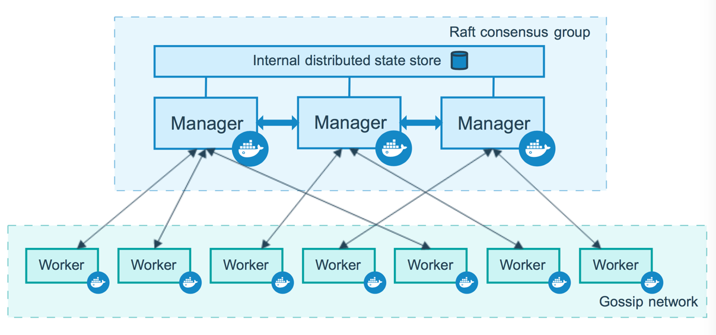
Swarm
Docker Swarm is a clustering and scheduling tool for Docker containers. With Swarm, IT administrators and developers can establish and manage a cluster of Docker host systems, or nodes, as a single virtual system

