Slide 1


Deep Learning Model For Text Summarization
Submitted By
M Yamini (19P31A1225)
P S S R Niveditha (19P31A1238)
J Abhinash (19P31A1217)
G Sai Nitheesh (20P35A1202)
Under the esteemed supervision of
Mr. R V V N Bheema Rao, M.Tech.,(Ph.D)
Department of Information Technology
Aditya College Of Engineering And Technology
Permanently affiliated to JNTUK Kakinada, Approved by AICTE,
Accredited by NAAC & NBA
Aditya nagar , ADB Road, Surampalem , Kakinada Dist,533437
2019-2023

Slide 2
Abstract
Deep learning based models have surpassed classical machine learning based approaches in various text summarization tasks, including sentiment analysis, news categorization, question answering, and natural language inference. In this, we used Sequence2Sequence model and LSTM and CNN algorithms for text summarization. For text summarization in this, we used News dataset it is widely used for text summarization. Finally, we provide a quantitative analysis of the performance of different deep learning models on popular benchmarks, and discuss future research directions.
An experimental result shows the good evaluation metrics as well and we have got 0.9 score which is one of the best scores compared to the previously done models.

Slide 3
Introduction
The summary is formed on the most important points and the main idea of the original text. As a result, the reader is presented with a compact and focused view of the original text.
There are two diverse groups of text summarization.They are indicative and informative. Indicative summarization only represent the main idea of the text to the user. The typical length of this type of summarization is 5 to 10 percent of the main text.
On the other hand, the informative summarization systems give concise information of the main text. The length of informative summary is 20 to 30 percent of the main text.

Slide 4
Introduction
Text Summarization methods can be classified into extractive and abstractive summarization.
An extractive summarization method consists of selecting important sentences, paragraphs etc. from the original document and concatenating them into shorter form.
Abstractive summarizers are so-called because they do not select sentences from the originally given text passage to create the summary.

Slide 5
Deep Learning
• Deep learning is a subset of Machine Learning which makes use of deep artificial neural networks, in which the system learns to perform various tasks by propagating through the neural network architecture.
--Frank Rosenblatt
• The goal of machine learning is to develop methods that can automatically detect patterns in data, and then to use the uncovered patterns to predict future data or other outcomes of interest.
-- Kevin P. Murphy
• The field of pattern recognition is concerned with the automatic discovery of regularities in data through the use of computer algorithms and with the use of these regularities to take actions.
-- Christopher M. Bishop

Slide 6
Deep Learning
• Deep learning is a machine learning technique that teaches computers to do what comes naturally to humans: learn by example.
• Deep learning is a key technology behind driverless cars, enabling them to recognize a stop sign, or to distinguish a pedestrian from a lamppost.
•In deep learning, a computer model learns to perform classification tasks directly from images, text, or sound.
•It's achieving results that were not possible before.

Slide 7
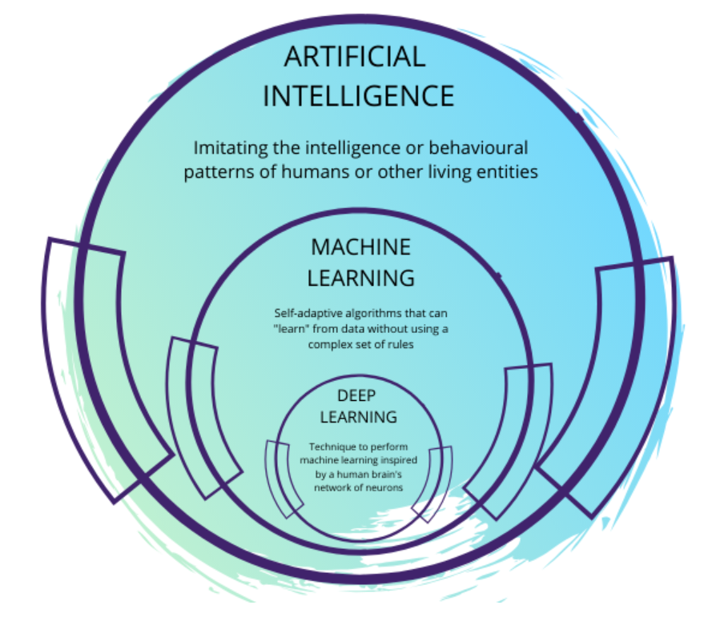

Slide 8

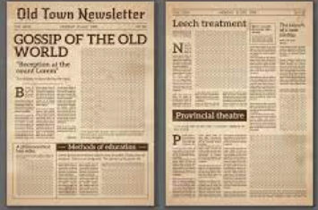
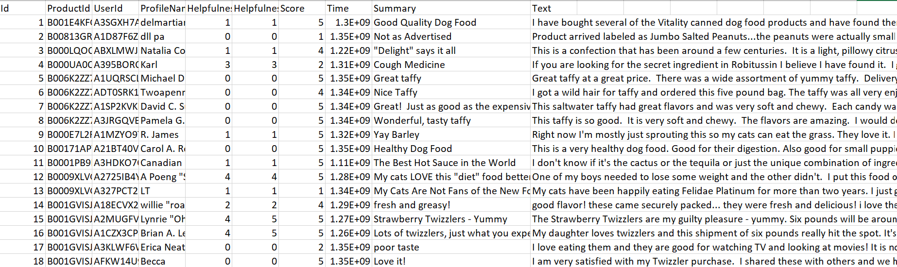
Dataset
• Datasets are mostly a collection of text pieces, articles, parts of newspapers, etc.
• They are
Books
News artilces
Reviews
documents

Slide 9
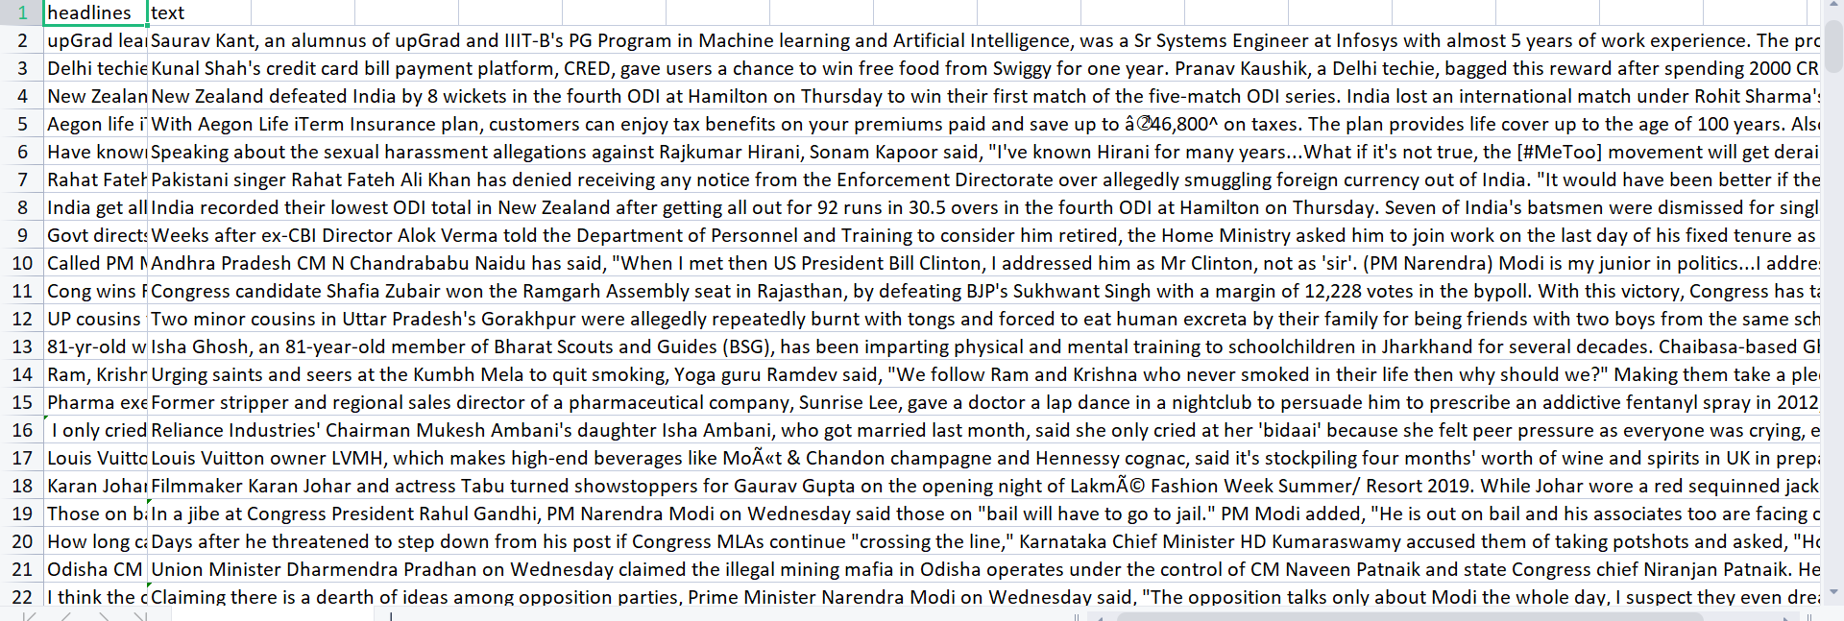
Dataset

Slide 10
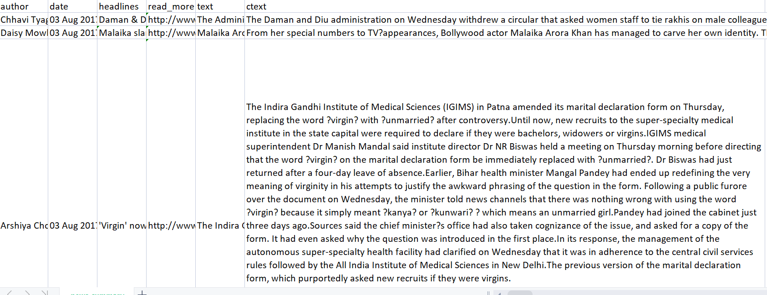

Slide 11
Data Preprocessing
Filter unnecessary characters / sentences
Tokenize articles into words
Create word embeddings
Word Embeddings
Example:
Apple is good for health
Apple is good place to work

Slide 12
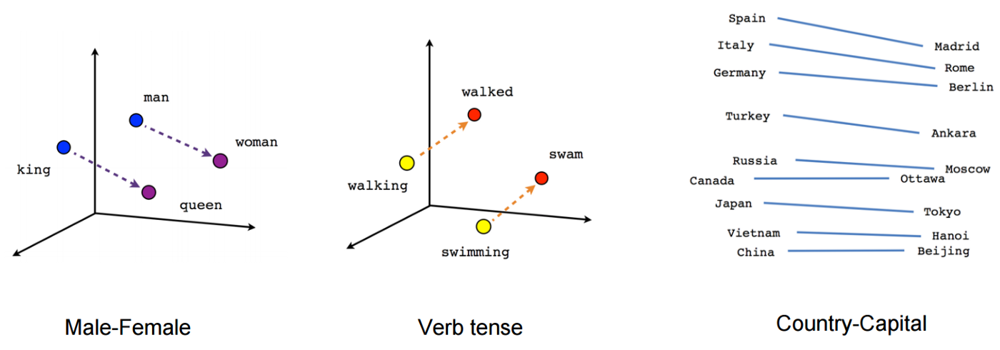
Word Embeddings

Slide 13
Model
Sequence-to-Sequence (Seq2Seq) Modeling
• Seq2Seq model is a model that takes a stream of sentences as an input
and outputs another stream of sentences.
• Sequence to sequence model is an example of conditional language
model.

Slide 14
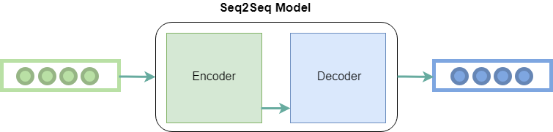
There are two major components in Seq2seq model.
Encoder
Decoder
Where sequence to sequence model is used?
Neural Machine Translation
Text summarization
Image captioning

Slide 15
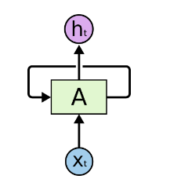
RNN
Recurrent Neural Network(RNN) is a type of Neural Network where the output from the previous step are fed as input to the current step.
In cases like when it is required to predict the next word of a sentence, the previous words are required and hence there is a need to remember the previous words.

Slide 16
LSTM
Long Short Term Memory networks – usually just called “LSTMs” – are a special kind of RNN.
These are capable of learning long-term dependencies.
Layers
Input Layer
Hidden Layer
Output Layer

Slide 17
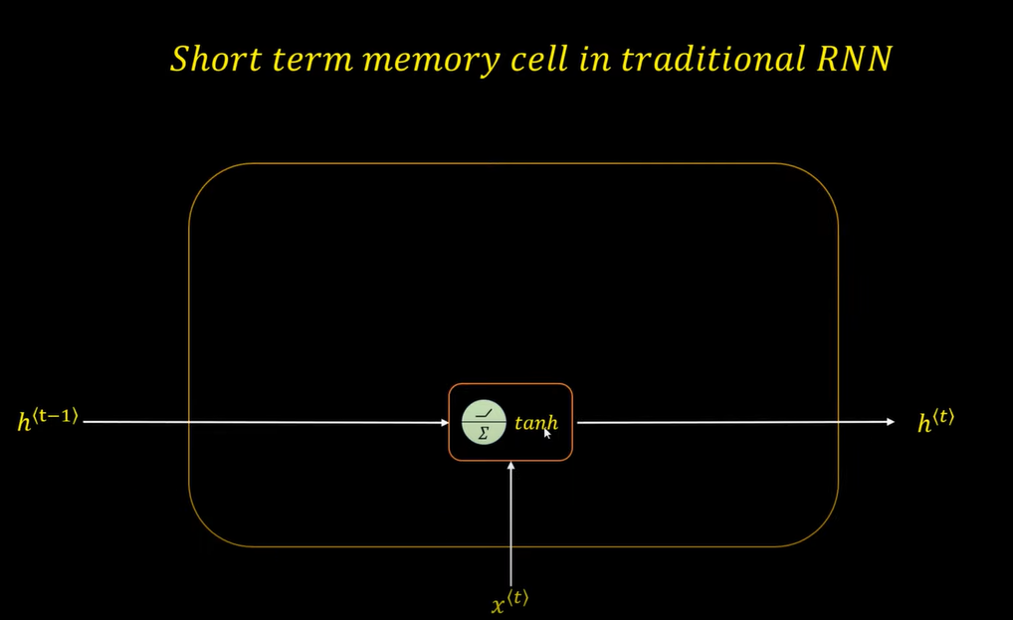

Slide 18
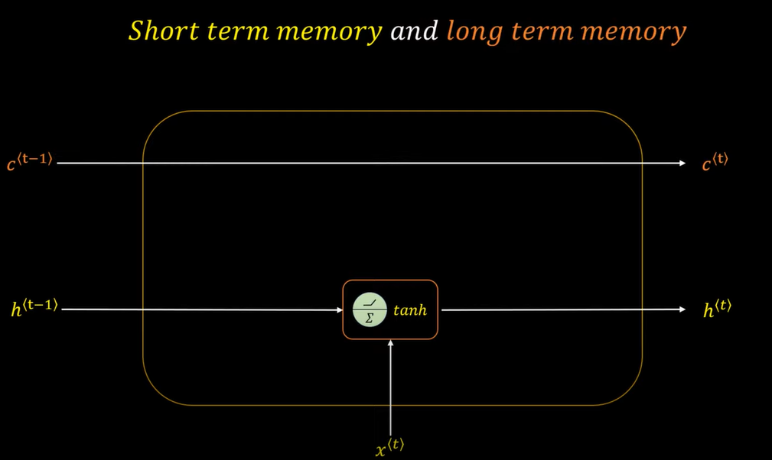

Slide 19
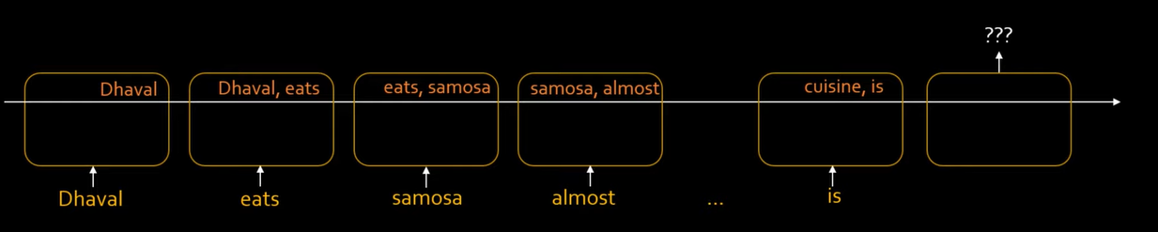
RNN or LSTM ???
Example : Dhaval eats samosa almost everyday, it shouldn’t be hard to guess that his favorite cuisine is ......
In Traditional RNN
Dhaval eats samosa almost everyday, it shouldn’t be hard to guess that his favorite cuisine is indian

Slide 20
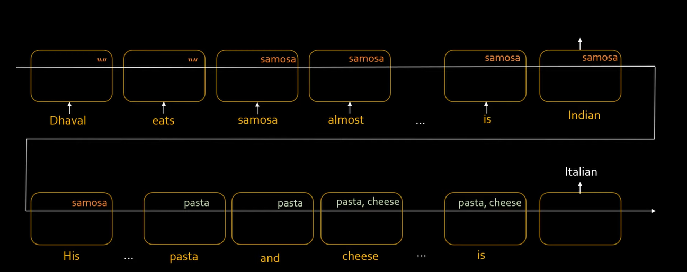
Ex2: Dhaval eats samosa almost everyday, it shouldn’t be hard to guess that his favorite cuisine is Indian. His brother Bala however is a lover of pastas and cheese that means Balu’s favorite cuisine is ….
Dhaval eats samosa almost everyday, it shouldn’t be hard to guess that his favorite cuisine is Indian. His brother Bala however is a lover of pastas and cheese that means
Balu’s favorite cuisine is italian

Slide 21
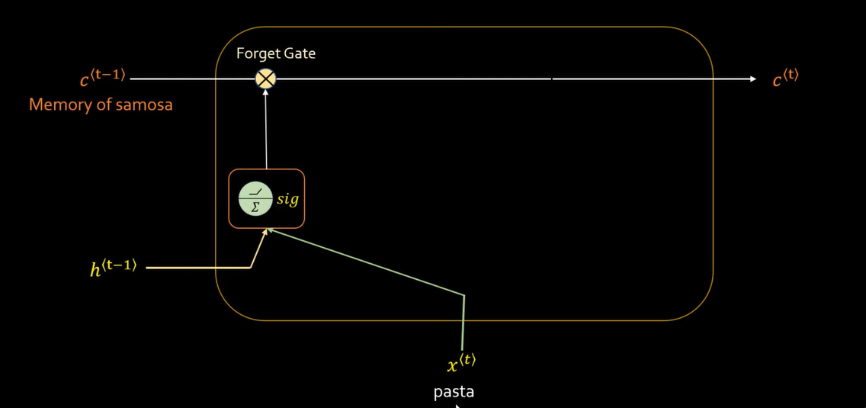
Forget Gate

Slide 22
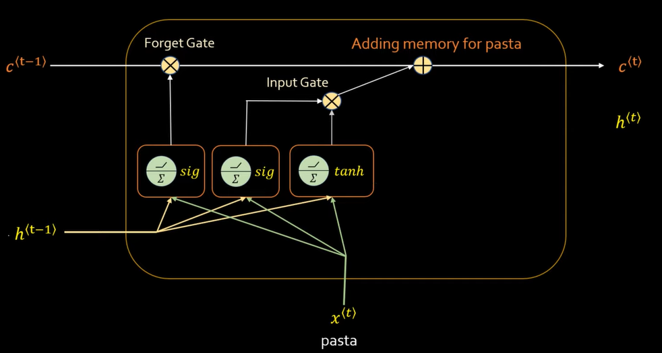
Input Gate

Slide 23
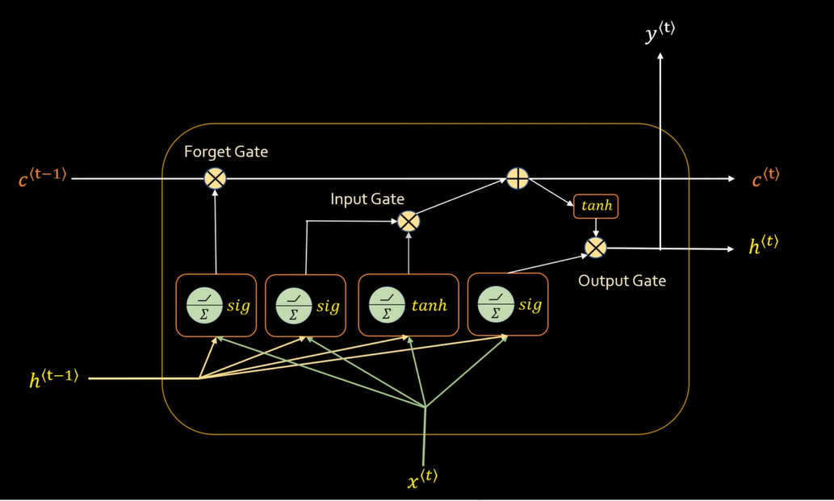
Output Gate

Slide 24
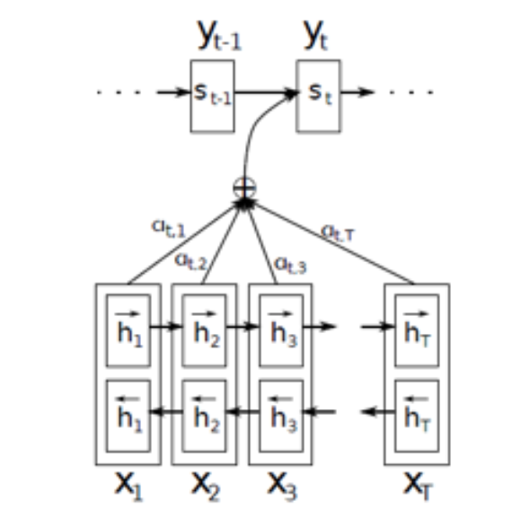
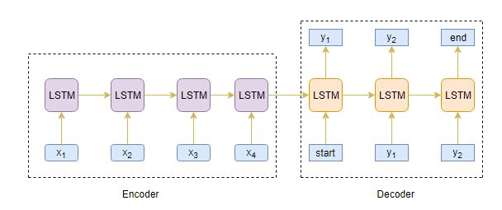
Architecture
Seq2Seq model architecture using Lstm

Slide 25
Evaluation Metrics
The metrics that are used to evaluate summarized content are
Rouge

Slide 26
Rouge
ROUGE stands for Recall-Oriented Understudy for Gisting Evaluation.
. It is essentially a set of metrics for evaluating automatic summarization of texts as well as machine translations.
It works by comparing an automatically produced summary or translation against a set of reference summaries (typically human-produced).

Slide 27
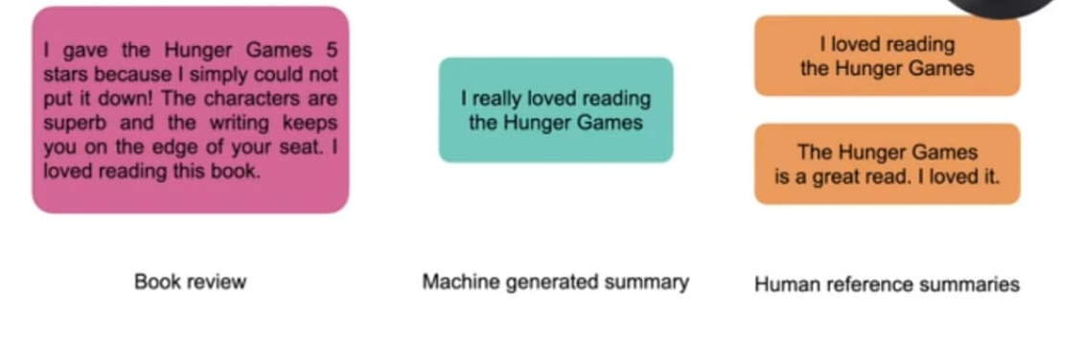
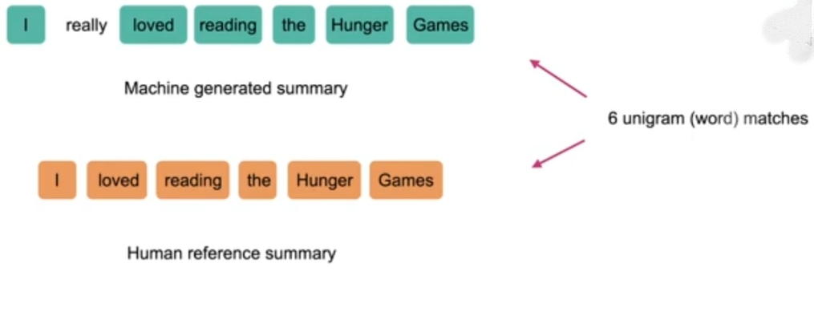

Slide 28
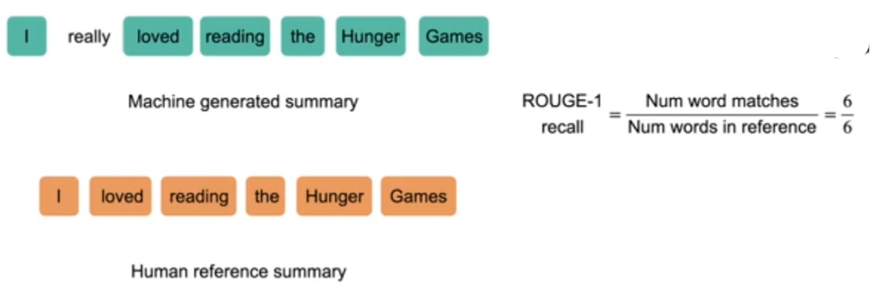
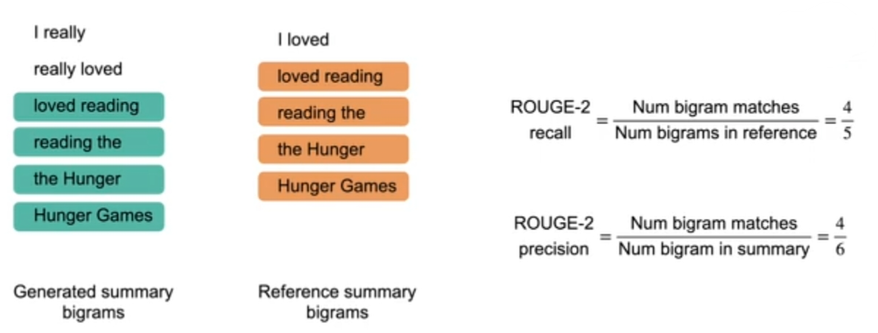

Slide 29
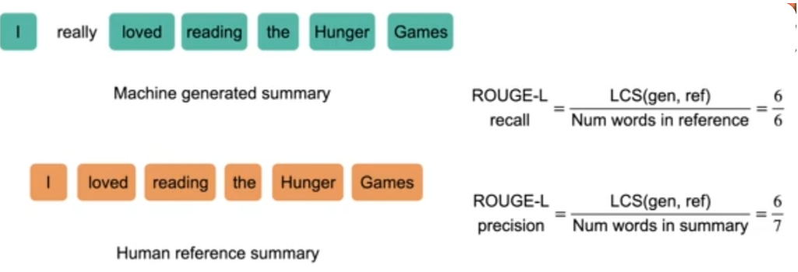
LCS Stands for Longest common subsequence

Slide 30
Applications
Books or Novel Summarization
Social Posts or Tweet Summarization
News Summarization
Email Summarization
Legal Documents Summarization

Slide 31
Advantages
Summaries reduce reading time.
When researching documents, summaries make the selection process easier.
Automatic summarization algorithms are less biased than human summarizers

Slide 32
Conclusion
Text summarization is used to produce a precised content called summary.
We have built the seq2seq model by LSTM
Hence we got 90% score for the summarized text

Slide 33
References
1. H. P. Luhn, ‘‘The automatic creation of literature abstracts,’’ IBM J. Res. Develop., vol. 2, no. 2, pp. 159–165, Apr. 1958.
2. Inderjeet Mani and Eric Bloedorn, “Multi-document summarization by graph search and matching,” AAAI/IAAI, vol. cmplg/ 9712004, pp. 622- 628, 1997.
3. J. M. Conroy, and D. P. O'leary, “Text summarization via hidden markov models,” In Proceedings of SIGIR '01, pp. 406-407, New York, NY, USA, 2001
4. D. K. Evans, “Similarity-based multilingual multidocument summarization,” Technical Report CUCS-014- 05, Columbia University, 2005.
5. S. Liu, M. X. Zhou, S. Pan, Y. Song, W. Qian, W. Cai, and X. Lian, ‘‘TIARA: Interactive, topic-based visual text summarization and analysis,’’ ACM Trans. Intell. Syst. Technol. (TIST), vol. 3, no. 2, pp. 1–28, Feb. 2012
6. N. Ramanujam and M. Kaliappan, ‘‘An automatic multidocument text summarization approach based on Naïve Bayesian classifier using timestamp strategy,’’ Sci. World J., vol. 2016, pp. 1–10, Jan. 2016.
7. B. Mutlu, E. A. Sezer, and M. A. Akcayol, ‘‘Multi-document extractive text summarization: A comparative assessment on features,’’ Knowl.- Based Syst., vol. 183, Nov. 2019, Art. no. 104848.
8. X. Wang, Y. Lu, J. Lv, Y. Shen, and C. Li, ‘‘Plausibilitypromoting generative adversarial network for abstractive text summarization with multi-task constraint,’’ Inf. Sci., vol. 521, pp. 46–61, Jun. 2020.

Slide 34
Thankyou

