Slide 1
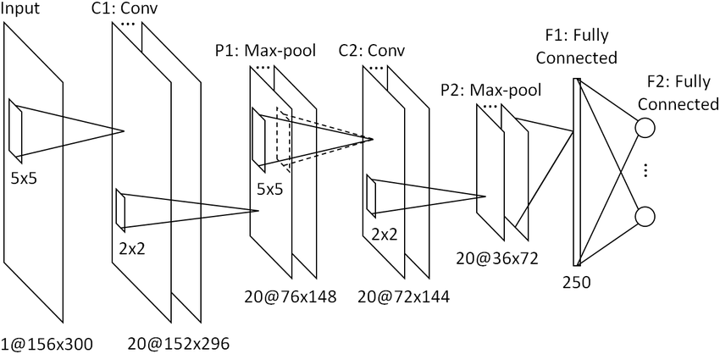
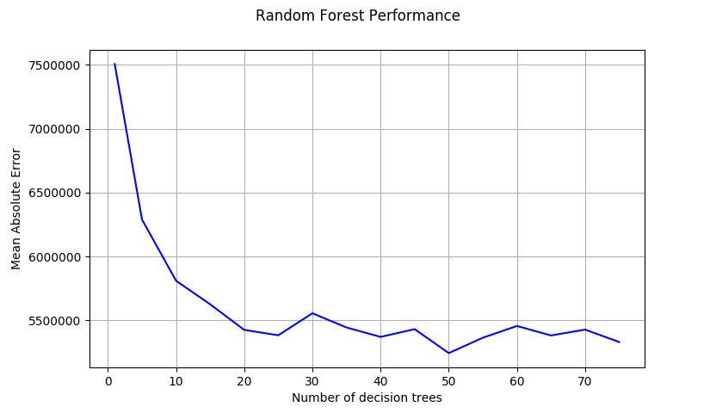
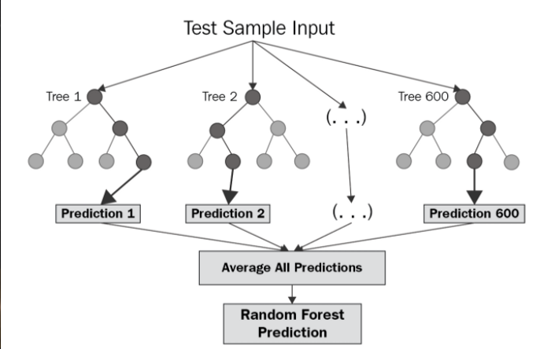
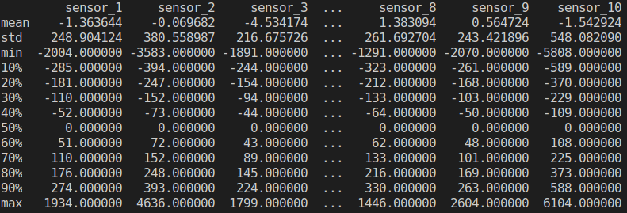
Volcanic Eruption Prediction
Matt Barrett
Problem
CNNs
Results
The goal of this competition was to predict how long it would be until a volcano erupted. Our submissions were evaluated on the mean absolute error(MAE) between our predictions and the actual time until eruption
I tried a variety of fully connected and convolutional neural
networks. The best results came from a neural network made up of two pairs of convolutional/pooling layers followed by four fully connected layers
My random forests significantly out performed my neural
networks. On my validation set, the best random forest had an MAE of 5.2 million, while my best neural network had an MAE of 10.6 million. The random forests were also considerably quicker to train and predict with.
Data
The data given was 10 minutes of readings taken every 1/100th of a second from 10 sensors around the volcano, for a total of 60,000 data points per volcano. We were provided with training data from 4,300 volcanoes
including the time until the volcano erupted. We were also given 4,500 volcanoes for which we were to predict the time until eruption.
Approach
I took several approaches to the problem. I tried extracting features from the data two different ways and I used both neural networks and random forests on each set of extracted features. The most successful feature extraction was to get the mean, standard deviation, and every 10th percentile, from 0 to 100, from each sensor for a total of 130 features per volcano.
Random Forests
I tried random forests made up of increasing numbers of decision trees to find where accuracy leveled off, which tends to happen with random forests. In this case, the accuracy began to converge after around 25 decision trees.
Conclusions
I believe that random forests work better on this
problem than neural networks because I am already
extracting relevant features from the data. This is where
random forests excel. Neural networks are best when
you do not know which features are important, e.g. image
classification. My current best score on the Kaggle
competition is 264 out of 358 with an MAE of 7.7 million
Source Code
https://github.com/mattb1888/cs5665_project
Image Citations
https://miro.medium.com/max/700/1*ZFuMI_HrI3jt2Wlay73IUQ.png
https://www.researchgate.net/profile/Shun_Miao/publication/280538045/figure/fig2/AS:354647291252736@1461565911272/Structure-of-the-multi-task-learning-convolutional-neural-network.png
Notes:
To change this poster, replace our sample content with your own. Or, if you'd rather start from a clean slate, press the New Slide button on the Home tab to insert a new page. Now enter your text and pictures in the empty placeholders. If you need more placeholders for titles, subtitles or body text, copy any of the existing placeholders, then drag the new one into place.

