Slide 1
Salary Predictor
By Matt Balint and Evan Kimmerlein

Slide 2
1.
The Problem

Slide 3

Notes:
In an ideal world, when a company gives you a job offer, they would give you a salary offer that’s good right out of the gate. Something that’s a fair value for your labor and skillset. The reality though, is companies want to maximize their profitability and so they’ll start off with an offer on the low-end and expect you to negotiate it up. The problem with negotiation though is you ask too little and the company is willing to pay more, you could potentially leave a lot of extra money on the table.

Slide 4
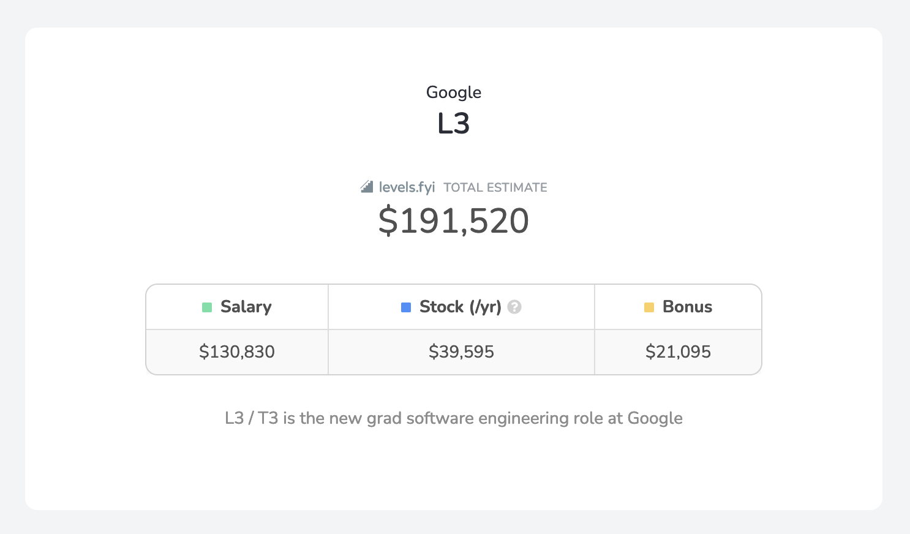
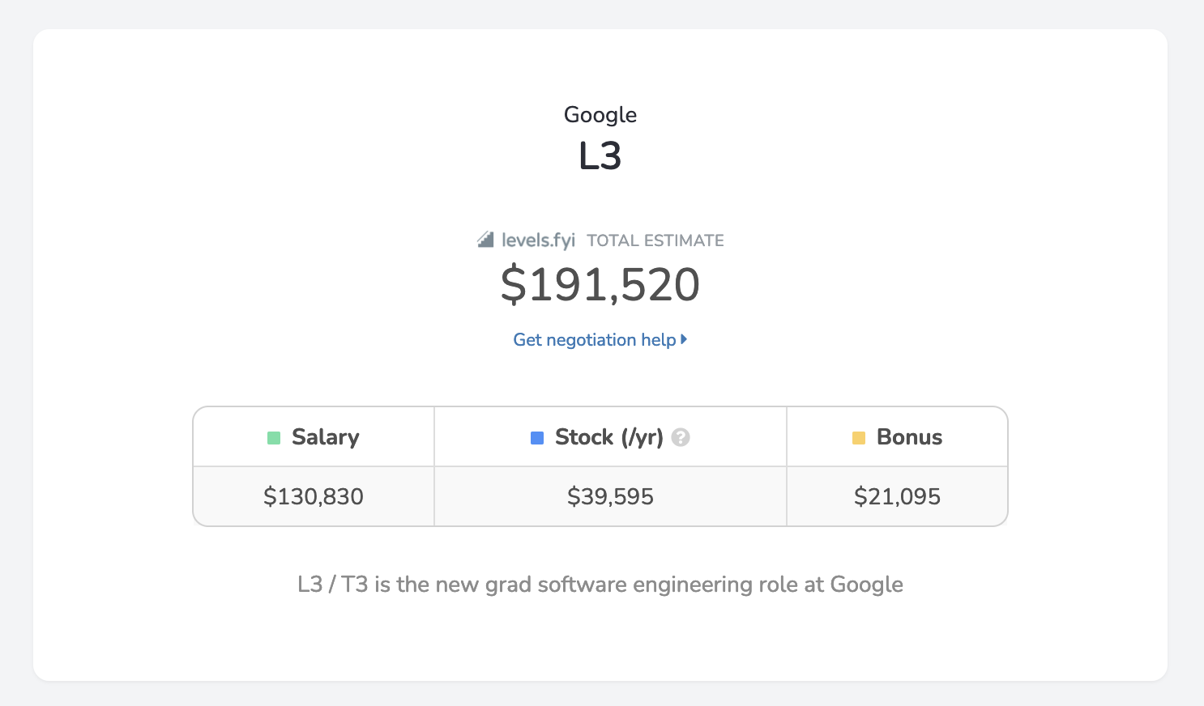
Notes:
For STEM jobs, it’s especially important you do well during pay negotiation because the salaries are significantly higher than regular jobs. If you mess up during negotiation, you could be losing out on tens of thousands of dollars.

Slide 5
The Problem
Poor salary negotiation could cost you $$$
Evan and I are graduating soon
Solution: build a ML model that predict STEM salaries
Notes:
Poor salary negotiation could cost you a ton of money.
Evan and I are also graduating within the next year, so we’d like to do a good job negotiating our salaries.
Solution: build a ML model that predict can STEM salaries

Slide 6
Hypothesis
There’s a direct correlation between years of experience and salary
We can use this correlation, plus other attributes like job title, location and company name, to predict a job seeker’s salary using a Linear Regression model
Salary
Years of Experience
Notes:
Motivation statement

Slide 7
2.
Methods

Slide 8
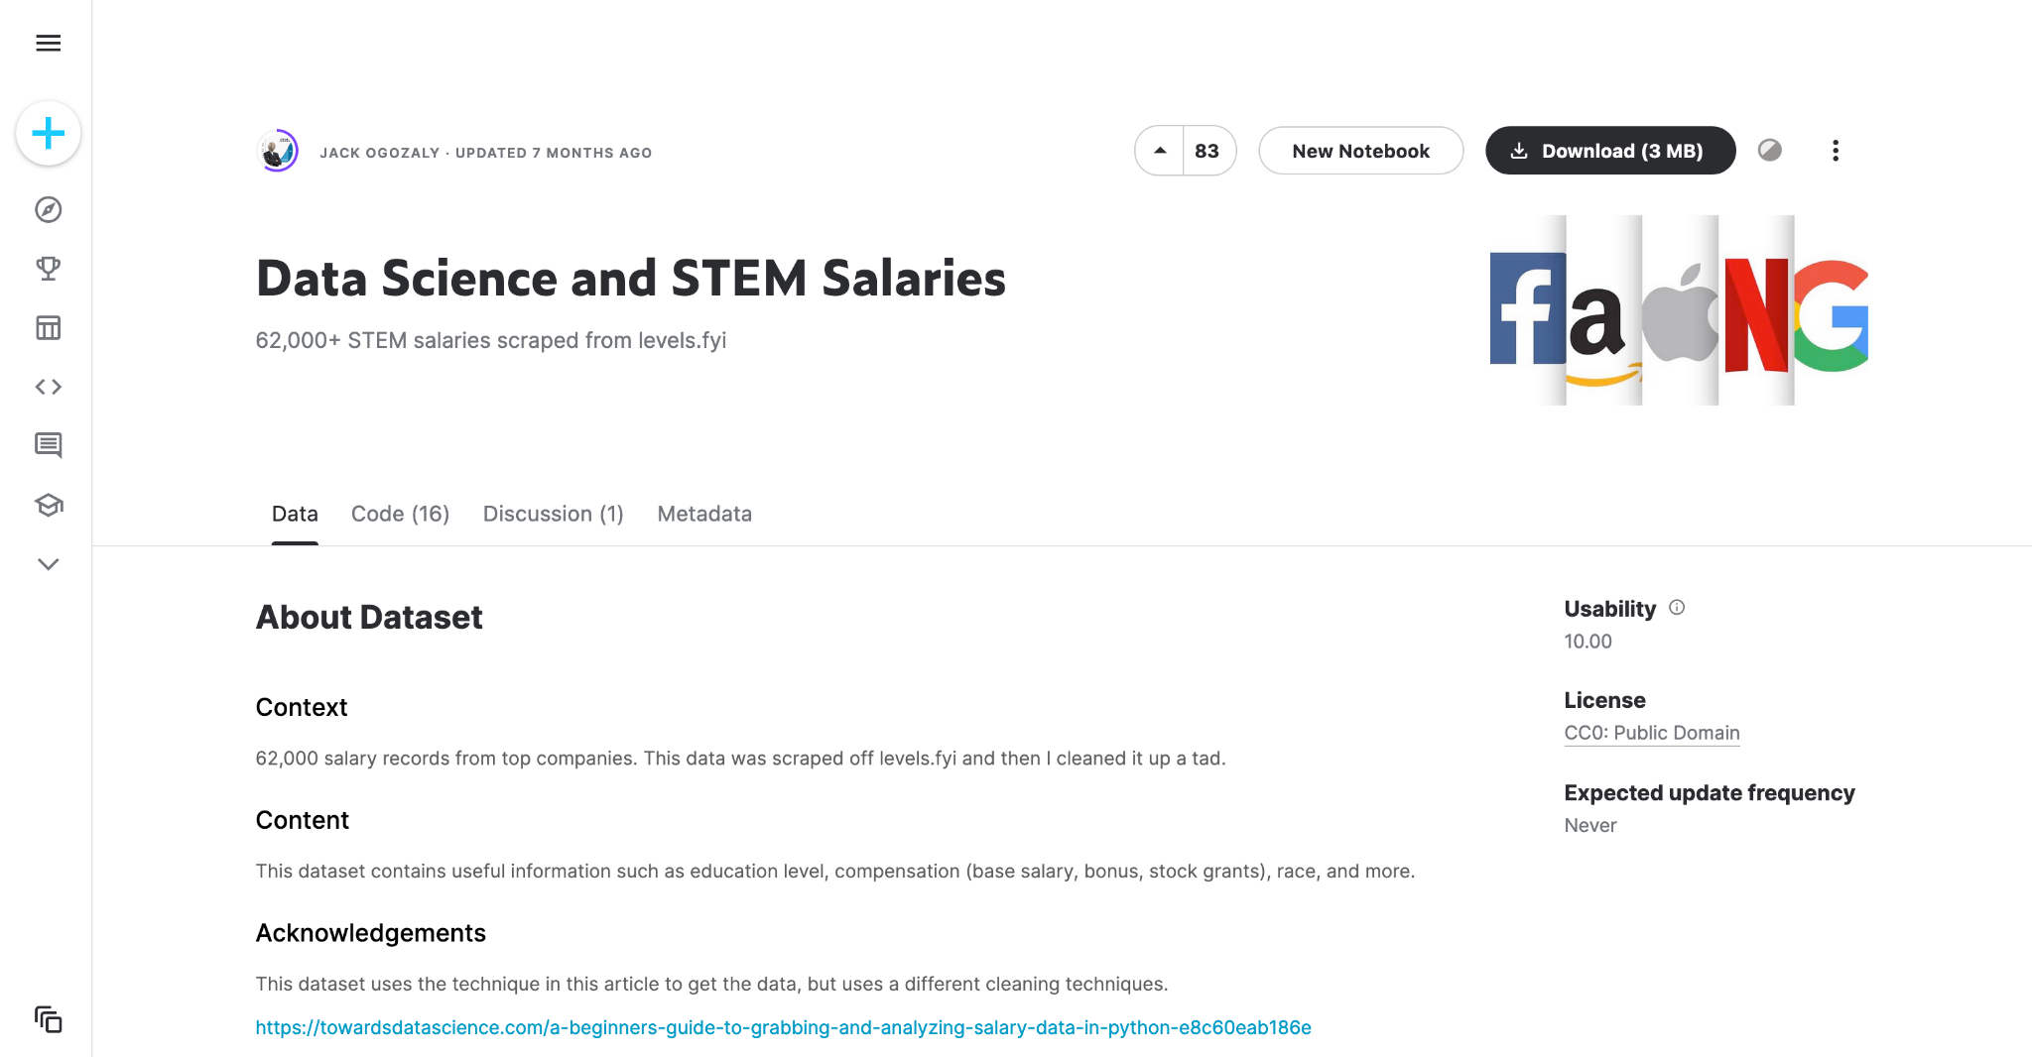
Notes:
To train our model, we used a collection of 62,000 verified salary records taken from levels.fyi.

Slide 9
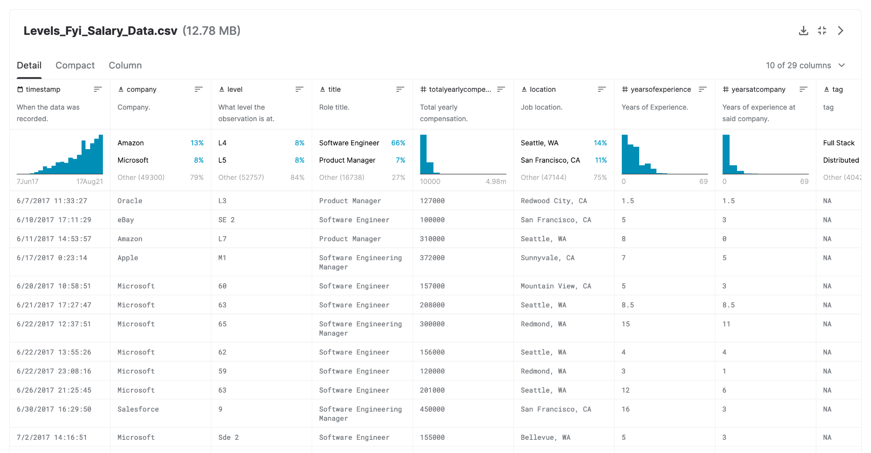
Notes:
These samples included a large number of attributes, that we could train our data off of. Some of these numerical, such as years of experience, while others where categorical, such as job title. This provided us with a challenge, as our model must support both. In the end we went with linear regression

Slide 10
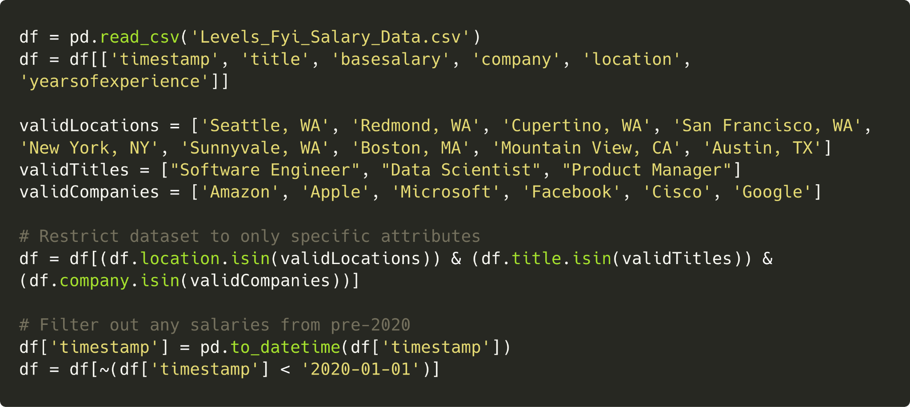
Methods
Notes:
While the huge number of parameters in the data set is nice, using all of them is impractical both computationally, and from a user experience standpoint. For these reasons we decided narrow our parameters down to Job title, company name, and location for inputs, and base salary for our output.
Since our dataset included a huge number of locations, job titles, and companies, we decided to narrow our data to a smaller, more relevant sample. We did the by only using samples that contained predetermined parameter values.
Finally, to make our model relevant to the current job market, we only included salaries reported after January 1st, 2020

Slide 11

Methods
Notes:
As mentioned earlier our input parameters include both categorical and numerical values. Unfortunately regression does not handle categorical data well. We decided to handle this by using Dummy Encoding, allowing each potential parameter value to be treated as its own separate parameter. This value is then set as one or zero, depending on whether it is included or not.
While this increases the number of features considerably, since we have already narrowed down our allowed parameters, it is not an issue. This method also avoids the bias caused by ordinal encoding, as no category is considered to be arbitrarily closer to another category

Slide 12
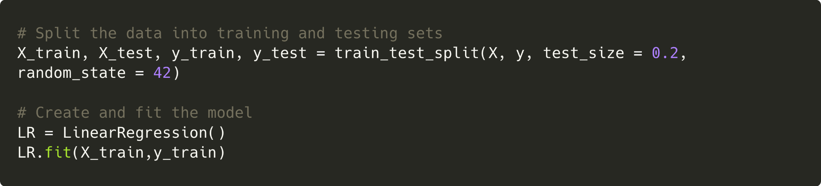
Methods
Notes:
Next we split our refined data, with 80% used as training data, and 20% used as testing data. The training data was then fit to a regression model

Slide 13
3.
Results
Notes:
Here are the results

Slide 14
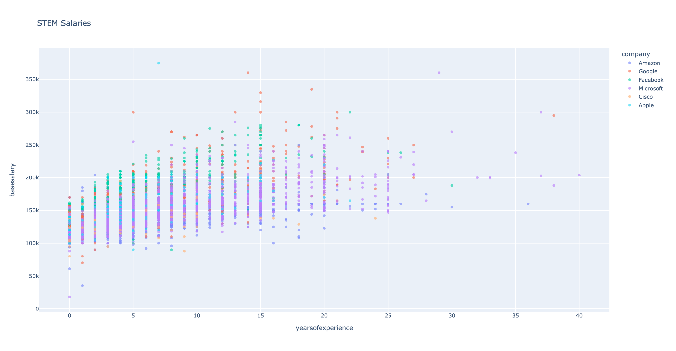
Notes:
Our model has many dimensions, so unfortunately we can’t display it all at once in just one graph and we can’t show the linear regression line very well, but if we use multiple graphs, we can get a pretty good sense of what our data looks like.
On this first graph here we have years of experience vs base salary, and you can see there’s a lot of colorful dots. Each color corresponds to a different company and if you look at the right hand side, you can see a key, which explains which company is which.
If the data looks a little strange here, keep in mind that these dots are for people in multiple different locations in and with multiple different job titles.

Slide 15
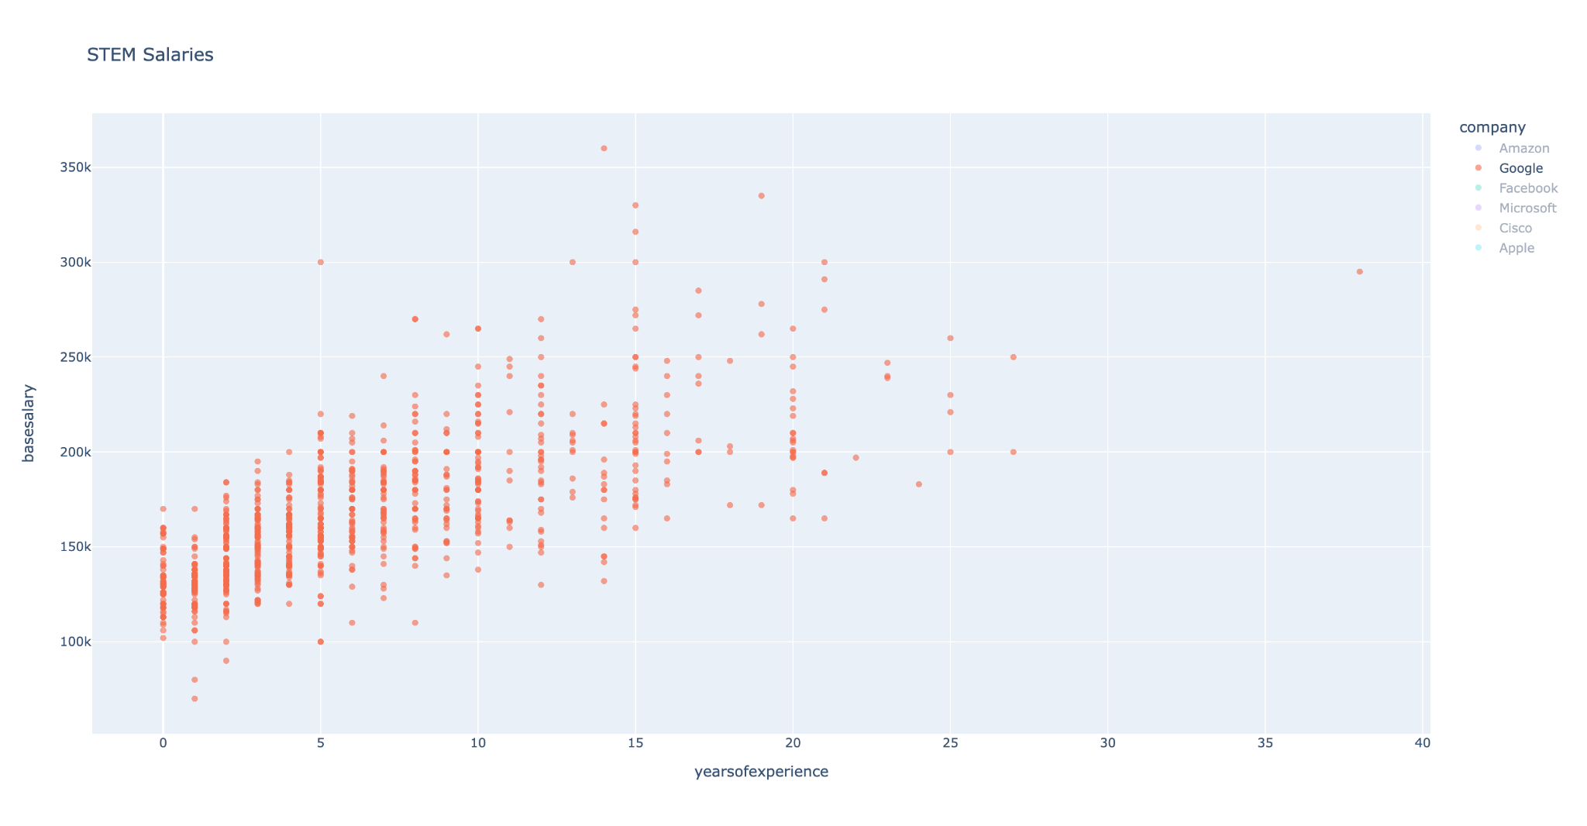
Notes:
One of the cool things about our project is that we used this library called Plotly to create all of our graphs. Plotly allows you to do some really nice things like being able to hover over data points and being able to create interactive keys. So this graph right is an example of what happens when you click a company name in the key. This is the same graph as the last slide, but since we’ve clicked Google in the key on the right hand, it has filtered all of the data and is showing us just Google’s data points.

Slide 16
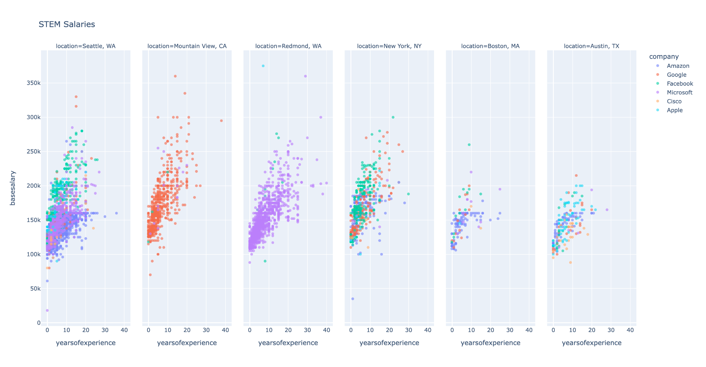
Notes:
Here’s another graph of our data. This shows the years of experience vs salary, but now it splits up into different location. So you can see how salary varies depending on the person’s location.

Slide 17
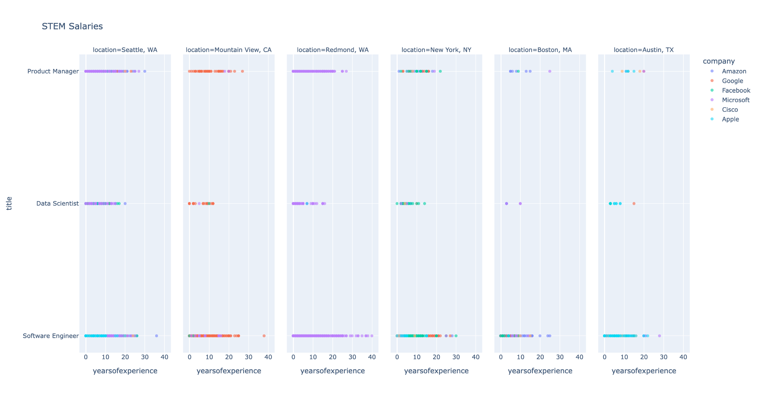
Notes:
Lastly, we have a graph that shows 3 of our features, the location, years of experience, and now job title.

Slide 18
Evaluation Metrics
R2 score = 0.526
Mean Squared Error = 459,272,196.266
Root Mean Squared Error = 21,430.637
Predicted Value | Actual Value | Difference (%)
160,785 | 190,000 | 15.38
131,564 | 125,000 | 5.25
139,185 | 155,000 | 10.2
Notes:
So how did our model do? Our current model has an R-squared score of 0.526, meaning that approximately 53% of the variability the data we tested could be explained by our model.
This is not surprising. There are countless factors that go into a job salary, some of which may not be realistically measurable. Despite that we achieved this score with only 4 parameters.
With that in mind this is still a fairly weak correlation, with a noticeably high Mean squared error.

Slide 19
Interpretation of Results
The results don’t support the hypothesis
The dataset does not lend itself well to creating one single model for all attributes (job locations, titles, years of experience, and company)
In the future, if we want to improve the performance of the model, we could:
Create one model per company
Use polynomial regression
Notes:
While there certainly is a correlation between our input parameters and base salary, it is not high enough for us to confidently predict what a base salary will be.
The nature of mixed categorical and numerical attributes makes training a model difficult, and the number of categories required to accurately predict salary likely impractical for a user to input.
However, there still are ways we can improve. Breaking the problem down into multiple models, organized by subgroups, such as companies may help increase accuracy. Using other models such as polynomial regression may better fit the data and improve our R-Squared score

