Slide 1

Open Source Continuous Integration Server

Slide 2

WHO AM I?
Matt Anderson
Moved to Dayton from Detroit eight years ago
Software Engineer at Northrop Grumman

Slide 3
Open Source Continuous Integration Server

Slide 4
WHAT IS JENKINS?
Monitors executions of repeated jobs
Used primarily for continuously building and testing software projects, i.e. “Continuous Integration” or “CI”
Previously known as “Hudson”
http://jenkins-ci.org

Slide 5














WHO USES JENKINS?

Slide 6
WHY USE JENKINS?
Immediate feedback on broken builds
No building from dev machines and manually copying files
Automated deployment
Automated test execution and feedback

Slide 7
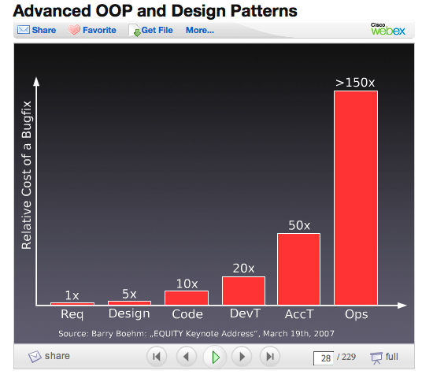
WHY USE JENKINS?

Slide 8
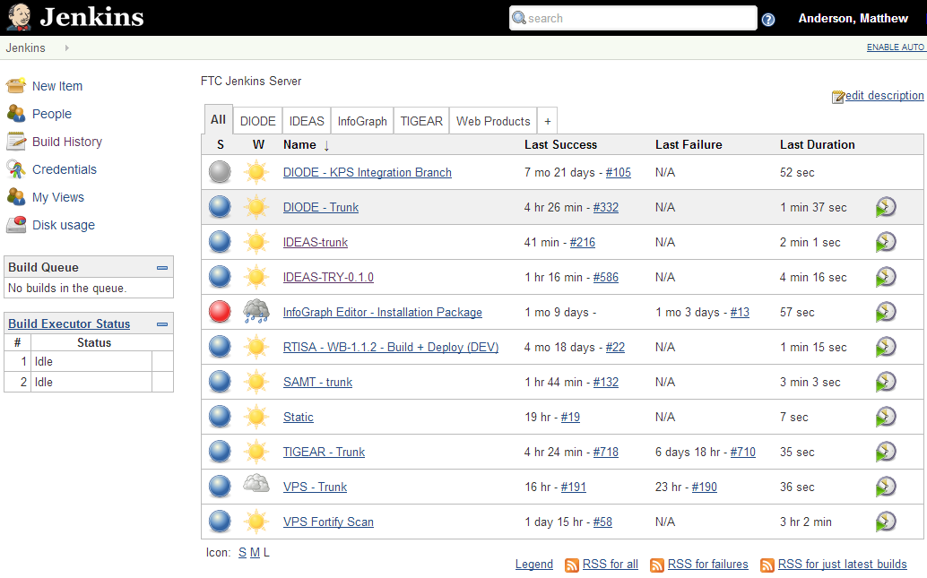
DASHBOARD
Notes:
This is the Jenkins Dashboard.

Slide 9
DASHBOARD
Notes:
Projects/Items can be organized into views.

Slide 10
DASHBOARD
Notes:
The build queue (pending builds) and currently executing builds are shown on the dashboard.

Slide 11
DASHBOARD
Notes:
The “S” column indicates the project’s last build status. Blue indicates success, red indicates failure, and grey means it is disabled.

Slide 12
DASHBOARD
Notes:
The “W” column shows build trends based on the last five builds. Sunny weather is better!

Slide 13
DASHBOARD
Notes:
The “W” column shows build trends based on the last five builds. Sunny weather is better!

Slide 14
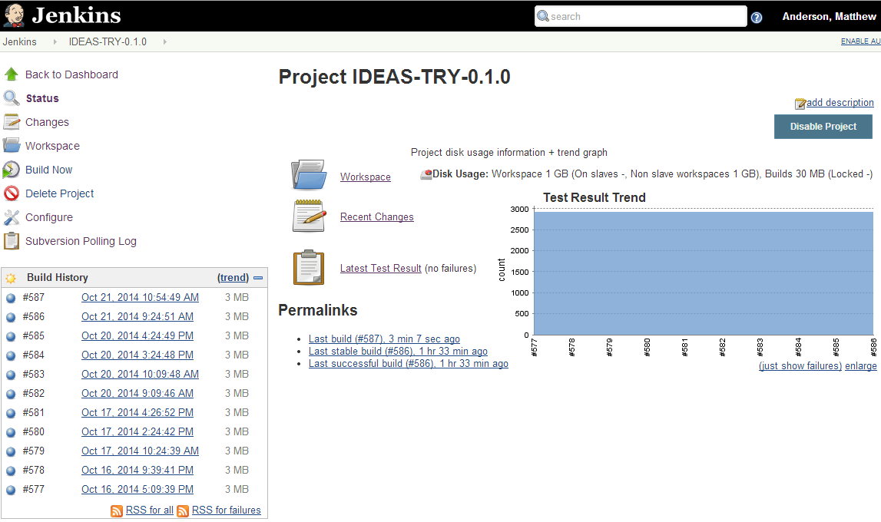
PROJECT VIEW

Slide 15
PROJECT VIEW
Notes:
Click on a build to view that build’s history.

Slide 16
PROJECT VIEW
Notes:
Click on a build to view that build’s history.

Slide 17
PROJECT VIEW

Slide 18
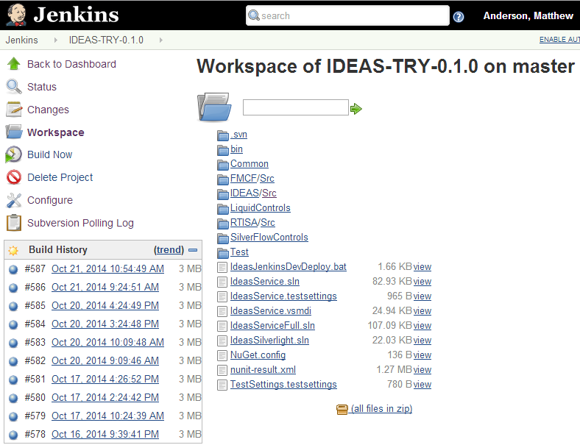
WORKSPACE
Notes:
Zipping up the project workspace and copying to another PC to execute a manual build in your IDE can be useful for diagnosing build errors.

Slide 19
PROJECT VIEW

Slide 20
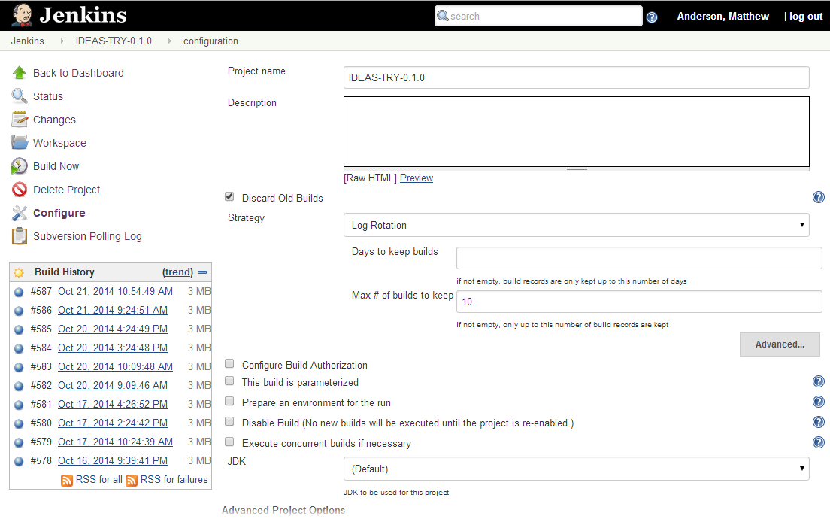
CONFIGURE

Slide 21
CONFIGURE
Notes:
The number of builds to keep can be specified to limit the amount of space used on the build server.

Slide 22
CONFIGURE

Slide 23
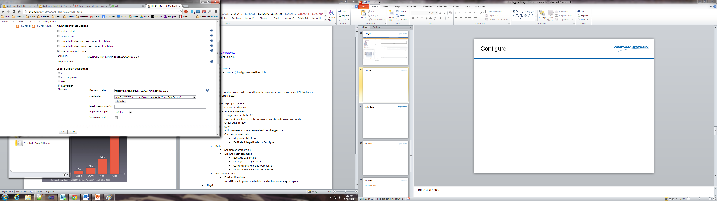
ADVANCED PROJECT OPTIONS

Slide 24
ADVANCED PROJECT OPTIONS
Notes:
Customizing the workspace can be useful if projects or dependencies expect a particular directory structure.

Slide 25
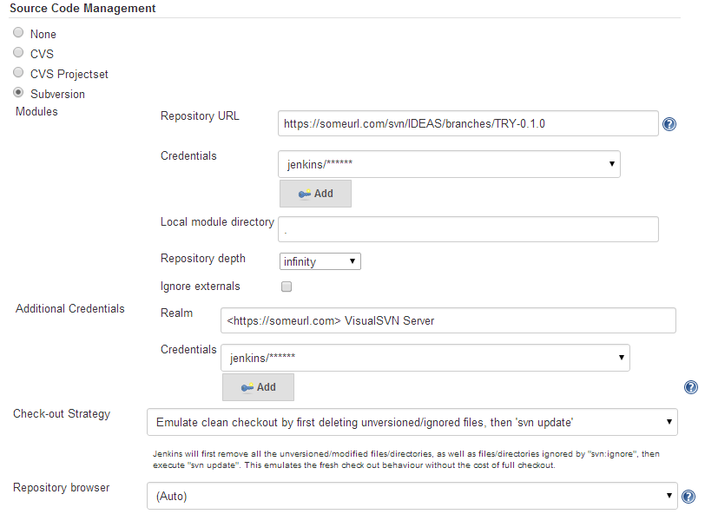
SOURCE CODE MANAGEMENT

Slide 26
SOURCE CODE MANAGEMENT
Notes:
Enter your SCM URL and credentials. A separate SCM account is preferable to using an individual’s credentials.

Slide 27
SOURCE CODE MANAGEMENT
Notes:
If a project has SVN externals, additional credentials are required.

Slide 28
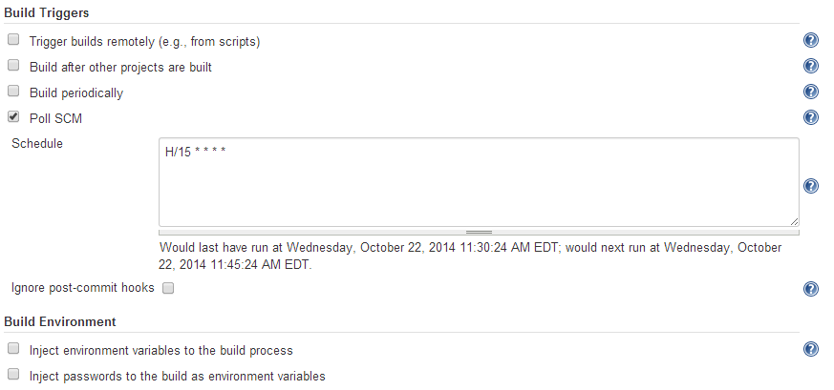
BUILD TRIGGERS

Slide 29
BUILD TRIGGERS

Slide 30
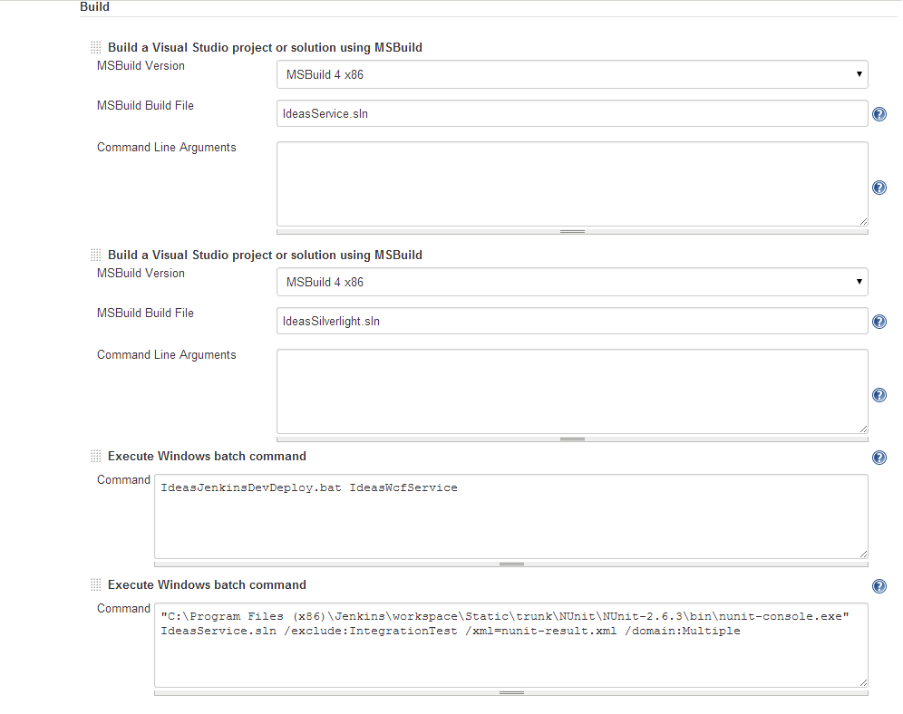
BUILD

Slide 31
BUILD

Slide 32
BUILD
Notes:
Scripts can be used to deploy code as part of the build process. Since this is part of the build, Jenkins will mark the build as failed if the script returns/exits with a value that represents an error.

Slide 33
BUILD
Notes:
Scripts can be used to deploy code as part of the build process. Since this is part of the build, Jenkins will mark the build as failed if the script returns/exits with a value that represents an error.

Slide 34
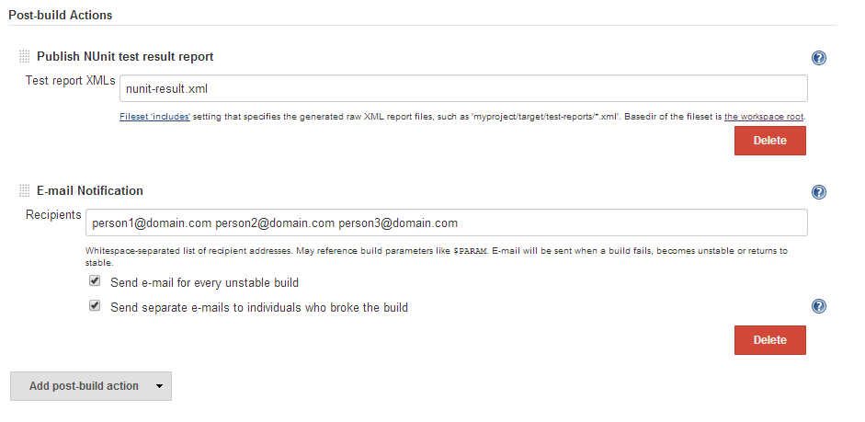
POST BUILD ACTIONS

Slide 35
POST BUILD ACTIONS
Notes:
It is preferable to only send emails to individuals who broke the build; however, Jenkins is not currently configured with email addresses. Thus, individual recipients must be specified and every receives an email.

Slide 36
POST BUILD ACTIONS
Customized email notifications
Build other projects
Create/update JIRA issues
Publish Javadocs

Slide 37
PLUG-INS
Over 600 plug-ins available for customization
Examples:
  JIRA
  Ant
  Maven
  JUnit
  Javadoc
  SSH
  MSBuild
  NUnit
  PowerShell
  Email Notifications
https://wiki.jenkins-ci.org/display/JENKINS/Plugins

Slide 38
LET’S DO THIS
A final word of encouragement
https://www.youtube.com/v/LkCNJRfSZBU&start=84&end=90&autoplay=1

Slide 39
QUESTIONS?

