Slide 1
LTS Dayton
Visualizing Traffic Stress Data for Local Cyclists
Matt Anderson

Slide 2
Roadmap
Hatching the idea
Getting the data
Building the app
Plenty of trial and error
Demo!

Slide 3
Bio
Matt Anderson
Detroit-area native, moved to Dayton in 2006
Software Engineer at Northrop Grumman
Bicycle commuter

Slide 4
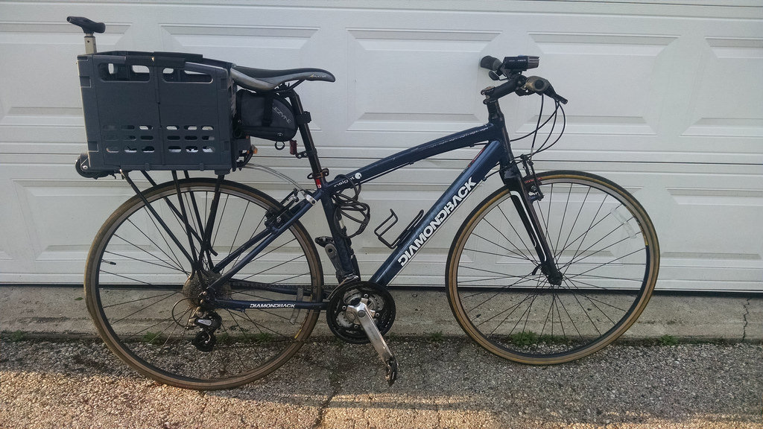

Slide 5
Adventure Summit 2016
Annual event celebrating spirit of outdoor adventure
Session: Past, Present, and Future of Biking Miami Valley
MVRPC Bike Plan Update 2015
Level of Traffic Stress (LTS) analysis

Slide 6
What is Level of Traffic Stress (LTS)?
Created by Mineta Transportation Institute in San Jose, CA
Used to measure the bike friendliness of a city
Streets categorized into four different stress levels

Slide 7
What is Level of Traffic Stress (LTS)?
LTS 1: bikeways and low-volume streets with speed limit <= 25 mph
LTS 2: some striped bike lanes, protected lanes, cycle tracks
LTS 3: roads with 30 mph+ speeds and/or four lanes
LTS 4: most roads with 30 mph+ speeds and/or five or more lanes

Slide 8


Slide 9
Getting the Data
Available, but not necessarily “open”
Ask, offer to help
Be flexible, patient

Slide 10
Getting the Data
Four .kmz files
Trails: 363 bytes(?)
Moderate stress streets (LTS 3): 707 KB
High stress streets (LTS 4): 3.2 MB
Low stress streets (LTS 1): 12.9 MB
Extracted to .kml
Trails: 491 bytes(?)
Moderate stress streets (LTS 3): 18.2 MB
High stress streets (LTS 4): 67.3 MB
Low stress streets (LTS 1): 100.8 MB

Slide 11
Convert to GeoJSON
Open standard for representing geographic features based on JSON
$ npm install -g togeojson
$ togeojson input.kml > output.geo.json
These files are really big
27.5 MB, 106.5 MB, and 211 MB
Almost 350 MB total ☹

Slide 12
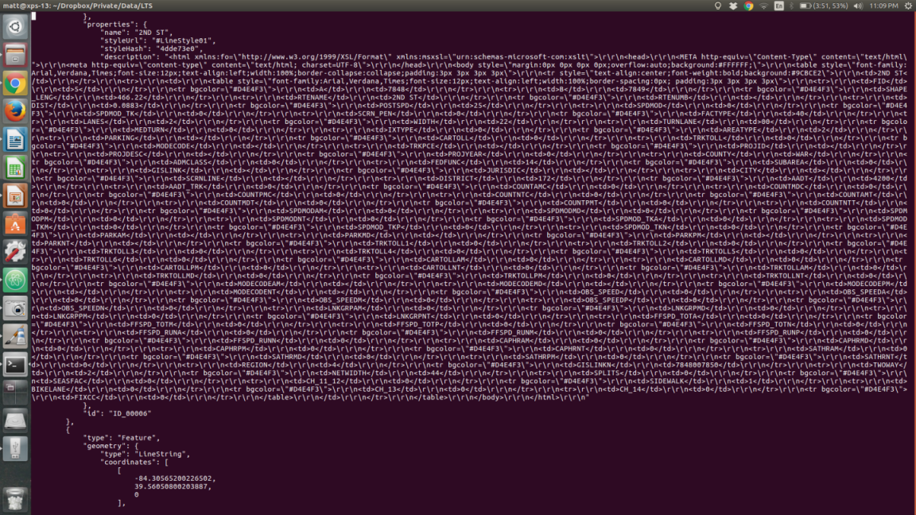

Slide 13
Giant description

Slide 14
Tiny geo-coordinates

Slide 15
Shed Some Weight
Features have long descriptions
Wrote small script to remove them
Largest file (LTS 1): 211 MB -> 39.1 MB

Slide 16
Shed Some Weight
Use geojson-minifier to reduce precision
  $ npm install -g geojson-minifier
  $ geojson-minifier -o pack -f geo.json -p 6
  $ geojson-minifier -o unpack -f geo.json.packed -p 6
39.1 MB -> 25.6 MB

Slide 17
Shed Some Weight
Use TopoJSON – extends GeoJSON, typically 80% smaller
$ npm install -g topojson
$ topojson input.geo.json > output.topo.json
25.6 MB -> 5.1 MB
Now we’re getting somewhere!

Slide 18
Spoiler
Upon further review…
$ topojson input.211mb.geo.json > output.5mb.topo.json

Slide 19
The App
Leaflet.js + OpenStreetMap for mapping
Npm for additional project structure*/dependencies
Express.js to host app and serve files locally
body-parser for JSON, and compression for gzip
$ npm install express body-parser compression –-save

Slide 20
Let’s Try It
Add a GeoJSON layer with Leaflet -> it works!
function addGeoJsonToMap(url) {
$.get(url, function(data) {
L.geoJson(data).addTo(map);
});
}
Note: GeoJSON not TopoJSON

Slide 21
Let’s Try It
Deploy to server to test performance
NOT GOOD
But not surprising, serving 25+ MB GeoJSON data

Slide 22
What Else?
leaflet-omnivore lets us consume TopoJSON
  Reference from MapBox Plugins CDN
  TopoJSON is < 1 MB gzipped!
function addTopoJsonToMap(url) {
var layer = L.geoJson(null);
omnivore.topojson(url, null, layer).addTo(map);
}

Slide 23
What Else?
Pan/zoom feels sluggish
We are rendering LOTS of lines (svg)
Any other ideas?

Slide 24
Slice and Dice
geojson-vt – slice GeoJSON into tiles on the fly
Draws lines using canvas element
Used by MapBox GL, light on details
Found a gist: https://gist.github.com/Sumbera/c67e5551b21c68dc8299

Slide 25
Slice and Dice
function addGeoJsonVtToMap(url, lineColor) {
$.get(url, function(data) {
var tileIndex = geojsonvt(data, { maxZoom: 18 });
var canvasTiles = L.tileLayer.canvas();
canvasTiles.drawTile = function(canvas, tilePoint, zoom) {
var tile = tileIndex.getTile(zoom, tilePoint.x, tilePoint.y);
drawFeatures(canvas.getContext('2d'), tile.features, lineColor);
};
canvasTiles.addTo(map);
});
}

Slide 26
Slice and Dice
Browser responsiveness much improved!
Does not support TopoJSON ☹

Slide 27
Combine and Stir
Let’s take the best of both worlds!
Serve TopoJSON
Convert to GeoJSON using TopoJSON client API

Slide 28
Combine and Stir
function addTopoJsonToGeoJsonVtToMap(url, lineColor, objectKey) {
$.get(url, function(data) {
var geoJsonFeatColl = topojson.feature(data, data.objects[objectKey])
var tileIndex = geojsonvt(geoJsonFeatColl, { maxZoom: 18 });
var canvasTiles = L.tileLayer.canvas();
canvasTiles.drawTile = function(canvas, tilePoint, zoom) {
var tile = tileIndex.getTile(zoom, tilePoint.x, tilePoint.y);
drawFeatures(canvas.getContext('2d'), tile.features, lineColor);
};
canvasTiles.addTo(map);
});
}

Slide 29
Combine and Stir
Serve < 1 MB of geo data!
One small downside – lines not perfectly smooth

Slide 30
Go Faster
IIS on Azure is really slow
  15-20 second page loads for 1.2 MB of JSON
Bump up service tier? CDN?
Use Express!
  TopoJSON gzips to 739 KB
  Page loads in 2-3 seconds

Slide 31
Demo Time!
http://ltsdayton.azurewebsites.net

Slide 32
Recap
Cliché, but find some data that interests you
Plenty of data available, might have to ask
Keep experimenting (e.g. Express vs. IIS)
Put it out there

Slide 33
Questions?
LTS Dayton:
https://github.com/mattbanderson/lts-dayton
Intro to Leaflet (starts at 26:38):
https://livestream.com/accounts/12766112/events/5328224

