Slide 1
An Intro to Leaflet.js
Matt Anderson

Slide 2
What’s so cool about maps?

Slide 3
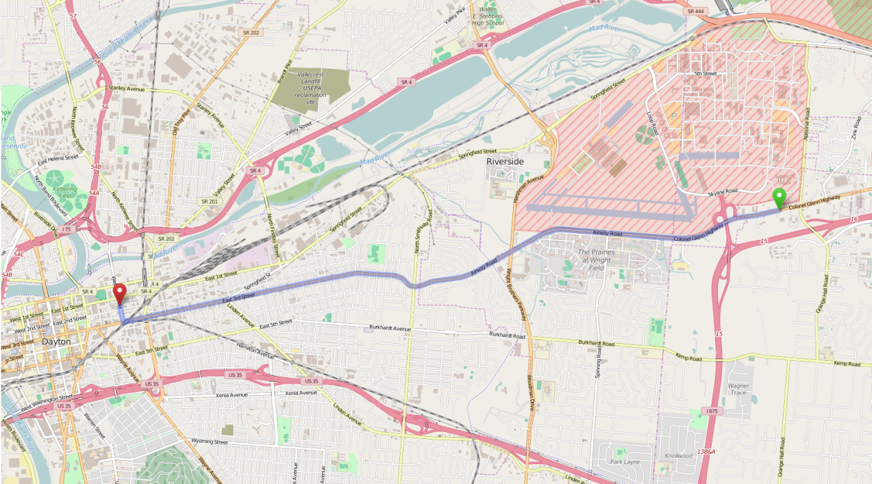

Slide 4
Open source
Lightweight
Mobile-friendly
Tons of features
www.leafletjs.com

Slide 5
Plugins
Map/tile options
Overlays (clusters, heatmaps, etc)
Advanced pan/zoom
Drawing
Timeline

Slide 6
Alternatives:
Google Maps
MapQuest
OpenLayers
Mapbox GL

Slide 7
Code!
  Reference Leaflet JS and CSS files from CDN

Slide 8
Add a map
var map = L.map('map').setView([39.774, -84.182], 11); // Center on Dayton
L.tileLayer('http://{s}.tile.osm.org/{z}/{x}/{y}.png', {
attribution: '&copy; <a href="http://osm.org/copyright">OpenStreetMap</a> contributors'
}).addTo(map);

Slide 9
Add a map
Lat/Lon
var map = L.map('map').setView([39.774, -84.182], 11); // Center on Dayton
L.tileLayer('http://{s}.tile.osm.org/{z}/{x}/{y}.png', {
attribution: '&copy; <a href="http://osm.org/copyright">OpenStreetMap</a> contributors'
}).addTo(map);

Slide 10
Add a map
Zoom
var map = L.map('map').setView([39.774, -84.182], 11); // Center on Dayton
L.tileLayer('http://{s}.tile.osm.org/{z}/{x}/{y}.png', {
attribution: '&copy; <a href="http://osm.org/copyright">OpenStreetMap</a> contributors'
}).addTo(map);

Slide 11
Add a map
Tile server URL
var map = L.map('map').setView([39.774, -84.182], 11); // Center on Dayton
L.tileLayer('http://{s}.tile.osm.org/{z}/{x}/{y}.png', {
attribution: '&copy; <a href="http://osm.org/copyright">OpenStreetMap</a> contributors'
}).addTo(map);

Slide 12
Draw a pin
var map = L.map('map').setView([39.774, -84.182], 11); // Center on Dayton
L.tileLayer('http://{s}.tile.osm.org/{z}/{x}/{y}.png', {
attribution: '&copy; <a href="http://osm.org/copyright">OpenStreetMap</a> contributors'
}).addTo(map);
var marker = L.marker([39.76257, -84.181685]).addTo(map); // 2nd Street Market

Slide 13
Demo time!

Slide 14
Questions?
www.leafletjs.com
https://github.com/mattbanderson/leaflet-demo

