Slide 1
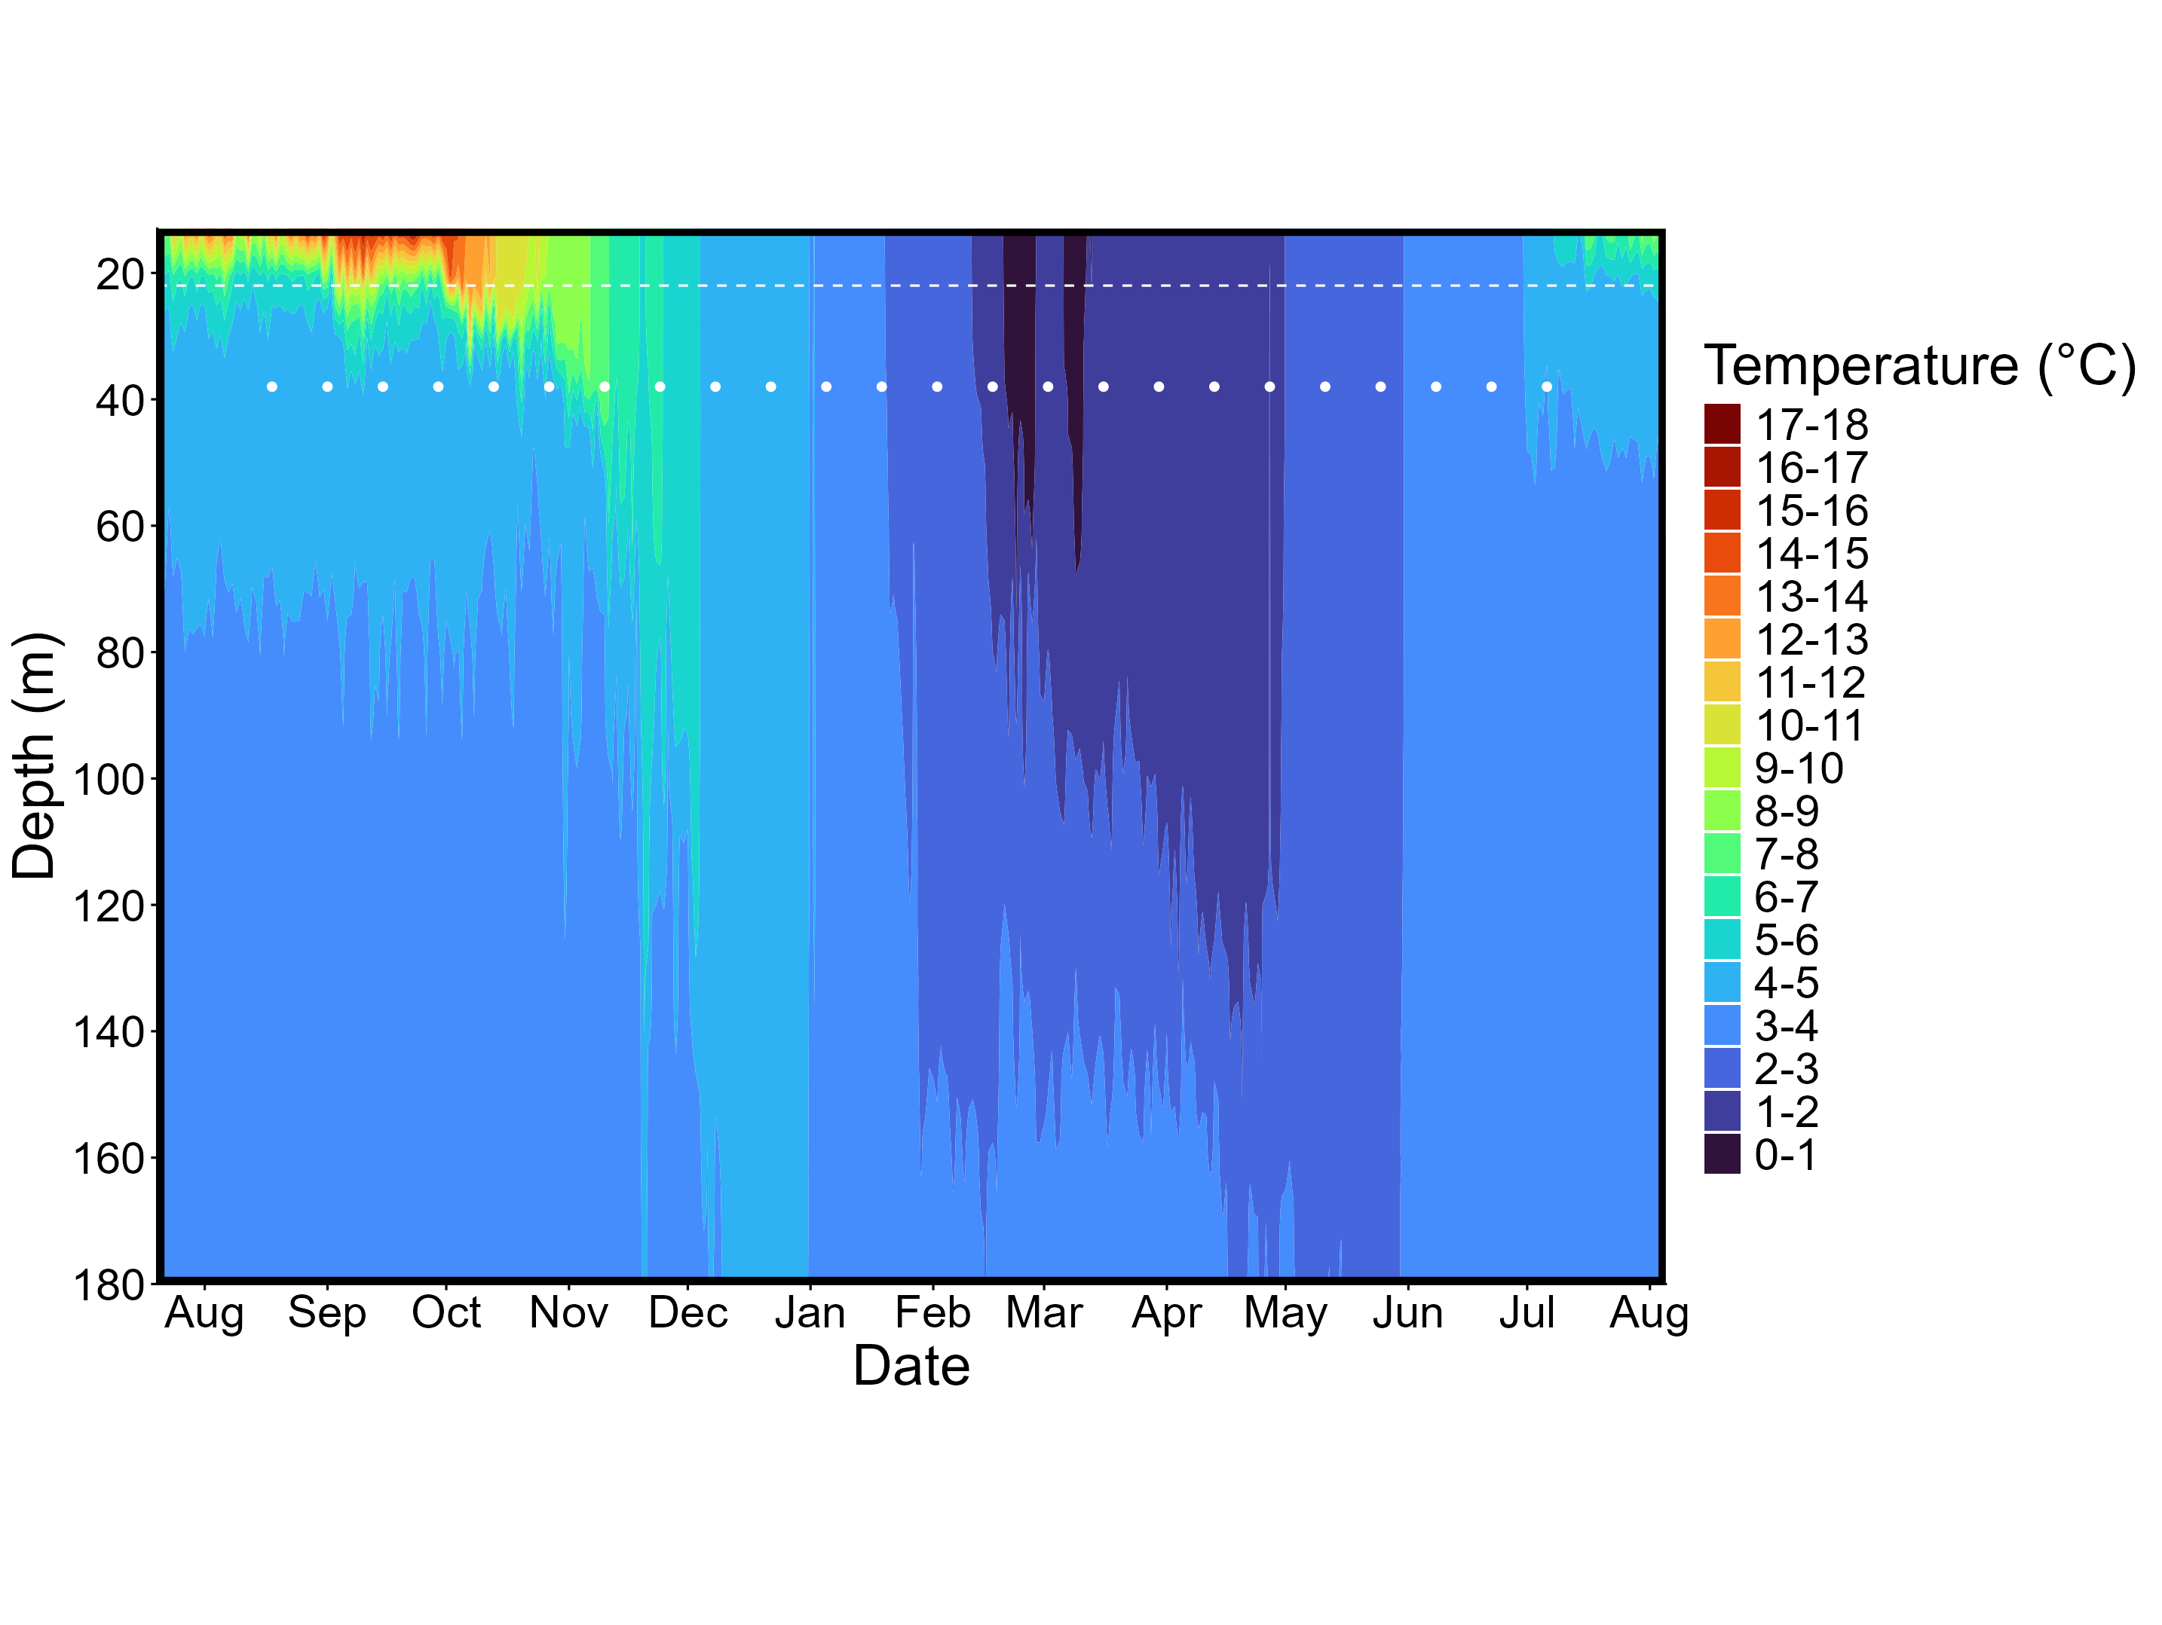
Summer
Fall
Winter
Spring
Sum

