Slide 1





Content includes material subject to © Crown copyright (2018), Dstl and © Crown copyright (2018), PHE. This material is licensed under the terms of the Open Government Licence except where otherwise stated. To view this licence, visit http://www.nationalarchives.gov.uk/doc/open-government-licence/version/3 or write to the Information Policy Team, The National Archives, Kew, London TW9 4DU, or email: psi@nationalarchives.gsi.gov.uk
Content includes material © Riskaware 2018
Uncertainty Visualization Study Group

Slide 2
Uncertainty Visualization Study Group Theme 1: Visualization of underpinning model assumptions Dr Ian Hall Public Health England University of Manchester
Notes:
giving the capability to make informed decisions based on the available ensemble of epidemic models.
together with a documented evidence thread for incorporation into the BSVE

Slide 3
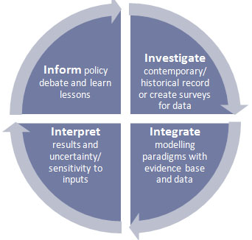
Epidemiology and Modelling
Emergency Response:
Real-time modelling
Expert advice
Visualization
Emergency Preparedness
Contingency planning
Risk mapping/assessment
Framing exercises

Slide 4
The art of modelling
Things change with:
Time
Space
Socio-economic factors
Individual
Diseases are transmitted in a variety of different ways.
We must make simplifications.
Each model is an abstraction of the real world.
Each model is designed to answer a specific question.
Model is always wrong but that isn’t the models fault – the assumption (or data) that built the model are the weakness… Garbage in garbage out…

Slide 5
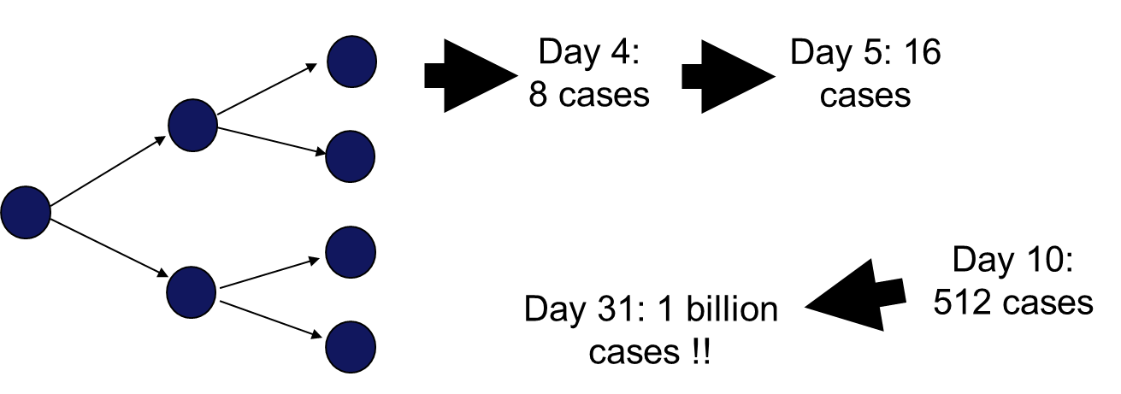
Exponential growth
Let us assume 1 person is infected with a disease and everyone else is susceptible to the disease…
The disease lasts for exactly one day and during this time each case infected exactly two more cases…

Slide 6
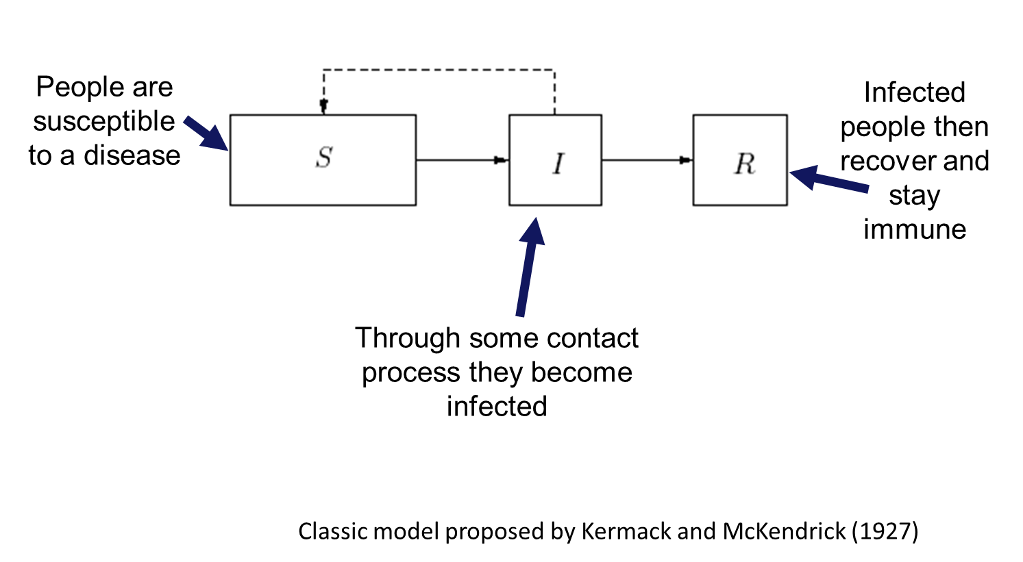
Transmission and Immunity

Slide 7
Model complexity
Five major assumptions
Closed
Compartmentalized
Deterministic
Memory-less
Mass action
General remarks possible
Reproduction number
Herd immunity
Final size estimate

Slide 8
Added complexity
Five major assumptions
Closed: allow for demography (natural birth and death)
Compartmentalized: allow for more complex disease states
Deterministic: allow for random events to occur
Memory-less: allow for more realistic disease progression
Mass action: allow for more complex mixing

Slide 9
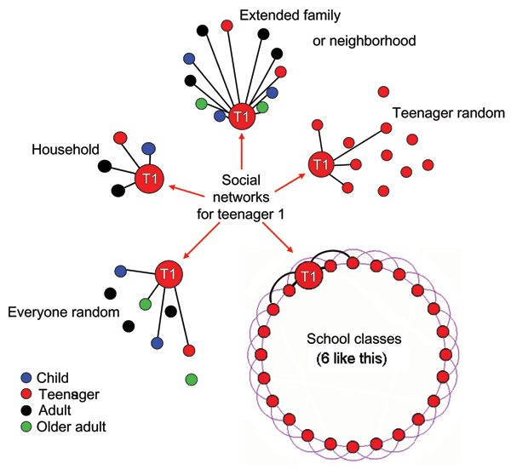
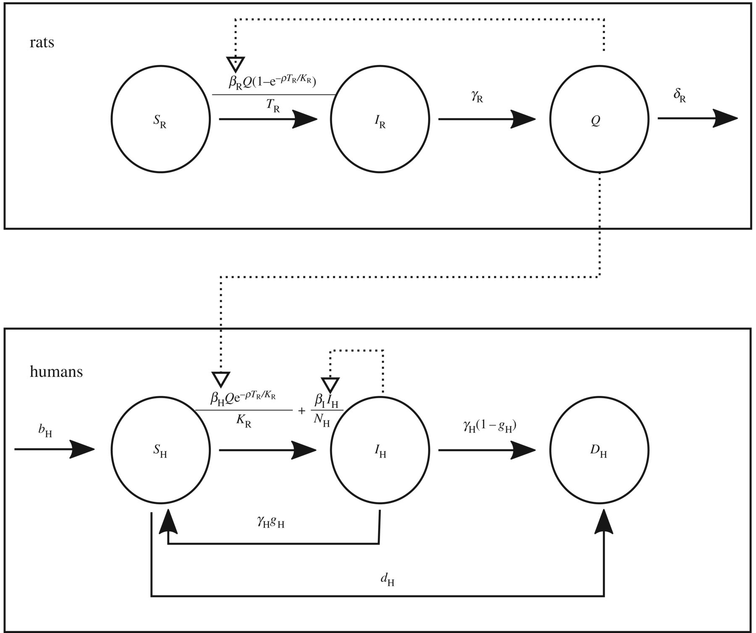
Examples
Glass et al, EID, 2006
Didelot, et al, 2018

Slide 10
Expectations
Innovative methods for visualizing the assumptions behind the models
Computer code
Illustrations
Concepts

