Slide 1





Content includes material subject to © Crown copyright (2018), Dstl and © Crown copyright (2018), PHE. This material is licensed under the terms of the Open Government Licence except where otherwise stated. To view this licence, visit http://www.nationalarchives.gov.uk/doc/open-government-licence/version/3 or write to the Information Policy Team, The National Archives, Kew, London TW9 4DU, or email: psi@nationalarchives.gsi.gov.uk
Content includes material © Riskaware 2018
Uncertainty Visualization Study Group

Slide 2
Uncertainty Visualization Study Group Theme 2: Decision aids that include data summaries and temporal predictions Dr Adrian Pratt Senior Mathematical Modeller Public Health England

Slide 3
Introduction
Transmissible diseases can be hard to predict
Susceptible, Infected, Removed (SIR) model is used to describe evolution of disease in a population
Stochasticity can be introduced to capture many possible outcomes
Effective communication to decision makers is essential
Transmissible disease:
A disease that can be passed from one person to another.
SIR model:
A mathematical model that divides population into susceptible, infected, and removed (no longer susceptible or infective).
Stochastic model:
A model possessing some inherent randomness.
Notes:
Dice image is CC0 license (Free for personal and commercial, no attribution required)

Slide 4

Stochasticity
Transmissible disease:
A disease that can be passed from one person to another.
SIR model:
A mathematical model that divides population into susceptible, infected, and removed (no longer susceptible or infective).
Stochastic model:
A model possessing some inherent randomness.
Notes:
Dice image is CC0 license (Free for personal and commercial, no attribution required)

Slide 5
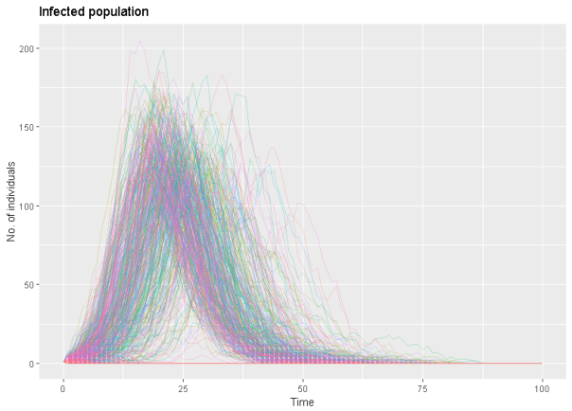
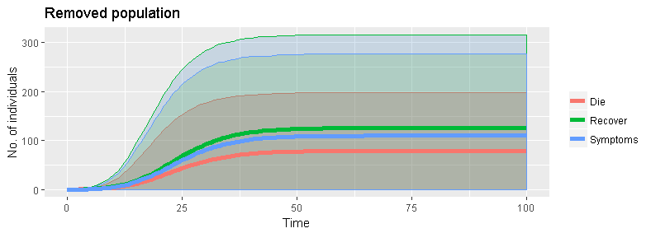
Existing approaches for visualization
Transmissible disease:
A disease that can be passed from one person to another.
SIR model:
A mathematical model that divides population into susceptible, infected, and removed (no longer susceptible or infective).
Stochastic model:
A model possessing some inherent randomness.
Notes:
Describe issues with these methods.

Slide 6
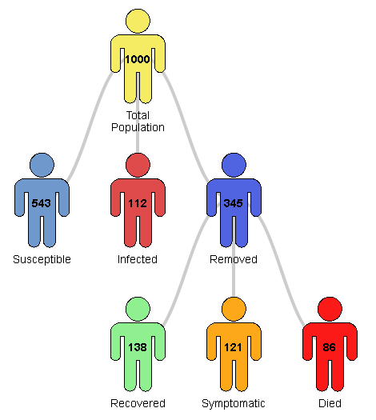
Existing approaches for visualization
Transmissible disease:
A disease that can be passed from one person to another.
SIR model:
A mathematical model that divides population into susceptible, infected, and removed (no longer susceptible or infective).
Stochastic model:
A model possessing some inherent randomness.
Notes:
Describe issues with these methods.

Slide 7
Data
SIR model for a flu-like disease
Removed population further split into three subgroups
Full recovery
Lasting symptoms
Death
Intervention considered
1000 realisations
See theme summary sheet for more details
Transmissible disease:
A disease that can be passed from one person to another.
SIR model:
A mathematical model that divides population into susceptible, infected, and removed (no longer susceptible or infective).
Stochastic model:
A model possessing some inherent randomness.

Slide 8
Expectations
Innovative methods for visualizing the variety of outputs
Computer code
Illustrations
Concepts
Transmissible disease:
A disease that can be passed from one person to another.
SIR model:
A mathematical model that divides population into susceptible, infected, and removed (no longer susceptible or infective).
Stochastic model:
A model possessing some inherent randomness.
Notes:
Static or dynamic. Possibly, but not necessarily involving material from existing approaches

