Slide 1





Content includes material subject to © Crown copyright (2018), Dstl and © Crown copyright (2018), PHE. This material is licensed under the terms of the Open Government Licence except where otherwise stated. To view this licence, visit http://www.nationalarchives.gov.uk/doc/open-government-licence/version/3 or write to the Information Policy Team, The National Archives, Kew, London TW9 4DU, or email: psi@nationalarchives.gsi.gov.uk
Content includes material © Riskaware 2018
Content includes material © University of Southampton 2018
Uncertainty Visualization Study Group

Slide 2
Uncertainty Visualization Study Group Theme 4: Visualizing uncertainty in the numbers in ‘at risk’ groups due to multiple model predictions Alex Forrester Associate Professor in Computational Engineering University of Southampton

Slide 3
Introduction
Transmissible diseases can be hard to predict
Susceptible, Infected, Removed (SIR) model is used to describe evolution of disease in a population
Stochasticity can be introduced to capture many possible outcomes
Effective communication to decision makers is essential
Transmissible disease:
A disease that can be passed from one person to another.
SIR model:
A mathematical model that divides population into susceptible, infected, and removed (no longer susceptible or infective).
Stochastic model:
A model possessing some inherent randomness.
Notes:
Dice image is CC0 license (Free for personal and commercial, no attribution required)

Slide 4
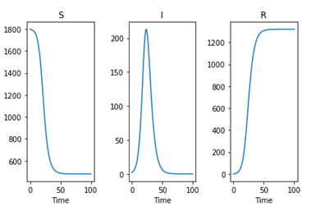
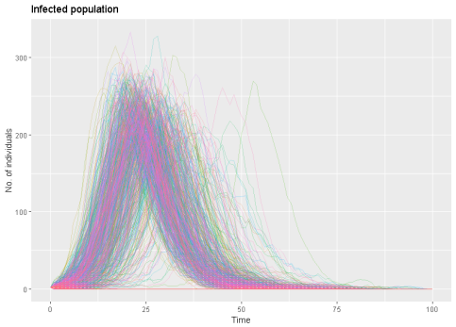
Stochasticity
Transmissible disease:
A disease that can be passed from one person to another.
SIR model:
A mathematical model that divides population into susceptible, infected, and removed (no longer susceptible or infective).
Stochastic model:
A model possessing some inherent randomness.
A ‘deterministic’ SIR model
Multiple ‘realizations’ of a stochastic SIR model (showing only the ‘I’ prediction)
Notes:
Dice image is CC0 license (Free for personal and commercial, no attribution required)

Slide 5
Multiple Models
Things change with:
Time
Space
Socio-economic factors
Individual
Diseases are transmitted in a variety of different ways.
We must make simplifications.
Each model is an abstraction of the real world.
Where do different models agree on low/high uncertainty?
Where do they disagree?
How can this be presented to aid decision making?

Slide 6
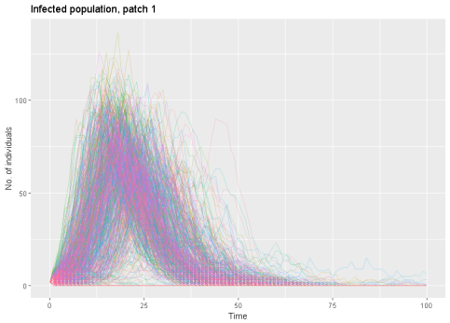
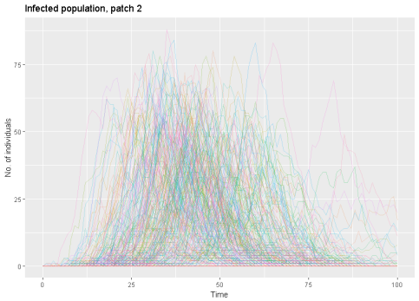
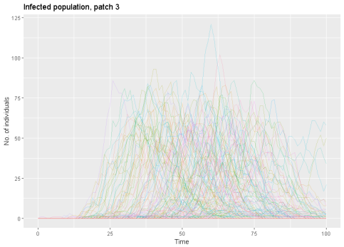
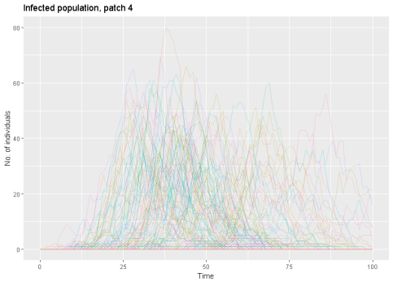
Multiple Models Example
Multiple realizations of a cheap model
Multiple realizations of an expensive model that splits the population into four geographical areas
Notes:
Describe issues with these methods.

Slide 7
Data
Model 1 – Stochastic SIR model for a flu-like disease
1000 realisations
Model 2 - Stochastic SIR ‘patch’ model for a flu-like disease
4 geographical areas (patches)
Each path has own SIR model
Movement of people between patches
1000 realisations
See theme summary sheet for more details
Transmissible disease:
A disease that can be passed from one person to another.
SIR model:
A mathematical model that divides population into susceptible, infected, and removed (no longer susceptible or infective).
Stochastic model:
A model possessing some inherent randomness.

Slide 8
Expectations
Innovative methods for visualizing the outputs of multiple models and their uncertainty
Computer code
Illustrations
Concepts
Notes:
Static or dynamic. Possibly, but not necessarily involving material from existing approaches

