Slide 1
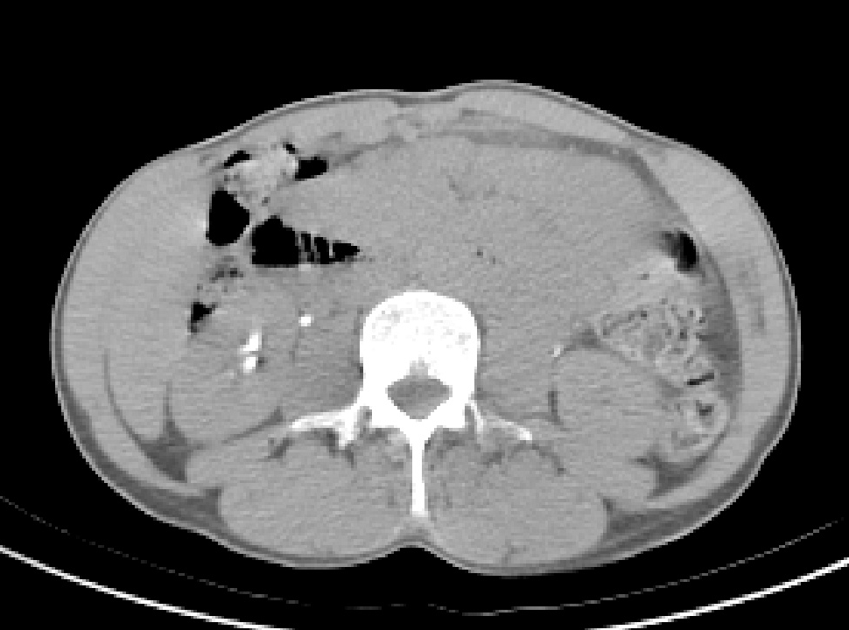
Object
Image
Imaging
System

