Slide 1
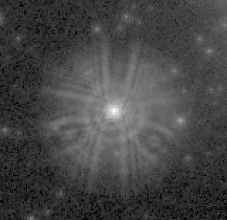
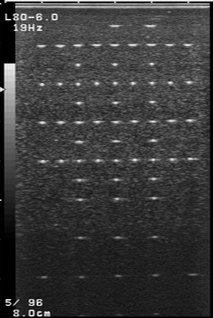
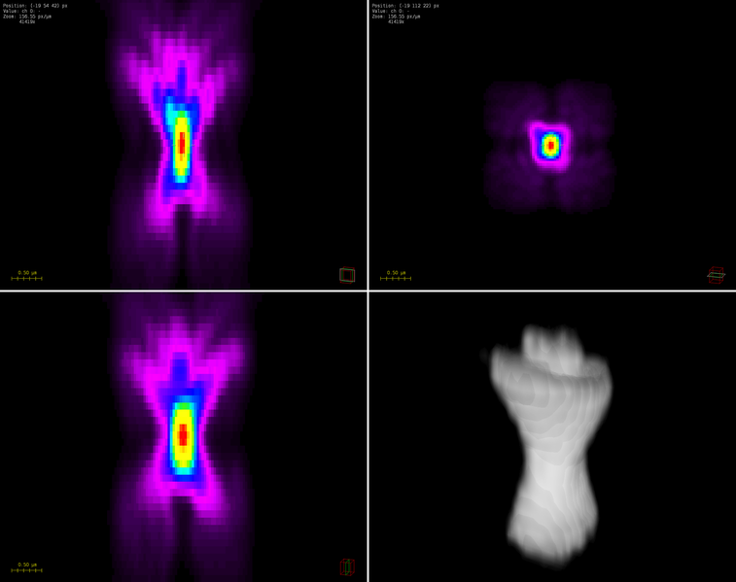
The star Melnick 34 as imaged by Hubble Space Telescope's first Wide Field and Planetary Camera¹
Ultrasound imaging is an example of non-shift invariant modality. This phantom has identical thin wires running perpendicular to the imaging plane, each acting as a point source. As the position deviates from the ultrasound focus (red arrow), the PSF resolution worsens.
An example of an experimentally derived 3D point spread function from a confocal microscope²
Sources
http://hubblesite.org/newscenter/archive/releases/1994/05/image/c/
https://commons.wikimedia.org/wiki/File:63x_1.4NA_Confocal_Point_Spread_Function_2%2B3D.png

