Slide 1
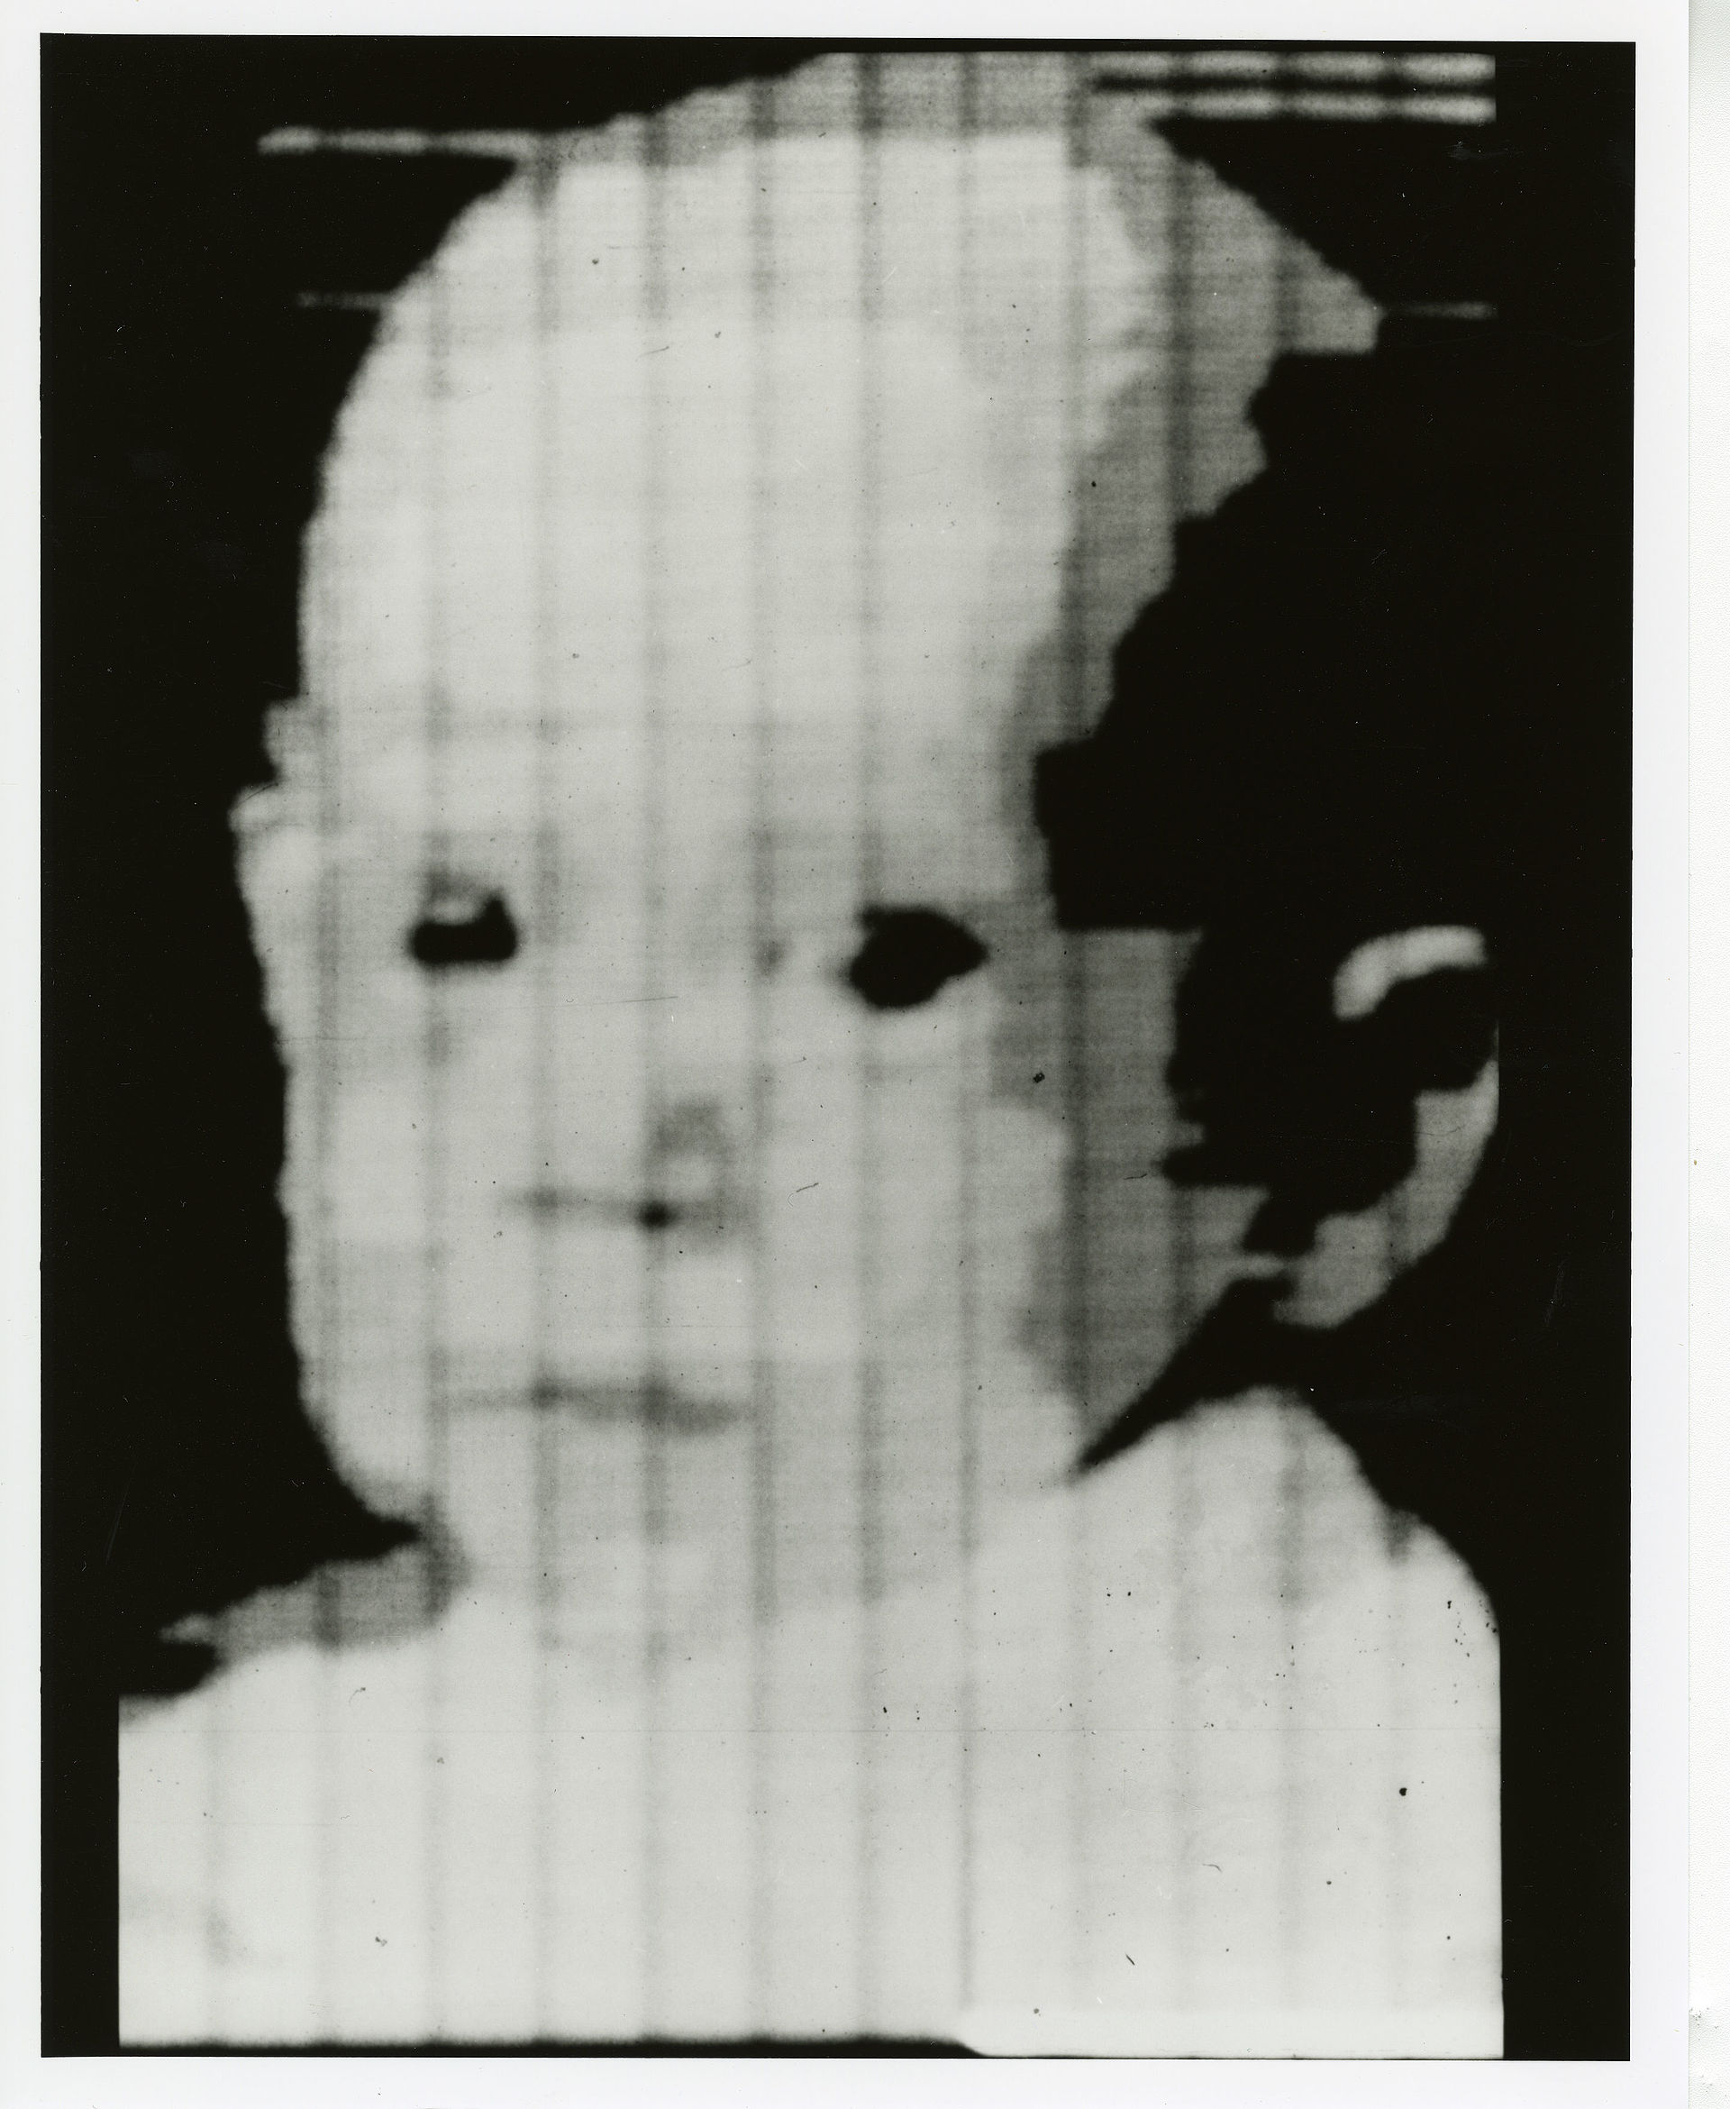
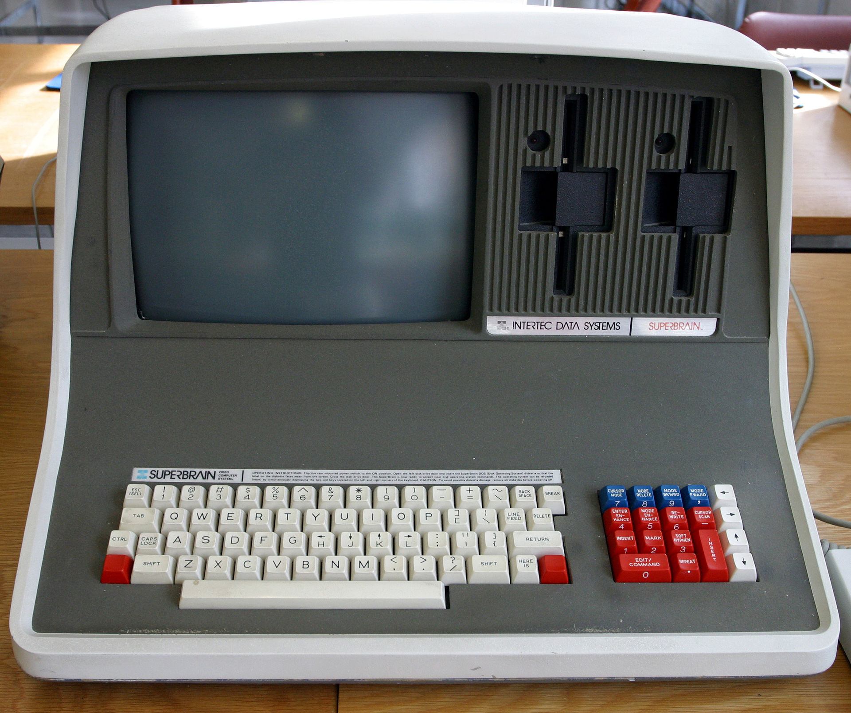
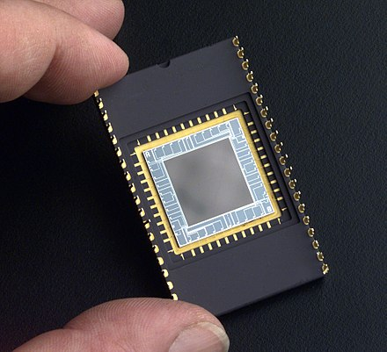
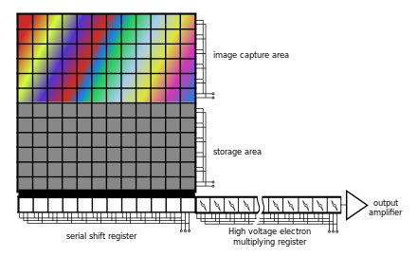
Charge-coupled device (CCD)
First digital picture stored onto a computer by
Walden Kirsch (1957)
https://en.wikipedia.org/wiki/Charge-coupled_device

