Slide 1
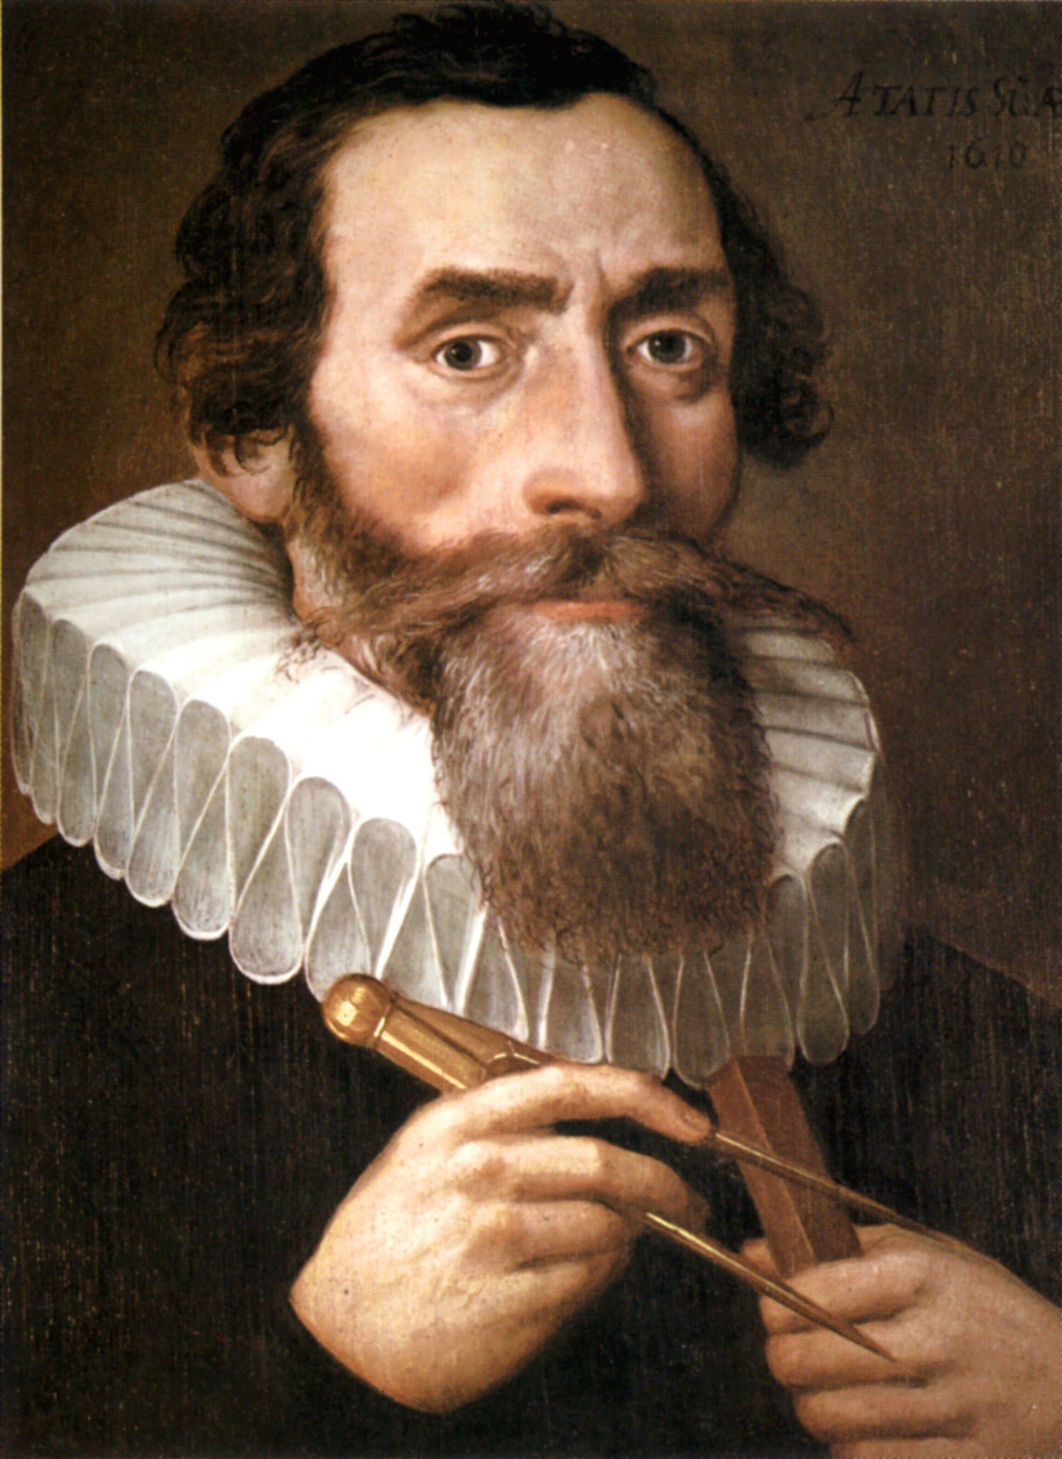
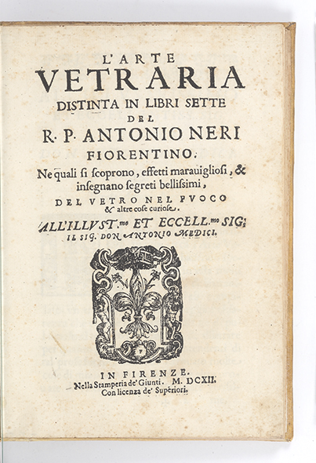
Johannes Kepler
(1571-1630)
‘The art of Glass’
By Antonio Neri (1612)

