Slide 1
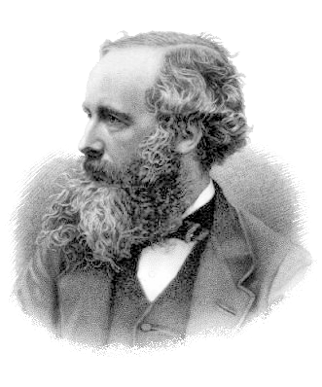
Maxwell’s Equations of EM
Wave-equation of light
James Clerk Maxwell
(1773-1829)

