Slide 1
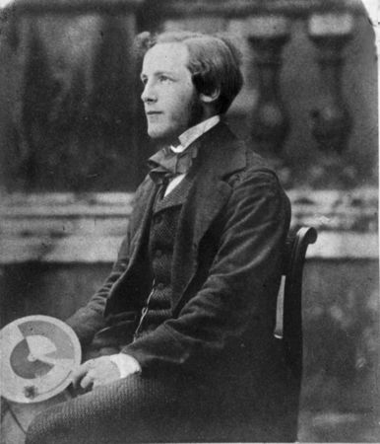
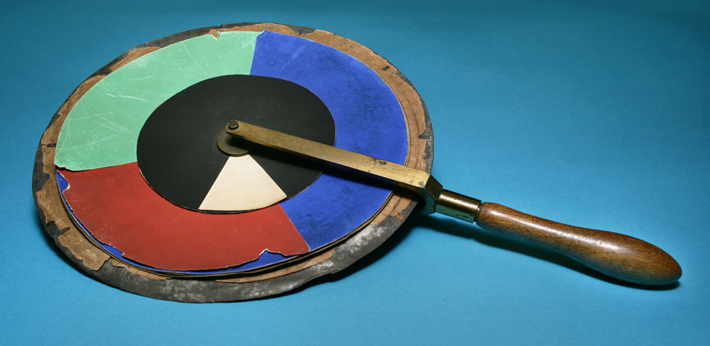
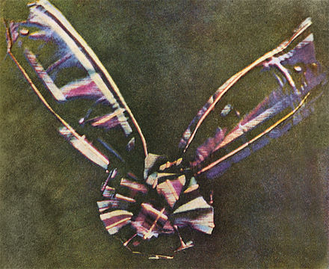
James Clerk Maxwell
(1773-1829)
The “Tartan Ribbon”
By Thomas Sutton (1861)

