Slide 1
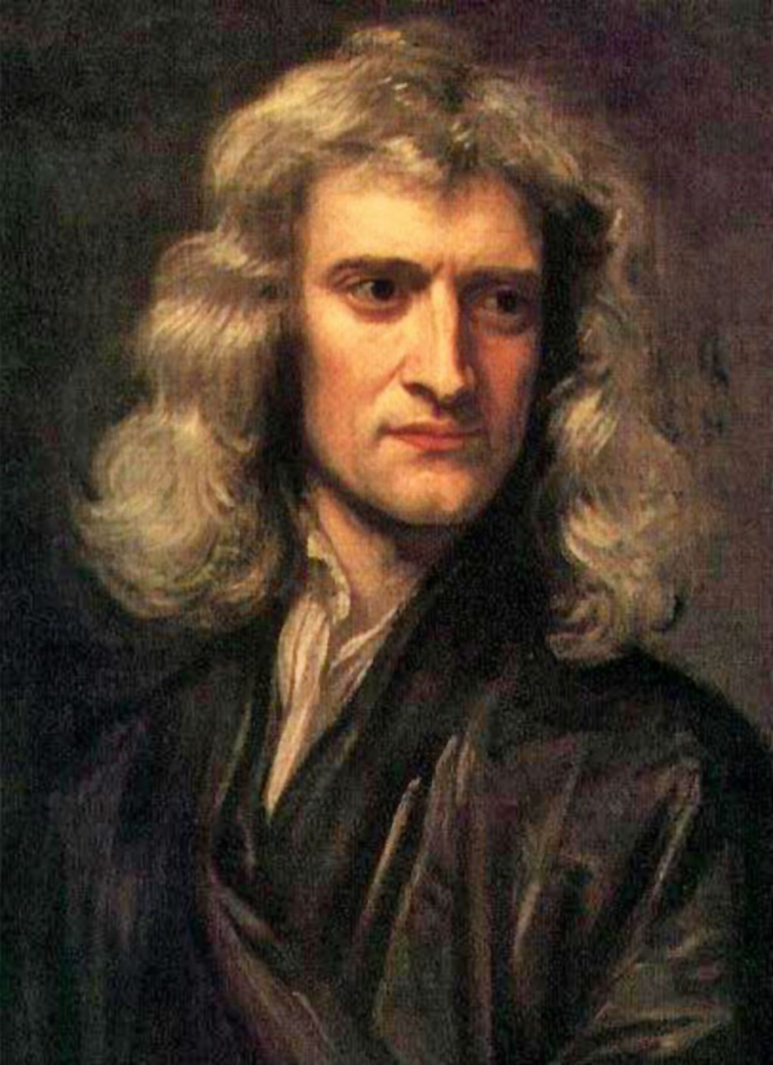
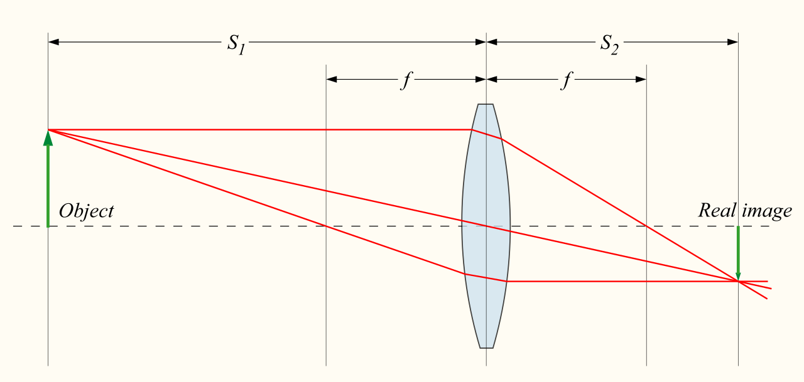
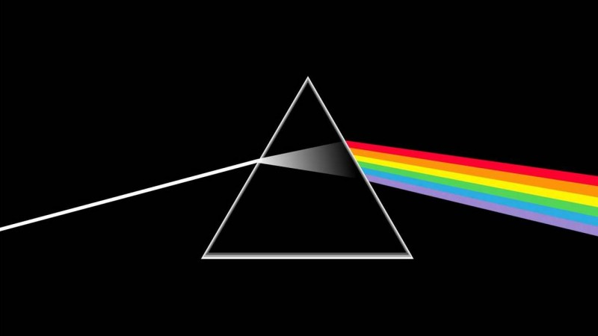
https://en.wikipedia.org/wiki/Lens_(optics)
Sir Isaac Newton
(1642-1726)

