Slide 1
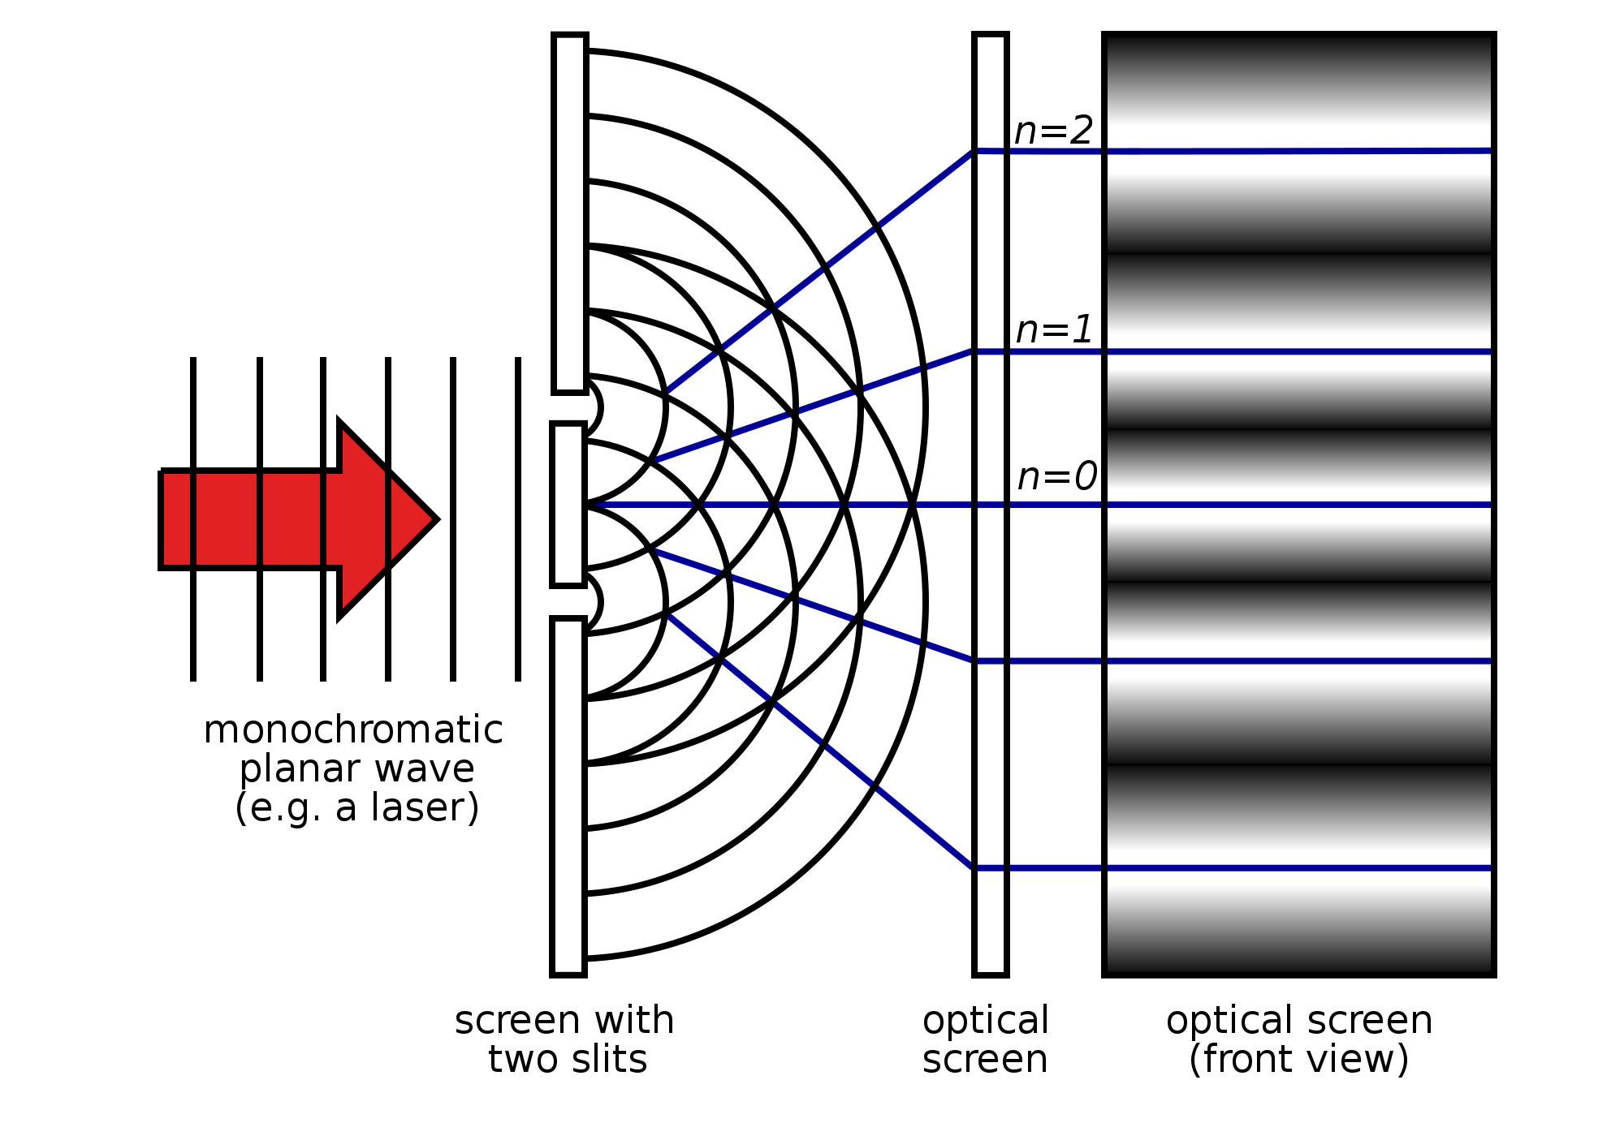
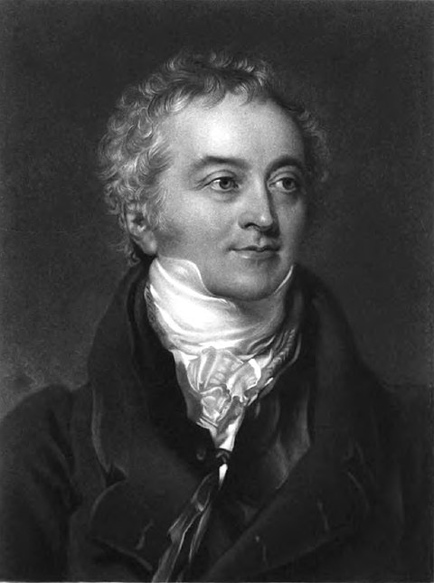
Thomas young
(1773-1829)
https://upload.wikimedia.org/wikipedia/commons/thumb/8/8b/Two-Slit_Experiment_Light.svg/2000px-Two-Slit_Experiment_Light.svg.png

