Slide 1
Securing Cryptocurrencies
@gummatt - 2018
Notes:
Let’s have a talk about simple security.

Slide 2
Goal
Keep your privates private.
Public address: 1FwviFRMi5TDP1xJVP9N76kuyeqmFM9ccT
Private key: KyjftGkpCw8wkvV6UxFagqSkejXTMheHwerXqjjQWXbcfndEp14d
The public address can be viewed by anyone, this is the address a user can pay you with, your private key is used by your software to create secure signed transactions.
Whoever holds the private key owns the bitcoin.
If your money is on an exchange, the exchange owns your money, you have an IOU, you trust they’ll one day honor this IOU and that they won’t get hacked (like all the other exchanges before them).
In Bitcoin the public key (address) isn’t really a public key but rather a double hashed representation of a public key.
Notes:
Try not to get carried away with technical talk. But inform of difference between base58 and base32

Slide 3
Problems
Exchanges get hacked
True blockchains are immutable and don’t do chargebacks.
Computers get hacked
Hackers don’t want company data, they want money.
Houses burn down - scary stuff.
People brag of how little they own, then the price rises...
@gummatt - 2017

Slide 4
Solutions
Be paranoid about everything.
No browser extensions, none.
Don’t use SMS 2fa
Don’t pass your email and phone number to random people.
Don’t accept any stranger on LinkedIn.
Never leave coins on an exchange.
Never let private keys hit an internet connected computer.
Never leave more than $100 in a mobile wallet.
Beat the $5 wrench.
Never tell anyone how much you own.
Have a plan for your house burning down.

Slide 5
Solutions...continued.
Never transfer coins to an app to collect an airdrop.
Never give your private keys to anyone to collect air-dropped coins or for any other reasons.
Never buy a hardware wallet from anyone other than the manufacturer, don't trust ebay, google or amazon etc.
Ignore everything you see on facebook.
There are no experts on YouTube.
The media hasn’t got a clue.
Notes:
No expert is on youtube telling you what to buy.

Slide 6
Tools.
Paper wallets
Brain wallets
Hardware wallets
Fireproof seed solutions.

Slide 7
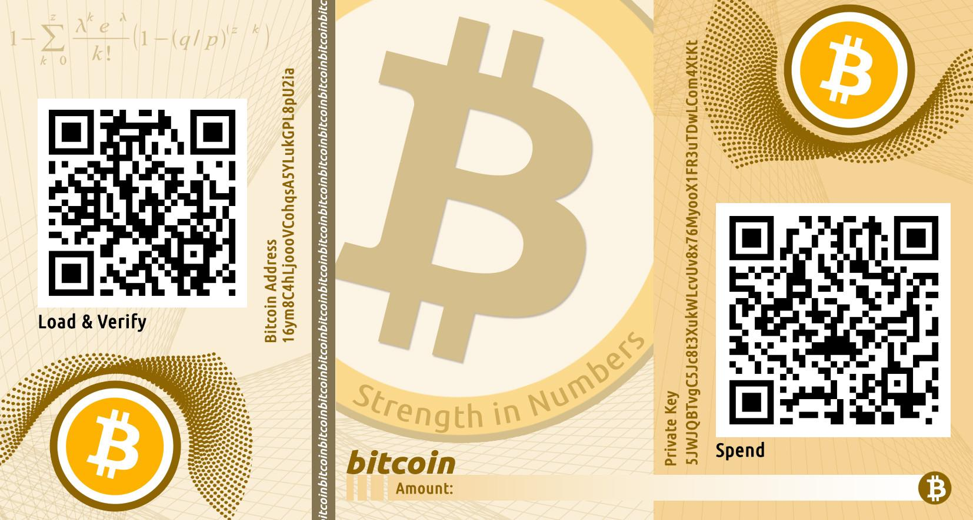
Paper wallet sample

Slide 8
Paper wallet creation
Generate private key on permanently air gapped device, eg old laptop with no wifi/ethernet, speakers, microphone or camera, don’t read your seed out loud.
Use dice?.
Print from a printer you control, assume printer stores all prints onboard. (Burn after using?)
Make duplicate copies, store at multiple locations.
Encrypt using BIP-38 - don’t forget your password ;)
Test you can decrypt before transferring funds.
Only spend once to reduce quantum attacks.

Slide 9
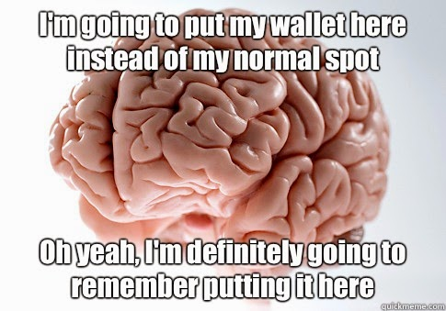
Brain wallet

Slide 10
Tips
Never sustain a brain injury, but plan for it.
Never create your seed yourself.
Use a Mnemonic 12 word seed list.
Spend weeks performing a Mnemonic seed peg before transferring funds.
When you go through an airport and you’re asked “Are you carrying large amounts of cash on you?” don’t be a smartass.
Print some HD public keys and send money to them over time, so as to be able to spend from your brain multiple times while remaining quantum resistant.
Notes:
Use 24 word seed for non brain wallets, don’t store too much in a brain wallet.

Slide 11
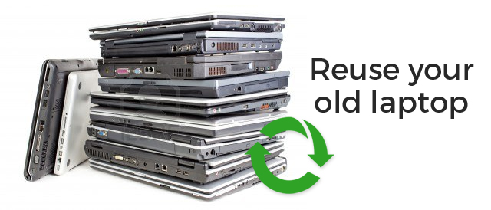
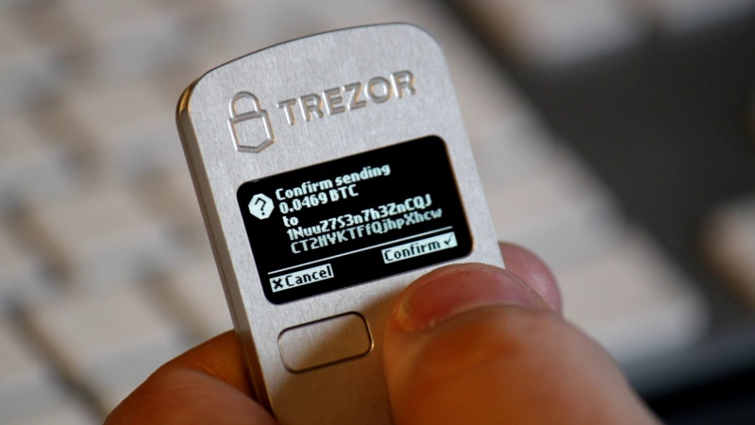
Hardware wallets
Hardware wallets can easily be created by technical users for free (using old parts laying around), however user friendly hardware wallets can be bought from as low as $30.
If you use an old laptop, never ever let that machine ever touch the internet. (Advanced broke users only)
Notes:
Don’t be a tight arse, buy a hardware wallet. Only buy from the manufacturer, again don’t be cheap.

Slide 12
Great hardware wallets
Connect to any computer with an unlimited number of viruses.
Keys never leave the device, only signed transactions.
Use a 24 word Mnemonic seed, supporting your language.
Are completely open hardware/software.
Can connect to both PC and mobile.
Prevent a $5 wrench attack via decoy wallets.
Have an ever increasing password retry delay.
Support Additional features like 2FA - U2F
Must contain a screen to prevent PC malware.
Have features like nLocktime.
Allow for XPUB export to mobile wallets.

Slide 13
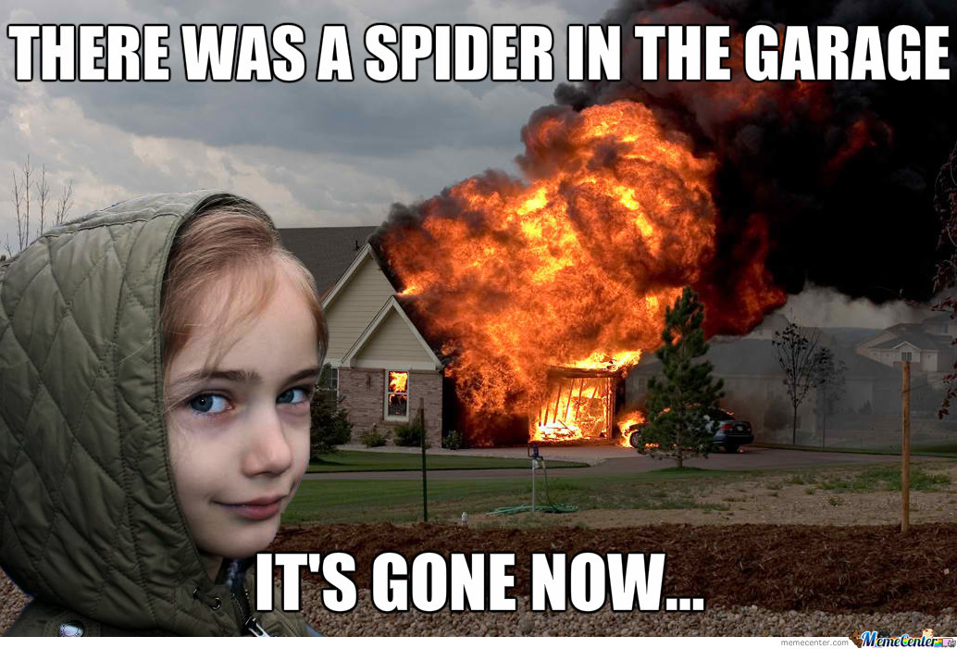
Paper and Hardware wallets….

Slide 14
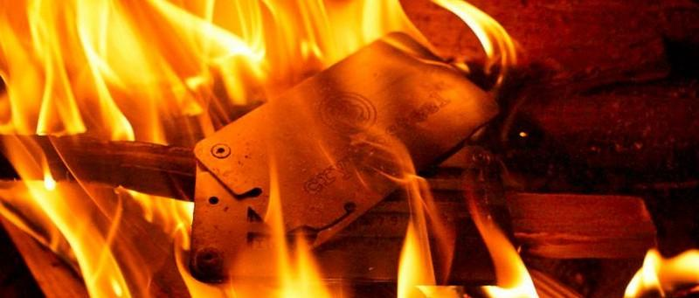
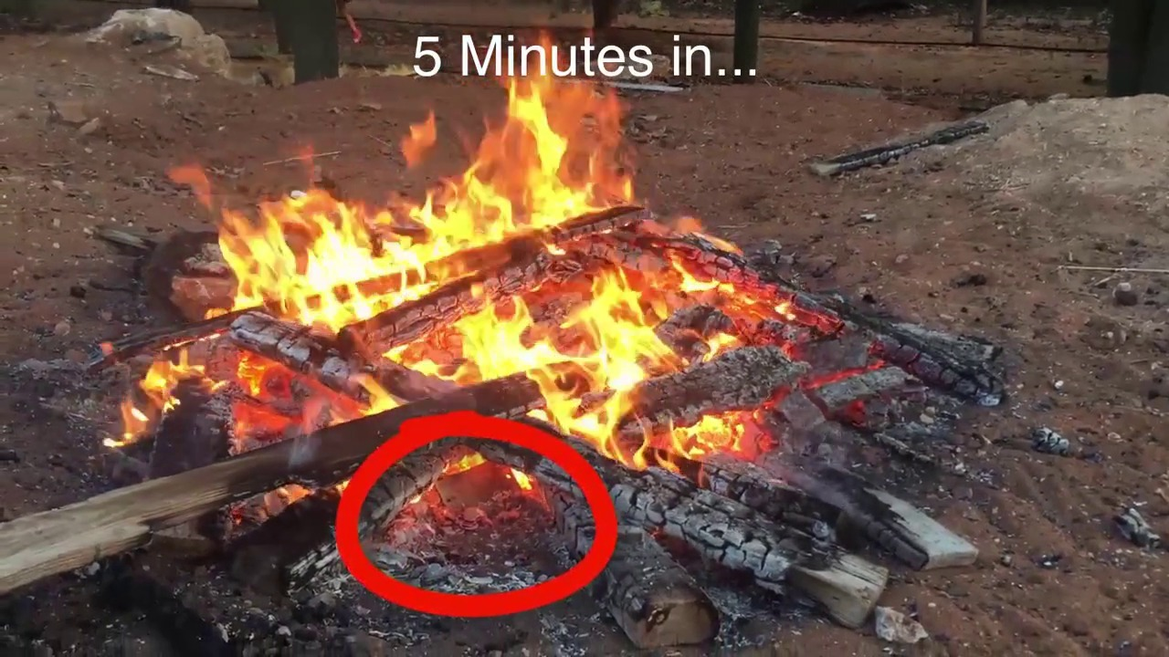
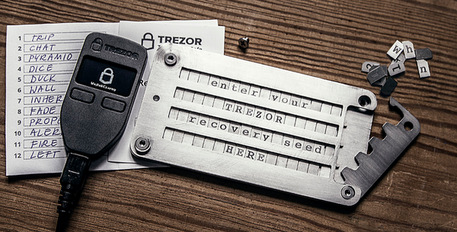
Cryptosteel

Slide 15
Cryptosteel
Will withstand fire up to 1200c.
Safe against solar flares.
Rust proof, 100% stainless steel.
Can store 24 words.
Open blueprints.

Slide 16
Final words.
Never store more than $100 on a phone.
If you plan to have over $200, buy a Ledger Nano S
If you plan to have over $500 buy a Trezor instead.
If you have over $1,000, buy a Trezor + Cryptosteel.
Be paranoid, never assume your computer is secure, never assume you know security better than others. The problems you’ll be sure you’re solving were already solved years ago.
Further tips:
Have multiple decoy wallets on your trezor, have a Cryptosteel stored securely
Be your own bank, don’t leave money on an exchange.
Don’t wait for permission, don’t ask for permission.
Notes:
You could create your own airbag for a car…. But in reality, leave it to the experts who have implemented, revised, implemented, revised again and implemented again better polished systems.

