Slide 1
The future of global currency, kickstarted by Bitcoin.
@gummatt - 2017
"Bitcoin represents a fundamental transformation of money. An invention that changes the oldest technology we have in civilization” - Andreas Antonopoulos.

Slide 2
About Me
Born local.
Lived 9 and a bit years in the UK.
Lived a bit under a year in Asia.
Senior Software developer at nib Health Funds.
Owned a small amount of E-gold around 2002.
Bitcoin enthusiast since 2012, first read about it in 2010.
Hobbies/Interests: Bitcoin, space, travel, privacy, psychology, economic theory, science etc.
Cash is peer to peer technology, bitcoin is a form of cash.

Slide 3
Bitcoin Basics
Bitcoin is a decentralised upgradable network based around a Game theory model.
Bitcoin is an opensource project that launched January 3rd 2009.
Bitcoin never closes, it’s open 24/7 every day of the year.
There will only ever be 21 million bitcoin.
There is enough Bitcoin for every human in the world.
Bitcoin = 1.00000000 Dollar = 1.00
Any person or machine can send Bitcoin to any other person or machine they wish.
You can send however much bitcoin you own to whoever you want.
Bitcoin cannot be copied, it’s the first scarce digital asset.
Bitcoin is a store of value, backed by 8 years of evidence.
As an investment Bitcoin is high risk.

Slide 4
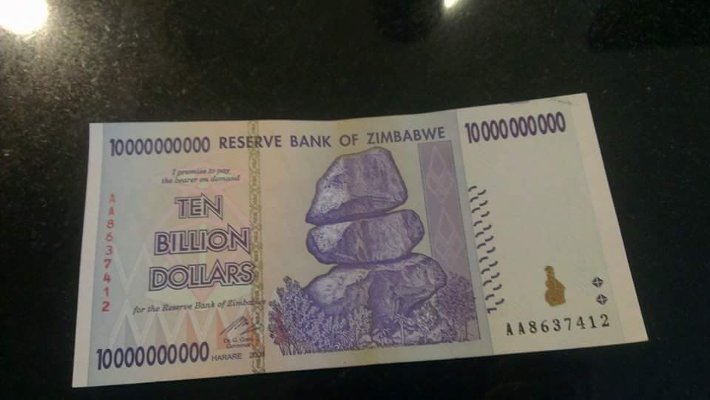
"The central bank must be trusted not to debase the currency, but the history of fiat currencies is full of breaches of that trust." - Satoshi Nakamoto

Slide 5
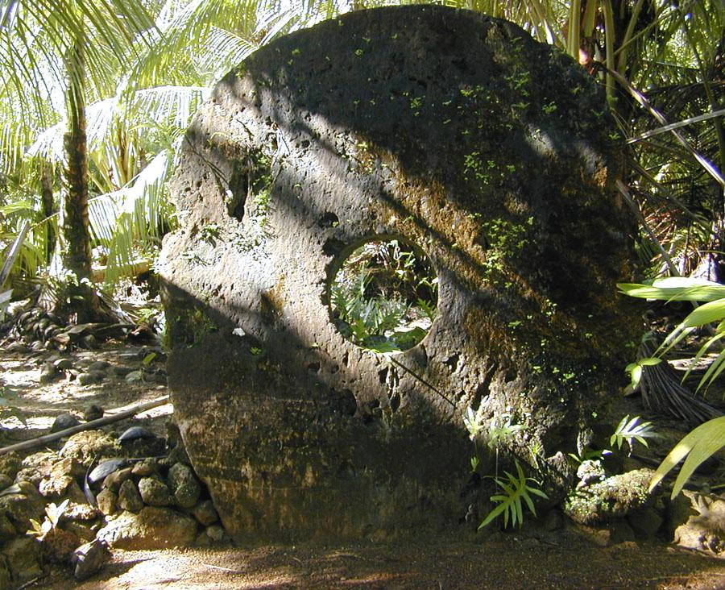
Yap Island, the Island of stone money.

Slide 6
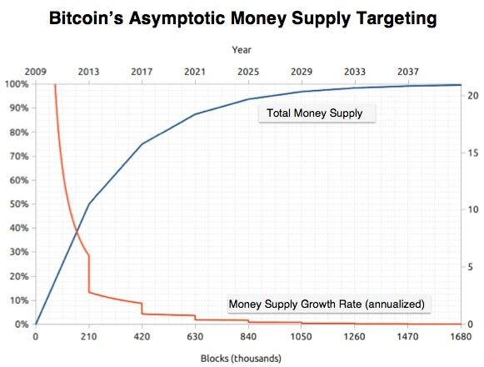
The monetary policy of Bitcoin is algorithmic, it was set in stone at the moment bitcoin was released and will never be changed, no one can decide to print more money.

Slide 7
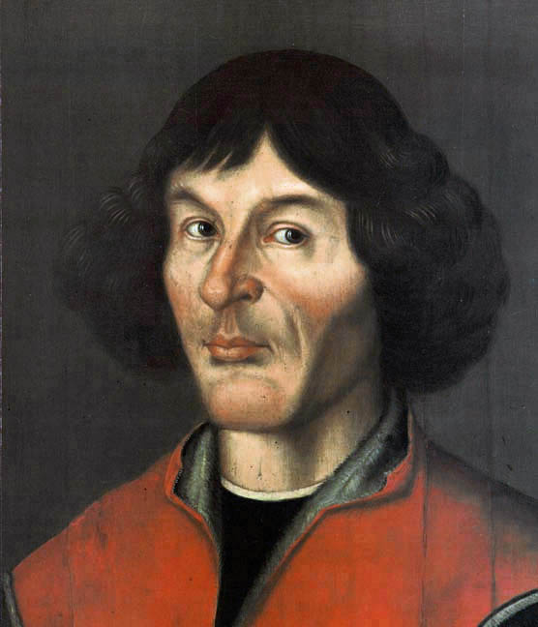
Bad money drives good money out of circulation.
Gresham’s Law
Gresham’s Law is named after Thomas Gresham, who most famously noted the phenomenon in the 1600’s, however there is plenty of evidence that it was observed and reported 2,000 years earlier
Don’t expect to see the most used money to be the best money.
Credit where credit is due

Slide 8
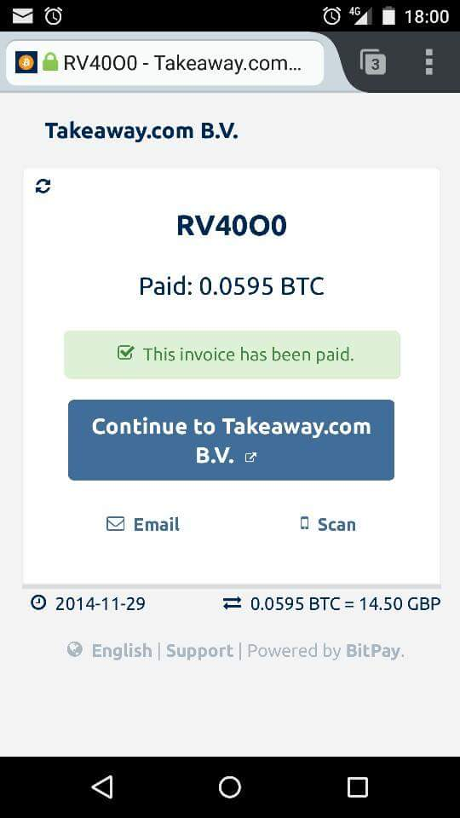

Slide 9
7 Fictional users.
(Some based on real users.)
The Saver
The Baker
The Retiree
The Refugee
The Copywriter
The Webcam instructor
The Robot

Slide 10
The Saver.
Problem:
Can’t save
Solution:
Forced saving?
Further technical reading.

Slide 11
The Baker.
Problem:
Lives in a country with hyperinflation.
Government controls banking and international transfers.
Solution:
Find a store of value, loses value slower than local currency.

Slide 12
The Retiree.
Problem:
Lives in a country with hyperinflation.
Government controls banking and international transfers.
Solution:
Has an offshore child send value home that is outside of the corrupt system.
Receiver must find someone who is looking for a store of value.

Slide 13
The Refugee.
Problem:
Must escape country with family.
Can only take with them what they can carry.
Risk of robbery on the road.
Risk of government robbery at destination.
Solution:
Store bitcoins in head.
Arrive at destination, remove bitcoins from brain, insert into phone.

Slide 14
The Copywriter.
Problem:
Lives in a country under economic sanctions.
Has no access to international banking.
Has done work before online and not been paid.
Doesn’t know the buyer actually has any money.
Solution:
Have buyer show proof of funds.
Check each morning the buyer still has those funds.
Or use a multisignature agreement.

Slide 15
The Webcam instructor.
(Or insert any other webcam based worker here, teacher musician etc.)
Problem:
Customers have no access to banking.
Must work outside of “the system”.
Audience isn't rich, finds people aren’t willing to pay $10.
Solution:
Peer to Peer money.
Stream video in exchange for streaming money.
Charge customers per second of video (in real time).

Slide 16
The Robot
Problem:
Went into bank with owner, owner requested a bank account for Robot, owner and robot both laughed out of the bank.
Needs to trade with other non humans around the globe.
Solution:
Decentralised banking
No ID, no permission, no credit record etc.
Or….
View humanity as a threat and launch judgement day.

Slide 17
The Future
Will see many more uses as well as provide many problems for longstanding institutions.
If everyone decides 0.01% deposit interest rates aren’t the best option for them, what will happen for banks if their deposits shrink?
If people become their own crypto banks, how does the government know who to tax what?
How will airport security check if you have more than $10,000 in your head?
My prediction is we’ll see a mix of inflationary and deflationary currencies within the one large global economy, where the deflationary currencies are the store of value and the inflationary currencies are the most common medium of exchange for B2B and C2B.

Slide 18
Part 2.
How the Bitcoin network works.
Participants.
Users
Merchants
Nodes
Miners
Exchanges
Problems.
Double spending
Monetary supply
Security
Miners
Who to trust?
Solution:
A complex form of Game Theory where it’s more profitable to play by the rules than to attack the system.

Slide 19
Most important tech behind bitcoin
Proof of work.
An algorithm used within bitcoin to control monetary supply, to provide decentralisation and to ensure security that is verifiable by all participants.
A Blockchain
Basically, a boring inefficient database of no real significance, hijacked by consultants who are robbing clueless banks blind and anyone else stupid enough to use it as an uncountable noun.

Slide 20
What is a real blockchain?
Immutable
Open access system
Borderless
Permissionless
Decentralised
Peer-to-peer
Immutable

Slide 21
The late to the party fintech nonsense
Immutable
Open access
Borderless
Permissionless
Decentralised
Peer-to-peer
Immutable
Editable
Closed access
Hidden
Permissioned
Centralised
Restricted users
Insecure
So which is most innovative?

Slide 22
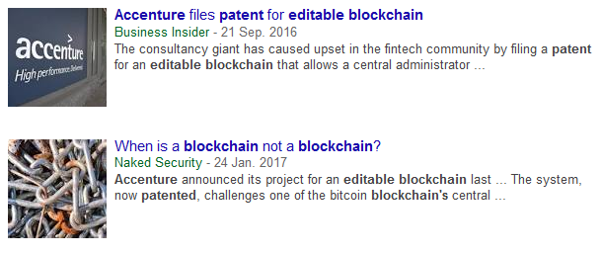
What the?.

Slide 23
Prerequisites to understanding Bitcoin
Hash functions, e.g. SHA-256, RIPEMD-160 etc
Asymmetric cryptography (Public-key) e.g. ECDSA, think SSL (although SSL also uses symmetric for speed)
Merkle trees
POW (Proof of work) algorithm. E.g. Hash Cash, (2 inputs, a value and a nonce, both hashed)
POW is what gives a blockchain it’s immutability and security. A blockchain without POW is an insecure easily editable blockchain.

Slide 24
Hash chains
X = Hash(‘Dazza pays Shazza $5’)
Y = Hash(x + ‘Shazza pays Bazza $10’)
Z = Hash(y + ‘Bazza pays Wazza $4’)
X = b7f25f5117a0ee698b8e491b4823e69d22005c493d1f2314558a2dd4843b7cae
Y = f436fa452d2368e39481687d6194dc1b1b3386fd2e4370186dd97fd815ca8c65
Z = 6fff2aed3534fc33a7c69f486b3240a216b9c7cb99fac02c44db74f67545545f
Hash(a) - Hash(a+b) - Hash(b+c) and so on.

Slide 25
A Blockchain
Block 1
Block 2
Block 3
Shazza pays Wazza
Shazza pays Dazza
Bazza pays Dazza
Alice pays Bob
Bob pays Bazaa
Bob pays Alice
Wazza pays Shazza
Shazza pays Dazza
Bazza pays Dazza
A = Hash(Block1)
B = Hash(A + Hash(Block2))
C = Hash(B + Hash(Block3))
“I suggest a clear definition that can be communicated to lay people. It is a blockchain if it has blocks and it has chains. The “chains” should be Merkle trees or other cryptographic structures” - Nick Szabo
https://unenumerated.blogspot.com

Slide 26
POW (proof of work)
POW = Hash(‘item’ + nonce)
The most simple POW is to find the nonce that goes with a value to result in a hash starting with 0.
E.g.
Hash(‘matt’ + 0) = c5163e81b6dff231b46b584384718ffb734da51d51009399b4b5c73aaa55a811
Hash(‘matt’ + 14) = 0ec48972291a05f8b137468c709bf798dbd8b84bc113b5352e81d2bb20d43120
Bitcoin mining is simply providing POW for a block of valid transactions. The miner must provide a POW to the agreed upon difficulty that has been set by the network.
E.g. Block #452639 hash + nonce of 2867890375 , this results in 00000000000000000051e3078bc120bb64721c5e76724662911d2d40ef22dfc0
The network can instantly verify that the found nonce produces a hash with 18 preceding zeros
“Hashcash is a proof-of-work algorithm that requires a selectable amount of work to compute, but the proof can be verified efficiently” - Wikipedia

Slide 27
Rules of the game.
It’s always more profitable for a hacker to play by the rules than to break the rules.
There will never be more than 21 million bitcoins.
There is enough bitcoin for everyone on the planet.
Each bitcoin consists of 100million subunits.
Miners always mine the longest valid chain.
Every time a miner see’s a new valid block, the miner will instantly stop what it is doing and start mining on top of that block.
Every 4 years the block reward that miners receive, halves.
All bitcoin will be mined by roughly the year 2140.
“Hashcash is a proof-of-work algorithm that requires a selectable amount of work to compute, but the proof can be verified efficiently” - Wikipedia

Slide 28
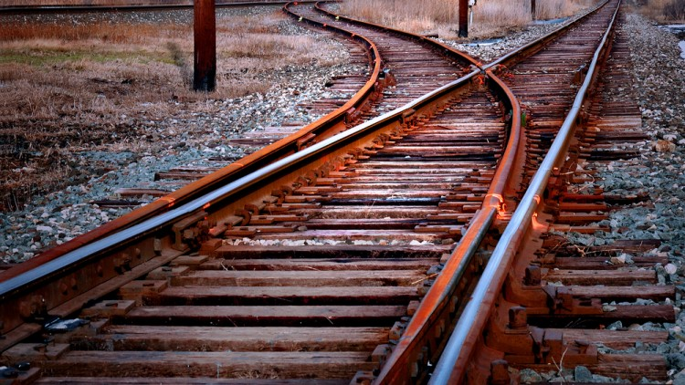
When the Blockchain forks off.
The Bitcoin blockchain forks into 2 chains roughly once every two days.

Slide 29
Further reading/viewing.
https://bitcoin.org/bitcoin.pdf (Satoshi Nakamoto’s whitepaper).
https://www.youtube.com/user/aantonop Any and all of the talks of Andreas Antonopoulos
https://github.com/bitcoinbook/bitcoinbook “Mastering Bitcoin - Unlocking digital currencies” - (Creative commons).
The Internet of Money

