Slide 1
Reproducible decentralized randomness.
@gummatt

Slide 2
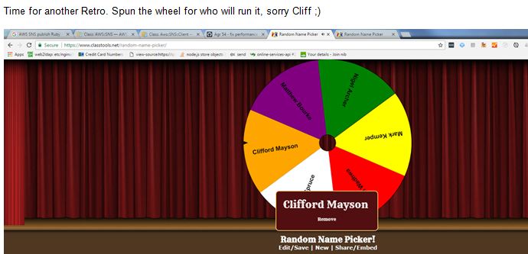
The problem
Unless everyone is co-located, how can we be sure the spinner didn’t spin the wheel multiple times until he/she got the desired result?

Slide 3
Where trust is needed
With the people who have visual site of the wheel.
That the wheel is actually random.
This problem is very similar to the “Byzentine Generals Problem”. This is the problem that Satoshi Nakamoto solved with Bitcoin, by using game theory with Hash Cash in a decentralised environment.
For my solution I also use Hash Cash to perform proof of work on each item within a list.
To prevent someone from pre-generating a group of hashes in advance, my tool requires the most recent block hash to be prepended to the item being worked in a similar way to salting and hashing a password.
This allows for guaranteed random results which are instantly verifiable by all remote parties.

Slide 4
Some possible uses
Solving a “where to go for lunch, no one can decide” deadlock.
Deciding who is on support.
Gambling applications
Eg. A bunch of users could put there names down and agree on a
future block to run Proof Of Work on top of. This could be done with considerable time accuracy.
“To implement a distributed timestamp server on a peer-to-peer basis, we will need to use a proof-of-work system similar to Adam Back's Hashcash, rather than newspaper or Usenet posts. The proof-of-work involves scanning for a value that when hashed, such as with SHA-256, the hash begins with a number of zero bits. The average work required is exponential in the number of zero bits required and can be verified by executing a single hash.” – Satoshi Nakamoto

Slide 5
Why I chose Vue.js
To learn something new.

Slide 6
What have I learnt so far?
Angular + React love child
Faster than most things
Very easy to learn
Quick solution to refactoring old code without throwing everything away.
Who uses it…..

Slide 7

Who uses Vue.JS

Slide 8
Further reading.
https://en.wikipedia.org/wiki/Hashcash
http://vuejsdevelopers.com/2017/05/28/switch-from-react-to-vue-js/
https://rawgit.com/krausest/js-framework-benchmark/master/webdriver-ts/table.html
https://vuejs.org/v2/guide/comparison.html

