Slide 1
Fantasy Football Lineup Optimizer
Hugh Goode, Matt Brillantes

Slide 2
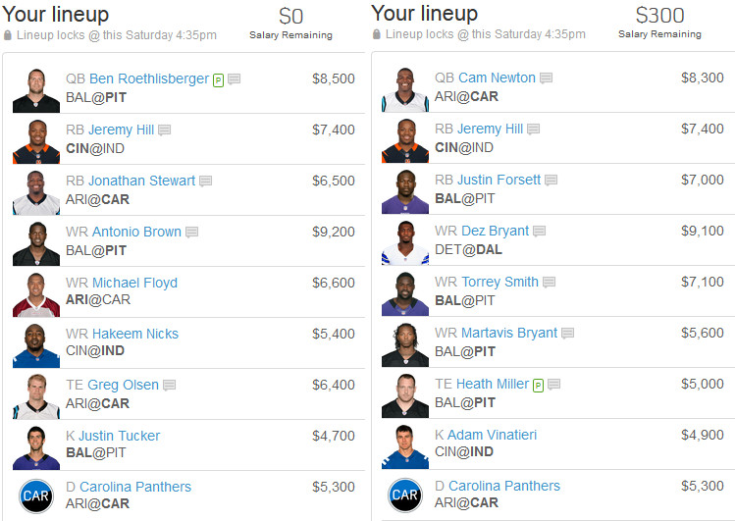
Intro/Recap

Slide 3
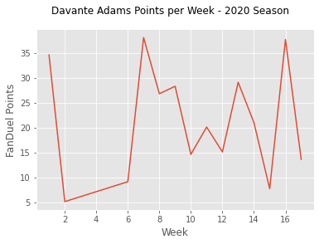
Project 1 Overview
Name | Pos | FanDuel Salary | Cumulative Points | Games Played | Average Points (Projection for Future Performance) | Cost per Point | Value Rank
Brown, Marquise | WR | $6,800 | 89.6 | 5 | 17.92 | $379.46 | 1
Williams, Mike | WR | $7,700 | 100.6 | 5 | 20.12 | $382.70 | 2
Samuel, Deebo | WR | $7,700 | 94.5 | 5 | 18.9 | $407.41 | 3
Kupp, Cooper | WR | $8,400 | 100.3 | 5 | 20.06 | $418.74 | 4
Chase, Ja'Marr | WR | $7,300 | 86.9 | 5 | 17.38 | $420.02 | 5
Brown, Antonio | WR | $6,500 | 61.1 | 4 | 15.275 | $425.53 | 6
Hill, Tyreek | WR | $8,500 | 96.6 | 5 | 19.32 | $439.96 | 7
Evans, Mike | WR | $7,000 | 77.8 | 5 | 15.56 | $449.87 | 8
Adams, Davante | WR | $8,200 | 90.9 | 5 | 18.18 | $451.05 | 9
Metcalf, D.K. | WR | $7,400 | 80.8 | 5 | 16.16 | $457.92 | 10

Slide 4
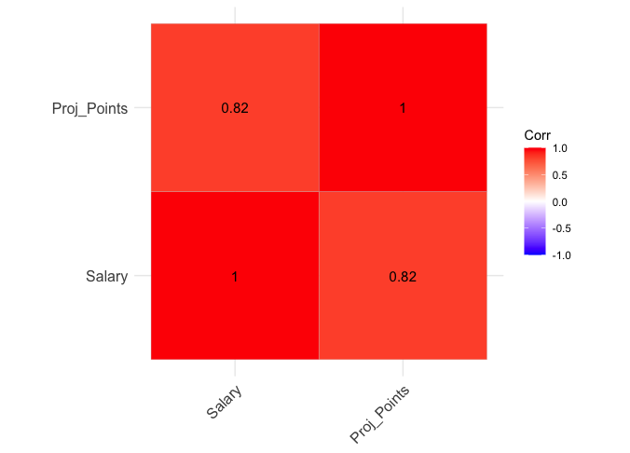
New Data – DraftKings Projections & Salaries for upcoming contests
Note: Correlation between salary and actual points = 0.58

Slide 5
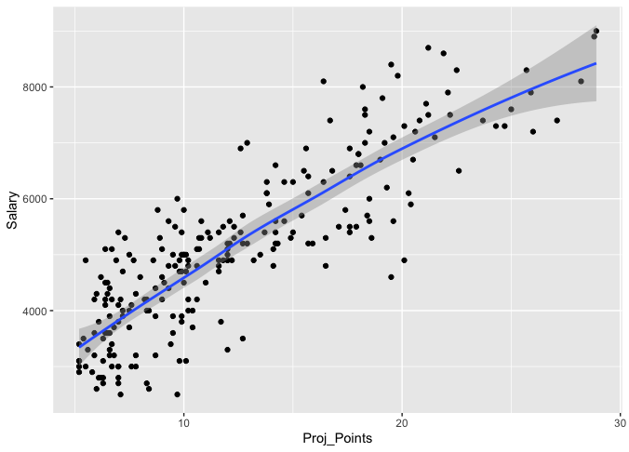
Linear Equation : y = 3.9x - 10.6
R^2 = 0.67
Residual Standard Error = 3.6

Slide 6
Possible Lineup Combinations
C = n! / ((n-r)! * r!)
C = combination
n = number of items
r = items to select
QB: n = 32, r = 1
RB: n = 64, r = 2
WR: n = 96, r = 3
TE: n = 32, r = 1
K: n = 32, r = 1
DEF: n = 32, r =1
32 * 2,016 * 142,880 * 32 * 32 * 32 = 302 Trillion Lineup

Slide 7
Random Walk
Create script to randomly generate lineups fitting the position and salary requirements
Inputs:
Table of players with positions, salaries, and project points
Number of lineups to simulate
Sort lineups by total projected team points
Output:
Top n lineups

Slide 8
Knapsack Problem
Given a set of items, each with a weight and a value, determine the number of each item to include in a collection so that the total weight is less than or equal to a given limit and the total value is as large as possible.
Linear programming is a technique for the optimization of linear objective function, subject to linear equality and linear inequality constraints
R Library “lpSolve”

Slide 9
App Demo

Slide 10
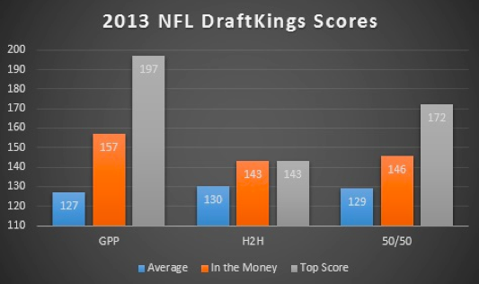
Compare Results
Average points in contest: 127
Average in the money score: 157
Average top score: 197
Source: rotogrinders.com

Slide 11
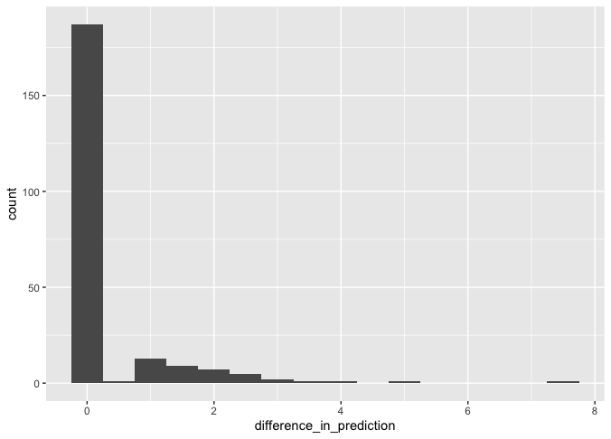
Histogram of Difference in Projection (Filter out players with projected points < 5)

Slide 12
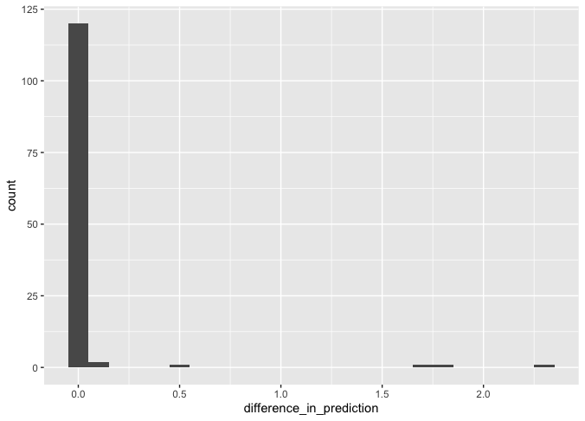
Histogram of Difference in Projection (Filter out players with projected points < 10)

Slide 13
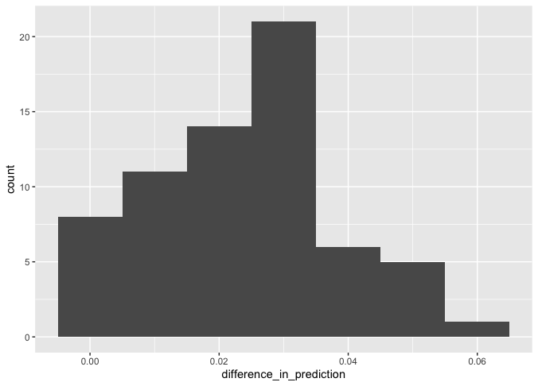
Histogram of Difference in Projection (Filter out players with projected points <15)

Slide 14
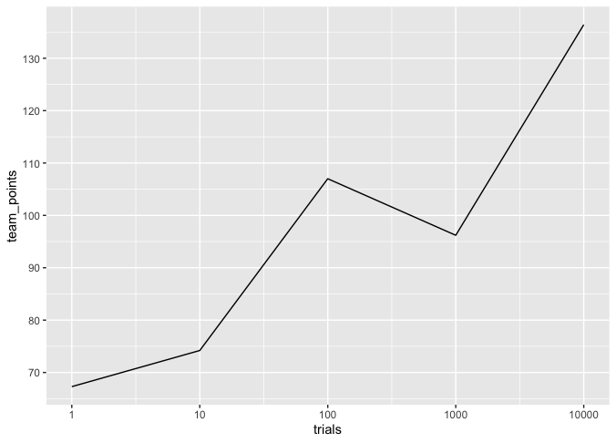
Improvement in Random Walk as #trials increase
LP Solver solution: 174

Slide 15
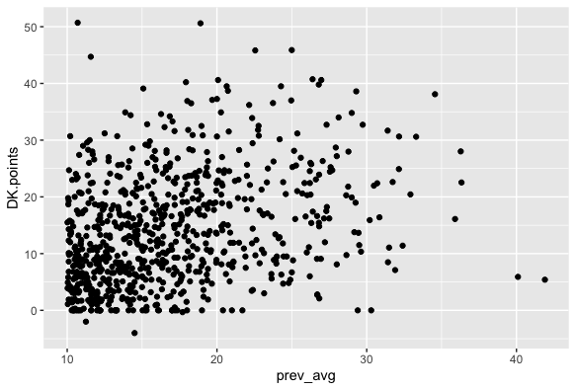
Prev. Week Projection vs. Actual Points

Slide 16
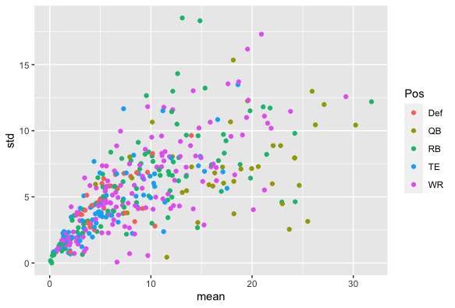
Average Points for Player vs. Standard Deviation

Slide 17
Conclusions & Next Steps
Include player standard deviation as constraint in LP Solver function
Incorporate actual player statistic and create model to run more accurate position than running average

