Slide 1
Behavioral Economics And Public Policy: Taxation of Internalities
Econ 178: Behavioral Economics
Marcelo Clerici-Arias

Slide 2
Agenda
Review taxation of externalities
Apply model to internalities
Interpret an optimal tax formula

Slide 3
Corrective Taxation of Externalities

Slide 4

Externality example: gasoline
Burning gasoline imposes externalities on society
Carbon emissions
Other local pollutants (air quality)
Suppose (for example) the total cost of all externalities is $4/gal
With your table:
What is the optimal gas tax?
Graphically illustrate the effect of an optimal tax on equilibrium
How does total surplus change? Consumer surplus? Producer surplus? Government revenues? Externality costs?
By how much do prices faced by consumers change?
What determines the incidence of the tax?
Notes:
Image: https://www.npr.org/2021/11/20/1055718914/giving-up-gas-powered-cars-for-electric-vehicles
Correctly estimating externality cost requires tons of assumptions and empirical work…

Slide 5


Taxation of Externalities
Supply and demand with no externalities
Supply
Price
CS
$$p_{0}$$
PS
Demand
$$q_{0}$$
Quantity

Slide 6


Taxation of Externalities
Social Cost
Add a negative externality social cost > private cost
Deadweight loss triangle from externality losses
$$E=\$4$$
Supply (cost to firms)
CS
DWL
Price
$$p_{0}$$
PS
Demand
$$q_{0}$$
Quantity

Slide 7




Taxation of Externalities
Social cost = Supply with tax
Introduce a tax equal to size of externality
Shift of supply curve
New supply = social cost
Externality loss disappears
New component of surplus: government revenue
Price changed
$$t=E=\$4$$
Original Supply
$$p_{1}+t$$
CS
Price
G
$$p_{0}$$
$$p_{1}$$
PS
Demand
$$q_{0}$$
Quantity
Notes:
Ask students: Why does G have value? Clarify, we’re saying $1 of G = $1 of CS = $1 of PS. “If $1 of G is worth more than $1 of CS and TS, then we want to tax more. You might think this is true if you think the government can cost-effectively provide public goods. If $1 of G is worth less than $1 of CS and TS, then we want to tax less. You might think this is true if you think the government is irredeemably corrupt or wasteful.”

Slide 8




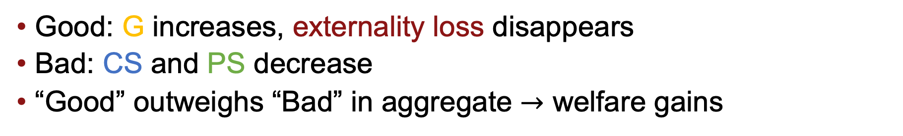




Change in surplus
Social Cost
Social cost = Supply with tax
Supply (cost to firms)
$$t$$
Original Supply
$$p_{1}+t$$
CS
CS
DWL
Price
G
Price
$$p_{0}$$
$$p_{0}$$
PS
$$p_{1}$$
PS
Demand
Demand
$$q_{0}$$
Quantity
$$q_{1}$$
$$q_{0}$$
Quantity
Good: G increases, externality loss disappears
Bad: CS and PS decrease
“Good” outweighs “Bad” in aggregate $→$ welfare gains
Notes:
Can ask students to show us surplus gains, and animate the answer

Slide 9
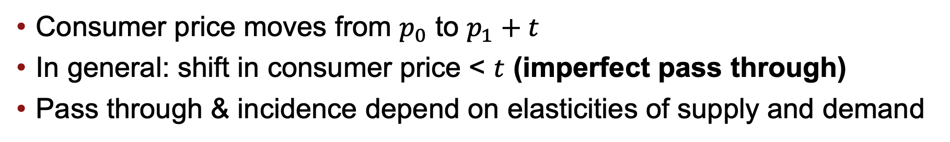
Change in price
Social Cost
Social cost = Supply with tax
Supply (cost to firms)
$$t$$
Original Supply
$$p_{1}+t$$
CS
CS
DWL
Price
G
Price
$$p_{0}$$
$$p_{0}$$
PS
$$p_{1}$$
PS
Demand
Demand
$$q_{0}$$
Quantity
$$q_{1}$$
$$q_{0}$$
Quantity
Consumer price moves from $p_{0}$ to $p_{1}+t$
In general: shift in consumer price < $t$ (imperfect pass through)
Pass through & incidence depend on elasticities of supply and demand
Notes:
Can ask students to show us surplus gains, and animate the answer

Slide 10
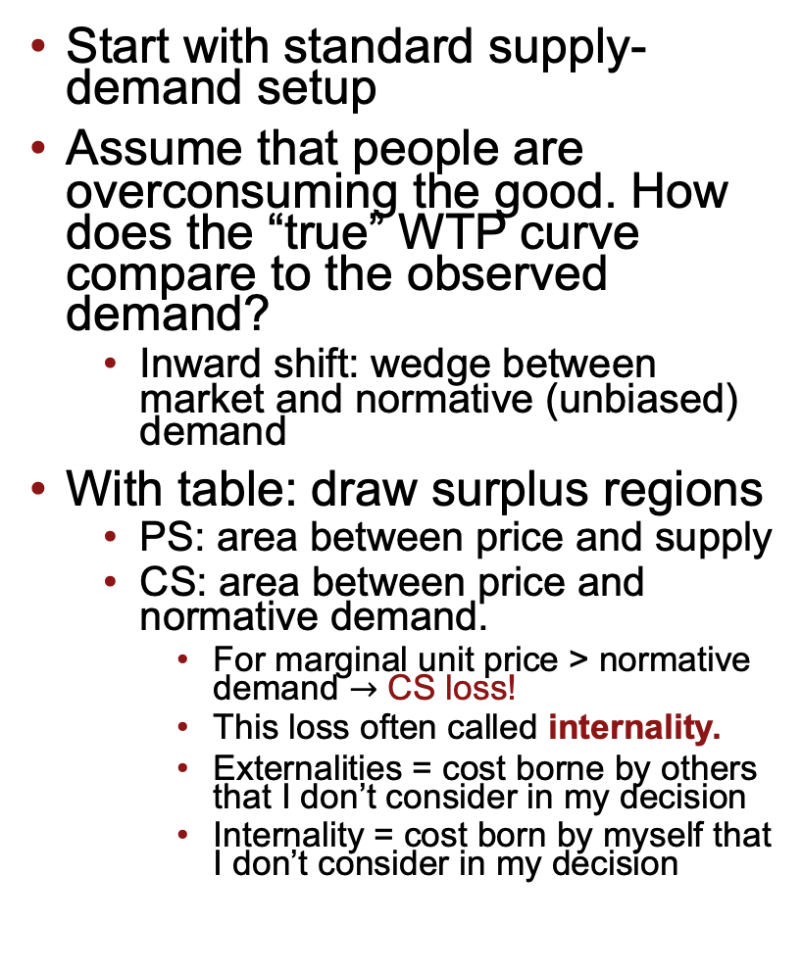


From externalities to internalities
Start with standard supply-demand setup
Assume that people are overconsuming the good. How does the “true” WTP curve compare to the observed demand?
Inward shift: wedge between market and normative (unbiased) demand
With table: draw surplus regions
PS: area between price and supply
CS: area between price and normative demand.
For marginal unit price > normative demand $→$ CS loss!
This loss often called internality.
Externalities = cost borne by others that I don’t consider in my decision
Internality = cost born by myself that I don’t consider in my decision
Supply
Price
CS
$$p$$
“Internality”
CS Loss
PS
Demand
Mistaken (market) Demand
Normative
Demand
$$q$$
Quantity

Slide 11
Behavioral deadweight loss
Region A: positive for total surplus
If no mistakes: total surplus = A
Region B: contributes zero to total surplus.
Positive PS cancels out negative CS
Region C: negative for total surplus
Pure CS loss from internality
Behavioral deadweight loss
We want to get rid of this!
Supply
Price
$$p$$
A
B
C
Mistaken (market) Demand
Normative
Demand
$$q$$
Quantity
Notes:
Say out loud that B <-> “Redistribution” from consumers to firms compared to a case where there’s no bias…

Slide 12







Effect of a tax
How would a small tax $t$ affect components of total surplus?
Shift supply curve up
New price and quantity
Components of surplus
CS gains and losses
PS
Government revenue
New behavioral DWL triangle smaller than original
Increase in total surplus!
Supply w/ tax
Supply (cost to firms)
Price
$$t$$
$$p_{1}+t$$
$$p_{0}$$
$$p_{1}$$
Normative Demand
Mistaken (market) Demand
$$q_{1}$$
$$q_{0}$$
Quantity
Notes:
PAUSE HERE to let students work out the graphs!

Slide 13

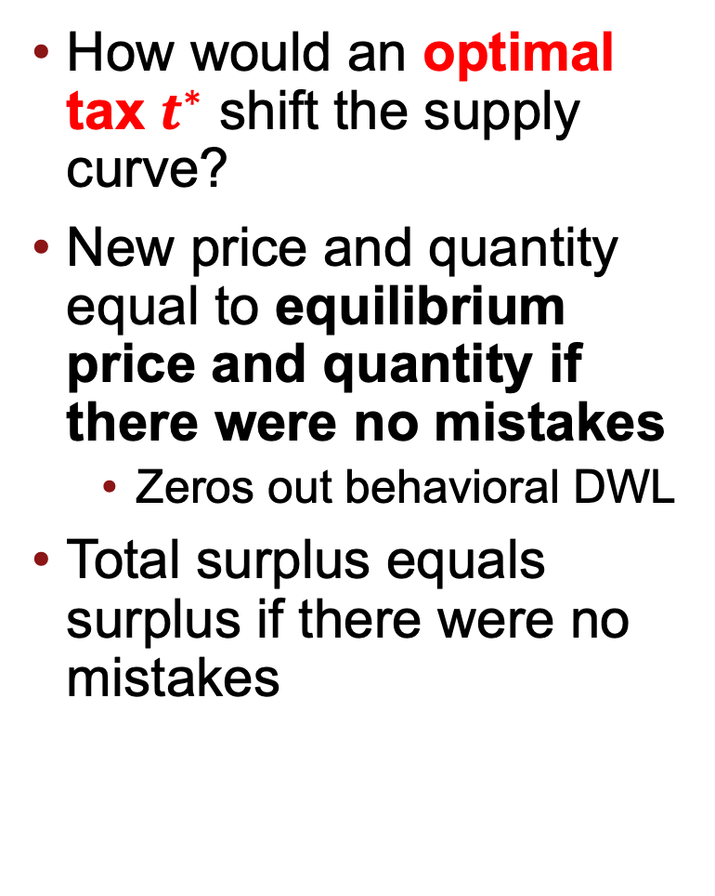





Optimal tax
Supply w/ tax
How would an optimal tax $t^{∗}$ shift the supply curve?
New price and quantity equal to equilibrium price and quantity if there were no mistakes
Zeros out behavioral DWL
Total surplus equals surplus if there were no mistakes
Supply
Price
$$t^{∗}$$
$$p_{1}+t$$
$$p_{0}$$
$$p_{1}$$
Mistaken (market) Demand
Normative
Demand
$$q_{1}$$
$$q_{0}$$
Quantity
Notes:
Exercise with table. This is harder than previous one, so give more time.

Slide 14

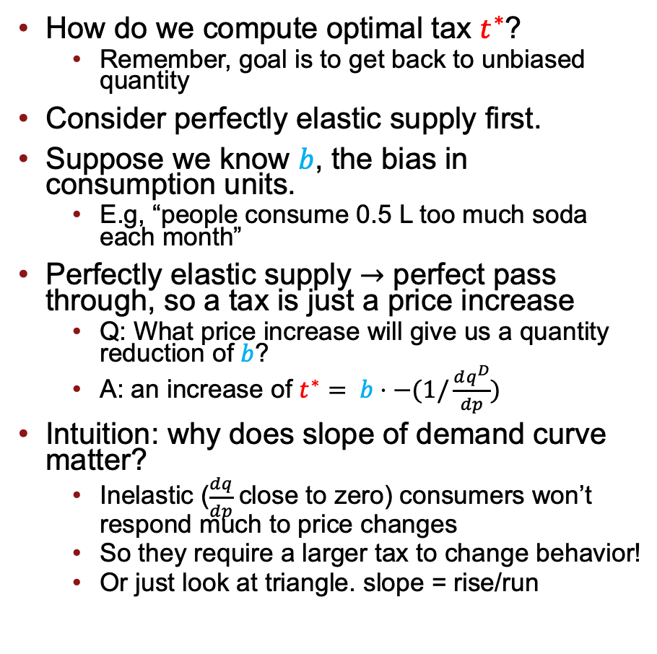






Computing the optimal tax: perfectly elastic supply
How do we compute optimal tax $t^{∗}$?
Remember, goal is to get back to unbiased quantity
Consider perfectly elastic supply first.
Suppose we know $b$, the bias in consumption units.
E.g, “people consume 0.5 L too much soda each month”
Perfectly elastic supply $→$ perfect pass through, so a tax is just a price increase
Q: What price increase will give us a quantity reduction of $b$?
A: an increase of $t^{∗}= b⋅−(1/\frac{dq^{D}}{dp})$
Intuition: why does slope of demand curve matter?
Inelastic ($\frac{dq}{dp}$close to zero) consumers won’t respond much to price changes
So they require a larger tax to change behavior!
Or just look at triangle. slope = rise/run
Supply w/ tax
$$p_{1}+t$$
Price
$$b$$
$$t^{∗}$$
$$p_{1}$$
$$p_{0}$$
Supply
Mistaken (market) Demand
Normative
Demand
$$q_{1}$$
$$q_{0}$$
Quantity
Notes:
Note: If we are doing well on time, we COULD ask them to try to figure out how slope of the supply curve would matter too. But I don’t anticipate that we’ll have time.

Slide 15

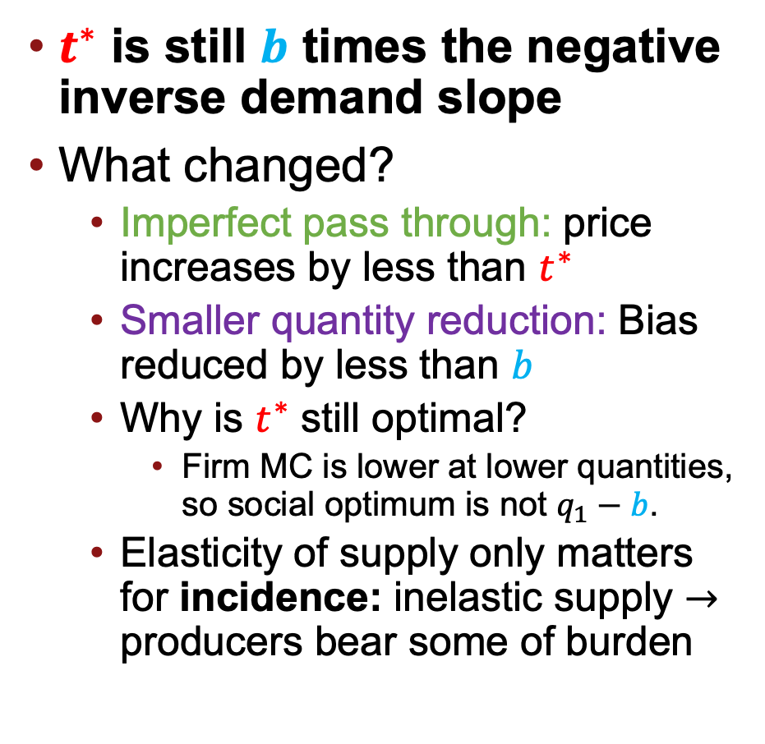




Computing the optimal tax: upward sloping supply
$t^{∗}$ is still $b$ times the negative inverse demand slope
What changed?
Imperfect pass through: price increases by less than $t^{∗}$
Smaller quantity reduction: Bias reduced by less than $b$
Why is $t^{∗}$ still optimal?
Firm MC is lower at lower quantities, so social optimum is not $q_{1}−b$.
Elasticity of supply only matters for incidence: inelastic supply $→$ producers bear some of burden
Price
$$b$$
$$t^{∗}$$
Supply
$$p_{1}+t^{∗}$$
$$p_{0}$$
$$p_{1}$$
Mistaken (market) Demand
Normative
Demand
$$q_{1}$$
$$q_{0}$$
Quantity

Slide 16
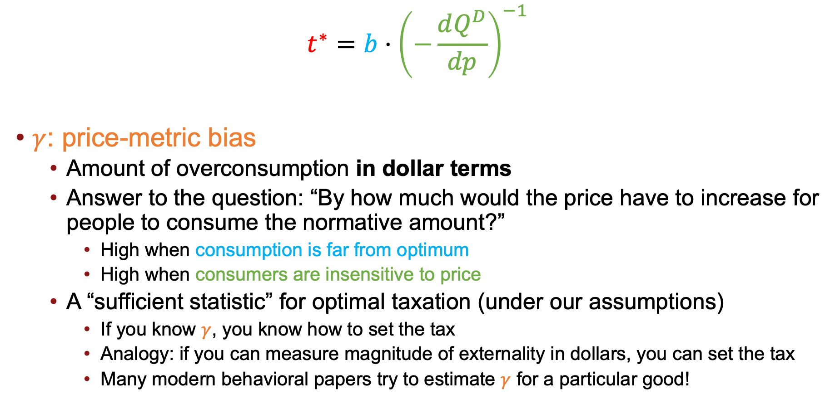

Optimal tax formula
$$t^{∗}=b⋅{\left(−\frac{dQ^{D}}{dp}\right)}^{−1}$$
$γ$: price-metric bias
Amount of overconsumption in dollar terms
Answer to the question: “By how much would the price have to increase for people to consume the normative amount?”
High when consumption is far from optimum
High when consumers are insensitive to price
A “sufficient statistic” for optimal taxation (under our assumptions)
If you know $γ$, you know how to set the tax
Analogy: if you can measure magnitude of externality in dollars, you can set the tax
Many modern behavioral papers try to estimate $γ$ for a particular good!
$$γ$$

Slide 17

Takeaways
$$t^{∗}=b⋅{\left(−\frac{dQ^{D}}{dp}\right)}^{−1}$$
$$γ$$
Analogy from corrective taxation of externalities to internalities
Optimal tax equal to price-metric bias
Depends on magnitude of overconsumption and demand slope
But we made strong assumptions!
Homogenous consumers
Don’t care about incidence
Next week: relax (1)
See Allcott et al. (2019) Journal of Econ Perspectives for discussion of (2)!

