Slide 1
Behavioral Economics And Public Policy: Nudges
Econ 178: Behavioral Economics
Marcelo Clerici-Arias

Slide 2
Agenda
The global impact of nudges
Nudges in our baseline model
When are nudges beneficial?

Slide 3
Nudges

Slide 4
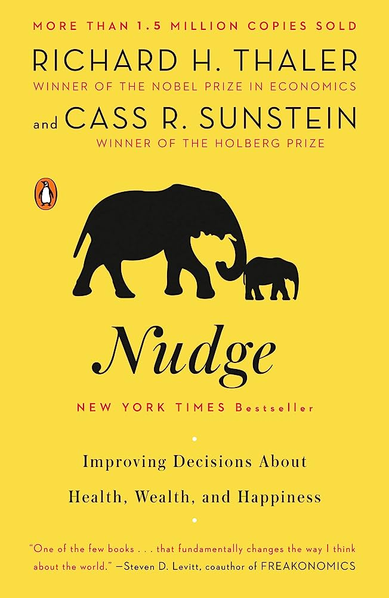
Thaler and Sunstein (2008): Synopsis
For this class: “nudge” = non-financial policy instrument.
Examples: Default options, information provision, reminders, social comparisons…
Make case for nudges as “libertarian paternalism”
Nudges can improve decision-making (paternalism)
Nudges preserve freedom of choice (libertarian)
Nudges are cheap and politically feasible
Our hope is that [our] recommendations might appeal to both sides of the political divide. Indeed, we believe that the policies… can be embraced by Republicans and Democrats alike. A central reason is that many of those policies cost little or nothing; they impose no burden on taxpayers at all… If incentives and nudges replace requirements and bans, government will be both smaller and more modest. So, to be clear: we are not for bigger government, just for better governance.
Notes:
On point 3: compare support for soda tax to support for warning labels on soda bottles.

Slide 5

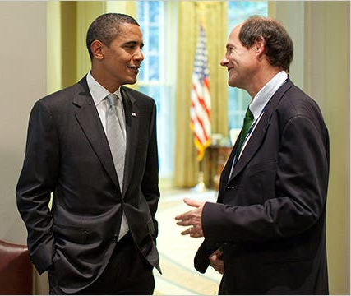

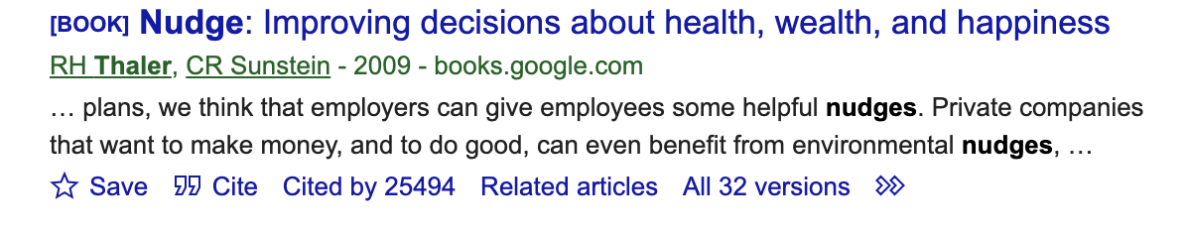
Thaler and Sunstein (2008): Impact
Notes:
Thaler: Econ Nobel Laureate. https://www.telegram.com/story/news/nation-world/2017/10/09/economics-nobel-goes-to-researcher-who-showed-choices-arent-always-rational/18351599007/
Sunstein: Director of Office of Information and Regulatory Affairs (OIRA) under Obama, which reviews regulations for federal agencies https://www.nytimes.com/2010/05/16/magazine/16Sunstein-t.html
Citation screenshot as of Aug 15 2023
Logo for U.K. Behavioral Insights team: https://www.bi.team/about-us-2/who-we-are/
Thesis of nudge:

Slide 6
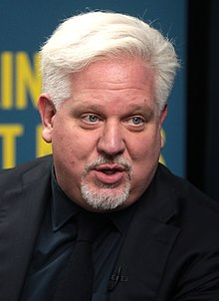
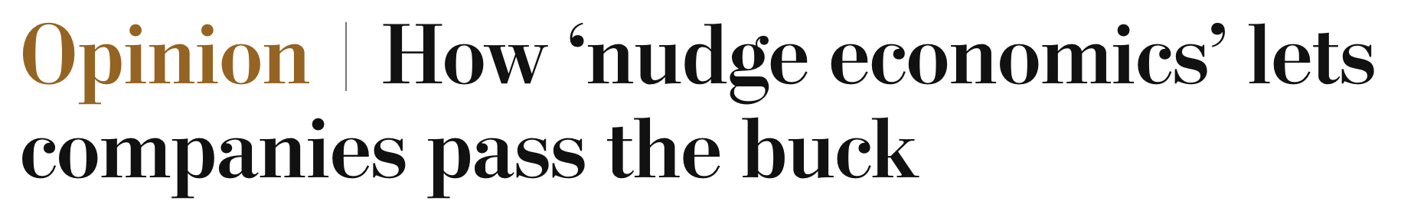
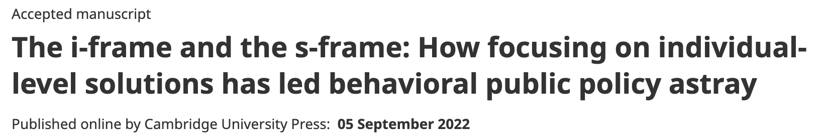
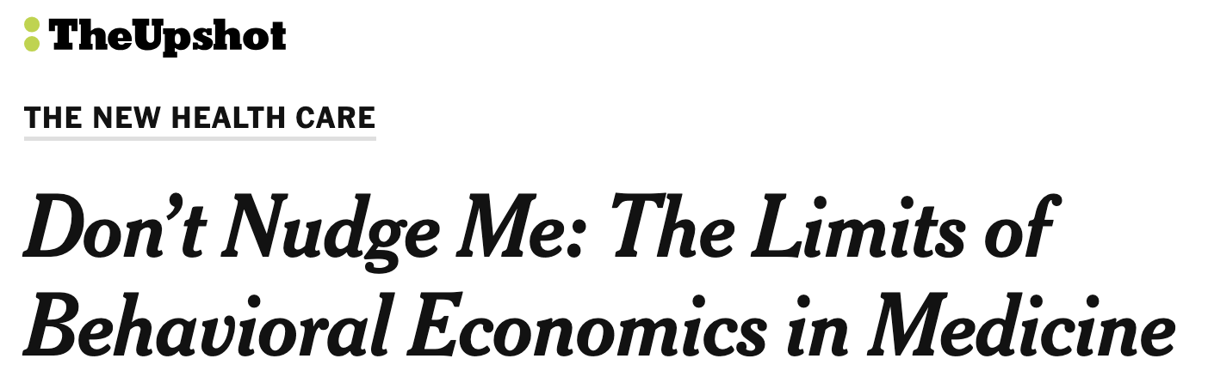
Prominence attracts criticism
Glenn Beck named Sunstein “the most dangerous man in America.”
Notes:
The first thing to say about the slide: There are criticisms from the left (Chater and Lowenstein), from the right (Beck), and on non-ideological grounds (NYT)
NYT Story is about getting people to comply with medication. They discuss a paper finding that nudges have only small TEs. https://www.nytimes.com/2017/11/06/upshot/dont-nudge-me-the-limits-of-behavioral-economics-in-medicine.html
WaPo story is about C&L. Link: https://www.washingtonpost.com/opinions/2022/05/16/nudge-economics-corporate-responsibility-consumers/
The full Beck quote is here: “I called him the most dangerous man in America because Sunstein's job is to figure out how to make people do what the government wants them to do, but in a stealth sort of way.”
https://www.foxnews.com/story/glenn-beck-sunsteins-cure-for-conspiracy-theories
C & L here
https://www.cambridge.org/core/journals/behavioral-and-brain-sciences/article/iframe-and-the-sframe-how-focusing-on-individuallevel-solutions-has-led-behavioral-public-policy-astray/A799C9C57F388A712BE5A8D34D5229A1

Slide 7
This week
Dive into the nudge debates!
Today: Using our model from last week, when do nudges…
Improve welfare at all?
Improve welfare more than standard policy instruments do?
Thursday: Study downstream consequences of policies
Firm response
Substitution to other goods
Political economy critiques

Slide 8
Nudges in a supply and demand model with internalities

Slide 9


Representative consumer model (last week)
Suppose this is the market for sugary beverages, so people over-consume.
Review: draw the following objects (1 minute)
Market demand
Eqm. price and quantity
Consumer Surplus
Producer Surplus
Behavioral DWL
Supply
Negative CS
Price
CS
$$p$$
DWL
PS
Mistaken (market) Demand
Normative
Demand
$$q$$
Quantity

Slide 10




Add a behavioral intervention
Warning label provides info about health consequences of sugary beverage consumption
How can we model this label’s effects on price and quantity (2 min)?
At any price, consumers buy less soda
Inward shift of demand curve from D0 to D1
Decrease in price and quantity
Supply
Price
$$p_{0}$$
$$p_{1}$$
Mistaken (market) Demand
Normative
Demand
D1
D0
$$q_{1}$$
$$q_{0}$$
Quantity

Slide 11
Optimal nudges
With your table (5 min):
How do small nudges affect the components of total surplus?
How large is the optimal nudge?
Compare effects of an optimal nudge to effects of an optimal tax on…
Price
Quantity
Total Surplus
Do all this graphically!
Supply
Price
$$p_{0}$$
Normative
Demand
D0
$$q_{0}$$
Quantity
Notes:
You can click through: Blue = initial CS, Orange = future CS. Then can see the gains and losses!

Slide 12
Effect of a marginal nudge on surplus components
How do CS, PS, and G change?
Interpretation 1: nudges as bias correction (cause shift of demand curve with no costs to consumer or producer)
CS: Gain A, B
PS: Lose A
G: no change
Total surplus gain of B
We are reducing DWL!
Supply
Price
$$p_{0}$$
$$p_{1}$$
Normative
Demand
D1
D0
$$q_{1}$$
$$q_{0}$$
Quantity
Notes:
You can click through: Blue = initial CS, Orange = future CS. Then can see the gains and losses!

Slide 13
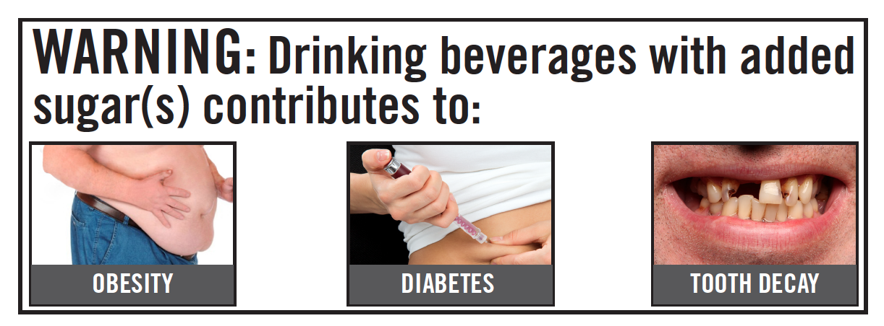




Effect of a marginal nudge on surplus components
Interpretation 2: nudges as psychological taxes
After seeing graphic label, may be less pleasant to drink soda
Normative/true cost to soda consumption increases!
Demand shifts inwards
Normative demand also shifts
Wedge bt. normative and true demand remains same!
CS: Lose A. Gain B.
Behavioral loss term stays same size!
PS: Lose B, C.
G: nothing!
Total loss = B + C
Remember, marginal financial tax has positive welfare effect. Why the negative sign here?
No increase in G to compensate for lost CS and PS
Supply
Price
$$p_{0}$$
$$p_{1}$$
Norm. D0
D1
D0
$$q_{1}$$
$$q_{0}$$
Norm. D1
Quantity
Notes:
Graphic label example… https://hbswk.hbs.edu/item/warning-scarey-warning-labels-work. Ask people “is this really information?”

Slide 14
Takeaways
Takeaway 1: The welfare effects of nudges depend on the mechanism by which the nudge affects behavior.
Case 1: Bias correction -> welfare enhancing
Case 2: Increase psychological cost of consumption -> welfare decreasing
Nudge may be an “emotional tax on behavior that creates no revenue” (Glaeser 2006)
Many interventions are mixes of both!
No standardized method to empirically assess whether nudges operate through bias correction or other means (active area of research)
For the rest of this exercise, assume case 1.

Slide 15
Magnitude of optimal nudge
Notes:
This can be a place where you draw the curve yourself, or ask a student to do so. See next slide for the figure that you should be drawing.

Slide 16



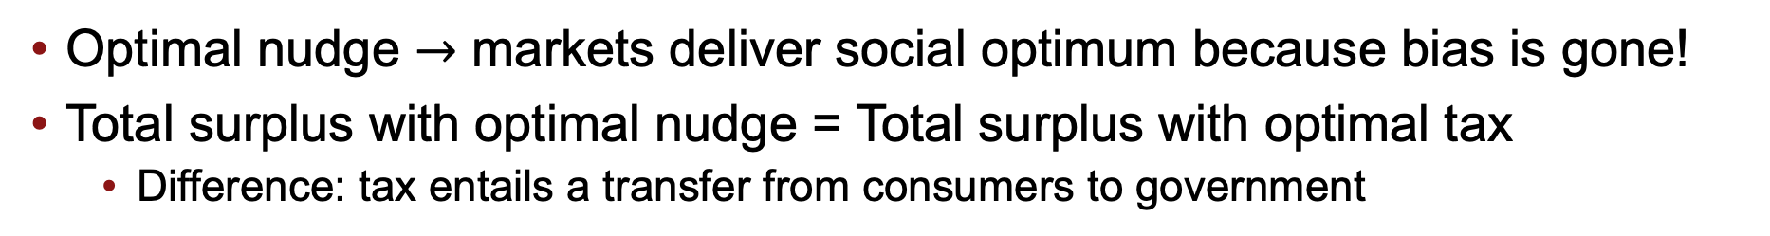




Welfare effects of an optimal nudge
Supply w/ tax
Supply
Supply
Price
Price
$$t^{∗}$$
$$p_{1}+t$$
$$p_{0}$$
$$p_{0}$$
$$p_{1}$$
$$p_{1}$$
Normative
Demand =
Mistaken (market) Demand
Mistaken (market) Demand
Post-nudge
Demand
Normative
Demand
$$q_{1}$$
$$q_{0}$$
Quantity
$$q_{1}$$
$$q_{0}$$
Quantity
Optimal nudge $→$ markets deliver social optimum because bias is gone!
Total surplus with optimal nudge = Total surplus with optimal tax
Difference: tax entails a transfer from consumers to government

Slide 17
Interpreting the tax-nudge equivalence result
This is a stark result! It says the trendy behavioral interventions provide no additional benefits beyond those of policy tools we already knew about.
But it only holds under the assumptions of the simple model.
No direct psychological costs or benefits of nudge
Homogenous consumers. Everyone has the same…
Bias
Responsiveness to nudge
Responsiveness to price changes
Bias is set exogenously (e.g, firms cannot compete over transparency)
Rest of this week: relax these assumptions!
Sometimes nudging will look relatively better than taxation, other times worse. Often it’s a good idea to combine policy instruments.
The whole point is to know which policy tool is most appropriate when.
Notes:
I think we want students to come up with the key assumptions themselves, and then .

Slide 18
Takeaways
Takeaway 1: The welfare effects of nudges depend on the mechanism by which the nudge affects behavior.
Takeaway 2: In representative consumer model, corrective nudges and corrective taxation have equivalent effects on total surplus.
Next: relax the representative consumer assumption.

Slide 19
Heterogeneous Bias

Slide 20

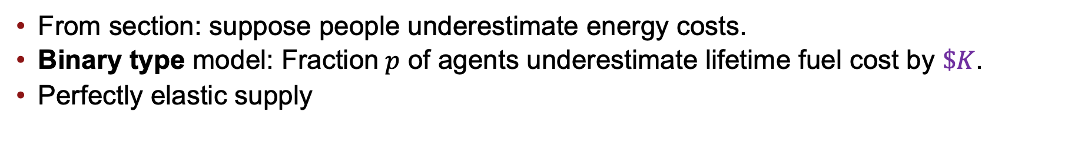



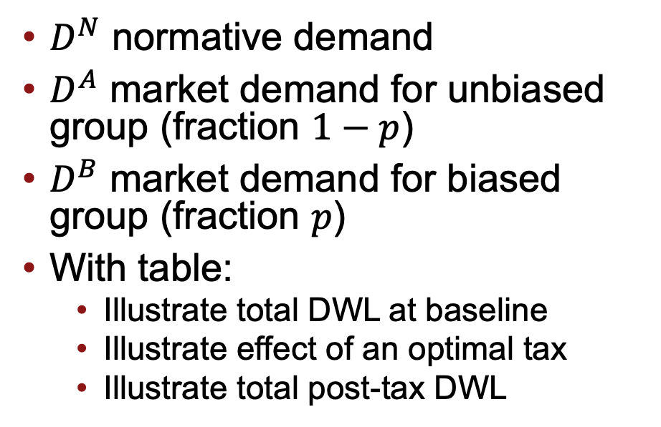

Refrigerator consumption with heterogenous bias
From section: suppose people underestimate energy costs.
Binary type model: Fraction$p$ of agents underestimate lifetime fuel cost by $\$K$.
Perfectly elastic supply
$D^{N}$ normative demand
$D^{A}$ market demand for unbiased group (fraction $1−p$)
$D^{B}$ market demand for biased group (fraction $p$)
With table:
Illustrate total DWL at baseline
Illustrate effect of an optimal tax
Illustrate total post-tax DWL
$$K$$
Price
Supply
$D^{N}=D^{A}$
$$D^{B}$$
$$q_{A}$$
Quantity
$$q_{B}$$
Notes:
MARCELO: Draw DWL at baseline on top of this graph.

Slide 21

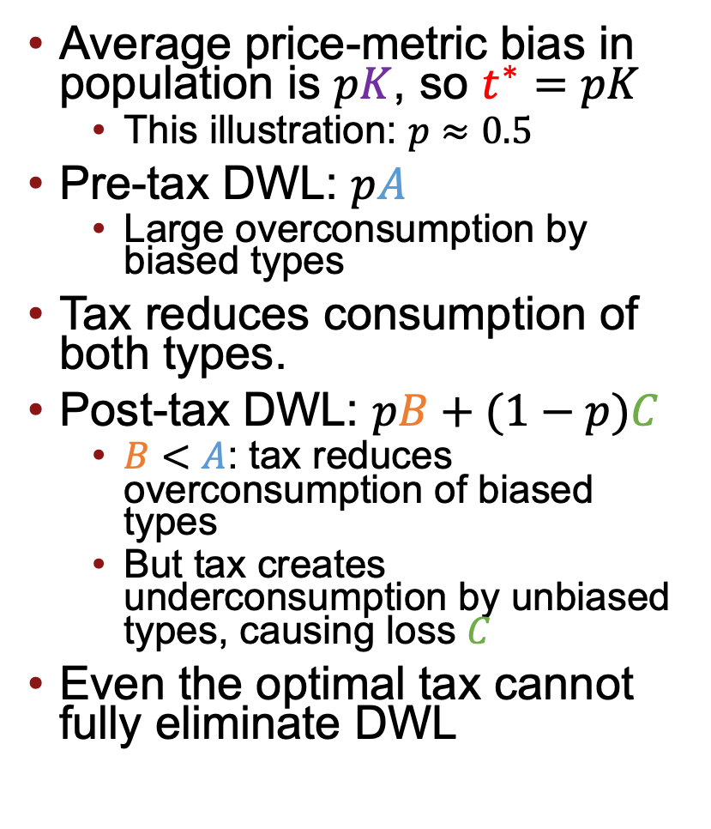







Taxing a heterogenous bias
Average price-metric bias in population is $pK$, so $t^{∗}=pK$
This illustration: $p≈0.5$
Pre-tax DWL: $pA$
Large overconsumption by biased types
Tax reduces consumption of both types.
Post-tax DWL: $pB+(1−p)C$
$B<A$: tax reduces overconsumption of biased types
But tax creates underconsumption by unbiased types, causing loss $C$
Even the optimal tax cannot fully eliminate DWL
$$K$$
Price
$$t^{∗}$$
C
Supply
B
A
$D^{N}=D^{A}$
$$D^{B}$$
$$q_{A}^{1}$$
$$q_{A}^{0}$$
$$q_{B}^{1}$$
$$q_{B}^{0}$$
Quantity

Slide 22
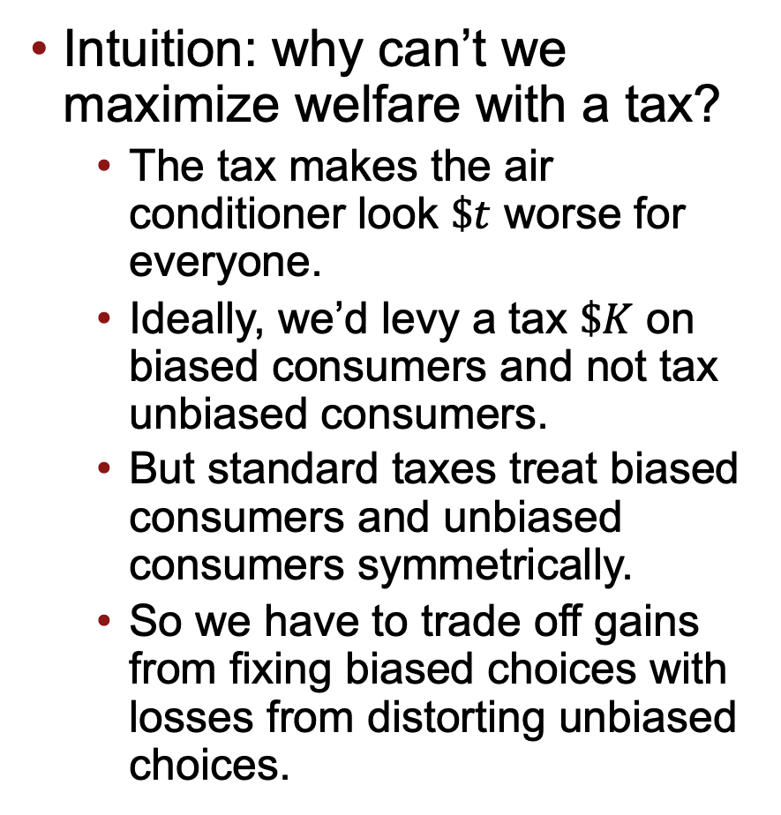
Taxing a heterogenous bias
Intuition: why can’t we maximize welfare with a tax?
The tax makes the air conditioner look $\$t$ worse for everyone.
Ideally, we’d levy a tax $\$K$ on biased consumers and not tax unbiased consumers.
But standard taxes treat biased consumers and unbiased consumers symmetrically.
So we have to trade off gains from fixing biased choices with losses from distorting unbiased choices.
$$K$$
Price
$$t^{∗}$$
C
Supply
B
A
$D^{N}=D^{A}$
$$D^{B}$$
$$q_{A}^{1}$$
$$q_{A}^{0}$$
$$q_{B}^{1}$$
$$q_{B}^{0}$$
Quantity

Slide 23
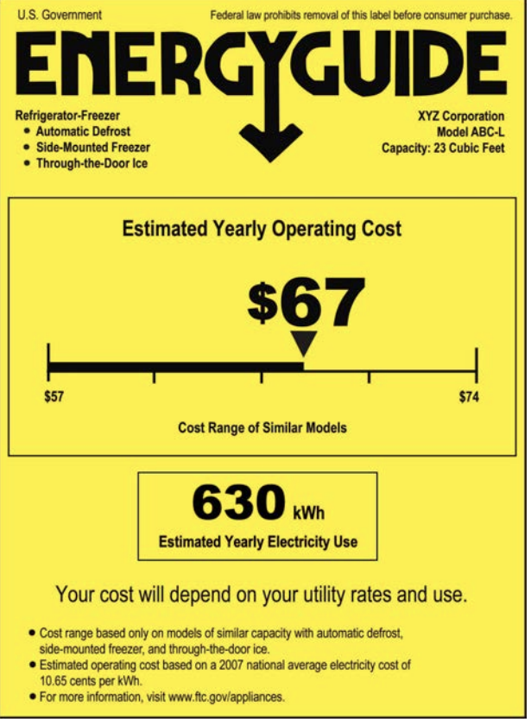

Nudges in the market for refrigerators
Energy Star: a certification from EPA that appliance is among most energy-efficient in market.
Energy Guide: a label with information about energy costs (required by FTC)
Notes:
Houde (2014) for program details https://www.nber.org/system/files/working_papers/w20019/w20019.pdf

Slide 24

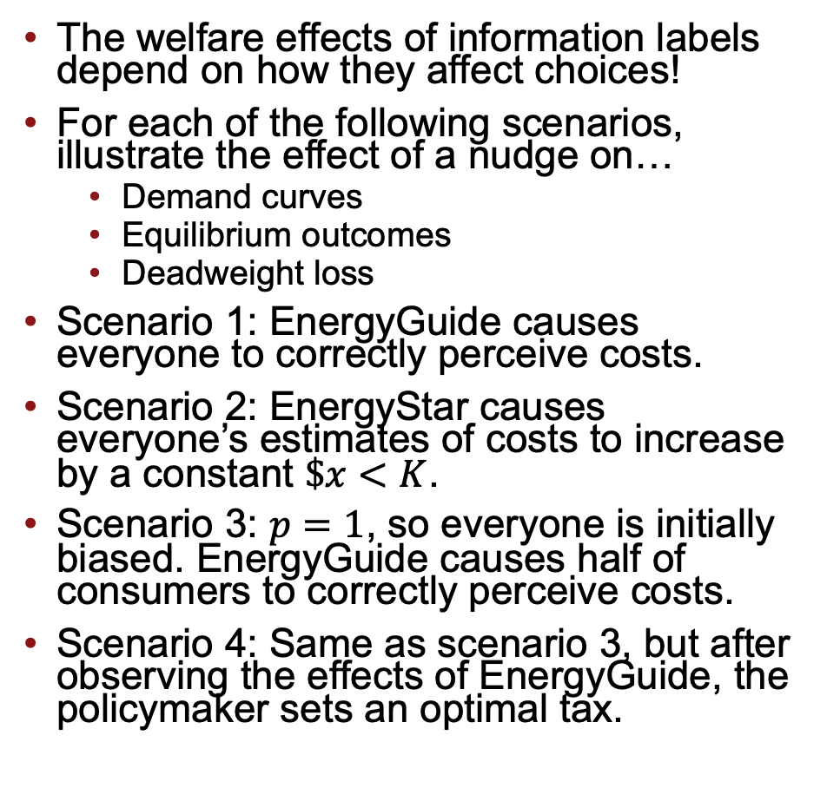




Exercise: Nudging a heterogenous bias
The welfare effects of information labels depend on how they affect choices!
For each of the following scenarios, illustrate the effect of a nudge on…
Demand curves
Equilibrium outcomes
Deadweight loss
Scenario 1: EnergyGuide causes everyone to correctly perceive costs.
Scenario 2: EnergyStar causes everyone’s estimates of costs to increase by a constant $\$x<K$.
Scenario 3: $p=1$, so everyone is initially biased. EnergyGuide causes half of consumers to correctly perceive costs.
Scenario 4: Same as scenario 3, but after observing the effects of EnergyGuide, the policymaker sets an optimal tax.
$$K$$
Price
Supply
$D^{N}=D^{A}$
$$D^{B}$$
$$q_{A}$$
Quantity
$$q_{B}$$

Slide 25






Scenario 1: Perfect Bias Correction
EnergyGuide causes everyone to correctly perceive costs.
Biased demand shifts inwards
Unbiased demand is unaffected
Everyone’s demand is equal to normative demand
Zero DWL
Note that this policy is better than the tax!
When bias is heterogenous, nudges that target the bias are good for welfare
$$K$$
Price
$$p$$
Supply
$$D^{B0}$$
$$q_{A}=q_{B1}$$
$$q_{B0}$$
Quantity
$$D^{N}=D^{A}=D^{B1}$$

Slide 26






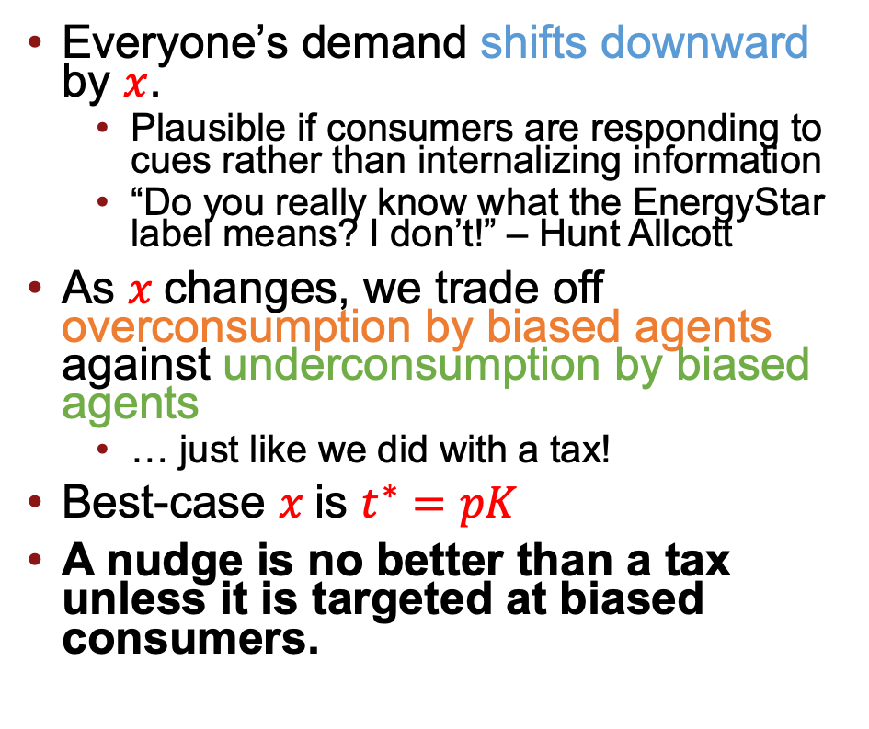


Scenario 2: Homogenous Effects
EnergyGuide causes everyone’s estimates of costs to increase by a constant $\$x<K$.
Everyone’s demand shifts downward by $x$.
Plausible if consumers are responding to cues rather than internalizing information
“Do you really know what the EnergyStar label means? I don’t!” – Hunt Allcott
As $x$changes, we trade off overconsumption by biased agents against underconsumption by biased agents
… just like we did with a tax!
Best-case $x$is $t^{∗}=pK$
A nudge is no better than a tax unless it is targeted at biased consumers.
$$K$$
$$x$$
Price
$$p$$
$$x$$
Supply
$$D^{B0}$$
$$q_{A0}$$
$$q_{A1}$$
$$q_{B1}$$
$$q_{B0}$$
$$D^{B1}$$
Quantity
$$D^{A1}$$
$$D^{N}=D^{A0}$$
Notes:
Verbalize: This is exactly the same tradeoff we faced setting a tax!

Slide 27




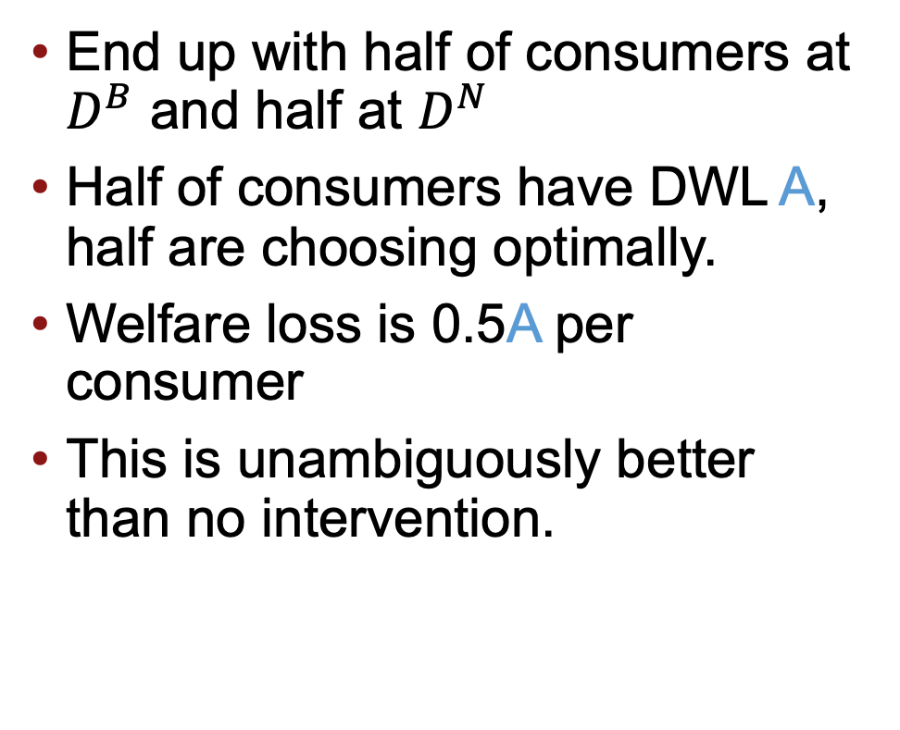

Scenario 3: Heterogenous Effects on biased consumers
$p=1$, so everyone is initially biased. EnergyGuide causes half of consumers to correctly perceive costs.
End up with half of consumers at $D^{B}$ and half at $D^{N}$
Half of consumers have DWL A, half are choosing optimally.
Welfare loss is 0.5A per consumer
This is unambiguously better than no intervention.
$$K$$
Price
Supply
A
$$D^{N}$$
$$D^{B}$$
$$q_{A}$$
Quantity
$$q_{B}$$

Slide 28




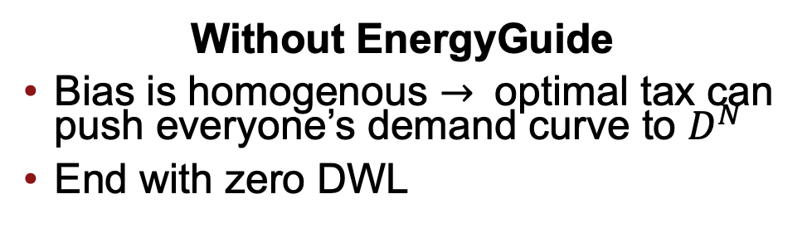












Scenario 4: Heterogenous effects with an optimal tax
$p=1$, so everyone is initially biased. EnergyGuide causes half of consumers to correctly perceive costs. The policymaker then sets an optimal tax.
With EnergyGuide
We face standard tradeoff from taxing heterogenous bias
End with positive DWL
Without EnergyGuide
Bias is homogenous $→$ optimal tax can push everyone’s demand curve to $D^{N}$
End with zero DWL
$$K$$
$$K$$
$$t^{∗}=K$$
$$t^{∗}$$
Supply
Supply
Price
Price
$$D^{N}$$
$$D^{B}$$
$$D^{N}$$
$$D^{B}$$
$$D^{N}$$
$$q_{N1}$$
$$q_{N0}$$
$$q_{B1}$$
$$q_{B0}$$
Quantity
$$q_{N1}$$
$$q_{1}$$
$$q_{B1}$$
$$q_{0}$$
Quantity
Notes:
Marcelo should verbally emphasize that this is really surprising! The nudge made things worse!

Slide 29
Intuition: Targeted Nudges
Suppose we experimentally measured the effects of EnergyGuide.
We would observe a negative average treatment effect of EnergyGuide on refrigerator consumption.
Since people overpurchase refrigerators on average, this seems like a good thing.
But in scenario 4, we concluded that EnergyGuide was bad for welfare! Why?
Informally: decompose effects of nudges into two components
Effect on average decision
Effect on variance of decisions
In the absence of other policies, we’d want (1) to counteract the average bias, and we want (2) to decrease variance (eliminate noise).
But if we’re allowed to set a tax, we can use the tax to counteract the average bias, so (1) becomes irrelevant. All that matters is (2).
The nudge from scenario 4 made decisions noisier, so it was bad.
Allcott et al (2022): this issue is empirically important. Many popular nudges may not be well-targeted at biases, so they might increase noise!
Notes:
https://www.nber.org/papers/w30740

Slide 30
Takeaways
Takeaway 1: The welfare effects of nudges depend on the mechanism by which the nudge affects behavior.
Takeaway 2: In a simple model, corrective nudges and corrective taxation have equivalent effects on total surplus.
Takeaway 3a: A nudge may improve upon a financial intervention if and only if the nudge asymmetrically affects biased consumers.
In English: the effects of the nudge must be “well-targeted” at the bias.
Takeaway 3b: In the presence of an optimal tax, the average treatment effect of a nudge is irrelevant to its welfare effects on welfare. All that matters is whether the nudge is well-targeted.

