Slide 1
Team
∞
Brief, requirements, effort estimates, solution Outline (specs)

Slide 2
Requirements
Must
M1: The process must find the closest exchange to a customer home address and display the id and location of said exchange.
M2: The distance must be calculated for each exchange and to find the closest using a grid pattern
M3: Each exchange must be defined by a unique identifier of the form ex:p:q where p and q are numbers between 0 and 9
M4: Must accept user input to specify grid dimensions (x&y independently) equal or greater than 0 and equal or less than 100,000.
M5: Customer must be at (0,0)
Could
C1: The process could print the location of the exchange
C2: The process could determine when exchanges are equidistant
C3: The process will display a map showing the customer and the location of the closest exchange

Slide 3
Assumptions and questionable
Assumed that the grid inputs are independent.
Assume that the exchange can be on the same coordinate as the home address.
Assume that the exchanges cannot have the same coordinates
Used by the CSR (Customer service representative)
Distance is measured by horizontal/vertical units not Pythagorean distance
Simpler
Cables in the real world don’t go direct
Assume that no UI is required

Slide 4
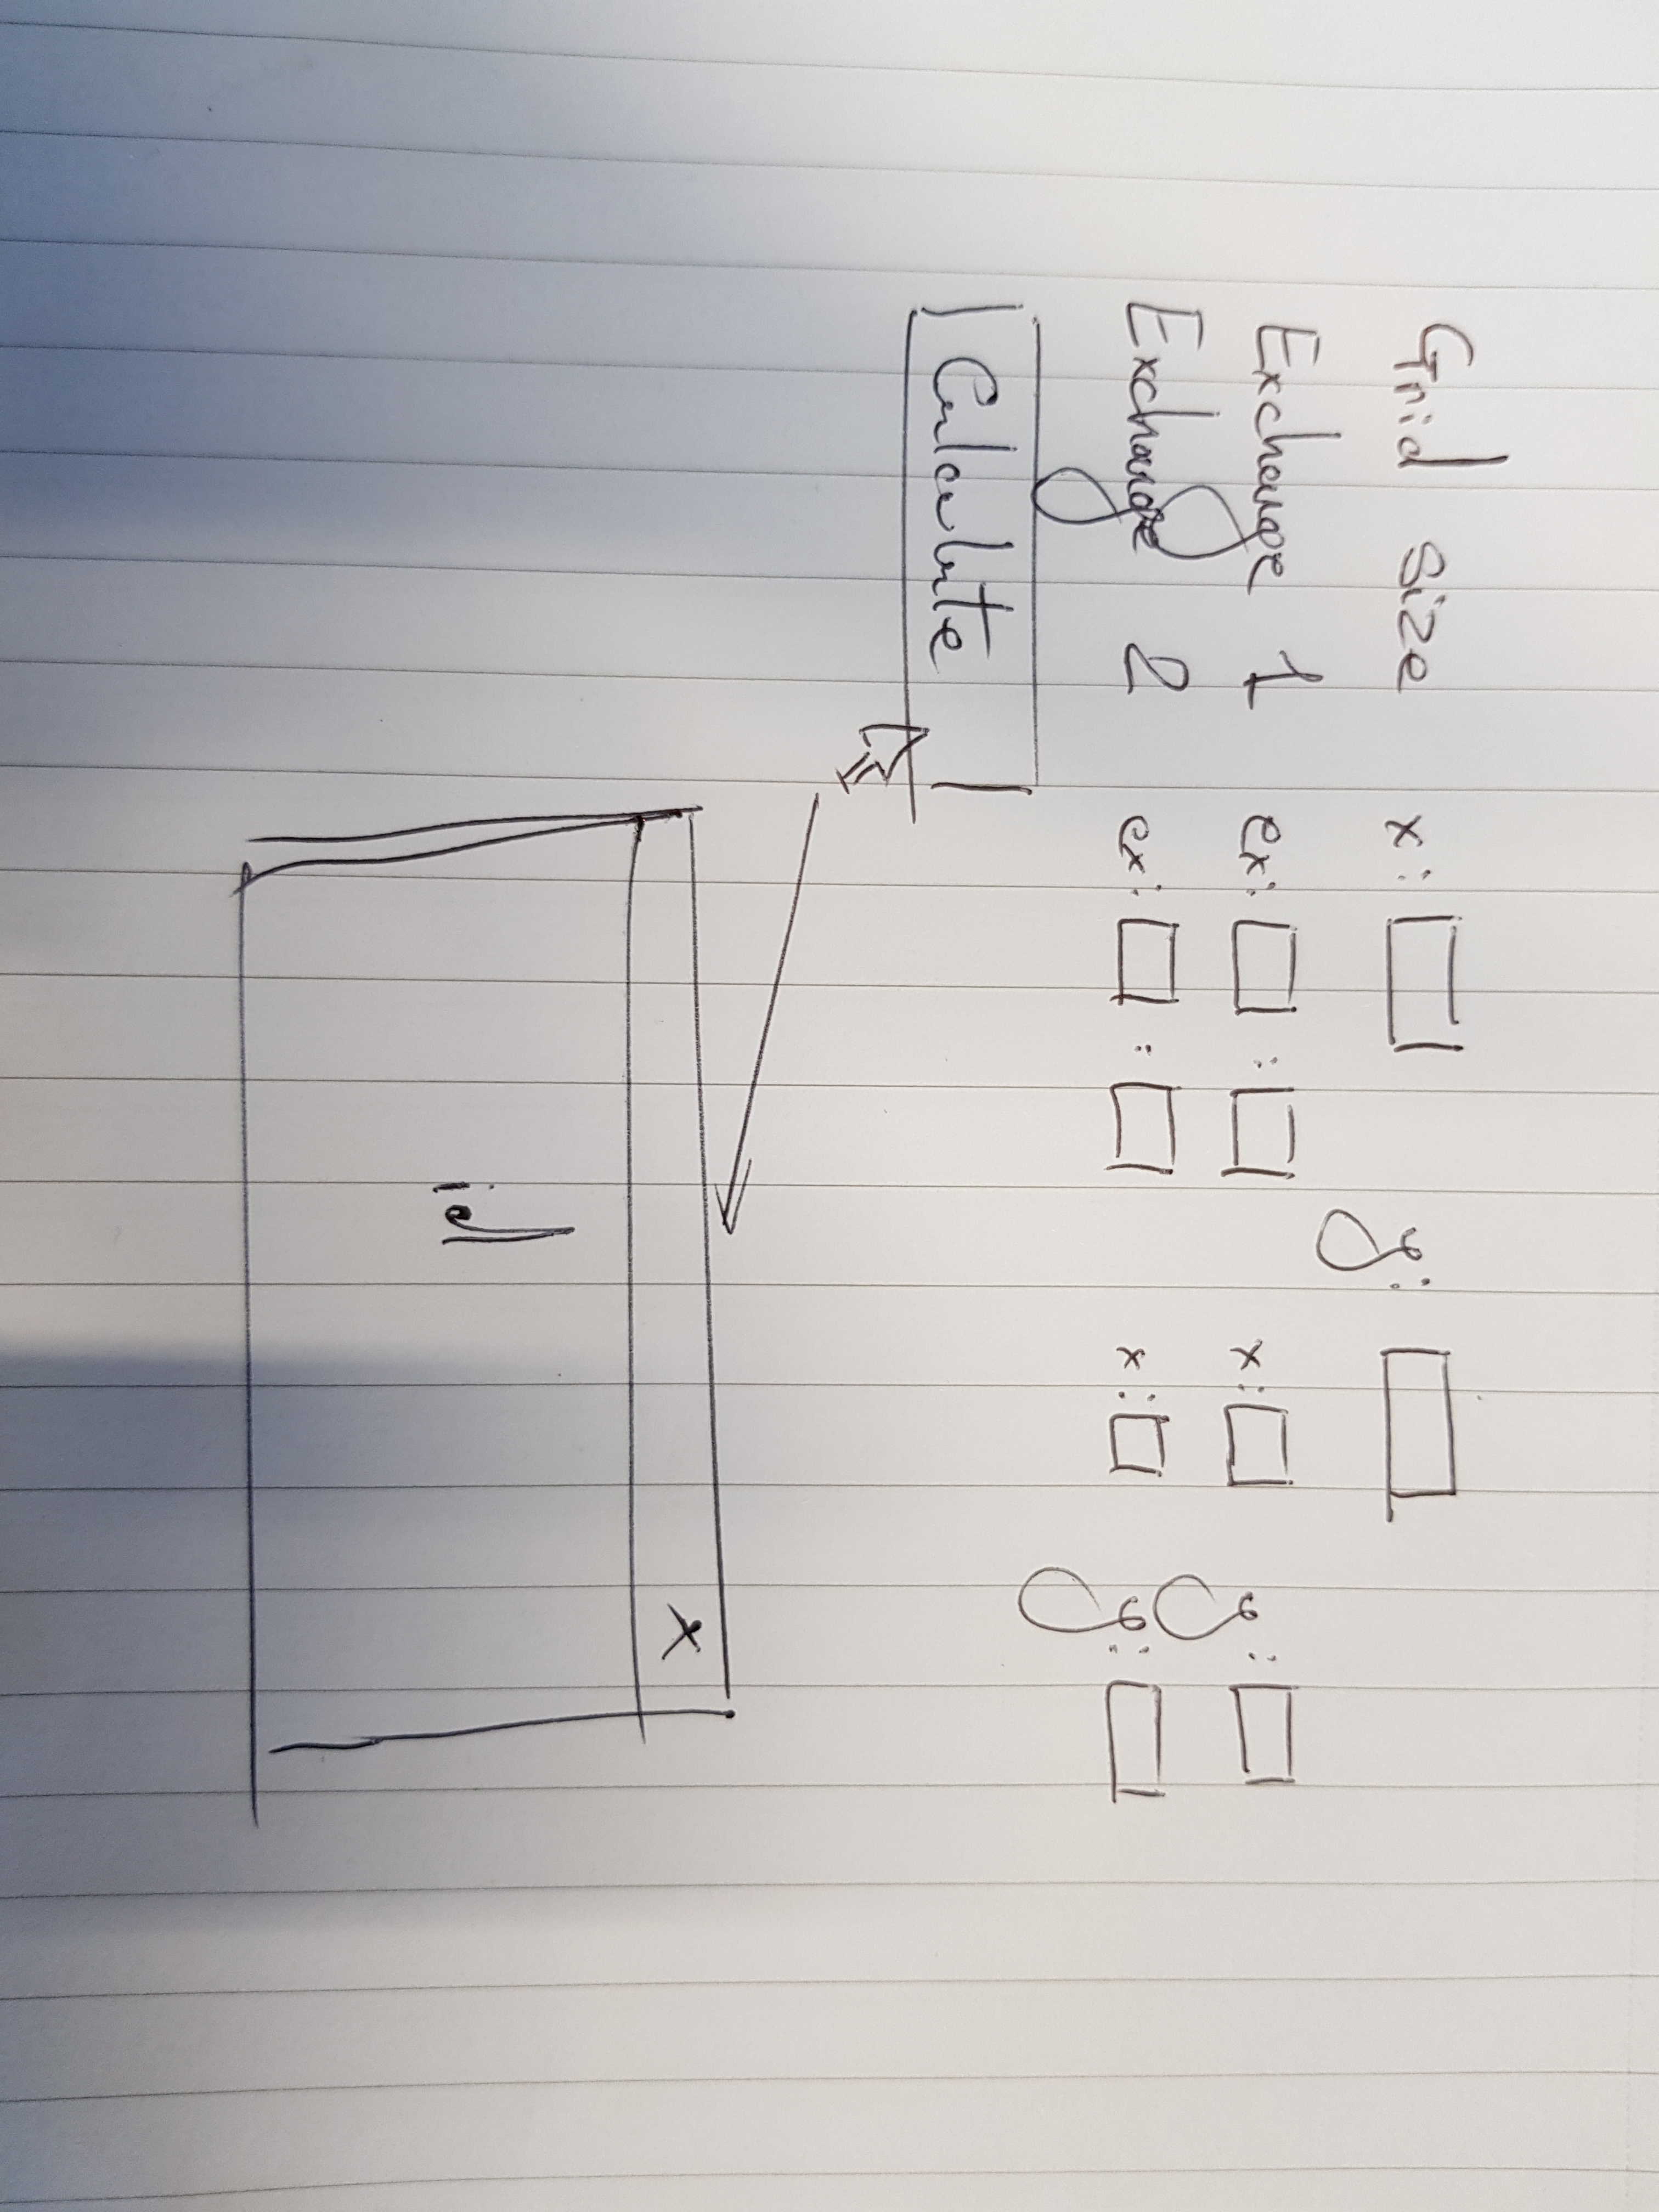
UI
Inputs
2 x TextFields for grid size [x & y]
2 x Exchange inputs:
2 x Textfields for ID inputs
2 x Textfields for x & y positions
1 x Button to call calculate function

Slide 5
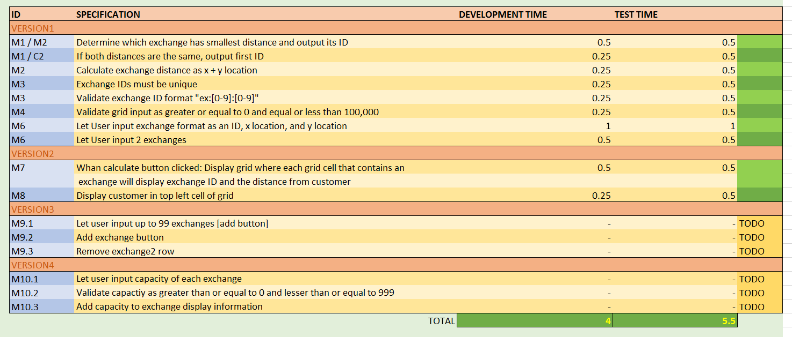
Specifications: Development & Testing and effort estimates

Slide 6
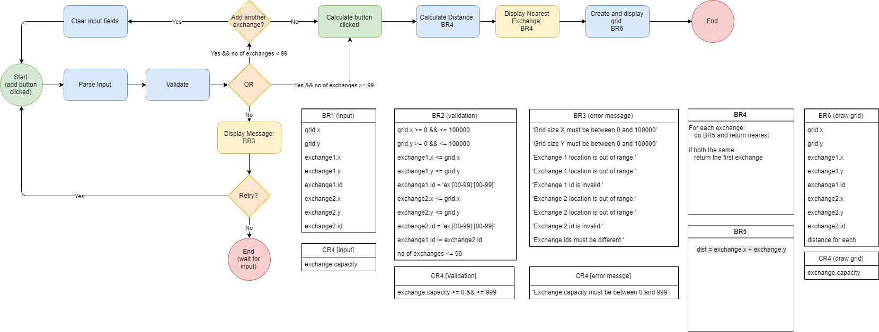
Flow Diagram (v4)

Slide 7
Solution Outline
1) Hardcoding exchange data
2) Calculate Distance function
3) Output to user
4) Test initial build
5) Implement could specs. (UI elements)
6) Test again
Software used: JSFiddle

