Slide 1


Customer Segmentation
By Matt Burnham
MINI PROJECT PRESENTATION
Feb-2020

Slide 2
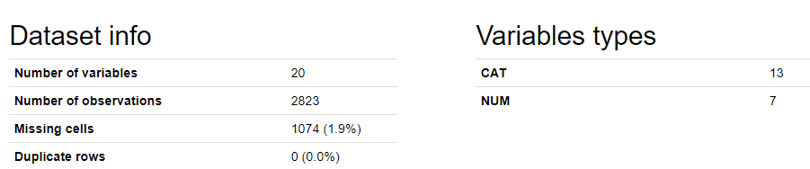
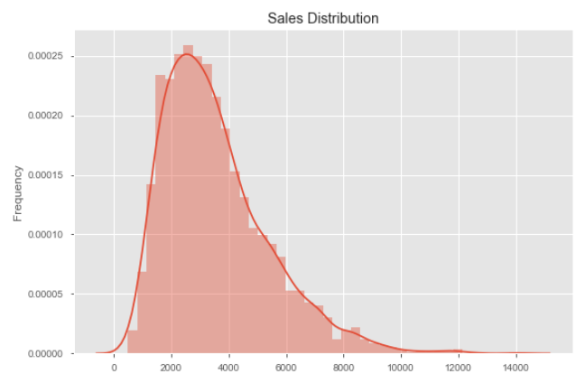
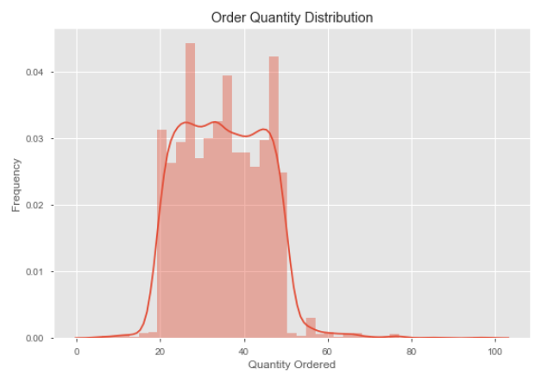
Information
Dataset: Kaggle – “sales_data_sample”: A Toy wholesaling business

Slide 3
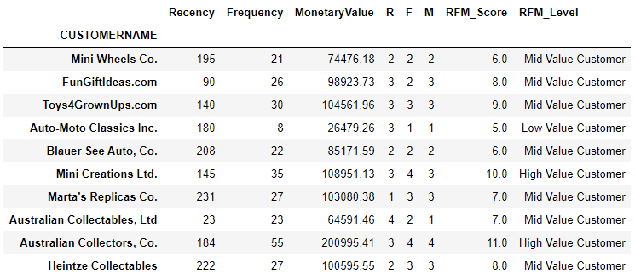
Clustering Approach
EDA:
Create a clustering / segmentation with arbitrary number of clusters, namely creating the following variables:
Recency - number of days between the customer's latest order date and the snapshot date
Frequency - Number of purchases made by the customer
MonetaryValue – Rev. generated by the customer
Dividing customers into 4 segments:
Create a spend quantile with 4 groups
Calculate a RFM_Score, then label them (3)

Slide 4
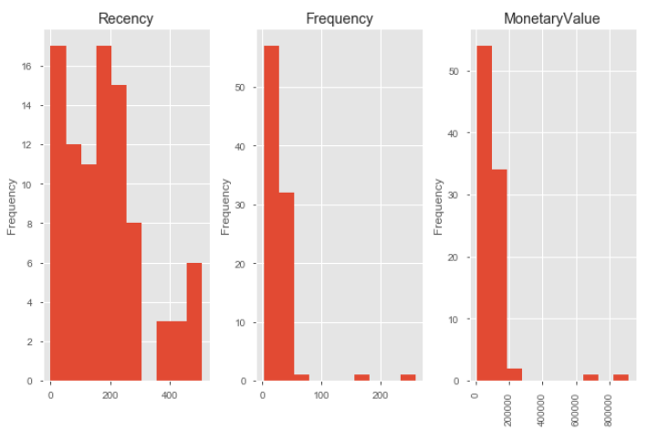
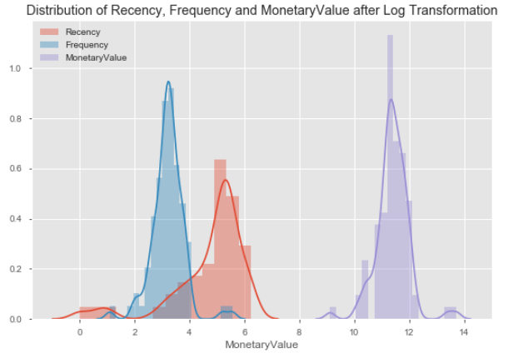
Segmentation using KMeans Clustering
Transformation:
Log for skewness
StandardScaler for equal variance and mean (to normalise)
Prior to transformation

Slide 5
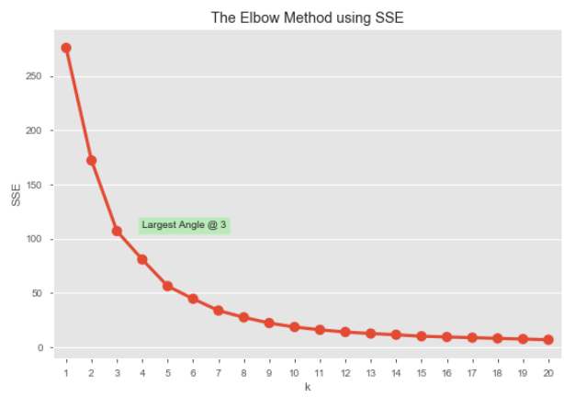
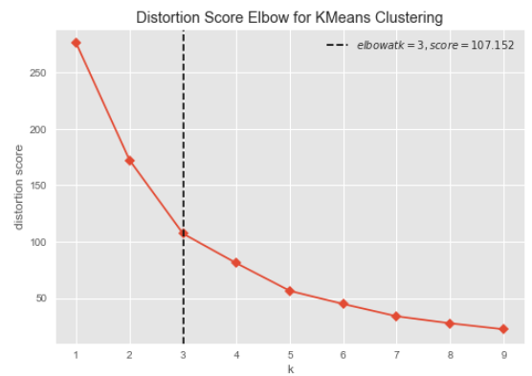
Choosing number of clusters
Build a Model - Finding a K-value using SSE
1. Sum Squared Errors (SSE)
Rate of Change highest k=3
Silhouette score = 0.438
2. Distortions & Inertias
Rate of Change also highest at k=3
K-Means Objective = 107.2
Quality of fit/Score (opposite) = -22.3

Slide 6
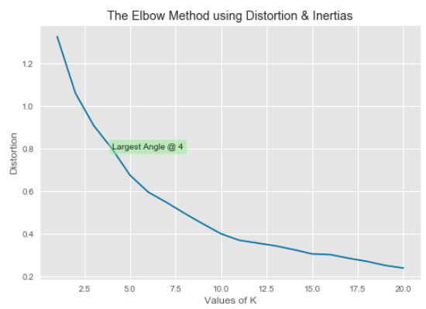
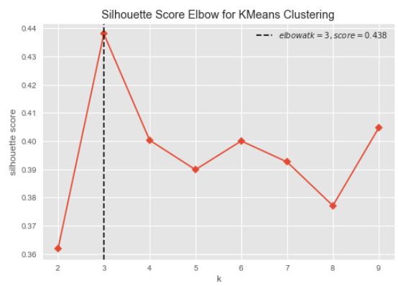
Choosing number of clusters
Build a Model - Finding a K-value using Distortion & Inertias
1. Distortions & Inertias
Rate of Change highest k=4
Silhouette score = 0.438
2. Distortions & Inertias
Rate of Change highest at k=3
K-Means Objective = 80.9
Quality of fit/Score (opposite) = -22.2

Slide 7
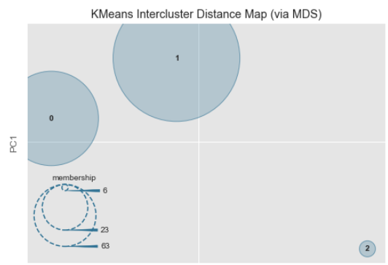
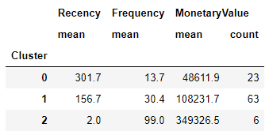
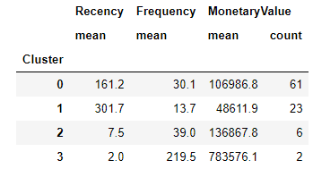
Implementing KMeans
K-Means is very susceptible to outliers, as you can see by the silhouette scores and by the clustering below.
Sum Squared Errors (SSE):
3 Clusters
Distortions & Inertias:
4 Clusters

Slide 8
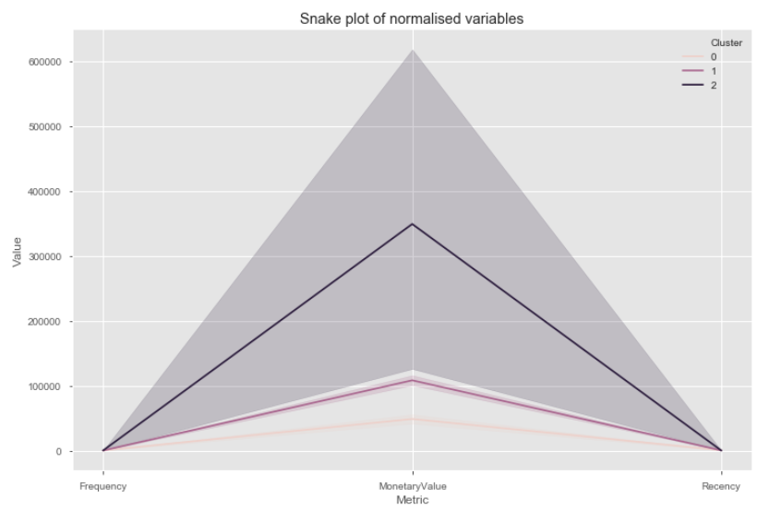
Implementing KMeans
Building Customer Personas
Customer Personas can be built by determining the summary stats of RFM values or via a Snake Plot. Example implementing k=3 clusters:

Slide 9
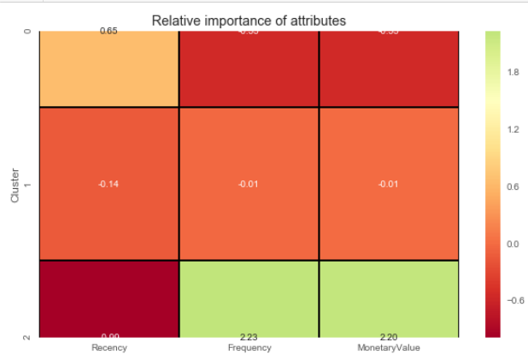
Implementing KMeans
Building Customer Personas
A visual representation of each segment's attributes helps us to determine the relative importance of segment attributes. Calculating the relative importance of a cluster's attribute value compared to population:

Slide 10

References
Data Source:
Kaggle: Sample Sales Data

