Slide 1

Chapter 4
UTILITY MAXIMIZATION
AND CHOICE
Copyright ©2005 by South-Western, a division of Thomson Learning. All rights reserved.

Slide 2
Objective:
Choosing among bundles of goods is a function of two things: (1) preferences, and (2) what you can afford
Last lecture: we studied a method to represent consumer’s preferences (1)
In this lecture, we will study (2) and how (1) and (2) are combined to study choice among bundles of goods

Slide 3
The Budget Constraint
What bundles of goods (X,Y) can the individual afford if he has £I and prices (p_{x} and p_{y} ) are independent of the quantity purchased?
Those for which:
p_{x}x + p_{y}y ≤ I;
It is helpful to draw the combinations of (x,y) such that p_{x}x + p_{y}y =I.
We solve for y:y = I/p_{y} – (p_{x} /p_{y}) x
We can see that it is a straight decreasing line with slope – (p_{x} /p_{y})
If x=0, y = I/p_{y} and if y=0, x= I/p_{x}

Slide 4
The Budget Constraint
If income changes, the budget constraint changes in parallel as the slope (ratio of prices) do not change
If prices change, then the slope also changes
See some examples in the board

Slide 5


The Budget Constraint
The line is the thick blue line
The individual can afford any of the bundles in the thick blue line as well as those in the shaded triangle
p_{x}x + p_{y}y ≤ I;
Quantity of y
If all income is spent
on y, this is the amount
of y that can be purchased
The slope of the thick blue line is
-(p_{x}/p_{y})
If all income is spent
on x, this is the amount
of x that can be purchased
Quantity of x

Slide 6
Starting to combine (1) and (2)
How are choices among bundles of goods done?
We assume that consumers will maximize utility among the bundles that they can afford

Slide 7
Optimal choice when the MRS is strictly decreasing
If the MRS is strictly decreasing then the indifference curve is convex
Using a graph, let’s study utility maximization (with convex indifference curves) subject to the consumer’s budget constraint

Slide 8
Optimal choice when the MRS is strictly decreasing
We can add the individual’s utility map to show the utility-maximization process
Quantity of y
The individual can do better than point A
by reallocating his budget
A
C
The individual cannot have point C
because income is not large enough
B
U₃
Point B is the point of utility
maximization
U₂
U₁
Quantity of x

Slide 9
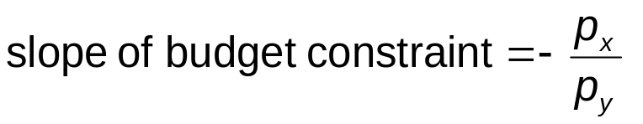
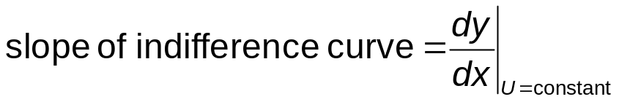
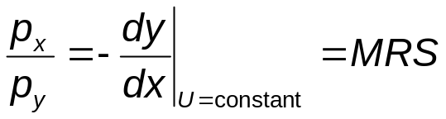
Optimal choice when the MRS is decreasing
Utility is maximized where the indifference curve is tangent to the budget constraint
Quantity of y
B
This last one is usually called the tangency condition
U₂
Quantity of x

Slide 10
Optimal choice when the MRS is strictly decreasing
We call the MRS=ratio of prices the tangency condition
Verifying the tangency condition is a sufficient condition for a bundle to be an optimal choice, when the MRS strictly is decreasing
What? is the intuition behind the tangency condition?

Slide 11
A Numerical Illustration
Assume that the individual’s MRS = 1
  willing to trade one unit of x for one unit of y
Suppose the price of x = $2 and the price of y = $1
The individual can be made better off
  trade 1 unit of x for 2 units of y in the marketplace
So, it cannot be an optimal bundle if MRS is different from the ratio of prices

Slide 12
Maths for when MRS is strictly decreasing
Same as before but using mathematics…
We will see how the tangency condition comes up in the mathematical exercise
The individual’s objective is to maximize
utility = U(x₁,x₂)
subject to the budget constraint
I = p₁x₁ + p₂x₂
Set up the Lagrangian:
L = U(x₁,x₂) + λ(I - p₁x₁ - p₂x₂ )

Slide 13
Mathematics continue…
Taking derivatives on the L function, we obtain the so called First Order Conditions
∂L/∂x₁ = ∂U/∂x₁ - λp₁ = 0
∂L/∂x₂ = ∂U/∂x₂ - λp₂ = 0
∂L/∂λ = I - p₁x₁ - p₂x₂ = 0

Slide 14
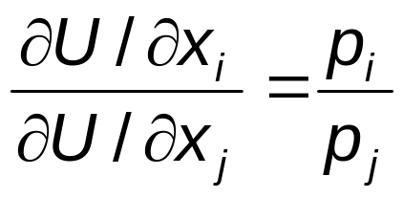
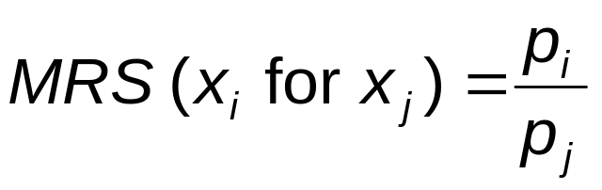
Implications of First-Order Conditions
For any two goods,
This implies that at the optimal allocation of income (tangency condition)

Slide 15
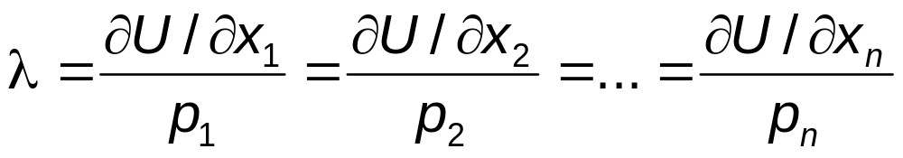
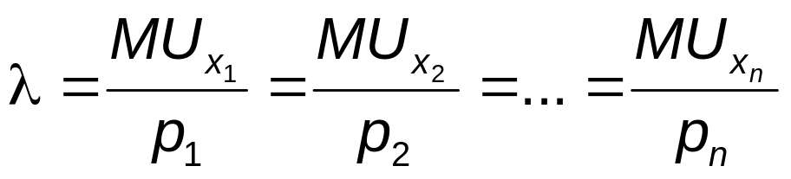
Interpreting the Lagrangian Multiplier
At the optimal allocation, each good purchased yields the same marginal utility per £ spent on that good
So, each good must have identical marginal benefit (MU) to price ratio
If different goods have different marginal benefit/price ratio, you could reallocate consumption among goods and increase utility. Hence, you would not be maximizing utility.

Slide 16
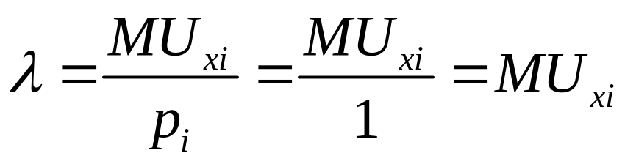
Interpreting the Lagrangian Multiplier
Assume that good x_{i} costs £1. If the consumer had an extra £1 that would allow him to buy one unit of x_{i}
Then, we would have that:
So, λ can be interpreted as the additional utility (=marginal utility) that the consumer can gain with an additional £1
λ is the marginal utility of an extra £1 of income (usually referred as just marginal utility of income)

Slide 17
Optimal choice when MRS is strictly decreasing
We said “Verifying the tangency condition is a sufficient condition for a bundle to be an optimal choice, when the MRS is decreasing”
So, it is not a necessary condition
This means that a bundle might be an optimal choice but might not verify the “tangency condition” even if the MRS is decreasing
This happens because of corner solutions (see next slide)
  Corner solution: consumption zero of at least one good of the bundle
  Interior solution: positive consumption of all the goods of the bundle

Slide 18
Corner Solutions
In some situations, individuals’ preferences may be such that they can maximize utility by choosing to consume only one of the goods
At point A, the indifference curve
is not tangent to the budget constraint
Quantity of y
U₁
U₂
U₃
Utility is maximized at point A
Quantity of x
A

Slide 19
Optimal choice when MRS is no decreasing
So far, we have assumed that MRS is decreasing. Otherwise…
The tangency rule is necessary but not sufficient
  That is the optimal choice (if it is interior) will verify the tangency rule but there will be bundles that verify the optimal rule but are not optimal choices
If MRS is not diminishing, then we must check second-order conditions to ensure that we are at a maximum

Slide 20
Optimal choice when MRS is no decreasing
The tangency rule is only a necessary condition
Quantity of y
There is a tangency at point A,
but the individual can reach a higher
level of utility at point B
B
A
U₂
U₁
Quantity of x

Slide 21
When does the tangency condition not work?
If the MRS is constant ( the indifference curves are straight lines), for instance: perfect substitutes
If either the indifference curves or budget constraint are non differentiable (have kinks). For instance: complements
In some cases, when the individual prefers to consume zero of one of the goods. When this happens, the solution is called a corner solution
Graphical analysis is usually very useful

Slide 22
Roadmap to compute optimal choice when prices are constant, and utility function is differentiable
A) Compute the utility at all possible corner solutions
B) Compute optimal interior bundles by solving the optimization using the Langrangian to obtain the tangency condition (alternatively, apply the tangency condition directly)
C) if MRS is strictly decreasing, solutions in B are local optima. Compare them with those in A) and obtain the optimal choice
D) if MRS is not strictly decreasing, you might have found some bundles that are not even local maxima. Apply SOC to find the local optima. If you get more than one local optima, find out which is the one that give more utility. Compare it with the ones obtained in A
E) Graphical analysis usually helps !

Slide 23
Example with Cobb-Douglas Utility
U(x,y) = x^{α}y^{β}
Budget constraint: I = p_{x}x + p_{y}y
Corner solutions cannot be optimal (U=0)
Budget constraint is standard, it does not have kinds
Utility function does not have kinks
It is easier if we take ln
U= αln(x)+βln(y)
MRS=y/x (-ratio of marginal utilities, see prev. lecture) is strictly decreasing in x
We can apply the maths and the tangency condition is necessary and sufficient

Slide 24
Example with Cobb-Douglas Utility function
U= αln(x)+βln(y)
Budget constraint: I = p_{x}x + p_{y}y
Setting up the Lagrangian:
L = αln(x)+βln(y) + λ(I - p_{x}x - p_{y}y)
First-order conditions:
∂L/∂x = α/x - λp_{x} = 0
∂L/∂y = β/y - λp_{y} = 0
∂L/∂λ = I - p_{x}x - p_{y}y = 0

Slide 25
Cobb-Douglas utility function
First-order conditions imply:
αy/βx = p_{x}/p_{y}
We obtain the tangency condition as a result of solving the optimization problem…
Substituting into the budget constraint:
I = p_{x}x + [β/α]p_{x}x = ((α + β )/α)p_{x}x

Slide 26
Cobb-Douglas utility function
Solving for x yields
  X*=(α/(α + β ))I/p_{x}
Substituting in the budget constraint, and solving for y, it yields:
  Y*=(β/(α + β ))I/p_{y}
If corner solutions were possible, we would have to compare these solutions with the corner solutions and see which gives more utility
The percent of his income that the individual dedicates to each good is fixed and given by α and β
This might not be realistic… CES does not have this property. We will use an exercise with CES

Slide 27
Example with perfect complements
U(x,y) = Min(x,4y)
Tangency condition will not hold, due to kinks in indifference curves. Do not use standard optimization technique but graphical analysis
The person will choose only combinations for which x = 4y (use board…)
This means that
I = p_{x}x + p_{y}y = p_{x}x + p_{y}(x/4)
I = (p_{x} + 0.25p_{y})x

Slide 28
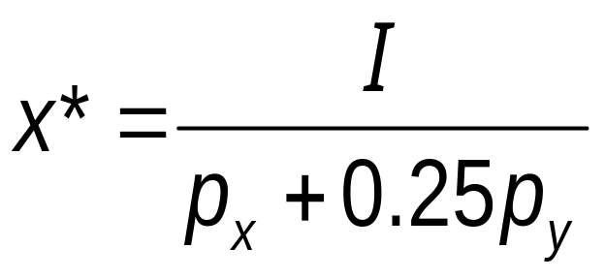
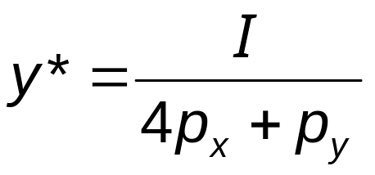
Hence, the optimal choices are

Slide 29
Marshallian Demand Function
It is the mathematical function that tell us the individual’s optimal choice of a good for each combination of income and prices that the individual might face
Examples that we have just seen:
Demand function for good “x” in the example of complements
X*=(α/(α + β ))I/p_{x}
Demand function for good “x” in the example of Cobb Douglas utility function

Slide 30
Indirect Utility Function
The indirect utility function: V(p_{x},p_{y},I) tell us which is the maximum utility that the individual will obtain if he has income I and prices p_{x} and p_{y.}
How do we obtain it? The usual way is to substitute the marshallian demand function in the utility function
This is because the maximum utility is obtained consuming the result of the demand function because the demand functions are the optimal choices (the one that max utility)

Slide 31
Indirect Utility Function
We can use the optimal values of the x* and y* (demand functions) to find the indirect utility function
maximum utility = U(x*,y*)
Substituting for each x* and y* , we get
maximum utility = V(p_{x},p_{y},I)
The optimal level of utility will depend directly on prices and income
  if either prices or income were to change, the maximum possible utility will change

Slide 32
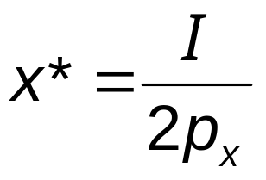
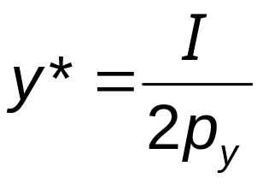
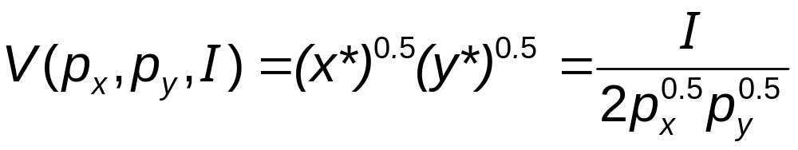
Example: Indirect Utility with Cobb Douglas
If the utility function is Cobb-Douglas with α = β = 0.5, we know that
So the indirect utility function is

Slide 33
Economic policy: taxing specific goods or taxing general purchasing power?
The government asks for your advice: is it best to tax income or specific goods?
The answer to this question is called the lump sum principle

Slide 34
The Lump Sum Principle
For the same amount of taxes collected, taxes on an individual’s general purchasing power are superior to taxes on a specific good
  an income tax allows the individual to decide freely how to allocate remaining income
  a tax on a specific good will reduce an individual’s purchasing power and distort his choices
  Study the graph in pg. 107 in the book. Be sure that you understand footnote 8 !!

Slide 35
Indirect Utility and the
Lump Sum Principle
If the utility function is Cobb-Douglas with α = β = 0.5, we know that
So the indirect utility function is

Slide 36
Indirect Utility and the
Lump Sum Principle
p_{x}=1, p_{y}=4, I=8. Indirect utility V=2
If a tax of £1 was imposed on good x
  the individual will purchase x*=2
  indirect utility will fall from 2 to 1.41
An equal-revenue tax will reduce income to £6
  indirect utility will fall from 2 to 1.5

Slide 37
Qualifying the Lump Sum Principle
In the above discussion, we have assumed that individuals will work the same independently of the income tax
If individuals work less because income tax is higher, it might be preferable to tax some goods rather than increasing income tax…
To study this, we need a more complicated model where individuals also choose how much to work, hence, their income

Slide 38
Expenditure Minimization
Another way of studying consumer’s optimal choices
Minimize expenditure subject to obtain a given level of utility
  Optimal bundle of goods: the one that minimizes the required expenditure to achieve a given level of utility
  this means that the goal and the constraint have been reversed

Slide 39
Expenditure Minimization
Point A is the solution to the dual problem
Expenditure level E₂ provides just enough to reach U₁
Quantity of y
Expenditure level E₃ will allow the
individual to reach U₁ but is not the
minimal expenditure required to do so
A
Expenditure level E₁ is too small to achieve U₁
U₁
Quantity of x

Slide 40
Expenditure Function
The expenditure function shows the minimal expenditures necessary to achieve a given utility level for a particular set of prices
minimal expenditures = E(p_{x},p_{y,}U)
The expenditure function and the indirect utility function are inversely related
  both depend on market prices but involve different constraints

Slide 41
Expenditure Minimization
The individual’s problem is to choose x,y, to minimize
total expenditures = E = p_{x}x + p_{y}y
subject to the constraint
utility = U₁ = U(x,y)
The optimal amounts of x,y will depend on the prices of the goods and the required utility level

Slide 42
Equivalence
Solve the standard problem with prices p_{x}, p_{y}, and I: MAX utility subject to budget constraint. Say that the optimal utility is U₁
If we solve the Min Expenditure, subject to achieving utility U₁
Then, the optimal bundles of goods are the same in both problems, and the optimal expenditure in the second problem is I
See this with the graph…

Slide 43
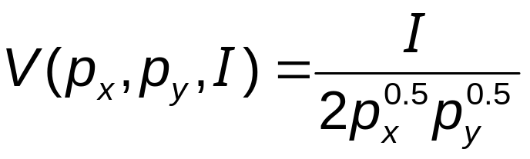
Example: Expenditure Functions 1
The indirect utility function in the two-good, Cobb-Douglas case is
If we interchange the role of utility and income (expenditure), we will have the expenditure function
E(p_{x},p_{y},U) = 2p_{x}^{0.5}p_{y}^{0.5}U

Slide 44
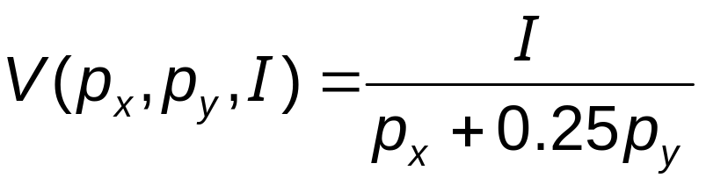
Example: Expenditure Functions 2
For the fixed-proportions case, the indirect utility function is
If we again switch the role of utility and expenditures, we will have the expenditure function
E(p_{x},p_{y},U) = (p_{x} + 0.25p_{y})U

Slide 45
Properties of Expenditure Functions
Homogeneity
  a doubling of all prices will precisely double the value of required expenditures
    homogeneous of degree one
Nondecreasing in prices
  ∂E/∂p_{i} ≥ 0 for every good, i
Concave in prices

Slide 46
Concavity of Expenditure Function
At p*_{x}, the person spends E(p*_{x},…)
If he continues to buy the same set of goods as p*_{x} changes, his expenditure function would be E^{pseudo}
E(p_{x},…)
E^{pseudo}
E(p_{x},…)
E(p*_{x},…)
Since his consumption pattern will likely change, actual expenditures will be less than E^{pseudo} such as E(p_{x},…)
p*_{x}
p₁

Slide 47
Important Points to Note:
Consumer’s optimal choice:
  spend all available income
  choose a commodity bundle such that the MRS between any two goods is equal to the ratio of the goods’ prices (if MRS is strictly decreasing, there are no kinks and no corner solutions)
  This is called the tangency condition

Slide 48
Important Points to Note:
The individual’s optimal choices implicitly depend on the parameters of his budget constraint
  choices observed will be implicit functions of prices and income
  utility will also be an indirect function of prices and income

Slide 49
Important Points to Note:
The dual problem to the constrained utility-maximization problem is to minimize the expenditure required to reach a given utility target
  yields the same optimal solution as the primary problem
  leads to expenditure functions in which spending is a function of the utility target and prices

