Slide 1
Inventory Management System Project
Presented by Matthew Cameron
Notes:
Introduce the presentation and yourself.

Slide 2
Approaching the project
Understanding the scope and objective
Project management tools (Jira)
Acceptance criteria
Getting started

Slide 3
Risk Assessment
Risk | Likelihood | Severity | Plan
Personal computer breakdown | Unlikely | Very severe | Don’t drink unsealed beverages in close proximity to PC
Internet connection downtime | Likely | Not very severe | Make sure mobile data is plentiful
Personal health during a pandemic | Unlikely | Severe | Minimise contact with large groups of people.
Power outage during coding | Likely | Severe | Backup code frequently
Notes:
Just go through the process of determining the risks briefly and the table.

Slide 4
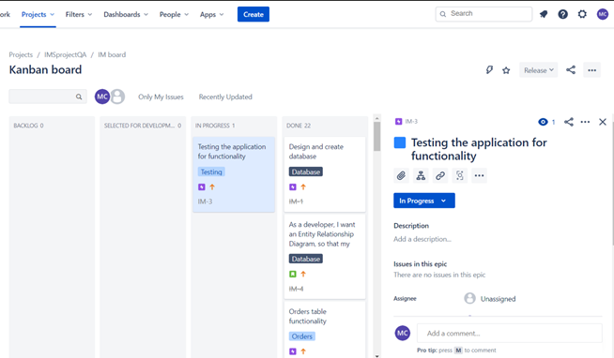
Jira & Kanban
Acceptance criteria.
Prioritising user stories.
Notes:
Talk about the user stories and epics and acceptance criteria. Also mention how I prioritised user stories by getting a general idea of the project as a whole and completed tasks based on difficulty. Explain prioritisation via MosCow method.

Slide 5
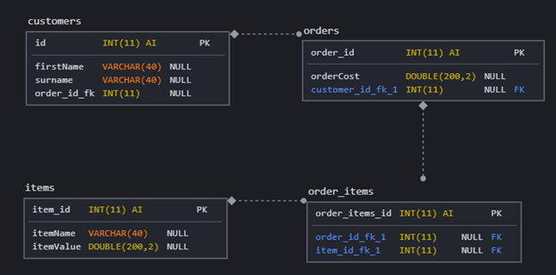
Database Design
Customers to orders is a zero or one relationship.
Orders to order_items is also a one-to-many.
Order_items to items is also a one-to-many.
Notes:
Talk about the relationship between entities and how the relationship between customers and orders is optional instead of a mandatory. The other two relationships are one-to-many.

Slide 6
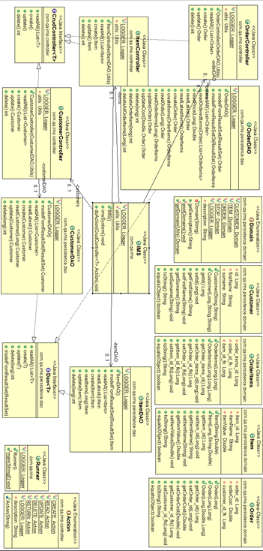
UML Class Diagram

Slide 7
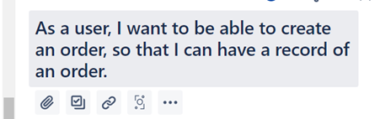
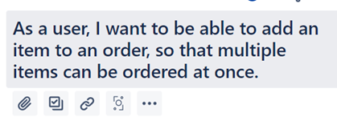
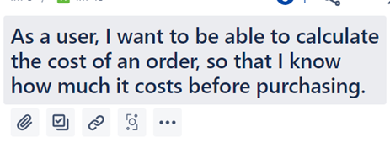
Code Demonstration
Some user stories to run through.

Slide 8
Version Control & CI
How did I approach version control?
How did I approach continuous integration?
How to approach next time.
Notes:
How I used version control correctly and how I didn’t continuously integrate but explain how I should have.

Slide 9
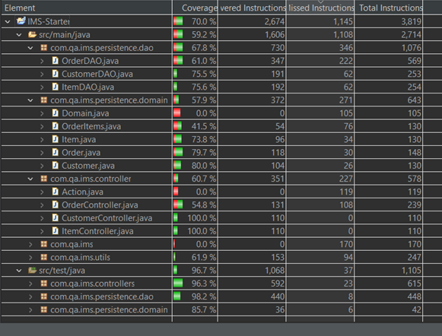
Testing
Notes:
Explain why I didn’t manage to get to the full 80% required testing percentage and what I will do in the future to prevent.

Slide 10
Reflection
Improve formatting
Include customers name on orders
Better use of version control to continuously integrate my working features.
Regularly review progress

