Slide 1

The New Ham’s Guide to Repeaters

Slide 2

What Is A Repeater?

Slide 3
What Is A Repeater?
A repeater is a device which will receive a signal on one frequency and simultaneously transmit it on another frequency.

Slide 4
All Repeaters Are not
Voice Repeaters

Slide 5
Types of Repeaters
FM Voice – Very common.
ATV – Amateur Television.
AM and SSB - Not very common.
Digipeaters – Primarily used for packet communications.
Multi-channel (wideband) – Amateur satellites.

Slide 6
Most hams are familiar with FM voice repeaters.
They are the most popular repeater used in Amateur Radio.
These repeaters are commonly found on 29, 144, 222 or 440 MHz bands.
Though not as popular, there are FM repeaters on the 6m amateur band.

Slide 7
When we use the term repeater we are almost always talking about transmitters and receivers on VHF or higher bands, where radio-wave propagation is normally line of sight.

Slide 8
Why Do We Use Repeaters?

Slide 9
Greater Range
A repeater’s expanded coverage greatly enhances the ability to communicate with mobile stations and hams using hand held transceivers.

Slide 10
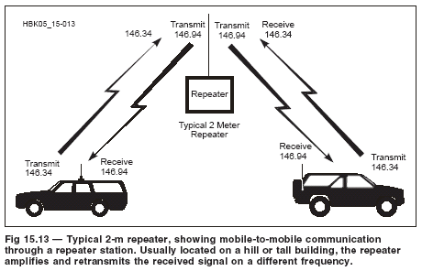

Slide 11
Location, Location, Location
Repeaters are often located on high ground or tall towers that offer greater coverage than that offered by simplex operation.

Slide 12
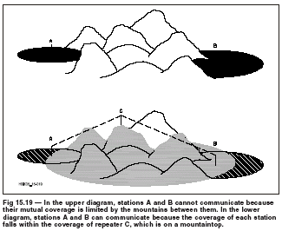

Slide 13
Using A Repeater

Slide 14
Using a repeater is not much different than making any other two way contact.

Slide 15
Simplex and Duplex
When two stations contact each other using the same frequency for both transmit and receive, they are said to be operating simplex.

Slide 16
Simplex and Duplex
Duplex operation is where one station transmits on frequency A and receives on frequency B and the other station transmits on frequency B and receives on frequency A.

Slide 17
Simplex and Duplex
Full duplex is when both stations can transmit and receive signals simultaneously.
A repeater operates in full duplex mode.

Slide 18
Simplex and Duplex
Because users of a repeater cannot transmit and receive simultaneously, the stations are actually operating in half duplex mode.

Slide 19
When making a contact through a repeater it is important to make sure that you are on the correct pair of frequencies.

Slide 20
Input and Output
The frequency that a repeater receives is the input frequency.
This is the frequency that your station will be transmitting on.

Slide 21
Input and Output
The frequency that a repeater transmits on is the output frequency.
This is the frequency that your station will be receiving.

Slide 22
Input and Output
Repeaters are commonly referred to by their transmit frequency. This is the receive frequency displayed on your radio.

Slide 23
Input and Output
Your radio should display your receive frequency (the repeater’s transmit frequency) when monitoring the repeater.

Slide 24
Offset
The difference between the repeater’s output frequency and input frequency is known as the offset.

Slide 25
Offset
Most repeaters use a standard offset.

Slide 26
Standard Frequency
Offsets for Repeaters
Band Offset
29 MHz 100 kHz
52 MHz 1 MHz
144 MHz 600 kHz
222 MHz 1.6 MHz
440 MHz 5 MHz
902 MHz 12 MHz
1240 MHz 12 MHz

Slide 27
Plus or Minus
The offset frequency can either be above or below the repeater’s transmit frequency.
The band plan has taken the guess work out of +/-.

Slide 28
Directory
The ARRL Repeater Directory list thousands of repeaters on the Amateur bands.
Think of it as a phone book for repeaters.

Slide 29
Directory
Among the information listed for each repeater are the callsign, location, TX/RX frequencies and PL tones, if any.

Slide 30
Directory
Travel Plus For Repeaters is a CD-ROM version of the Repeater Directory.
The electronic format allows more information and a lot more features than a book can.

Slide 31
Directory
Travel Plus For Repeaters allows you to find repeaters along a planned route.

Slide 32
Directory
Travel Plus For Repeaters also works with most radio programming software to program your radio’s memories with the proper repeater information.

Slide 33
Making Contact
Listen first.
Then listen again
If the repeater is not busy then make your call.

Slide 34
Making Contact
If you want to call a particular station then press your mic button and say the station’s call and then your call
“W1ABC this is K2XYZ”

Slide 35
Making Contact
When you release your mic button you should hear the repeater signal for a second or two often followed by a tone or beep.
This is called the “squelch tail”, “courtesy tone” and “hang time.”

Slide 36
Making Contact
The courtesy tone tells you that the repeater has reset its timer and it is ok to transmit.

Slide 37
Making Contact
If you want put out a general call to any station then press your mic button and announce your call.
“This is W1ABC listening.”
or
“This is W1ABC monitoring.”

Slide 38
Making Contact
If you want to enter a conversation in progress do so when one station ends transmission and before the other station begins transmitting.

Slide 39
Making Contact
Simply key your mic and announce your call during the pause in the ongoing conversation.

Slide 40
Making Contact
Do not use the word BREAK
This is usually reserved for emergencies.

Slide 41
Making Contact
It is proper etiquette to only enter a conversation if you have something constructive to add.

Slide 42
Making Contact
(Or Not)
If the other operators do not recognize your call or if people are not responding to you make sure that all of your settings are correct.

Slide 43
Making Contact
(Or Not)
Especially check your offset and PL tones.

Slide 44
Making Contact
(Or Not)
Before making a rash assumption that the other operators are rude and are ignoring you, have someone else go over your settings with you.

Slide 45
Etiquette
Listen, Listen, Listen and then Listen some more.

Slide 46
Etiquette
Do not KERCHUNK the repeater
This is simply keying the repeater and not saying anything.
Not only is it annoying but it puts undue wear and tear on the equipment.

Slide 47
Etiquette
If you do want to test your equipment and see if all of your settings are correct and you are “getting into the machine” …

Slide 48
Etiquette
… Then give your call and say “testing”
It is good practice not to make a habit of this.

Slide 49
Etiquette
Don’t time it out
Keep your transmissions brief.
Most repeaters have a 3 minute timer to prevent long winded transmissions and to protect the equipment.

Slide 50
Etiquette
Don’t time it out
Wait for the courtesy tone before transmitting. This tells you that the timer has reset itself.
You don’t have to wait for the repeater to “drop” after the courtesy tone.

Slide 51
Etiquette
Jargon
Speak normally when using a repeater.
As with any voice mode it is not proper to use Q signals or lingo.

Slide 52
Have Fun
Repeaters are a great way to stay in touch with local hams and club members.

Slide 53
The Serious Side
Repeaters play a big role during emergencies.
When used for emergencies keep the repeater open for priority communications.

Slide 54
The Serious Side
Repeaters are also used for public service events that you may wish to volunteer to help with.

Slide 55
The Serious Side
Make sure that you have registered with the event coordinator before joining in any type of net or organized communications for an event.

Slide 56
Support
Repeaters are built and maintained at the expense of a club, an individual or a small group of hams.

Slide 57
Support
While not required, it is a nice gesture to support the sponsor of a repeater that you frequently use by joining the club or making a donation.

Slide 58
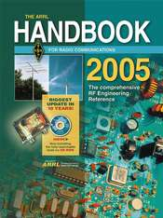
Publications
ARRL Handbook
http://www.arrl.org/catalog/?item=9280

Slide 59
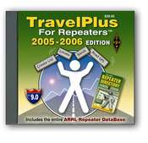
TravelPlus for Repeaters CD-ROM
-- 2005/2006 Edition. Version 9.0

Slide 60
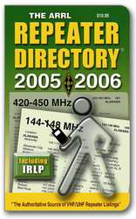
The ARRL Repeater Directory
-- 2005-2006 Edition

Slide 61
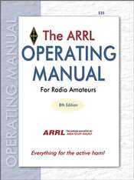
The ARRL Operating Manual for Radio Amateurs
-- Everything for the active ham!

Slide 62
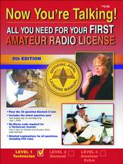
Now You're Talking!--5th Edition
-- All You Need For Your FIRST Amateur Radio License

Slide 63
Contact
Norm Fusaro, W3IZ
ARRL Affiliated Clubs/Mentor
Program Manager
225 Main St. Newington, CT 06111
860-594-0230
w3iz@arrl.org

