Slide 1
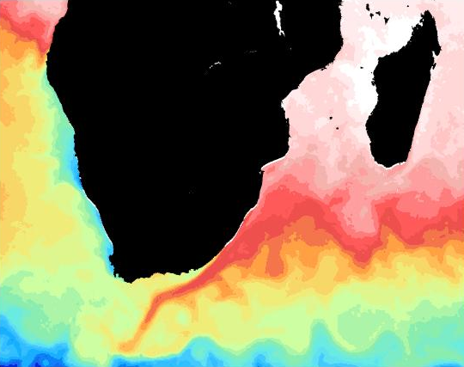


Accessing Sea Surface Temperature data
Brief introduction into the different SST products
Where to get SST data from?
How to download SST data
How to manage large data
downloads

Slide 2





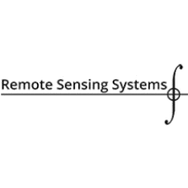
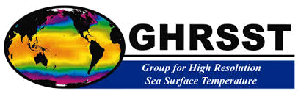
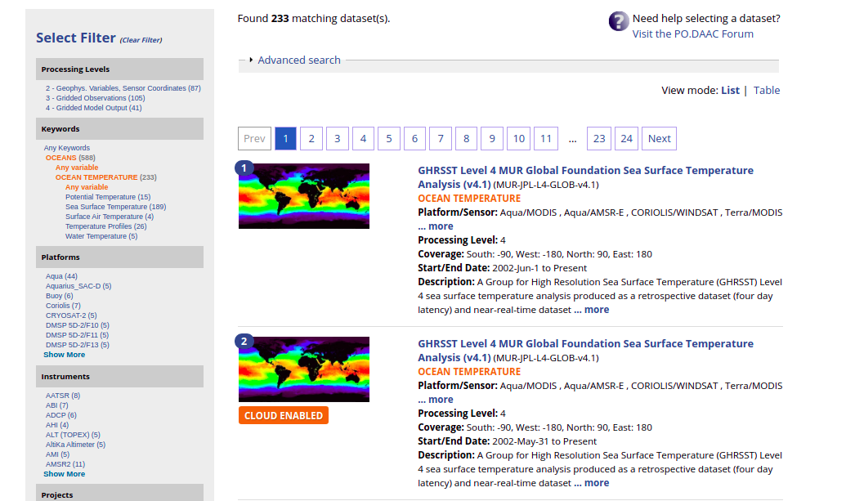
Introduction into remotely sensed SST products
Numerous freely available SST products.
Lots of different website to download data from.
Therefore, it’s essential to know exactly which kind of SST product to download.

Slide 3
The definition of SST
SST is a challenging parameter to define as the upper ocean (~10 m) has a complex and variable vertical temperature structure.
In addition there are large diurnal differences in SST (day vs night).
This is important as the different instruments measure temperature at slightly different depths.
Two very good resources for explain the definition of SST: (https://www.ghrsst.org/ghrsst-data-services/products/ https://podaac.jpl.nasa.gov/forum/viewtopic.php?f=7&t=298)

Slide 4
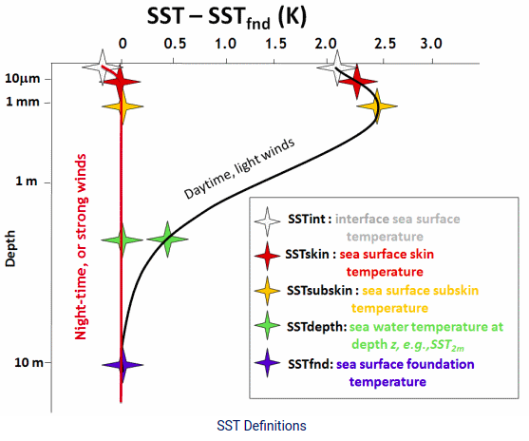
The definition of SST continued
Skin SST (SSTskin): The temperature of the water column at 10-20µm depth. Measured by infrared radiometers. SSTskin experiences large diurnal variation.
Sub-skin SST (SSTsub-skin): The temperature at the base of the thermal skin layer (~1mm). The sub-skin SST is assumed to be equal to the temperature measured by a microwave radiometer although the relationship depend on environmental conditions.
SST at depth: (SSTdepth): All measurement taken below SSTsub-skin (typically in situ observations) and ideally is accompanied with a reference depth z (e.g. SST(5m)/ SST(z)).
Foundation SST (SSTfnd): SSTfnd is defined as the temperature which does not include diurnal variability. SSTfnd can only be observed by in situ observation but satellite observation can be used to infer SSTfnd through various algorithms.

Slide 5
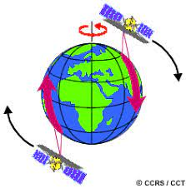
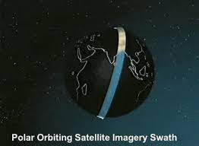
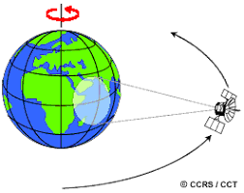
Satellites used to observe SST
Polar orbiting platforms: Polar orbiting satellite provide global coverage with a repeat sampling time of 12 hour to several days depending on the swath size on the instrument onboard.
Geostationary platforms: Geostationary satellites orbit at the exact angular speed as the earth, focusing on a single region on the earth’s surface. The geostationary orbit reduces the spatial coverage as only focus on one region. The sampling interval (temporal resolution) is greatly improved.

Slide 6
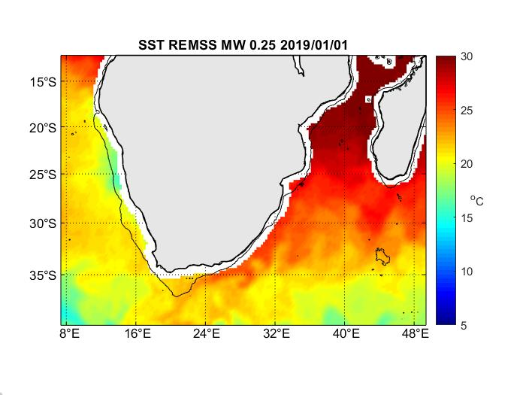
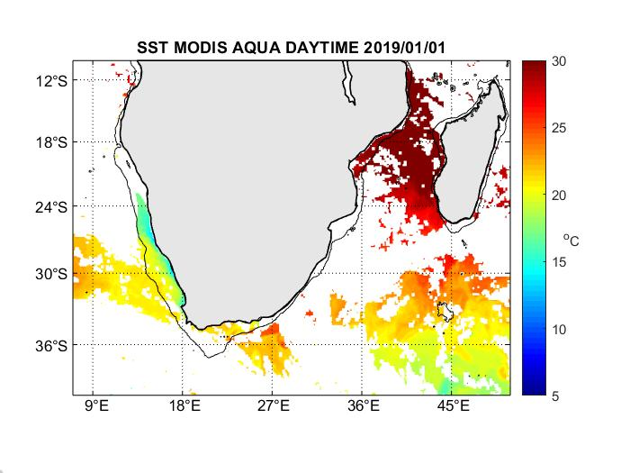
Sensors used to observe SST
Microwave sensors: Microwave radiometers are able to penetrate cloud cover providing SST fields without missing data due to cloud cover . Microwave retrievals are limited to a relatively low spatial resolution of between 25 – 50 km. Microwave sensors are contaminated by the land for regions 50 – 75 km from the coast.
Infrared sensors: Infrared sensors are not able to penetrate cloud cover and, therefore, have missing data points. Infrared sensors are able to produce a much higher resolution (±1km) than microwave retrivals.

Slide 7
Processing of SST data
Level 1: Data products which contain the raw telemetry from the sensors with the appropriate metadata such as geolocation, time and calibration information.
Level 2: Data products with the geophysical variables (SST) derived for the satellite radiances (Level 1 data). Level 2 products that have the same resolutions and geolocation as the Level 1 products.
Level 3: Data products with the derived geophysical variable mapped with a uniform space, time grid. Level 3 products include validation and quality controls before distribution to the data user. Level 3 processing does not usually include interpolation.
Level 3U: Products which are remapped without using overlapping orbits
Level 3C: Products which use data from a single instrument but combines multiple passes/orbits.
Level 3S: Products which combine data from multiple instruments.
Level 4: Data products which combine observations from multiple instruments and platforms in order to produce a gap-free gridded field. Level 4 data products may also include in situ observations. These products are often interpolated in order to produce spatially complete fields.

Slide 8
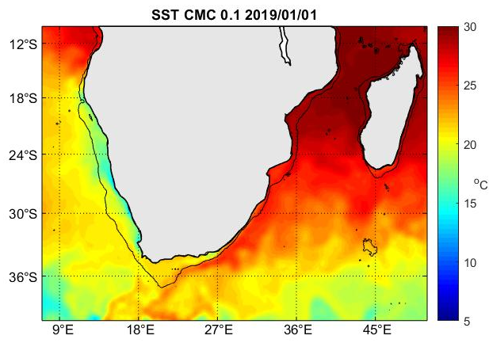
Examples of L3 and L4
Level 3 product
Level 4 product

Slide 9
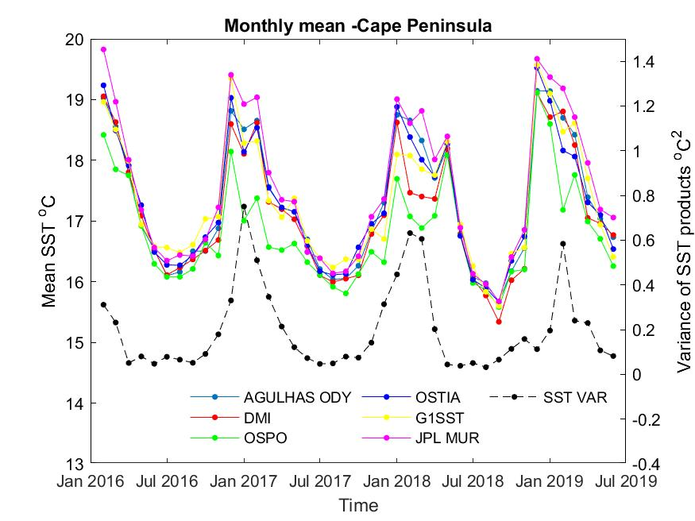
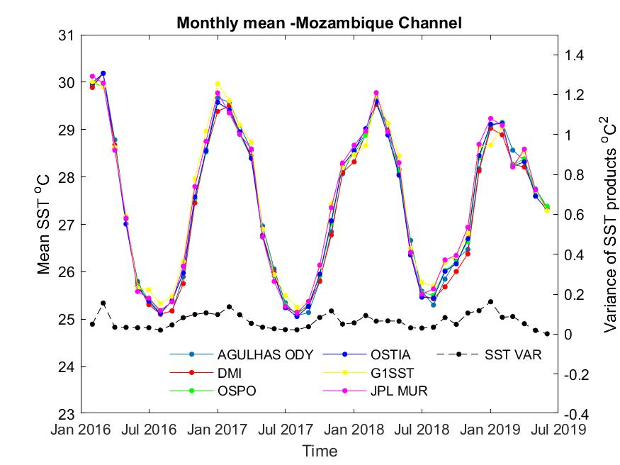
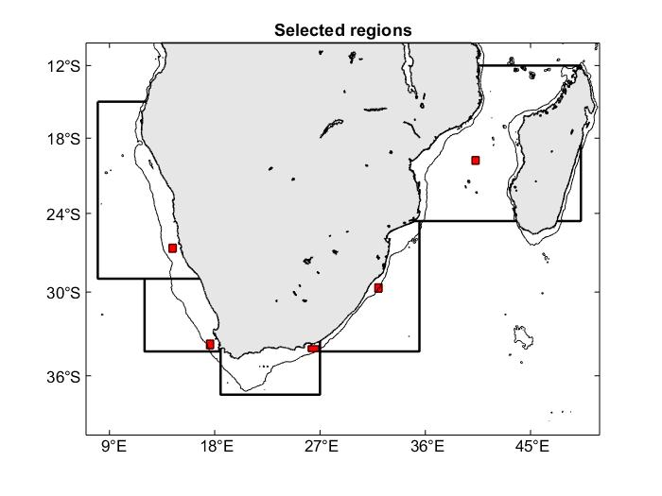
Deciding which SST product to use?
Unfortunately no easy answer
L4 spatial complete, high resolution, but with uncertainties.
L3 missing data, high resolution, less uncertainties
L2 limited spatial resolution, closer to ground truth

Slide 10
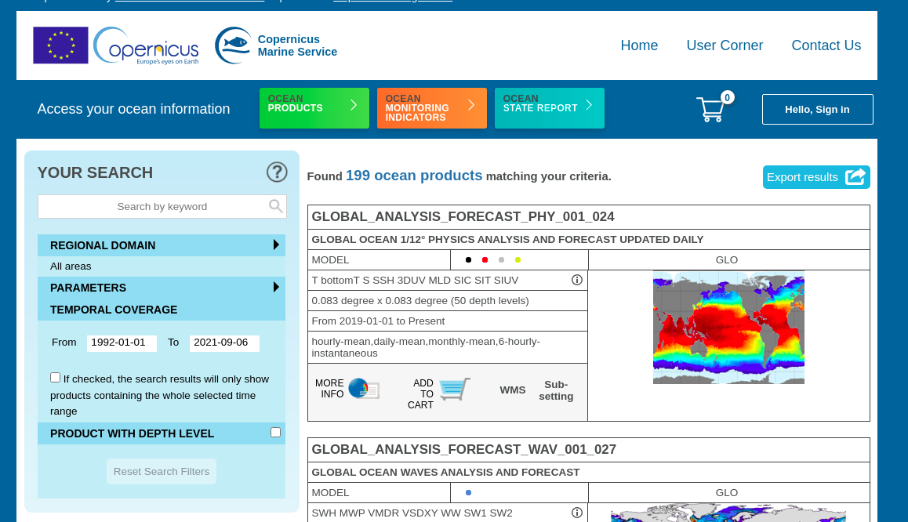
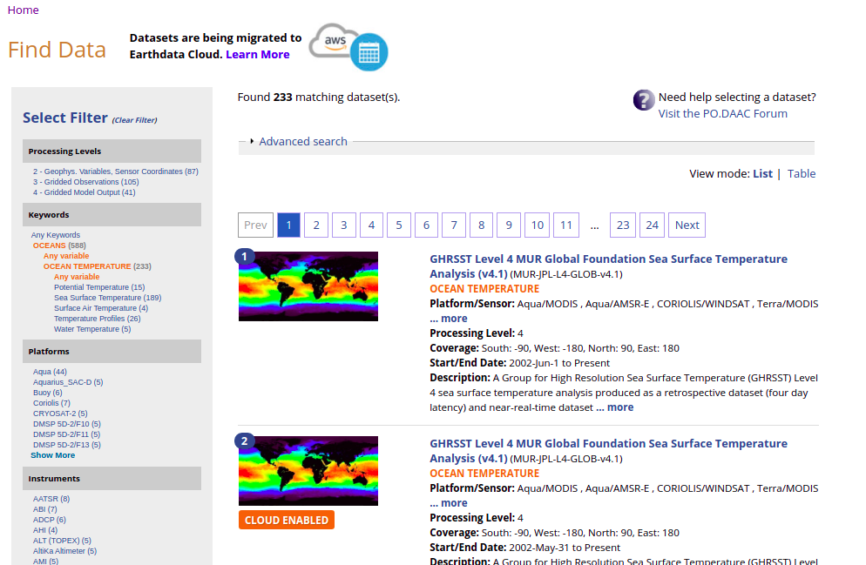
Where to get SST data from?
Copernicus Marine Service https://marine.copernicus.eu/
Physical Oceanography Distribution Active Archive Centre (PODAAC https://podaac.jpl.nasa.gov)
ESA climate office (https://climate.esa.int/en/projects/sea-surface-temperature/)

Slide 11
How to download SST data
Downloading data is simple enough, however, downloading large amounts is more tricky
Main methods of downloading:
Directly from the website
Filezilla (https://filezilla-project.org/ only works for ftp storage)
Python scripts
Always look for the help provided by the website!!!

Slide 12
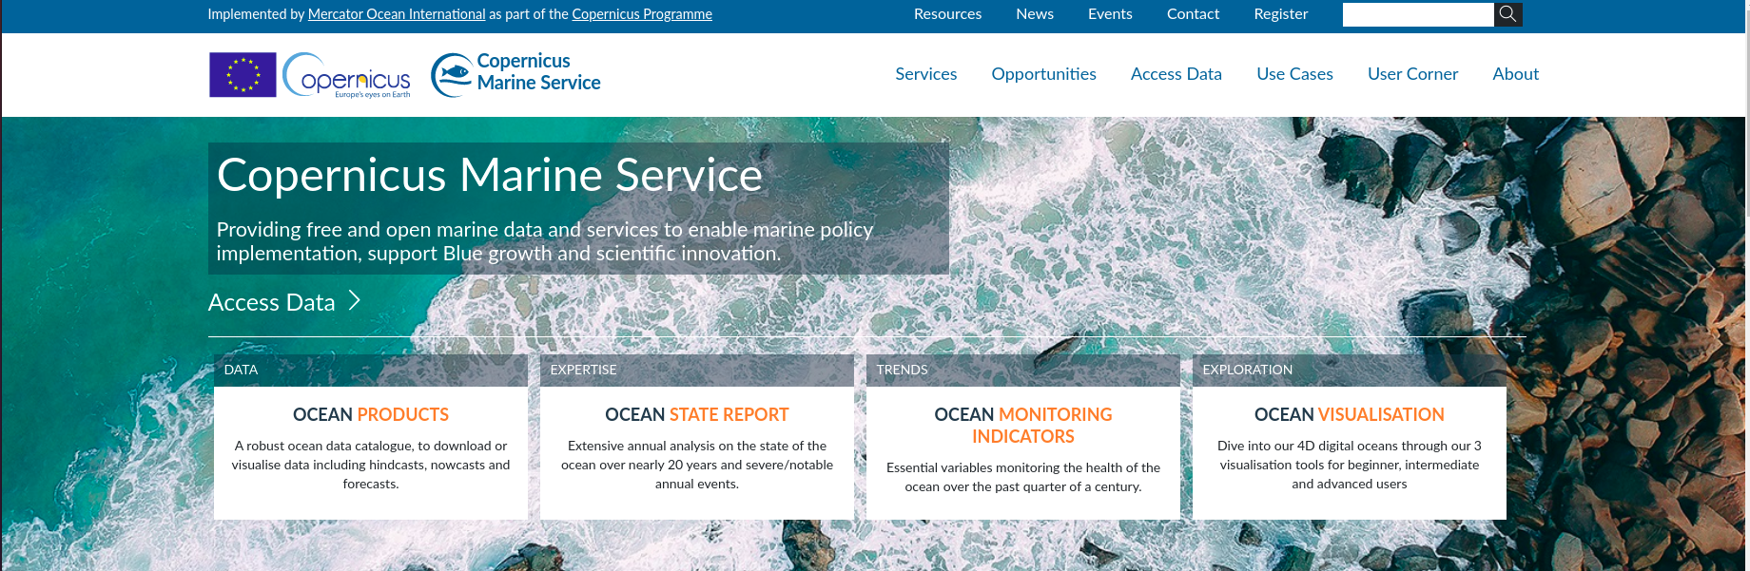
Copernicus Marine Service (https://marine.copernicus.eu/)
CMEMS provides LOTS of online help to download data, please use the online resources provided:https://help.marine.copernicus.eu/en/
Python script to download data (https://github.com/mattcarr03/Automating_downloads/CMEMS_OSTIA_subset.py)

Slide 13
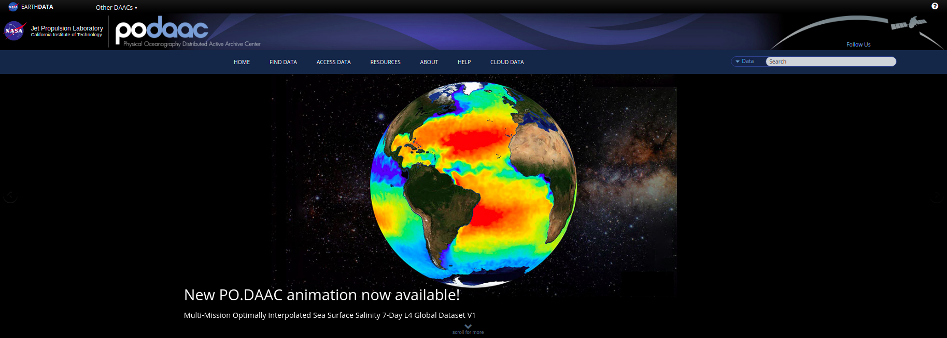
Physical Oceanography Distrubited Active Archive Center (PODAAC) https://podaac.jpl.nasa.gov/
PODAAC provides LOTS of online help to download data, please use the online resources:https://podaac.jpl.nasa.gov/forum/
Automating downloads from PODAAC with python and wget
https://github.com/mattcarr03/Automating_download/ podaac_wget_download.py

Slide 14
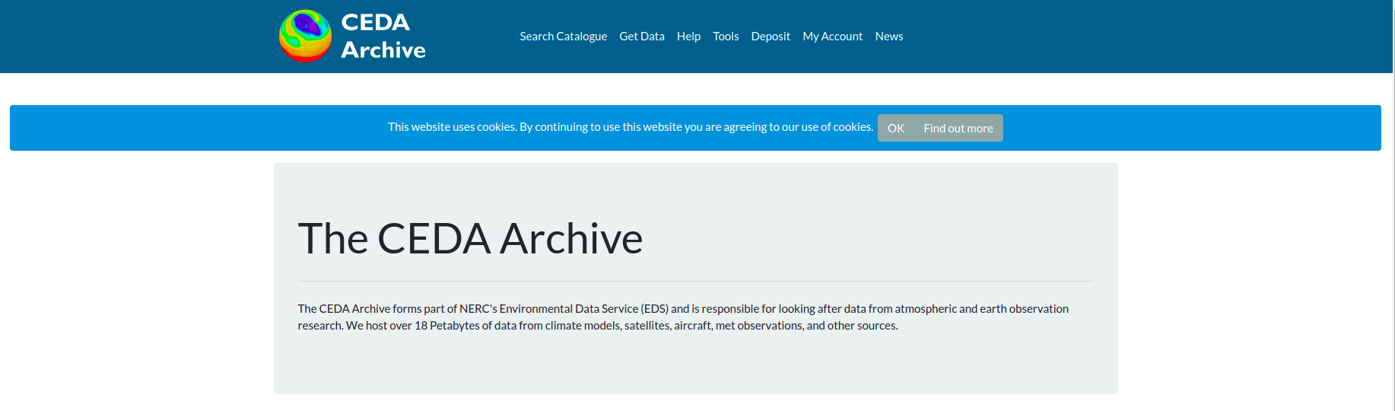
CEDA/ESA the European Space Agency
Automating downloads from PODAAC with python and urllib:
https://github.com/mattcarr03/Automating_downloads/CCI_ESA_download.py

