Slide 1
Hop Data Vault 2.0 Plugin
Model-driven Data Vault and Business Vault on Apache Hop 2.18.1

Slide 2
The problem
Enterprise data warehouses built with hand-written pipelines drift from the model.
Hashing rules change in one pipeline but not another
Satellite CDC logic is copy-pasted across feeds
Business Vault / SCD2 timelines are rebuilt in SQL or dbt without a shared contract
Hybrid teams (Hop + dbt + SQL) cannot share one metadata picture
Result: slower delivery, inconsistent loads, and fragile consumption layers.

Slide 3
The approach
Model once. Generate loads and consumption layers.
Define sources, hubs, links, and satellites in a visual model (.hdv)
Validate structure and types before anything runs
Generate DDL and insert-only load pipelines automatically
Build Business Vault SCD2 tables from satellite history (.hbv)
Run controlled batch updates from workflow actions
The model is the contract — not a diagram that diverges from production.

Slide 4
Raw Data Vault layer
Hubs — core business entities (Customer, Product, Order)
Links — relationships between hubs
Satellites — descriptive history attached to hubs or links
Insert-only loading — new rows only when keys or attributes actually change; every batch shares one load timestamp.
Supports multi-active satellites, link satellites, load end dating, multi-source hubs, and sentinel rows (unknown / invalid).

Slide 5
Business Vault layer
Raw vault stores technical history (when the warehouse loaded a change).
Consumption often needs functional history (when the source says a value was true).
The plugin generates SCD Type 2 Business Vault tables:
valid_from / valid_to (or your column names)
Open-ended sentinels for current rows
Single-satellite or multi-satellite merge (e.g. Customer 360 from four satellites)
Saved as .hbv files, linked to the underlying .hdv model.

Slide 6
Hybrid warehouses
Mode | Meaning
Hop managed | Hop generates DDL and update pipelines (default)
External read-only | Table exists elsewhere (dbt, SQL, another ETL); Hop documents it for BV
Custom pipelines | Hop orchestrates your own .hpl files
Not every raw vault table must be Hop-loaded.
Integration modes per hub, link, or satellite:

Slide 7
Business Vault generation reads metadata (table layout, hash keys, attributes) — not Hop-generated DV pipelines. External tables participate fully in BV and catalog publish.

Slide 8
Model-driven operations
Operation | Purpose
Check model | Catch broken references and type mismatches early
Generate DDL | Preview CREATE/ALTER for the vault database
Debug | Open generated pipelines for inspection
Data Vault Update | Full raw vault batch load from a workflow
Business Vault Update | Rebuild BV tables from satellite history

Slide 9
Same validation engine in the GUI and in workflow actions.

Slide 10
Data catalog and lineage
Sources live in the Hop data catalog (record definitions, field layouts, groups)
Optional publish of target table layouts after DV or BV updates
Foundation for downstream dimensional modeling and lineage (Marquez / OpenLineage planned)
Catalog + model = shared vocabulary between ingestion, vault, and consumption teams.

Slide 11
AI advisory (optional accelerator)
AI Help on the DV model toolbar:
Analyze catalog sources and suggest hubs, links, satellites
Propose layout and type mappings with review-before-apply
Troubleshoot validation and integration errors
Requires a configured LLM in Hop GUI → Configuration → AI Assistant. Human modelers remain in control.

Slide 12
Quality and repeatability
The sample project/ includes:
Golden-dataset unit tests per suite
Docker-based test runner (PostgreSQL, MySQL, SingleStore)
Metrics JSON per Data Vault / Business Vault update run
Orchestrated workflow covering basic vault, multi-active, link satellite, load end date, status tracking, multi-source hub, and multi-satellite Business Vault (Customer 360)
CI-friendly: fail fast on model checks or DDL drift.

Slide 13
Architecture (logical)
Sources (catalog / CRM) │ ▼ Raw Data Vault (.hdv) hubs · links · satellites │ ├── Hop-managed loads ├── External read-only tables └── Custom .hpl orchestration │ ▼ Business Vault (.hbv) SCD2 · PIT · future bridges │ ▼ Dimensional / marts (roadmap)
One metadata chain from staging to consumption.

Slide 14
Who benefits
Role | Value
Architects | Governed hashing, naming, and load patterns; hybrid warehouse support
Modelers | Visual design, generated pipelines, BV without hand-written SQL
Operations | Workflow-driven batches, parallel execution, metrics, validation gates
Analytics / BI | Functional SCD2 timelines and standardized BV column names

Slide 15
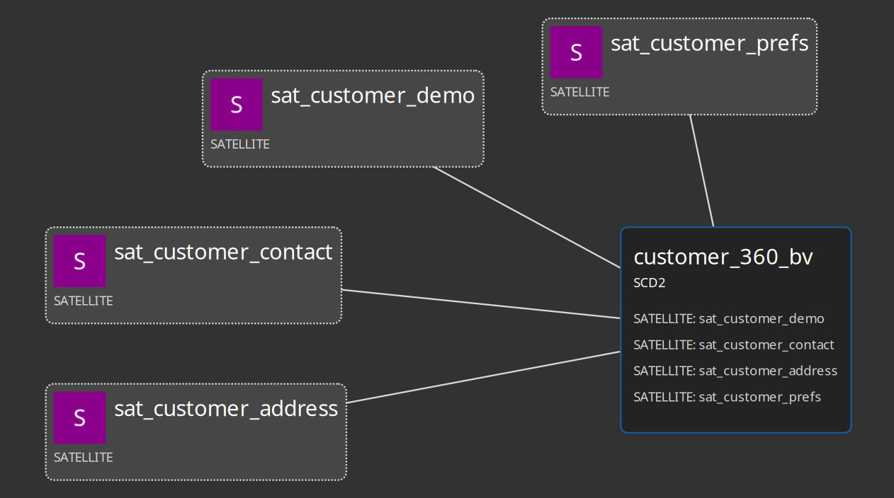
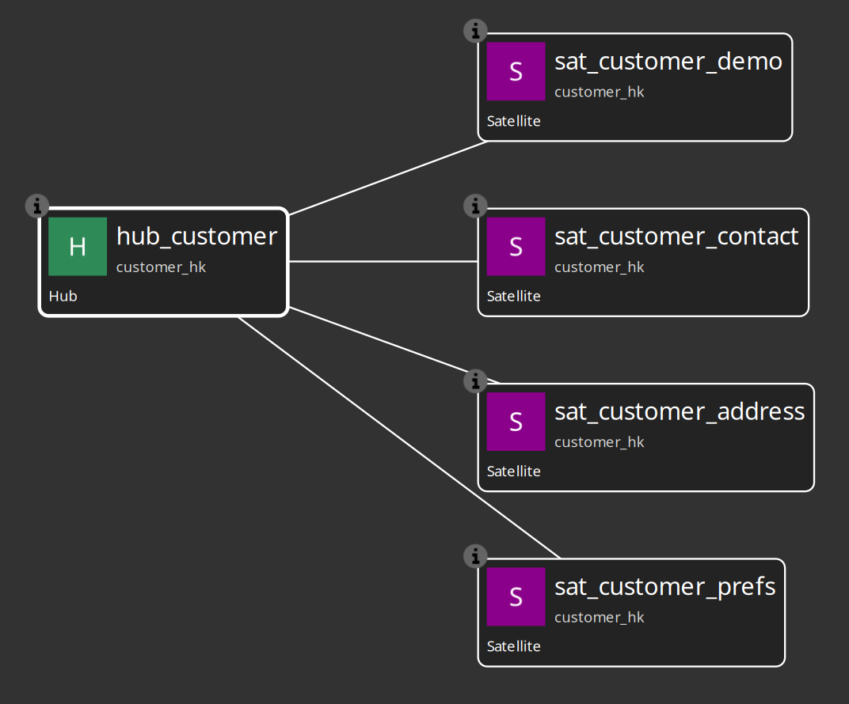
Sample project highlights
Under project/tests/:
vault1 — classic hub / link / satellite
customer-phone — multi-active satellite
customer-360 — four satellites merged into one BV SCD2 table
customer-360-external — same BV model with external read-only DV satellites
Runnable via project/run-tests.sh or Hop GUI with the hop-data-vault project open.
Customer 360 Data Vault model
Customer 360 Business Vault model

Slide 16
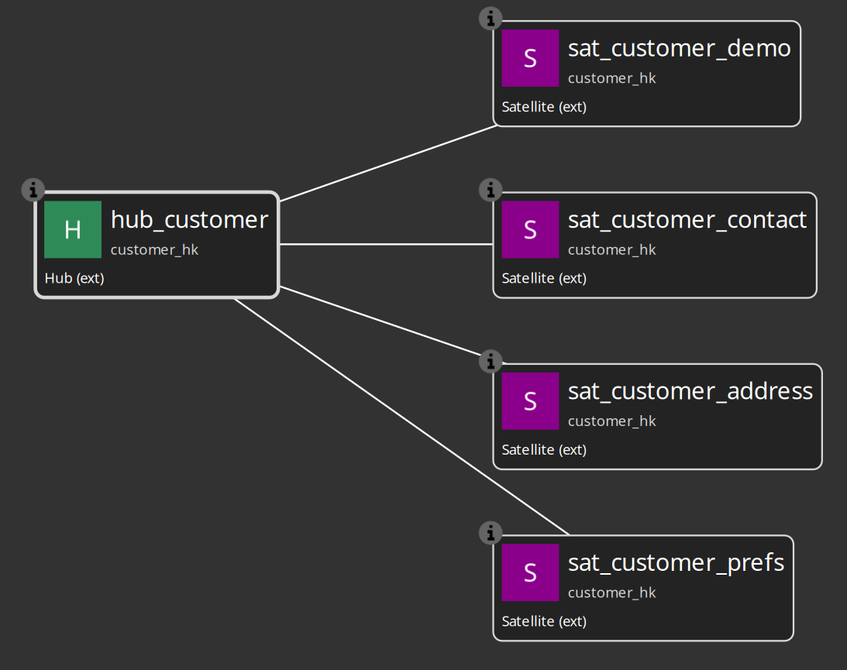
Integration modes (when to use which)
Hop managed — greenfield vault tables owned by Hop; full DDL + pipeline generation.
External read-only — dbt or another tool loads the raw vault; Hop models structure for BV, checks, and catalog. Canvas shows (ext).
Custom pipelines — you maintain .hpl loaders; Hop runs them in the same orchestrator as generated pipelines. Canvas shows (custom).
Choose per table — mixed models are supported.
External read-only satellites

Slide 17
Maturity and roadmap
Available today
Raw DV modeling and loading
Business Vault SCD2 (single and multi-satellite)
PIT table type in BV model
External / custom integration modes
AI advisory
Planned
Dimensional modeler (Kimball-style from DV/BV metadata)
Business Vault field dictionary (naming / typing rules)
Marquez / OpenLineage lineage export

Slide 18
Getting started
Audience | Start here
Modelers | docs/getting-started-modeler.adoc
Implementers | README.md and project/PROJECT.md
Reference | docs/README.md — full doc index

Slide 19
Open the project/ folder as Hop project hop-data-vault, configure CRM and Vault connections, install plugin 0.0.14-SNAPSHOT, and run tests/run-tests.hwf.

Slide 20
Summary
The Hop Data Vault plugin turns Data Vault 2.0 from a pile of pipelines into a governed, model-driven platform:
Raw vault loads generated from .hdv
Business vault SCD2 from .hbv
External tables welcomed, not blocked
Validation before execution
Sample project proves it end-to-end
Model the warehouse. Let Hop generate the mechanics.

