Slide 1
Regional expansion options
Working draft for internal review

Slide 2
Volume outlook supports a second line
Committed volume fills the current line
Spot demand is turned away every month
Two anchor customers asked for capacity
Competitor lead times keep lengthening
Key takeaway
Demand evidence supports the expansion case
Meridian Advisory | synthetic corpus
02

Slide 3
Site shortlist narrows to two regions
Northern site has the stronger labor pool
Training partner is already on site
Southern site has the cheaper energy
Grid interconnect is pre-approved
Side note
Late addition, pasted in
Key takeaway
Both sites clear the hurdle rate; labor risk separates them
Meridian Advisory | synthetic corpus
03

Slide 4
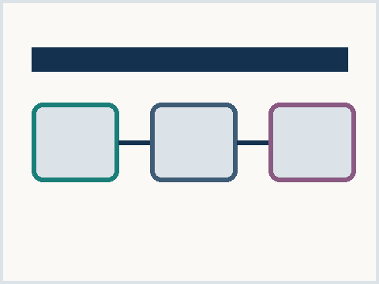
Lease the shell or build to suit
Lease shell
Occupancy in two quarters
Landlord controls expansion
Lower upfront cash
Build to suit
Occupancy in six quarters
Full layout control
Higher upfront cash
Exhibit 1 - site options, synthetic
Meridian Advisory | synthetic corpus
04

Slide 5
Thank you
Contact
Meridian Advisory
expansion team, synthetic
meridian.example
Meridian Advisory | synthetic corpus
Draft - not for distribution
05

