Slide 1
Meridian market entry review
Prepared for the executive committee

Slide 2
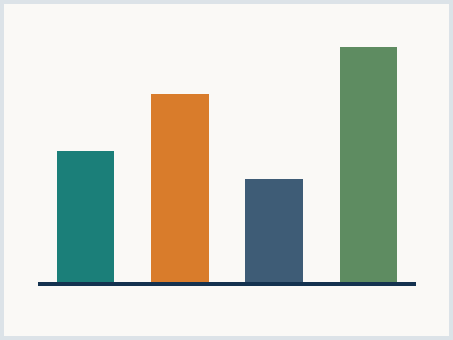
Agenda for the working session
Where the market stands today
Entry routes on the shortlist
Investment ask and phasing
Decision points for this committee
Next steps and owners
Exhibit 1 - category growth, synthetic
Meridian Advisory | synthetic corpus
02

Slide 3
Where the market stands
SECTION 01

Slide 4
Demand is recovering faster than supply
Category demand grew nine percent this year
Premium tier carried most of the growth
Entry tier stayed flat for four quarters
Supply additions lag by roughly two years
Two announced plants slipped to next cycle
Permitting drove both slips
Pricing held firm across all regions
Key takeaway
A two year demand-supply gap keeps pricing attractive for a new entrant
Meridian Advisory | synthetic corpus
04

Slide 5
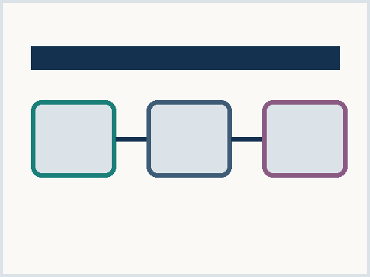
Two entry routes lead the shortlist
Build
Full control of the asset
Slowest route to first revenue
Highest capital at risk
Partner
Shared economics with incumbent
Fastest route to first revenue
Limited influence on roadmap
Exhibit 2 - route comparison, synthetic
Meridian Advisory | synthetic corpus
05

Slide 6
Thank you
Contact
Meridian Advisory
strategy team, synthetic corpus
meridian.example
Meridian Advisory | synthetic corpus
06

