Slide 1
Operating model diagnostic
Readout for the transformation office

Slide 2
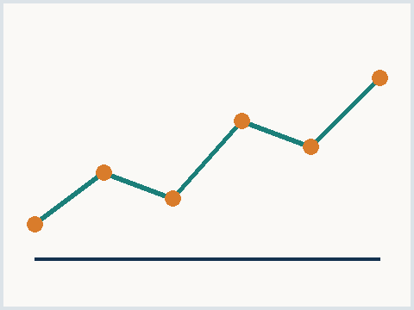
What we will cover today
Diagnostic scope and method
Findings across the four functions
Cost and service level trade-offs
Recommended sequence of moves
Exhibit 1 - service trend, synthetic
Meridian Advisory | synthetic corpus
02

Slide 3
Handoffs between functions drive most delay
Order journey crosses five functional lines
Each handoff adds queue time
No single owner tracks the full journey
Rework concentrates in two steps
Both steps rely on manual re-entry
Automation covers under a third of volume
Key takeaway
Collapsing two handoffs removes roughly half of the end to end delay
Meridian Advisory | synthetic corpus
03

Slide 4
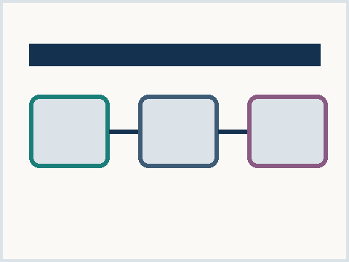
Centralize or federate the shared services
Centralize
One global process owner
Deepest scale economics
Longer change program
Federate
Regional autonomy preserved
Faster local adoption
Duplicated tooling remains
Exhibit 2 - model options, synthetic
Meridian Advisory | synthetic corpus
04

Slide 5
Recommended sequence
SECTION 03

Slide 6
Thank you
Contact
Meridian Advisory
operations practice, synthetic
meridian.example
Meridian Advisory | synthetic corpus
06

