Slide 1
Pricing program update
Monthly steering committee readout

Slide 2
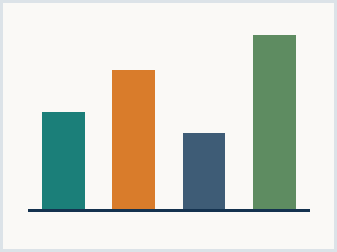
Program status at a glance
Wave one results against target
Wave two pilot readiness
Risks and mitigations
Asks of the steering committee
Exhibit 1 - realized uplift, synthetic
Meridian Advisory | synthetic corpus
02

Slide 3
Wave one delivered above the uplift target
Realized uplift reached the top of the range
List price moves landed with low churn
Discount discipline held in both regions
Win rates stayed inside the guardrail
Two accounts required manual exceptions
Key takeaway
Wave one economics validate the playbook for the next two waves
Meridian Advisory | synthetic corpus
03

Slide 4
Wave two pilots start in two markets
Pilot markets chosen for contract mix
Renewal-heavy book in the first market
New-logo-heavy book in the second
Playbook adapted for channel partners
Partner margin floor stays unchanged
Key takeaway
Pilot design isolates the two contract archetypes before full rollout
Meridian Advisory | synthetic corpus
04

Slide 5
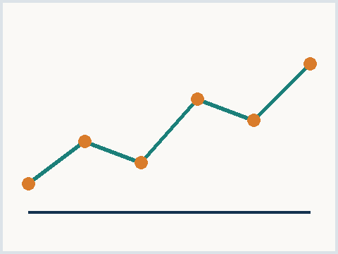
Escalate or hold the exception policy
Hold policy
Preserves price integrity
Risks two flagship renewals
Simple to communicate
Escalate
Retains the flagship logos
Signals flexibility to the field
Requires deal desk review
Exhibit 2 - exception volume, synthetic
Meridian Advisory | synthetic corpus
05

