Slide 1
Supply chain resilience assessment
Findings and countermeasure options

Slide 2
Exposure by tier
SECTION 02

Slide 3
Tier two concentration is the binding risk
Three inputs share a single tier two source
All three sit in one coastal cluster
Qualified alternates exist for one input
Qualification lead time is nine months
Inventory covers six weeks of disruption
Key takeaway
Dual-sourcing the two unqualified inputs closes most of the exposure
Meridian Advisory | synthetic corpus
03

Slide 4
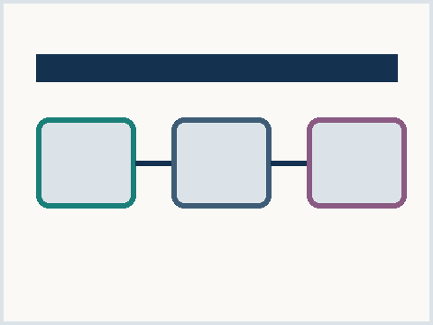
Buffer stock versus dual sourcing
Buffer stock
Live within one quarter
Ties up working capital
Decays as demand shifts
Dual source
Nine month qualification
Durable structural fix
Small unit cost premium
Exhibit 1 - option economics, synthetic
Meridian Advisory | synthetic corpus
04

Slide 5
Thank you
Contact
Meridian Advisory
supply chain practice, synthetic
meridian.example
Meridian Advisory | synthetic corpus
05

