Slide 1
Digital roadmap briefing
Quarterly portfolio review

Slide 2
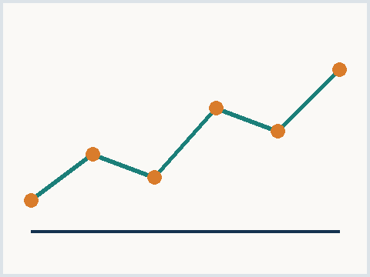
Portfolio review agenda
Delivery status by initiative
Budget consumption against plan
Re-prioritization proposals
Decisions requested today
Exhibit 1 - delivery velocity, synthetic
Meridian Advisory | synthetic corpus
02

Slide 3
Two initiatives need a scope decision
Customer portal is ahead of schedule
Second release can pull forward
Data platform burn exceeds plan
Scope grew after the pilot feedback
Storage costs doubled the estimate
Field app awaits the platform decision
Key takeaway
Trimming platform scope funds the portal pull-forward inside the same envelope
Meridian Advisory | synthetic corpus
03

Slide 4
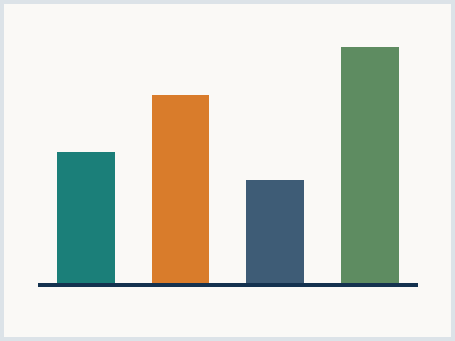
Trim scope or extend the timeline
Trim scope
Holds the budget envelope
Defers two data domains
Keeps the release date
Extend timeline
Delivers the full scope
Adds two quarters of burn
Delays dependent projects
Exhibit 2 - scope options, synthetic
Meridian Advisory | synthetic corpus
04

Slide 5
Decisions requested
SECTION 04

