Slide 1

Wood Flooring

Slide 2
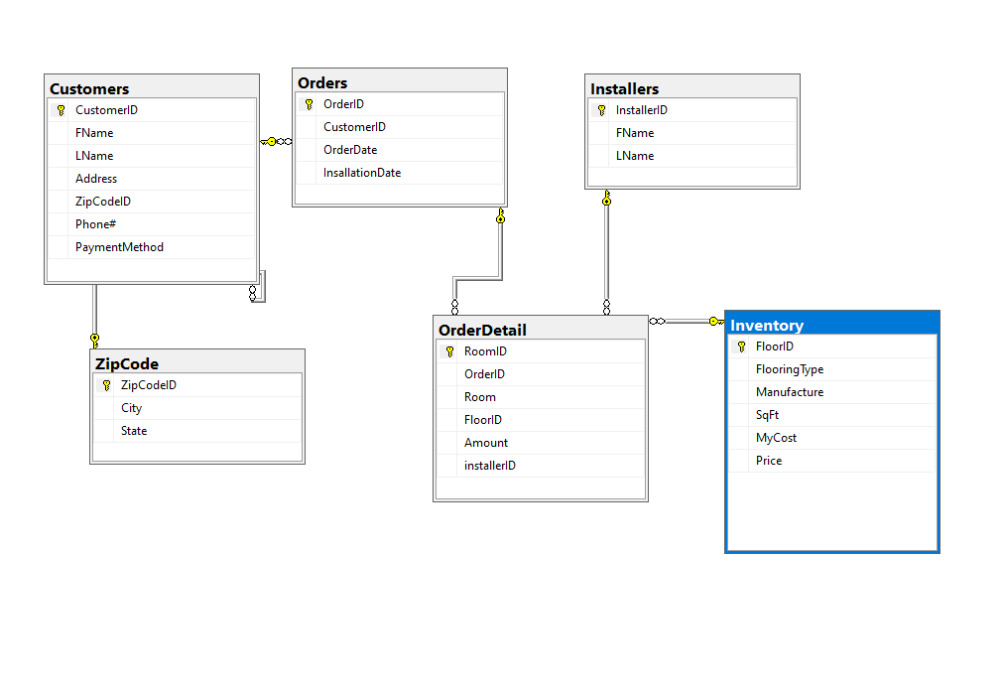
Database Diagram

Slide 3
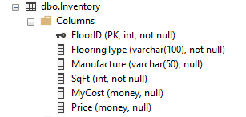
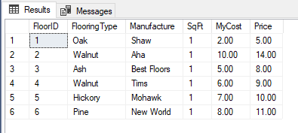
Inventory Table

Slide 4
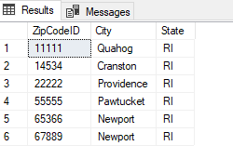

Zipcode table

Slide 5
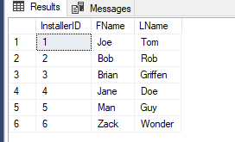

Installers Table

Slide 6
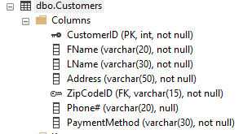
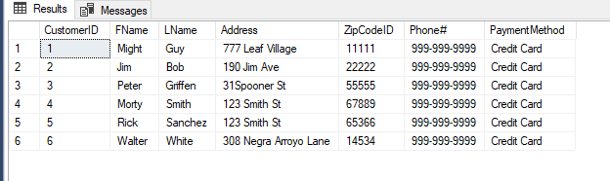
Customers table

Slide 7
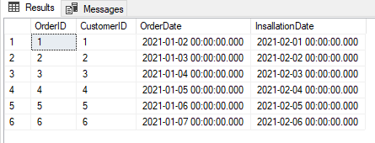
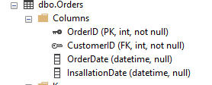
Orders table

Slide 8
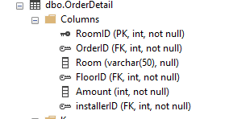
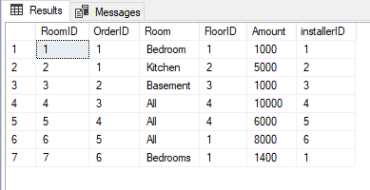
Order detail table

Slide 9


Summary Query #1
Min and Max Price Per Item

Slide 10
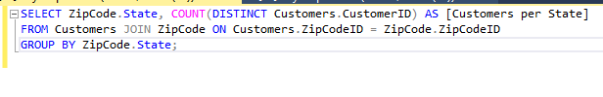

Summary Query #
Customers Per State

Slide 11
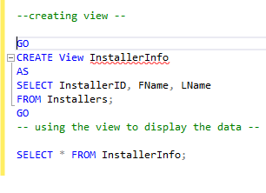
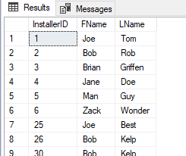
View #1

Slide 12
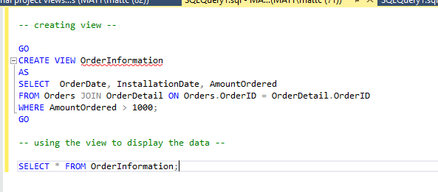
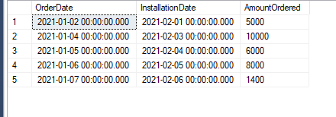
View #2

Slide 13
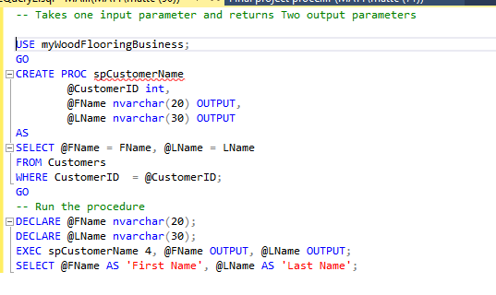

Stored Procedure #1
Retrieves the customer’s first name, last name when given the customer ID

Slide 14
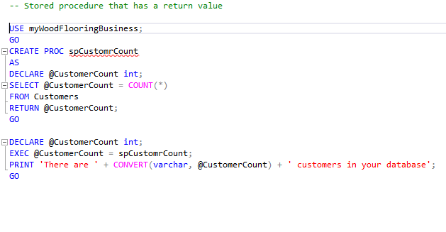

Stored Procedure #2
Counts the number of customers in the database

Slide 15
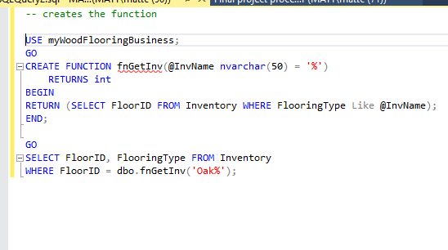

User Defined Function #1
Retrieves the item number when given the item name

Slide 16
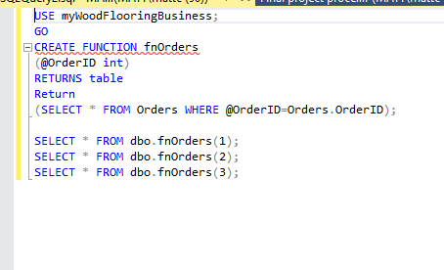
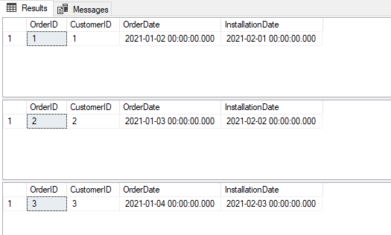
User Defined Function #2
retrieve product dates using the product ID

Slide 17
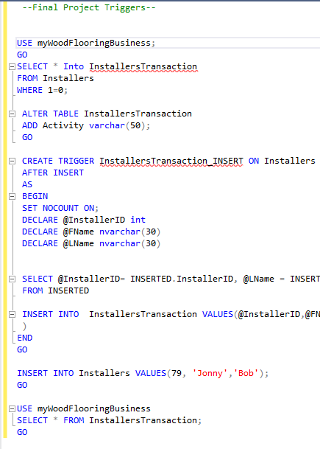
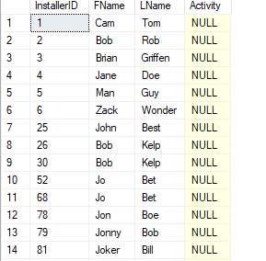
Triggers
create a log entry every time data is added to the Installer table

Slide 18
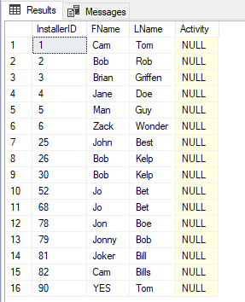
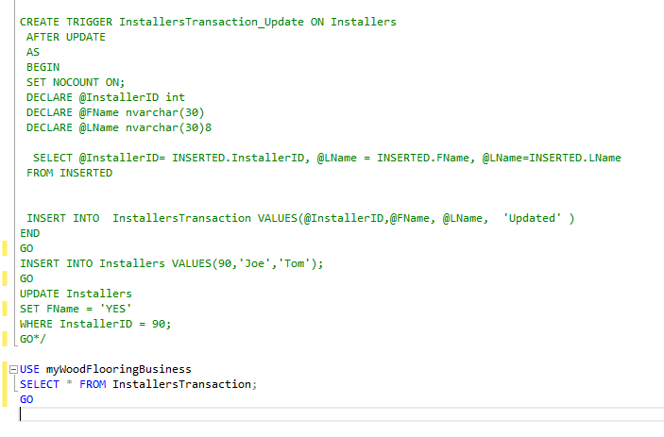
Triggers #2
create a log entry every time data is updated in the Installer table

Slide 19
What went well
Creating the summary queries
Creating the views
The Stored Procedures

Slide 20
What did you have problems with
I had problems with the triggers I kept having to fix them. I also realized in the milestone 3 I screwed them up so I had to fix them for this showcase.

Slide 21
What did you learn
Learned the basics of triggers how to make them
Learned how create functions

Slide 22
What would you like to include in future releases
I would like to include more tables and more products
Have more triggers and include a delete trigger
I would also like to include more calculations

