Slide 1
Machine Learning: Zero to Up and Running
Matt Coventon, EntreFEST 2019

Slide 2

About Me
Matt Coventon
12 years at ISE
Data Engineering & Data Science
Songwriter & strategy board game addict

Slide 3
About You
Show of hands for:
I’m brand new to machine learning
I’m familiar with some machine learning concepts
I can write code
I’m familiar with Python
I’ve used scikit-learn

Slide 4
The Data Journey
Value
Experiments
Questions
Data

Slide 5
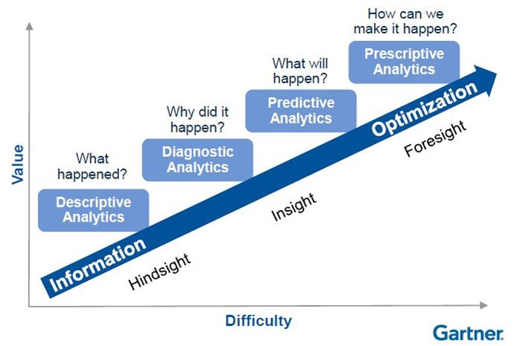
The Data Journey
Don’t try to skip to the end!

Slide 6
The Data Journey
The true potential of data is rarely obvious, rather it is discovered as you progress through questions and experiments.

Slide 7
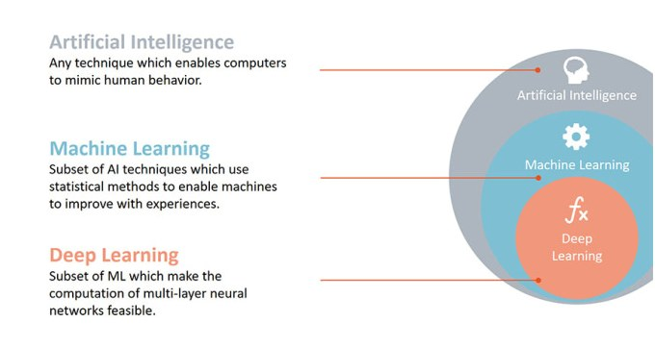
What is Machine Learning?
Where do I start?
https://www.kdnuggets.com/2017/07/rapidminer-ai-machine-learning-deep-learning.html

Slide 8
Types of Machine Learning
Two main categories
Supervised Learning
Classification – Predict a category
Regression – Predict a real value
Unsupervised Learning
Clustering – Find related groups
Anomaly Detection – Find non-conforming items
Today, most of the economic value is through supervised learning

Slide 9
When should I use Machine Learning?
“Rule #3: Choose machine learning over a complex heuristic.” – Martin Zinkevich, Research Scientist at Google
Rules of Machine Learning: Best Practices for ML Engineering

Slide 10
Getting Organized
Steps to develop a predictive model:
Define the problem
Gather data
Explore data
Clean, transform, select features
Evaluate algorithms
Don't forget to baseline accuracy!
Tune
Finalize Model

Slide 11
Now let’s dig in!
Follow along using this github repo:
https://github.com/mattcoventon/ml_zero_to_up_and_running

