Slide 1
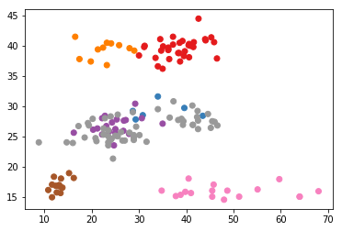
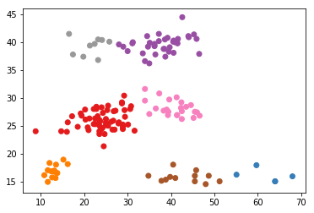
Fish Clustering – Simple Measurements
True Species
Predicted Species Clusters
Height
Length
Length

Slide 2
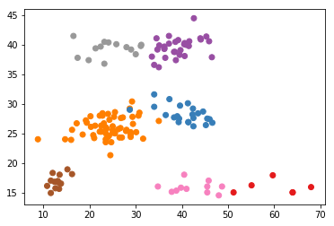
Fish Clustering – Raw Measurements
True Species
Predicted Species Clusters
Height
Length
Length

Slide 3
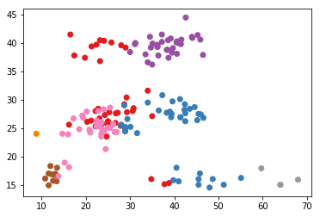
Fish Clustering – Measurement Ratios
True Species
Predicted Species Clusters
Height
Length
Length

Slide 4
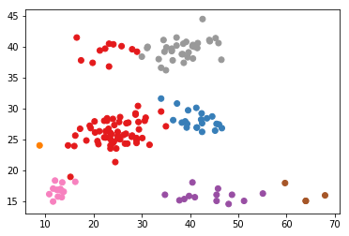
Fish Clustering – Both Raw and Ratio
True Species
Predicted Species Clusters
Height
Length
Length

