Slide 1
Bivariate Correlation & Regression

Slide 2
Correlation
Does an association between two variables exist?
test for independence (ANOVA)
How strong is the relationship?
compute measure of association called correlation
What is the form of the relationship?
develop a prediction equation
usually in the form of a linear relationship; i.e., straight line

Slide 3
Covariance
Underlying the commonly used measures of association between normally distributed variables is the statistical quantity of covariance.
Covariance measures the unscaled linear association between two variables
If we have 2 continuous variables, x and y:
if observations of x and y co-vary with one another, meaning they are associated, then if one is above its mean, the other will also tend to be above its mean and vice versa

Slide 4

Covariance
If x_{i} and y_{i} are both above their means, or both below their means, the product will tend to be positive, and we will have positive covariance (positive association)
If one of the variables, say x,, on average has values above the mean, and y has values below the mean, the covariance will be negative (negative association)
$$\sum_{i=1}^{n}{(x_{i}− \overline{x})(y_{i}− \overline{y})}$$

Slide 5

Covariance
The population covariance of x and y is written
We can say that, if two variables are so-called bivariate normally distributed, then if the covariance between them is 0, then they are independent, but if there is a non-zero covariance between them the are dependent to some degree on one another
If two variables have a 0 covariance, then they are linearly independent, which does not make them totally independent
For instance, they could display a nonlinear association, that suggests strong dependence, but a covariance would never be able to accurately measure that association

Slide 6
Covariance
Keep in mind that covariance is said to be scale dependent, meaning that, unless both x and y are measured on a common scale, the covariance is uninterpretable

Slide 7
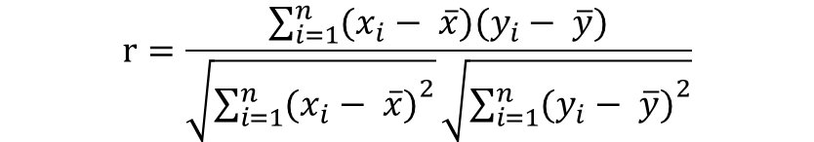
Correlation
The idea behind correlation is to standardize the covariance to make it scale invariant. This is a very important idea since many times our variables are measured on different scales
e.g. years of education and income, or height and weight
To do this you divide the covariance by the standard deviations of both x and y
$$r=\frac{\sum_{i=1}^{n}{(x_{i}− \overline{x})(y_{i}− \overline{y})}}{\sqrt{{\sum_{i=1}^{n}{(x_{i}− \overline{x})}}^{2}}\sqrt{{\sum_{i=1}^{n}{(y_{i}− \overline{y})}}^{2}}}$$

Slide 8
Correlation
Pearson’s Correlation Coefficient
Used to interpret the STRENGTH & DIRECTION of the relationship
Correlation can take on the value in the range of -1.0 to +1.0
Strength – r values that are closer to -1 or +1, the stronger the correlation is between the two variables
In practice, if we get correlations in the neighborhood of the .3 to .6 range, we get excited.
Direction – The sign of the correlation indicates the direction of the relationship
$$r=\frac{\sum_{i=1}^{n}{(x_{i}− \overline{x})(y_{i}− \overline{y})}}{\sqrt{{\sum_{i=1}^{n}{(x_{i}− \overline{x})}}^{2}}\sqrt{{\sum_{i=1}^{n}{(y_{i}− \overline{y})}}^{2}}}$$

Slide 9
Correlation: Assumptions
Randomly Chosen
Variables are Continuous and Numeric
Variables are Independent from one another
Variables are normally distributed
Variances are equal
Linear Relationship
Meaning, variables must display a straight line
Test this assumption using a scattergram aka scatter plot
$$r=\frac{\sum_{i=1}^{n}{(x_{i}− \overline{x})(y_{i}− \overline{y})}}{\sqrt{{\sum_{i=1}^{n}{(x_{i}− \overline{x})}}^{2}}\sqrt{{\sum_{i=1}^{n}{(y_{i}− \overline{y})}}^{2}}}$$

Slide 10
Scattergram
Visual method used to display a linear relationship between two interval/ratio variables where the observations (e.g. test scores) are plotted and approximated with a straight line
Involves charting the linear relationship of the X (independent) value and Y (dependent) value
“Perfect” linear relationship – Straight line between the two interval/ratio variables and all observations fall along a straight line
In other words, all the variability in one variable is explained by the variability in the other variable

Slide 11
Scattergram Examples
Positive Correlation
Negative Correlation
No Correlation
Curvilinear Correlation

Slide 12
Scattergram Examples
Positive Correlation
Negative Correlation
No Correlation
Curvilinear Correlation

Slide 13
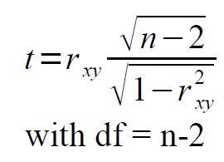
Correlation: Test
We can calculate a test statistic to see if our measured correlation coefficient is “significant”, or in other words, if the association between our variables is significant
H₀ : ρ_{xy} =0
H_{a} : ρ_{xy} ≠0
Test statistic:
$$r=\frac{\sum_{i=1}^{n}{(x_{i}− \overline{x})(y_{i}− \overline{y})}}{\sqrt{{\sum_{i=1}^{n}{(x_{i}− \overline{x})}}^{2}}\sqrt{{\sum_{i=1}^{n}{(y_{i}− \overline{y})}}^{2}}}$$

Slide 14
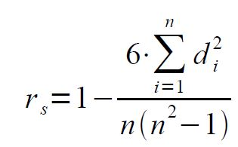
Correlation: Spearman’s Rank
If our data are not normally distributed, an alternative is the Spearman correlation.
For a given set of paired data: (xi, yi), i=1..n
We first rank the x's and y's by themselves
We then calculate:
where d_{i}² is the squared difference between the ranks of x_{i} , y_{i}

Slide 15
Correlation: Spearman’s Rank
H₀ : r_{s} =0
H_{a} : r_{s} ≠0
z=r_{s} * sqrt(n-1)
if z <= -2.575 or z>= 2.575, we reject H₀ and conclude there is an association between x and y

Slide 16
Linear Relationships
How does the conditional distribution of Y vary according to values of X ?
Linear function – the relationship between X and Y summarized as straight line
Response variable Y is a linear function of the explanatory variable X with slope β and Y-intercept α

Slide 17
Linear Relationships
a = intercept
b = slope
(Indicates the unit change in Y with each unit change in X)
Y = dependent variable
X = independent variable
Y
run
rise
rise
run
= b
a
X

Slide 18
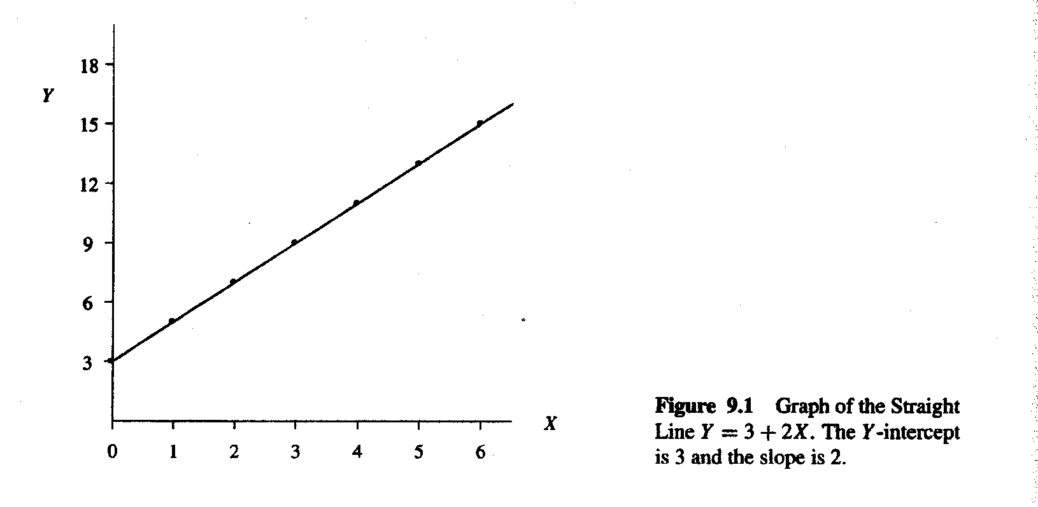
Linear Relationships
Given Y = α + β X, let α=3 and β=2
What are some Y values when X = 0, 1, 3?

Slide 19
Assumptions of Bivariate Linear Regression
Variables are interval level
Linear relationship
Cases are independent of one another
Variables are normally distributed
Variances are equal

Slide 20
Interpreting the Coefficient Output
b is a coefficient of X, and indicates the unit change in Y_{pred} with every unit change in X
When X changes one unit, the Y_{pred} value changes

