Slide 1
Statistical Tests
Continuous Variables

Slide 2
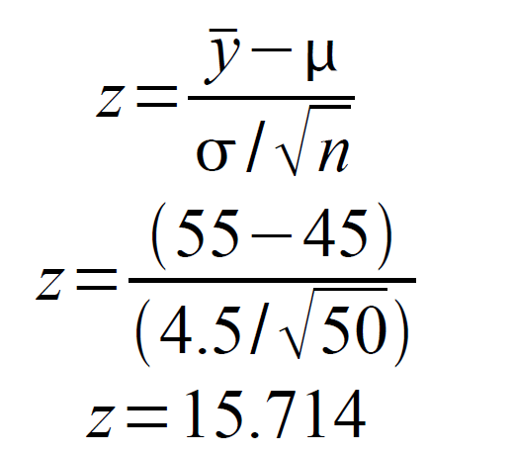
Statistical tests
We employ a z-test for the mean, when we know the population mean and the variance, and these are not estimated from data
The z-test can be used when you want to test a sample mean verses a hypothesized mean value
We want to know if our sample value of 55 is different from the previous sample value of 45.
We have n=50 subjects
We know σ=4.5
We assume our distribution is normally distributed

Slide 3
Statistical Tests
How large is our test statistic?
Our observed value of z was 15.714
How common is it to observe a value this large from a standard normal (z) distribution ?
What is the probability of observing such a value from this distribution?
This is a p-value
In the standard normal distribution, 95% of all values should be within +/-1.96 units of the mean
If we compare our value to those of a standard normal table (like in your book), we see the probability of seeing a value this large is equal to 9.56e-55, thats 0.0 and 54 other zeros, so it is INCREDIBLY uncommon to see a difference like this by random chance.

Slide 4
P-Values
p-values are probabilities
They are generally associated with test statistics
They are what give us the “certainty” in our analysis.
If the probability of seeing a test statistic as large as the one we calculate is large (>.05, for instance), then our test does not negate the null hypothesis
If test statistics like ours occur very rarely then we have a small p value (<.05 or smaller), and we conclude that our research hypothesis has some support

Slide 5
Critical values and p-values
A critical value is the value of a reference distribution that occurs at a certain level of probability
We choose critical values to compare our test statistics to based on how certain we want to be that our observed test statistic is “rare” or “significant”
For example if we want to be 95% certain that our difference (z test) is not simply an artifact of random sampling bias, then we choose a critical value from a standard normal distribution that occurs a very small percent of the time (z=1.96, for a 5% occurrence)
We compare our observed value of the z test to this critical value and see if it is less, equal or larger.
If it is less, then we cannot be certain that our null hypothesis is falsified
If it is greater, then we have evidence that our null hypothesis is falsified, and our research hypothesis is supported

Slide 6
Example of significance test for a mean
Background
Evaluation of large alcohol treatment program
Sample of 127 clients
Interesting finding about absences from work:
Overall in the community: μ = 7.2 days per year,
From clients sample:
= 6.8 days per year
s = 1.43 days
Do program clients have lower absentee rates that the community as a whole?

Slide 7
Example of significance test for a mean
1. Assumptions
Quantitative measurement
Random sampling
Population distributed normally
(robust esp. for larger samples, say n ≥ 30)
2. Hypotheses
H0: μ = 7.2 days
Ha: μ ≠ 7.2 days

Slide 8
Example of significance test for a mean
3. Test statistic
Since n >= 30, the sampling distribution of is approximately normal around μ (7.2)

Slide 9
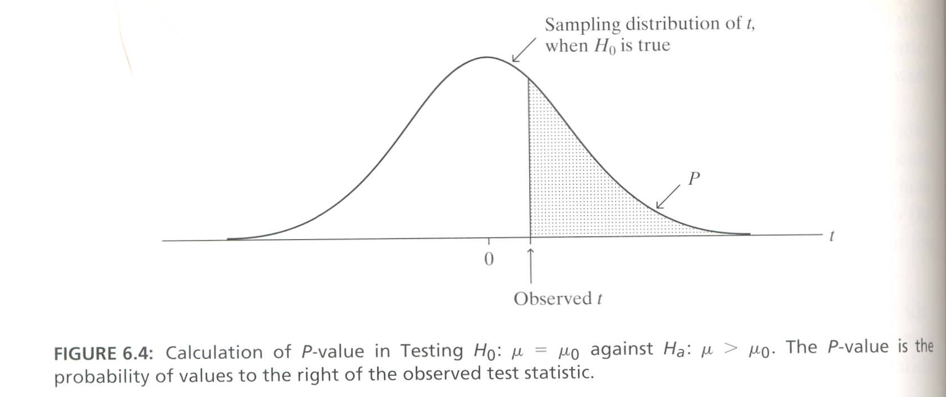
One-Tailed Significance Test
Other forms of alternate hypothesis:
H_{a}: μ > μ₀ i.e., is μ larger than a certain number?
H_{a}: μ < μ₀ i.e., is μ smaller than a certain number?

Slide 10
Example of one-tailed significance test for a mean
Background
The rural “turnaournd”
Quality of life
Decaying urban centers
High-cost suburbs
Data for 51 states for 1970 and 1980
Metropolitan Statistical Areas (MSAs)
In 1970, on average 64.4% of the population resided in MSAs; By the mid-1980s, the average was 64.2% with a standard deviation of 22.4%
Was there a rural turnaround such that fewer persons lived in MSAs by the mid-1980s?

Slide 11
Example of one-tailed significance test for a mean
1. Assumptions
Quantitative measurement
Random sampling
Population distributed normally
(robust esp. for larger samples, say n ≥ 30)
2. Hypotheses
H₀: μ ≥ 64.4%
H_{a}: μ < 64.4%

Slide 12
Example of one-tailed significance test for a mean
3. Test statistic
the sampling distribution of is approximately normal around μ (6.4)

Slide 13
Example of one-tailed significance test for a mean
4. P-value
The P-value is the one-tailed probability that z would exceed -0.06 if H₀ were true.
From Z-Score Table, we see that a z of -0.06 is associated with a probability greater than 0.10. By conventional standards, this is a fairly high probability that H₀ is true.
This is a large P-value meaning that we would not reject the null hypothesis about half the time.

Slide 14
Bivariate Analysis

Slide 15
Two-Group Comparisons
Compare two (and only two) groups
Quantitative v. qualitative
Large and small sample (z, t)
Longitudinal v. Cross-sectional
Data collected at two points in time
Single survey with respondents split into two groups
Independent v. Dependent random samples
Independent: Choice of subjects in one sample not dependent on another sample; OK to split one sample
Dependent: Subjects are somehow matched across samples taken at different times

Slide 16
T-Test
To test for the difference in the mean of two samples, we use a t-test, which assumes:
The two samples have been drawn from normal distribution
The observations within each sample are independent of one another
The sample sizes of the two samples, n₁ and n₂ are large (>30 each)
The population standard deviation, σ₁ and σ₂ are equal
Why not use a z test?
Well, this test is based on sample estimates of means and variances, not known ones

Slide 17
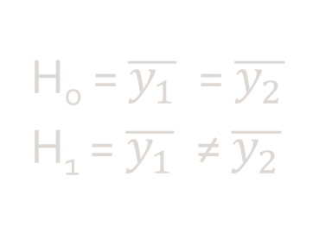


T-Test
$$\frac{( \overline{y_{1}} −\overline{y_{2}})}{s_{p}\sqrt{\frac{1}{n_{1}}+\frac{1}{n_{2}}}}$$
H_{o} = $\overline{y_{1}}$ = $\overline{y_{2}}$
H₁ = $\overline{y_{1}}$ ≠ $\overline{y_{2}}$
Where S_{p} is the pooled standard deviation equal to:
$$s_{p}=\sqrt{\frac{\left(n_{1}−1\right)s_{1}^{2}+\left(n_{2}−1\right)s_{2}^{2}}{n_{1}+ n_{2} −2}}$$

Slide 18
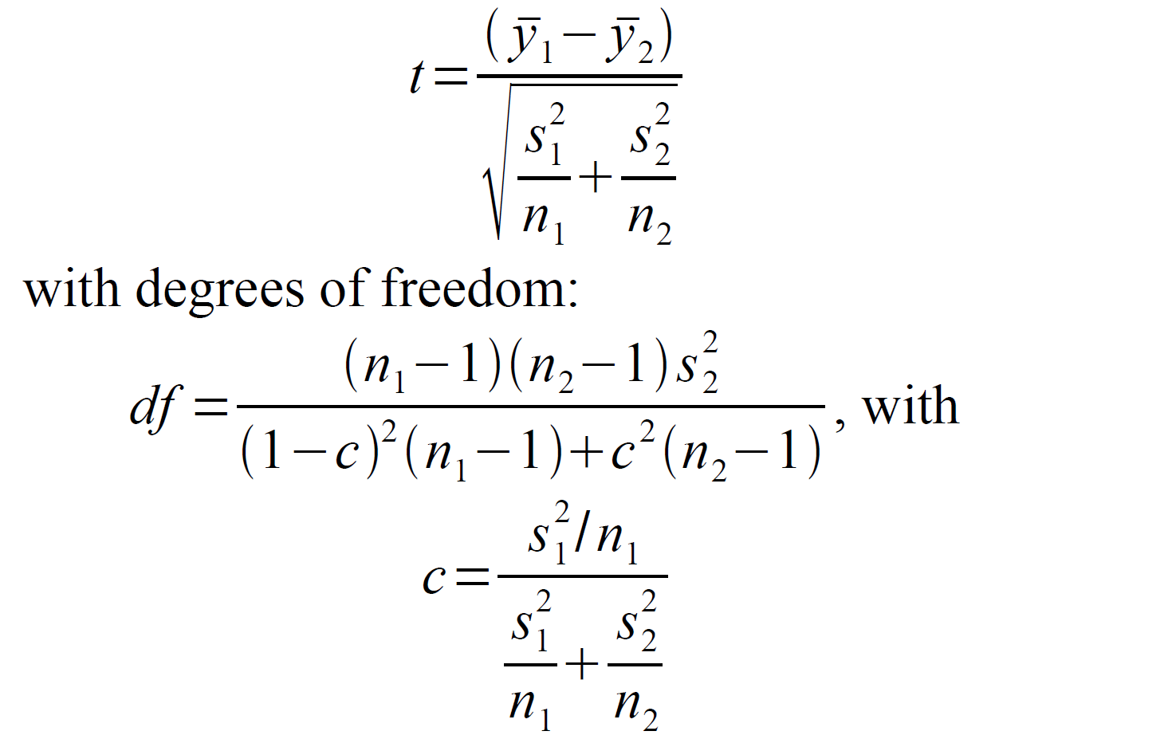
T-Test
If Standard Deviations of samples are not equal you use a Satterwaite’s Approximation Correction

Slide 19
T-Test
OUTPUT

Slide 20
T-Test
The t-test is only appropriate if your data are normally distributed, or approximately normally distributed
This test is fairly robust to deviations due to small outliers
If your data are highly skewed, this test it not appropriate

Slide 21
Non-Parametric Tests
We call tests like the z and t-tests parametric because they test for differences between samples by using parameters from those samples (the mean, variance)
These tests often rely on specific sampling distributions for their test statistics, so your data typically have to follow a certain distribution (usually a normal one)
Nonparametric tests do not typically assume a distribution for your data or for the test statistics themselves

Slide 22

Non-Parametric Tests: Wilcoxon Rank Sum Test
H_{o} = Δ $=0$
H₁ = Δ ≠ $0$
Assume:
We have 2 sample of size n₁ and n₂ and that the observations are independent of one another
We assume the distributions of these samples are the same, except for a shifting factor: Δ (delta)
Often data that are skewed have large extreme values, outliers, that make them skewed
One method of dealing with this is to replace the actual value of the observation with its rank

Slide 23
Non-Parametric Tests: Wilcoxon Rank Sum Test
Pool all of the data, keeping group designations intact
Sort the data from lowest value to highest value
Assign ranks from 1 to N (N being the size of the pooled sample) to each observation
If there are ties present, take the average of the rank each would receive
Denote T1 to be the sum of the ranks in sample 1 and T2 be the sum of the ranks in sample 2
If the null hypothesis is true, then the sums of the ranks, T's, only depends on the sample sizes (n1 and n2), not on the shape of the distributions
If our observed T is larger than the theoretical expectation, we have evidence that the distributions are shifted by some difference, Δ
The Wilcoxon test is very similar to the Mann- Whitney U test, and if you see them cited, you know they are doing the same thing: a nonparametric test of equality of two samples

