Slide 1
Statistical Tests
Discrete Variables Across Multiple Groups

Slide 2
Association Review
So far we have basically treated variables in a univariate framework, each variable considered with respect to only itself
In the ANOVA model we saw our first bivariate association, where we asked whether our dependent variable differed based upon what “group” you belonged to.
In fact, the logic of this was also contained in the t-test, Wilcoxon test, Kruskal-Wallis test...
We were simply looking for an association between a continuous variable and a categorical variable (group)

Slide 3
Association Review
A very common method of summarizing data in statistics is through the use of contingency tables.
These represent a cross-tabulation of counts of events
These are typically used to summarize nominal, or categorical data that are represented by a series of distinct categories
We call this the Contingency Table

Slide 4
Contingency Tables: Numeric
Displays all possible combinations of two categorical variables
Of those who are Democrat, 722 are female.
Out of 1,496 females in the sample, 722 are Democrat
Notes:
No vertical lines in tables. It is more of table etiquette.
Put where you got data from in the note table
Marginals – usually are just sums

Slide 5
Contingency Tables: Percentage
Conditional distribution – explanatory variable as percentage within categories of the response variable
Here party identification is conditional on Gender
19.3% of females are Independent politically
Notes:
Party Identification depends on gender. If the total does not equal you would put a footnote stating that ‘total does not equal 100 due to rounding error’

Slide 6
Contingency Tables: Percentage Distribution
Joint distribution – each table cell expressed as a percentage of the overall sample size
Of the sample, 8.9% are Independent males
Of those surveyed, 18.1% are female and Republican.

Slide 7
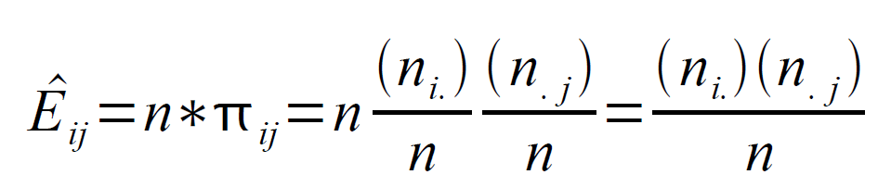
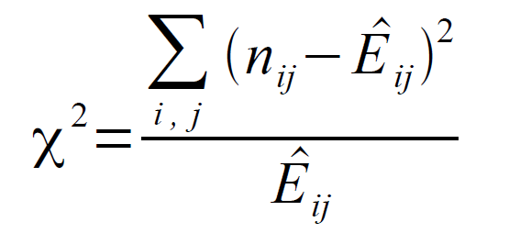
Calculation of Expected Frequency
We first calculate the expected number of observations in each cell
Out test statistic is the following.
Notes:
F_{e} – gives us what frequencies we should expect if there is independence in the variables.

Slide 8
The Chi-Squared Test Statistic χ²
To test for association, we use a χ2 (chi-squared) test of independence
Two variables are independent if the population conditional distributions on the response variable are the same
Hypotheses:
H₀: The variables are statistically independent
H_{a}: The variables are statistically dependent
Expected frequencies for independence: ƒ_{e}
The table cell count if the variables are independent
Observed frequency: the actual cell count, ƒ_{o}

Slide 9
The Chi-Squared Test Statistic χ²
Defined symbolically:
If ƒ_{e} and ƒ_{o} for the cells of a table are fairly close to one another, then χ² will be small and we may not reject H₀
If H₀ is false, then the difference between ƒ_{e} and ƒ_{o} across the table will be large and the χ² value will be large.

Slide 10
Chi-Square Assumptions
The chi-squared test for independence assumes that we have at least 5 observations in each cell, or that no fewer that 20% of the cells has fewer that 5 observations.
If this occurs, you must consider whether you need to collapse one or more rows/columns to get enough cases in each cell
This test tells you nothing about the strength of association between the rows and columns, only that they are not independent
Notes:
F_{e} – gives us what frequencies we should expect if there is independence in the variables.

Slide 11
Calculation of Expected Frequency
ƒ_{e} = the product of the row and column totals for a cell, divided by the total sample size
For female democrats, ƒ_{e} = (1190)(1496)/2681 = 664
For male democrats, ƒ_{e} = (1190)(1185)/2681 = 526
Notes:
F_{e} – gives us what frequencies we should expect if there is independence in the variables.

Slide 12
Expected Frequency (ƒ_{e} )and Statistical Independence
1190/2681 or 44.4% of the GSS respondents say they are Democrats
If gender and party identification were independent, we’d expect 44.4% of men and 44.4% of women to identify with the Democratic Party.
Thus, the expected value for democratic females would be:
But, the observed frequency for democratic females is 772, a difference of 772-664 = 108 more than expected

Slide 13
Calculation of Expected Frequency

Slide 14
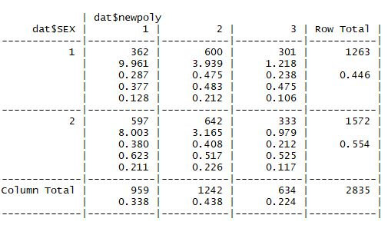
Cross Tabulation Table
Row Total
Row Percent
Individual Cell Percent
Column Percent

Slide 15
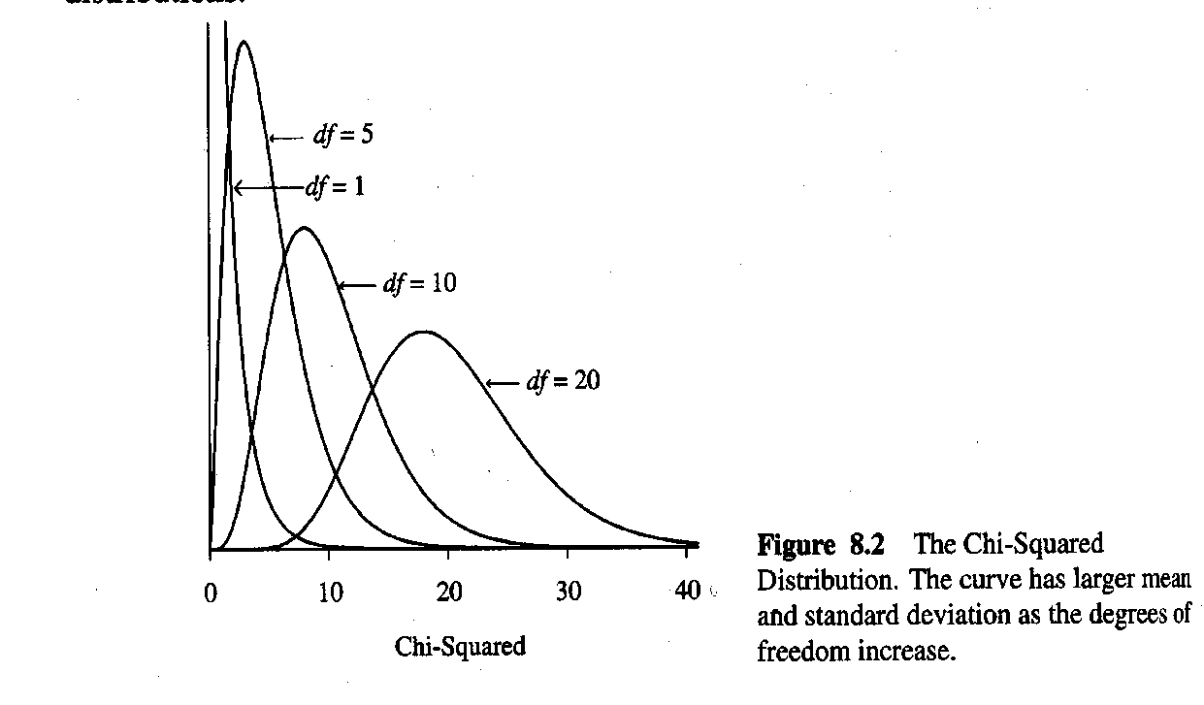
χ² Sampling Distribution
Known as the chi-squared probability distribution
All positive due to squaring in test statistic; skewed right
If χ² = 0, then ƒ_{e} - ƒ_{o} = 0 in all cells; there is complete statistical independence
Shape depends on degrees of freedom
Chi squared distribution with (r-1)(c-1) degrees of freedom
Notes:
Degrees of Freedom in chi-sqaure depends on table cells

Slide 16
5 Elements of χ² Test
Assumptions: Two categorical variables, random sampling, ƒ_{e} ≥ 5 in all cells
Hypotheses:
H₀: The variables are statistically independent
H_{a}: The variables are statistically dependent
Test statistic:
Where ƒ_{e} = (Row Total)(Column Total)/Total Sample Size
P-Value: taken from right-hand tail probability above observed χ² value with df = (r – 1)(c – 1)
Conclusion: Report P-Value; if P ≤ α, then reject H₀

Slide 17
Back to Gender and Party Identification
χ² = 23.3
From Chi-Square Table:
χ² with df = 2, α = 0.05, = 5.99
23.3 > 5.99, so reject H₀
It is very likely that gender and political party identification are associated in the U.S. adult population.

Slide 18
The Odds Ratio
Another way to interpret nominal variables is by the use of odds and odds ratios.
The odds of an event (binomial, 1-0 outcome) are
Odds = P(a)/(1-P(a)), where P(a) is the probability of observing a 1, so sum(1's)/n
For example, in the TX PUMS data the probability of being employed for non high school graduates was:
33160/34734 = 0.9547
The odds of being employed for these folks were:
0.9547/(1-0.9547) = 21.08
We would say they were 21 times more likely to be employed than unemployed
Notes:
Odds are not probability, rather it is the ratio of probability of something over the probability of something else (related).
Odds = Probability of X/ Probability of Y
Odds > 1, x is more likely than y
Odds < 1, y is more likely than x

Slide 19
The Odds Ratio
Odds of being employed for non HS grad:
0.9547/(1-0.9547) = 21.08
Odds of being employed for a HS grad+:
0.973/(1-.973) = 36.04
Odds ratio:
36.04/21.08 = 1.71, or
Those with a HS education or more were
1.71 times more likely to be employed that those without a HS education.
Notes:
Odds are not probability, rather it is the ratio of probability of something over the probability of something else (related).
Odds = Probability of X/ Probability of Y
Odds > 1, x is more likely than y
Odds < 1, y is more likely than x

Slide 20
The Odds Ratio: The 2x2 Case
Odds:
Odds are positive
When odds > 1, success is more likely than failure
When odds < 1, failure more likely than success
Odds ratio
Odds in row 1 divided by odds in row 2
A measure of association
Notes:
Odds are not probability, rather it is the ratio of probability of something over the probability of something else (related).
Odds = Probability of X/ Probability of Y
Odds > 1, x is more likely than y
Odds < 1, y is more likely than x

Slide 21
Odds Ratios for r x c Tables
 | Dem. | Rep.
Female | 722 | 485
Male | 468 | 478
Select a 2 x 2 partition of the table, such as this one
The odds that a female’s response was Democrat rather than Republican equal 1.52 times the odds for males. Of those subjects who responded Democrat or Republican, females were more likely than males to respond Democrat.
Notes:
Cell₁₁ = Row first, column second.

